Slide 1
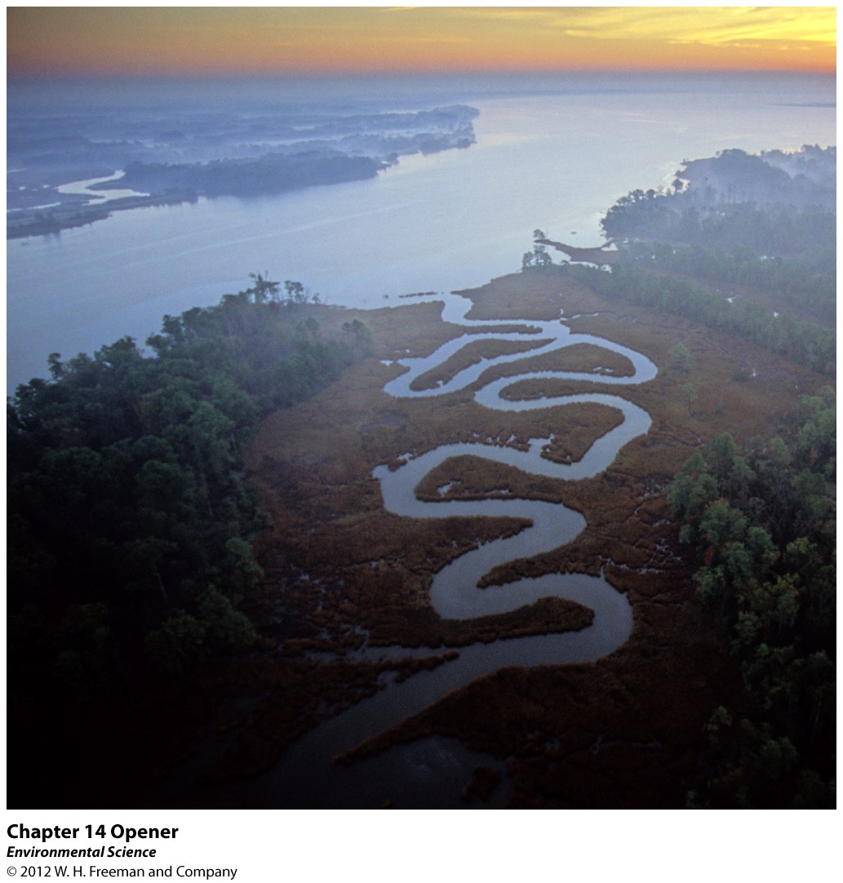
Chapter 14
Water Pollution

Slide 2
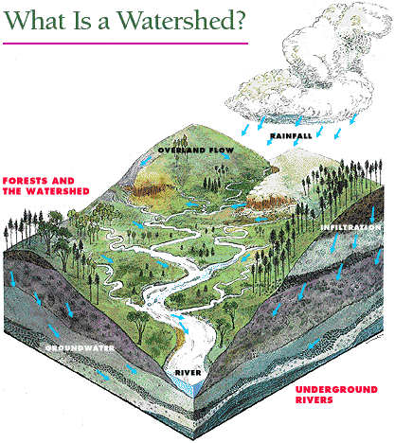

Slide 3
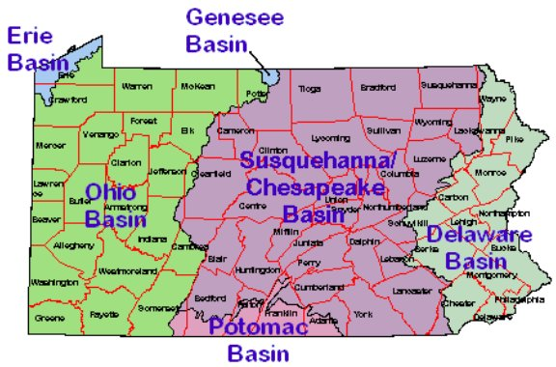
PA Watersheds
Watershed - is that area of land where a river drains.

Slide 4
Water Pollution and The Chesapeake Bay
Largest estuary (salt and fresh water meet) in the United States.
Receives fresh water from rivers and streams and mixes with salt water from the ocean to produce a productive estuary.
Consequences of receiving water from a large watershed is that the water dumping into the bay is full of nutrients, sediments and chemicals from adjacent land.
Culprits – Nitrogen (600 million pounds) and Phosphorus (30 million pounds).

Slide 5
Three Major Sources:
Water discharged from sewage treatment plants
Animal wastes from animal feed lots, generate large amounts of manure
Fertilizer from both agricultural fields and suburban lawns (Run-off of soil)
When the nutrients reach the Bay – explosion of algae! Creates a Dead Zone

Slide 6
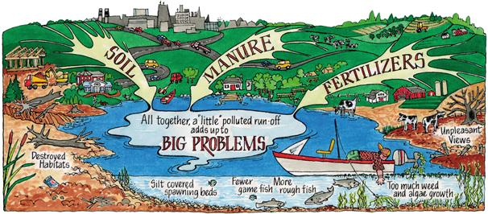

Slide 7
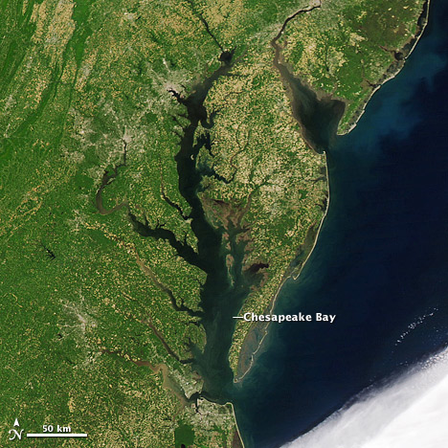
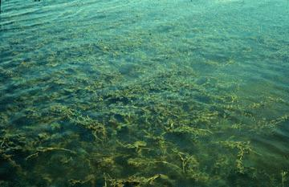
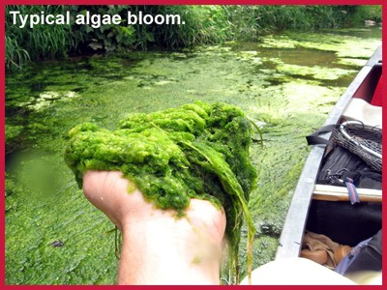
The Chesapeake Bay

Slide 8
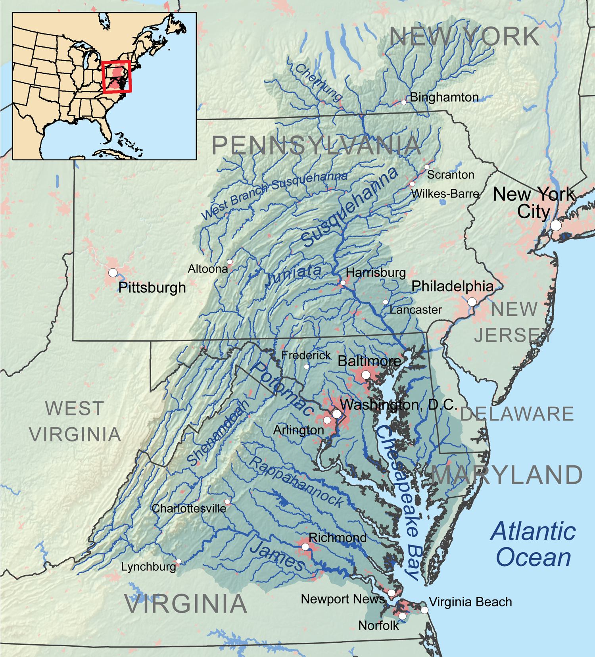
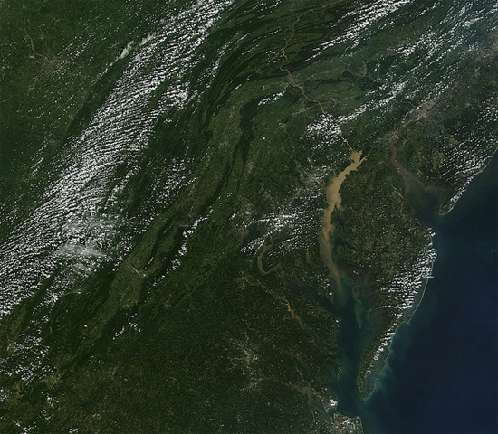
Water Pollution

Slide 9
I. Pollution can come from specific sites or broad areas
Water Pollution
Point Source
Nonpoint Source

Slide 10
Water Pollution
Water pollution- the contamination of streams, rivers, lakes, oceans, or groundwater with substances produced through human activities and that negatively affect organisms.
Point sources- distinct locations that pump waste into a waterway.
Nonpoint sources- diffuse areas such as an entire farming region that pollutes a waterway.

Slide 11
Water Pollution
Pollution can come from specific sites or broad areas
Human wastewater is a common pollutant
III. We have technologies to treat wastewater from humans and livestock
IV. Heavy metals and other substances can pose serious threats to human health and the environment
V. Oil pollution can have catastrophic environmental impacts
Not all water pollutants are chemicals
A nation’s water quality is a reflection of the nations water laws and their enforcement

Slide 12
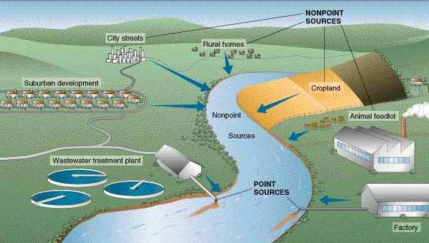
Point Source vs. Nonpoint Source

Slide 13
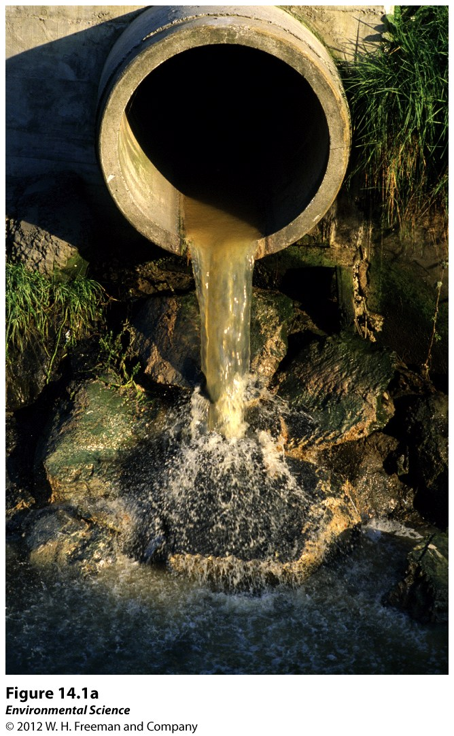
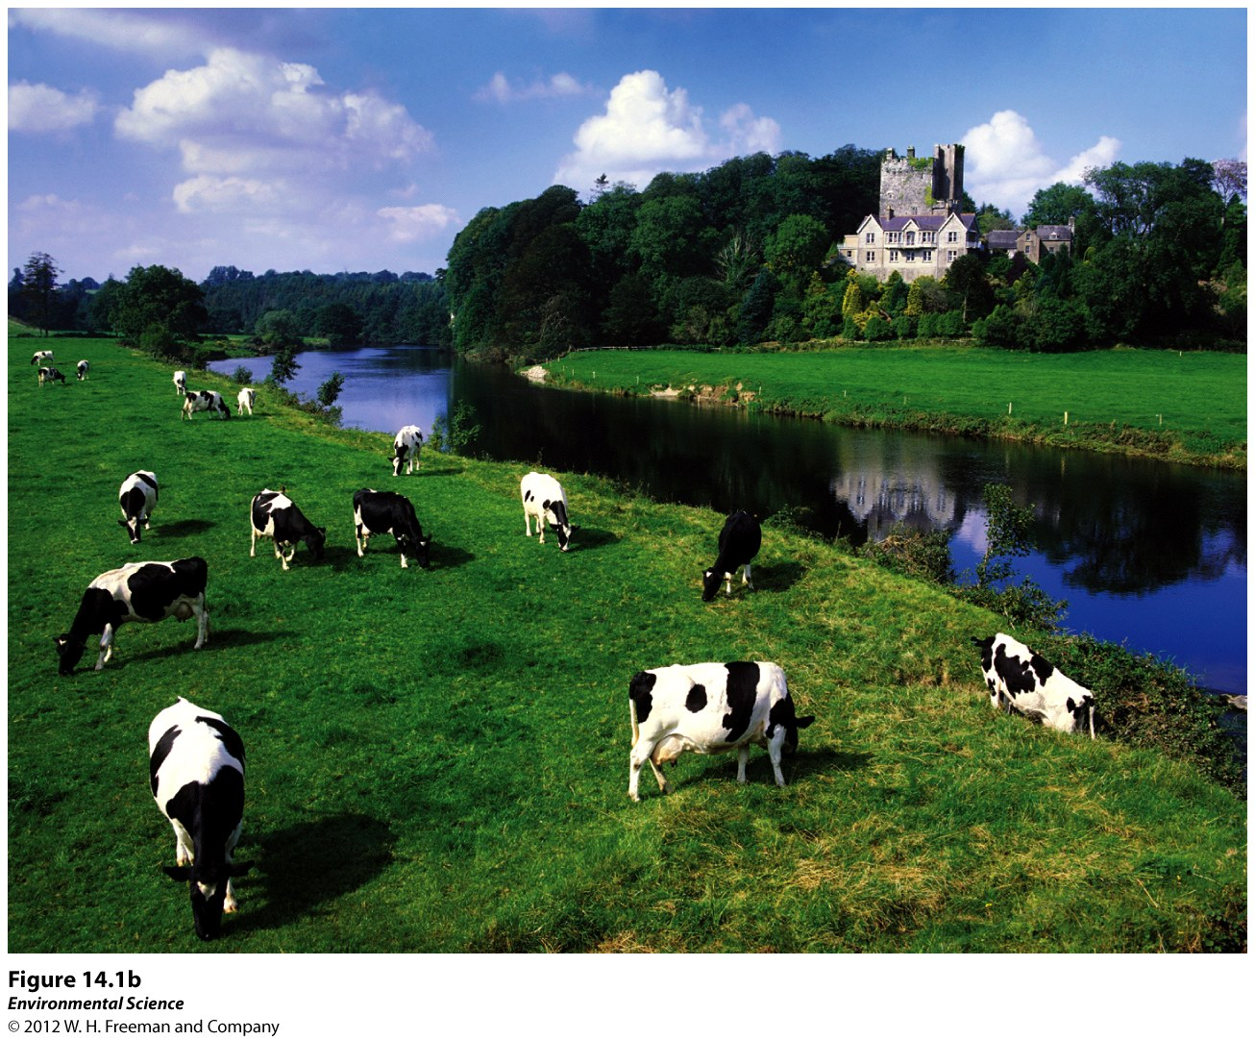
“Effluent” – entering a water

Slide 14
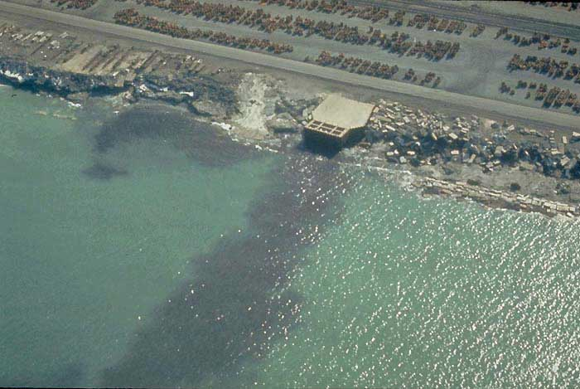
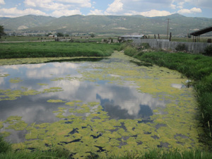
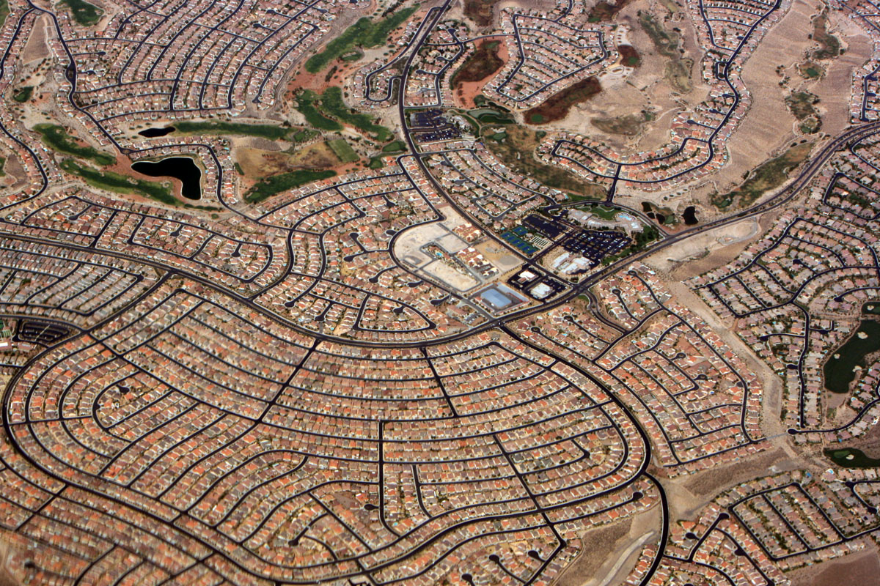
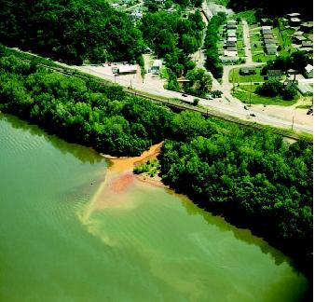
PS v NPS?

Slide 15
II. Human wastewater is a common pollutant
Oxygen Demand
Nutrient Release
Disease-causing organisms (pathogens)

Slide 16
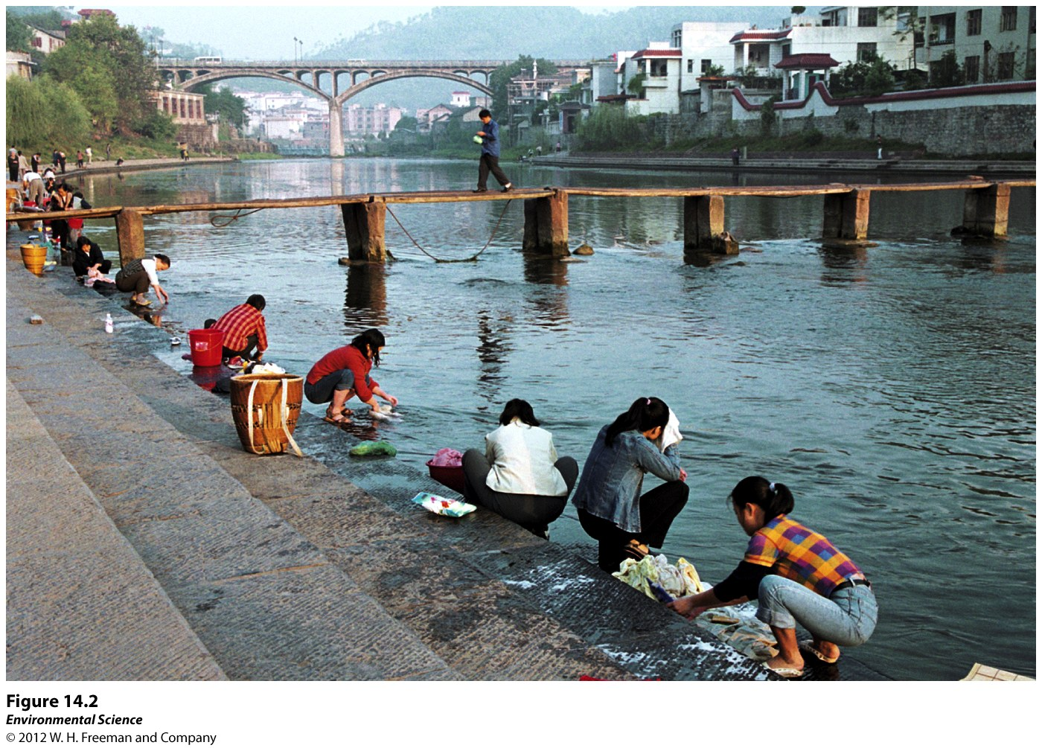
Human Wastewater
Water produced by human activities such as human sewage from toilets and gray water from bathing and washing clothes or dishes.

Slide 17
Three reasons scientists are concerned about human wastewater:
Oxygen-demanding wastes like bacteria that put a large demand for oxygen in the water
Nutrients that are released from wastewater decomposition can make the water more fertile causing eutrophication
Wastewater can carry a wide variety of disease-causing organisms.

Slide 18
Biochemical Oxygen Demand (BOD)
Oxygen-demanding waste – is organic matter that enters a body of water and feeds the growth of the microbes that are decomposing.
BOD- the amount of oxygen a quantity of water uses over a period of time at a specific temperature.
Lower BOD values indicate the water is less polluted and higher BOD values indicate it is more polluted by wastewater.

Slide 19
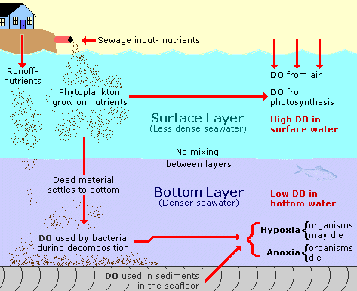
Biological Oxygen Demand

Slide 20
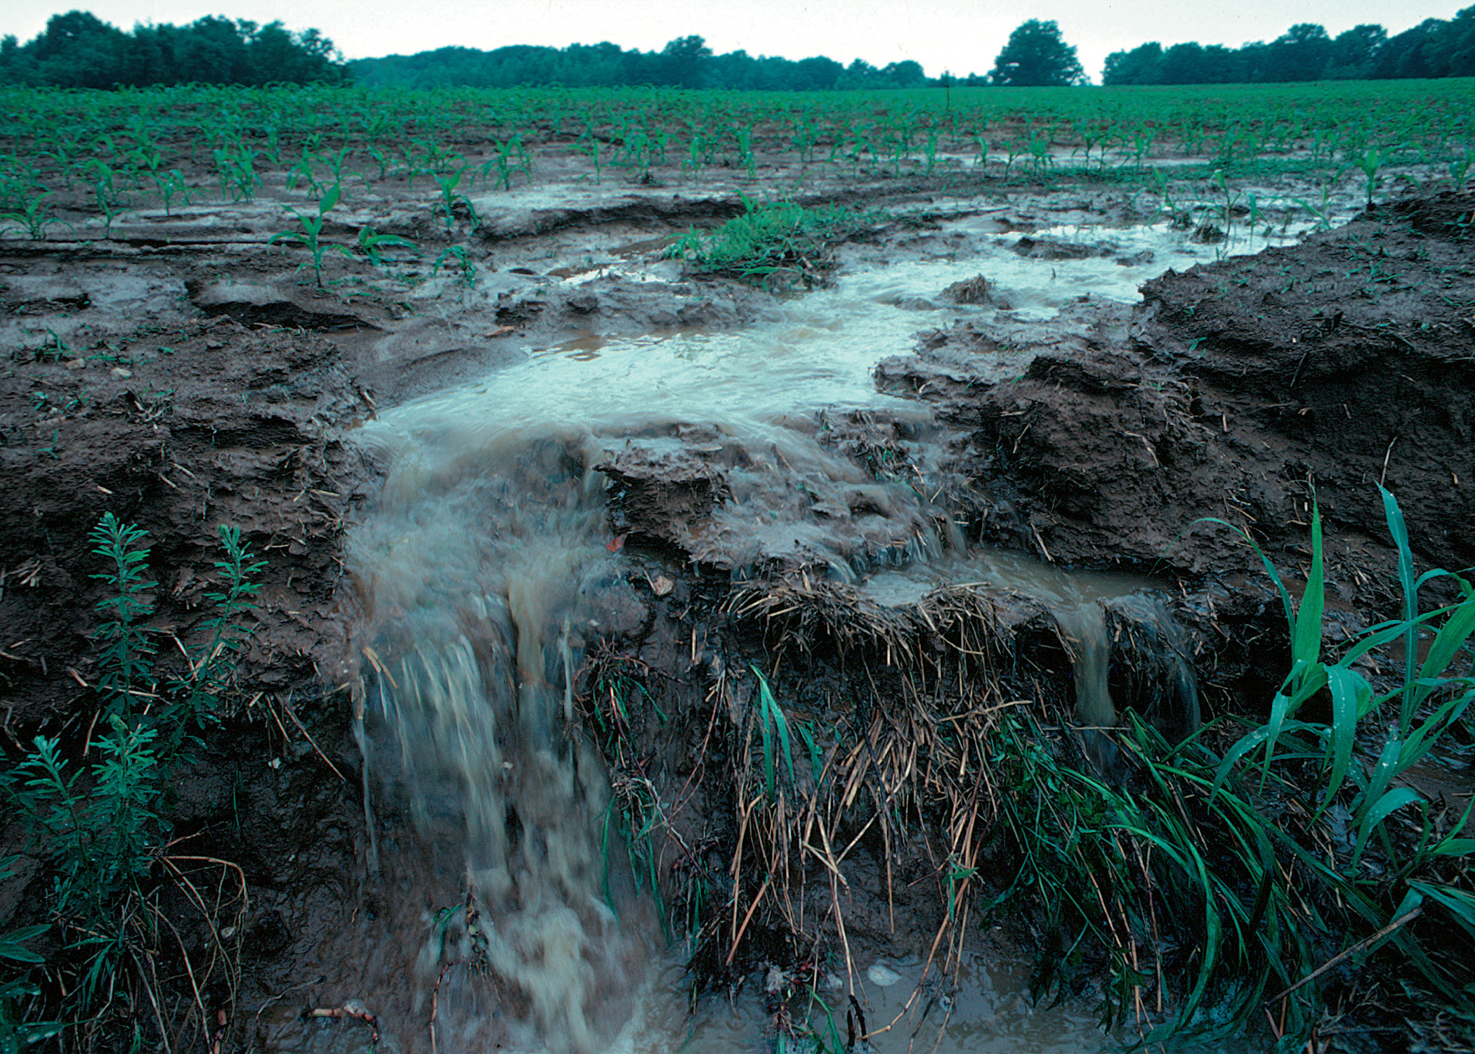
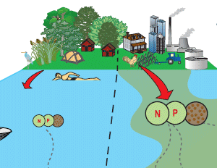
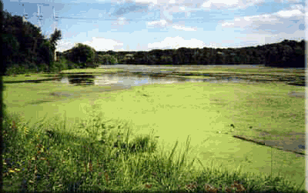
2. Nutrient Release

Slide 21
Eutrophication
Eutrophication is an abundance of fertility to a body of water.
Caused by an increase in nutrients, such as fertilizers.
Causes rapid growth of algae which eventually dies, causing the microbes to increase the BOD.
Dead Zones – areas with little oxygen so little life exists. (Chesapeake Bay and Gulf of Mexico)

Slide 22
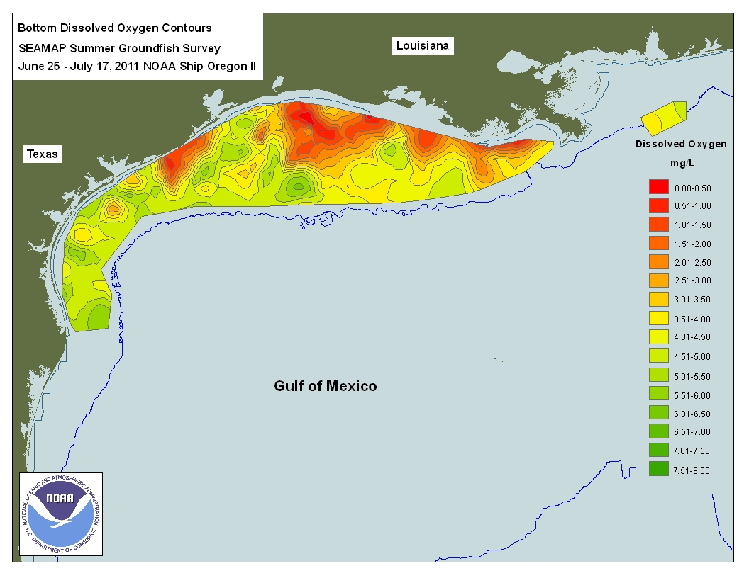
Oxygen Demand

Slide 23
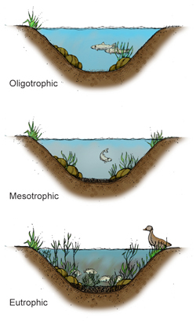
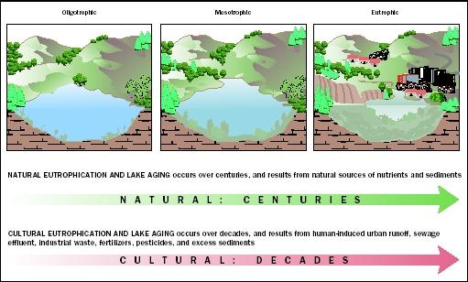
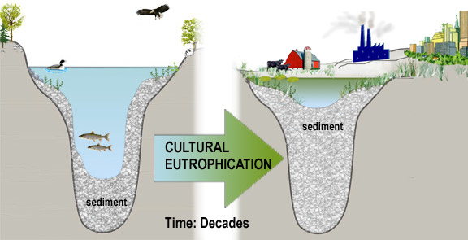

Slide 24
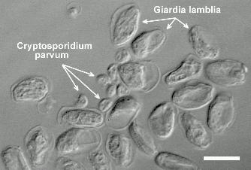
Human Wastewater:
Disease-Causing Organisms
Carries pathogens: viruses, bacteria, parasites
Illness: cholera*, hepatitus*, typoid fever, stomach flu, diarrhea
Examples
Cryptosporidium
Giardia lamblia

Slide 25
World health Organization Stats
1.1 billion people do not have access to safe drinking water
3.1 annual deaths due to related diseases.
42% of world population lacks proper sanitation
½ live in China, India and Africa
Only 36% have improved sanitation

Slide 26
Indicator Species
An organism that indicates whether or not disease-causing pathogens are likely to be present.

Slide 27
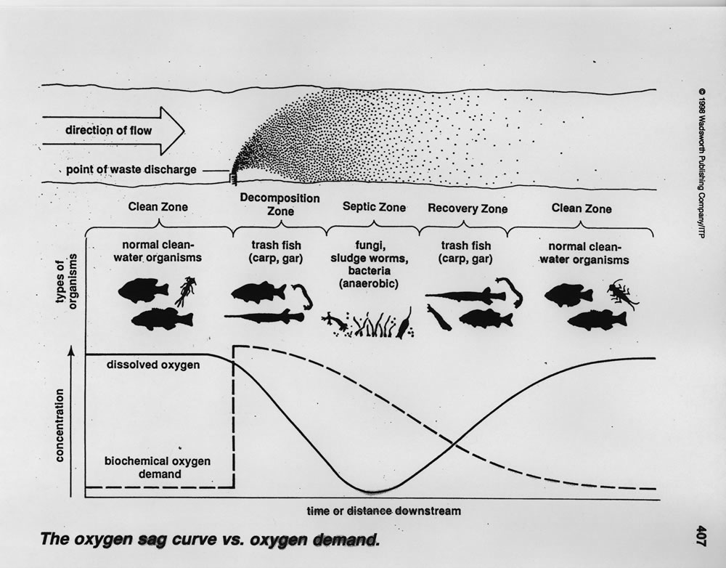
Indicator Species

Slide 28
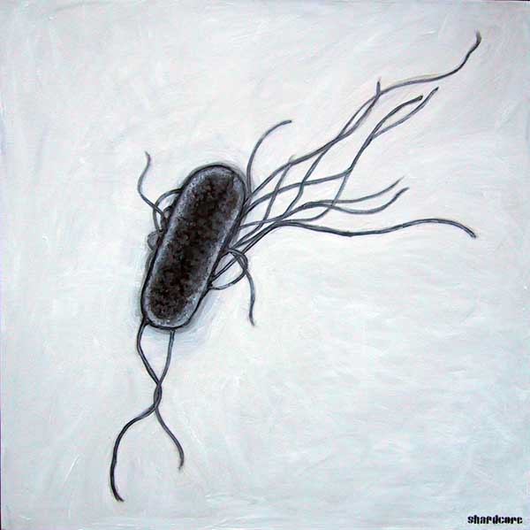
Best Indicator: Fecal coliform bacteria
Escherichia coli; E. Coli
Live naturally in human digestive system and are not harmful
There are strains that can be harmful for young, old, and weak immunity
Detecting E.coli in water indicates human waste has enter, but not necessarily mean harmful levels.
Presence indicates an increase risk of other waste water pathogens

Slide 29
Public Water Supplies
Public drinking water supplies and swimming pools are required by law to test water.
Swimming Levels considered “safe” if between 500-10,000 colonies per 100 mL water (river, beach, lake)
Closed if public facility; “presence of fecal coliform bacteria count”
Private “Wells” no law to test, up to the owner.

Slide 30
Common Diseases from Human Wastewater
Cholera
Typhoid fever
Stomach flu
Diarrhea
Cholera
Hepatitis A

Slide 31
III. We have technologies to treat wastewater from humans and livestock
Septic systems
Sewage treatment plants
(Legal Sewage Dumping)
Animal feed lots and manure lagoons

Slide 32
Various Solutions Use Same Basic Approach
Bacteria break down the organic matter into carbon dioxide and inorganic compounds.
Two Most Common Methods
Septic Systems
Sewage Treatment Plants
Method used to treat animal waste
Manure lagoons

Slide 33
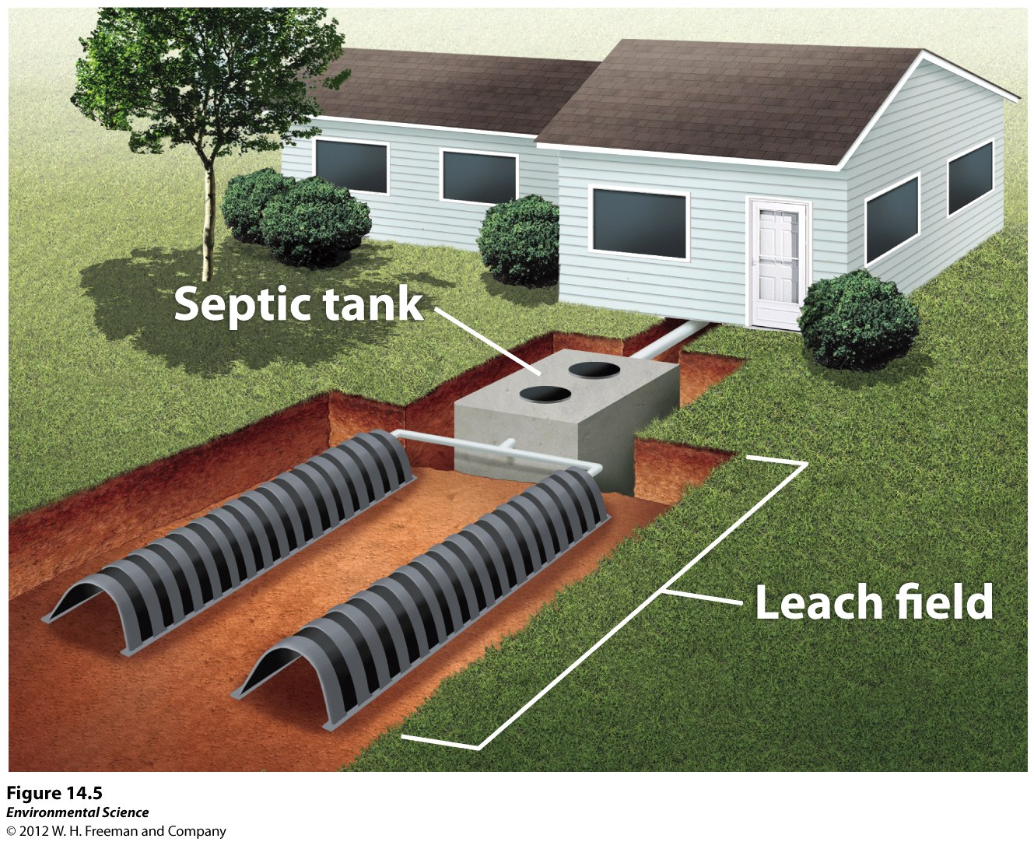
Treatments for Human and Animal Wastewater
Septic Systems-
Septic Tank - a large container that receives wastewater from the house.
Have a septic tank and leach field

Slide 34
Home Septic System
Liquid (septage) and solid (sludge) go from the house to a holding tank
Water flows onto a leach field leaving the solids in the tank for decomposition by microbes
Microbes in the soil digest any harmful materials before they reach the groundwater
Homeowners need to get the tank pumped out on a regular basis (2 yrs)

Slide 35
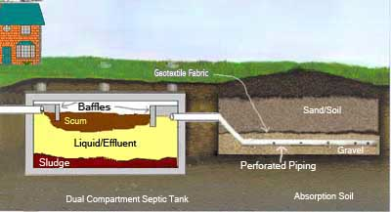
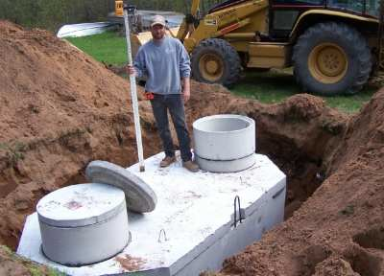
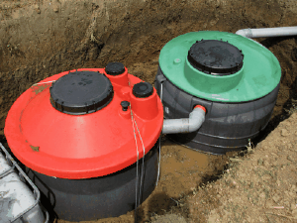
Septic systems: Step by Step

Slide 36
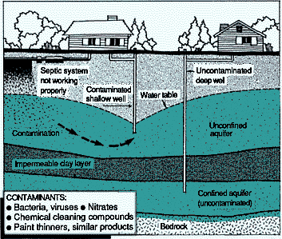

Slide 37
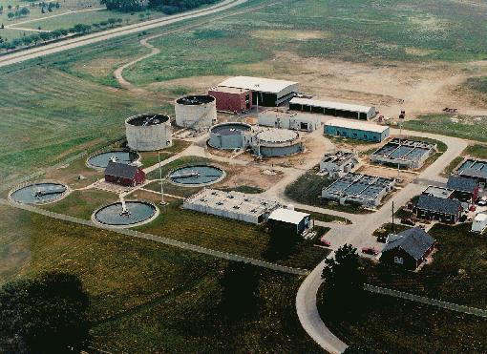
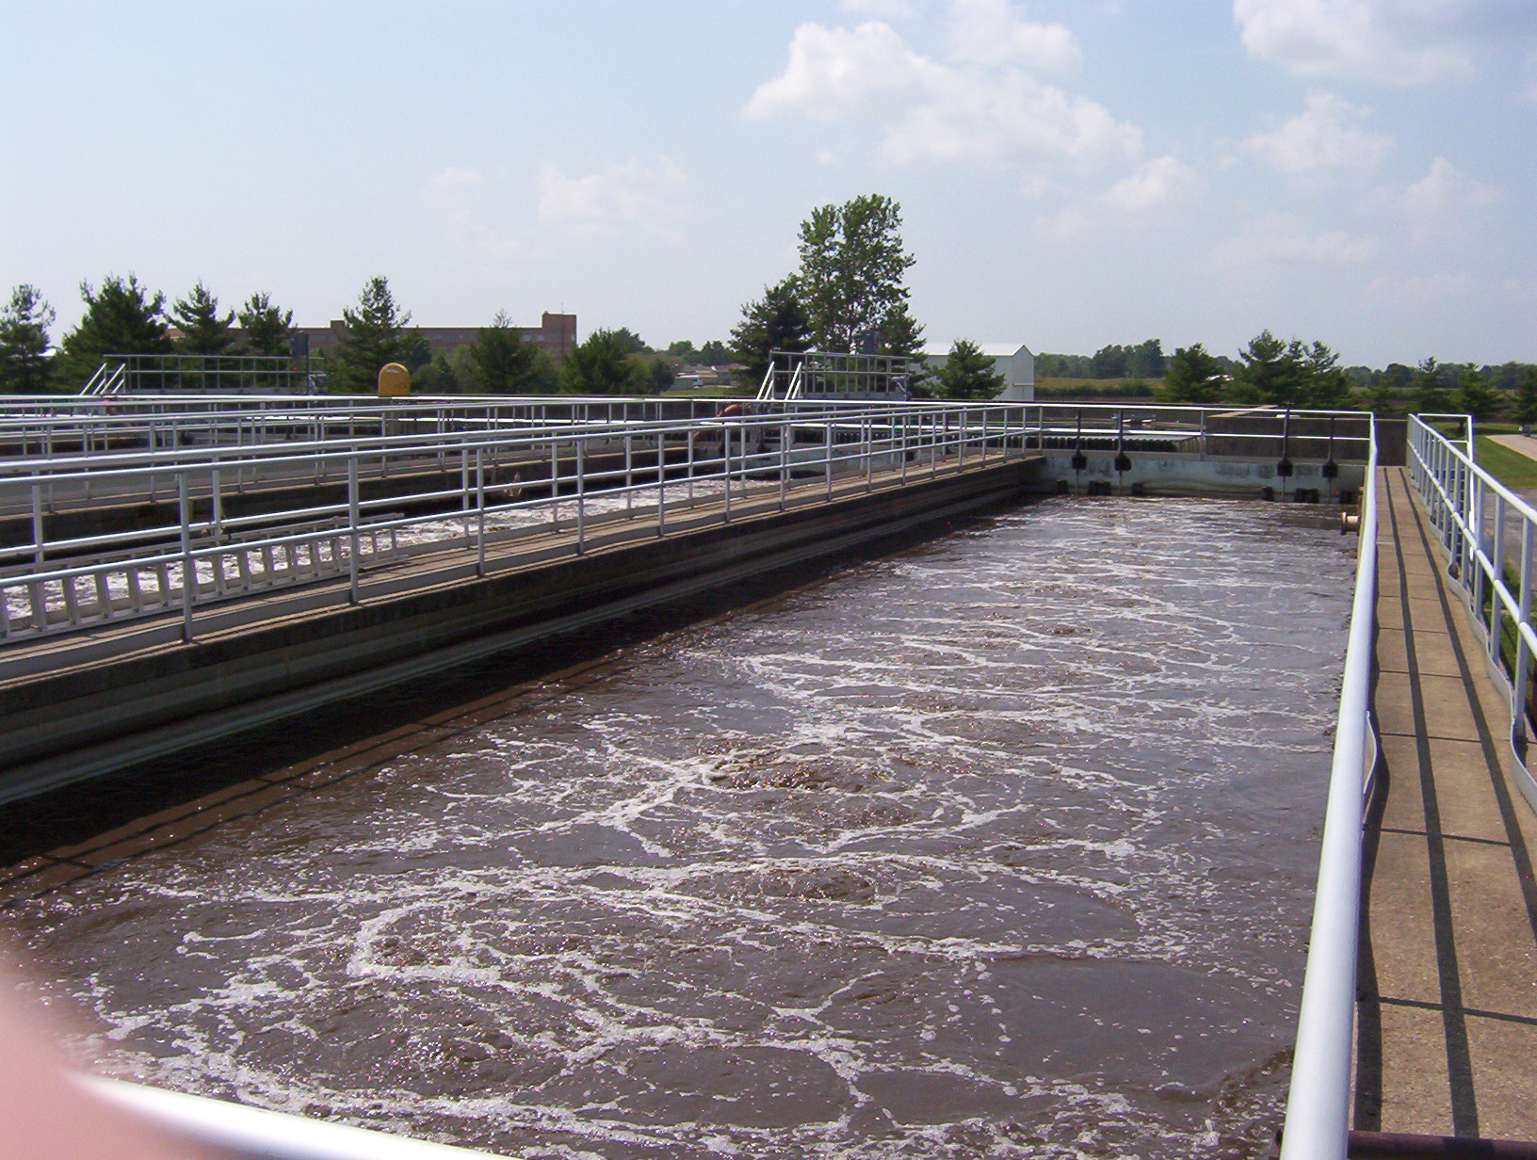
Sewage treatment plants

Slide 38
Treatments for Human and Animal Wastewater
Sewage Treatment Plants- used for more developed areas.
Centralized plants that receive wastewater via a network of underground pipes.

Slide 39
Preliminary Treatment
Removal of large particulate matter
Uses equipment such as:
Screens
Large “garbage disposals”
Grit chambers
All material removed here is sent to a landfill for disposal

Slide 40
Primary Treatment
Separate suspended solids from grease
Wastewater is held in a tank for several hours to allow settling – solids to bottom/ greases to top. These are removed for further treatment
Sludge – dried and landfilled, burned, or converted to fertilizer pellets
Equipment used
Clarifiers
Septic tanks

Slide 41
Secondary Treatment
Biological Process – removes organic matter
Microorganisms are cultivated and added to the wastewater in one of 3 systems
Fixed Film – grow microbes on rocks and sand
Suspended Film - grow microbes on film trailed through wastewater
Lagoon – Shallow basin to hold wastewater and allow microbes to naturally breakdown materials

Slide 42
Final Treatment
Removal of pathogens
Uses treatment of the water in one of 2 main ways
Chlorine
High levels of Cl can be harmful to aquatics when water is released to river systems. Water may be neutralized after this process.
Ultra-violet light

Slide 43
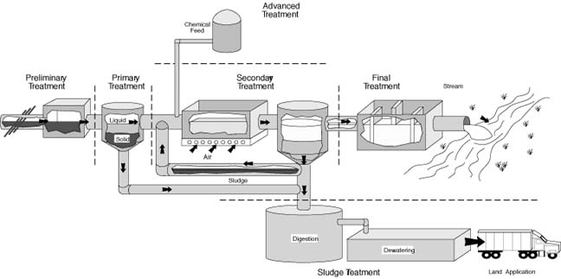

Slide 44
Advanced Treatment
Help deal with specific problems in wastewater and vary by treatment facility.
Removal of nutrients
Remove nitrogen or phosphorous to avoid artificial eutrophication of the river system
Coagulant added to accomplish this.

Slide 45
What’s Left afterward?
Water is discharged to the closest river system after being cleaned.
Solids are in the form of sludge
Treated to reduce odor
Removal of water to produce dried sludge or “sludge cake”
Volume of sludge reduced by removal of water and treatment with bacteria

Slide 46
Regulations to be Met
Wastewater treatment and release to river systems is governed by the state as dictated by the Clean Water Act.
Discharge permits are issued to the facility and have specific requirements depending on location.
Local health department regulates small septic systems serving 1-3 families.

Slide 47
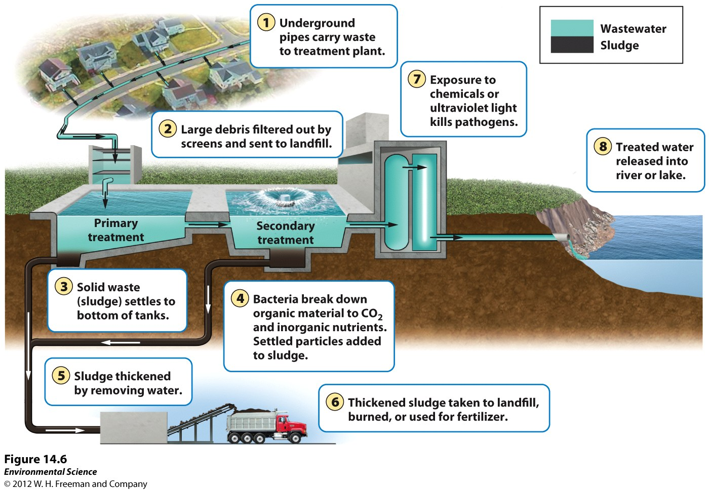

Slide 48
Legal Sewage Dumping
Older sewage plants were also a hub for storm water distribution
“During periods of heavy rain, the combined volume of storm water and wastewater overwhelms the capacity of the plants. When this happens, the treatment plants are allowed to bypass their normal treatment protocol and pump vast amounts of water directly into an adjacent body of water.”
Indianapolis: 1 billion gallons per year
US swimming illnesses: 1.8-3.5 million per year
US drinking illnesses: 500,000 per year

Slide 49
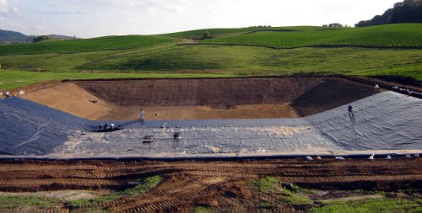
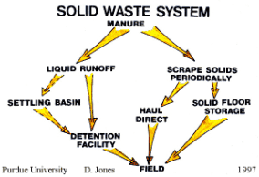
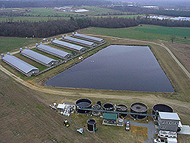
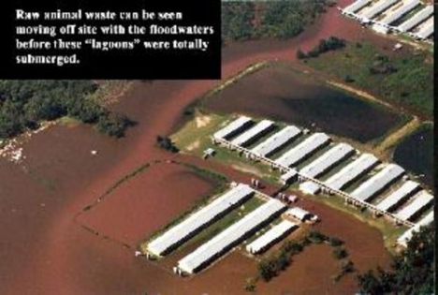
Animal feed lots and manure lagoons EPA: Manure Management

Slide 50
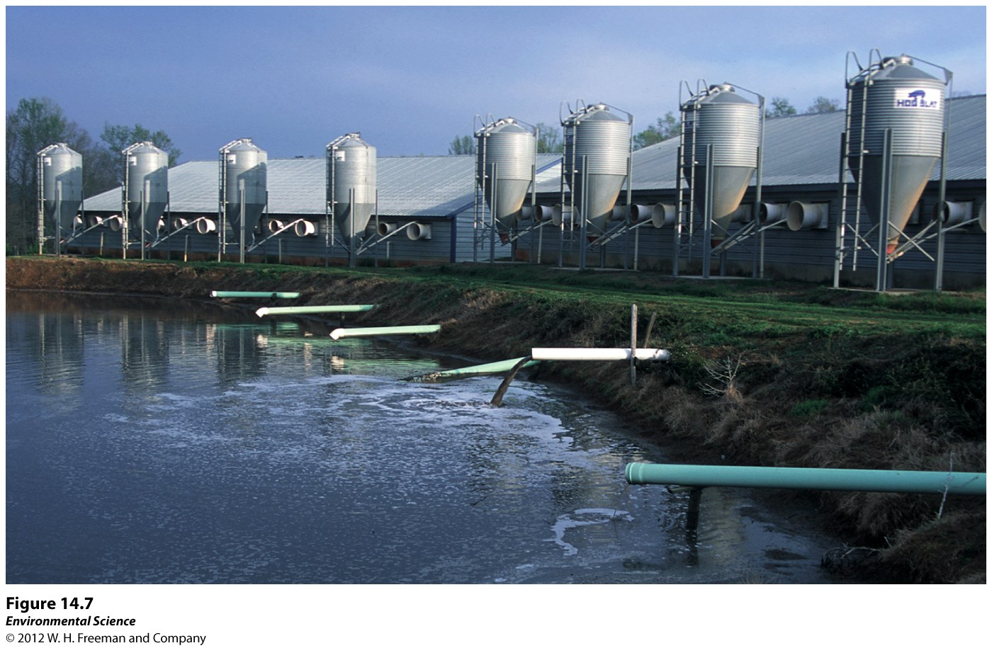
Treatments for Human and Animal Wastewater
Manure lagoons- large, human-made ponds line with rubber to prevent the manure from leaking into the groundwater. After the manure is broken down by bacteria, it is spread onto fields as fertilizers.

Slide 51
IV. Heavy metals and other substances can pose serious threats to human health and the environment
Lead
Arsenic Mercury
Acid deposition and acid mine drainage
Synthetic organic compounds (4)

Slide 52
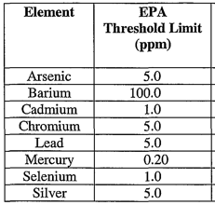
Heavy Metals: Lead and Arsenic
Lead:
Heavy metal harmful to fetuses and young; damage to brain, nervous system and kidneys.
Enters water via old pipes
Arsenic:
occurs naturally in Earth’s crust & dissolves into groundwater
Mining releases stores; contaminates wells; carcinogen: skin, lungs, kidneys, bladder

Slide 53
Heavy Metal - Mercury
Mercury: Two-thirds produced by human activities
Burning of fossil fuels (coal)
Garbage incineration, hazardous waste from medical supplies
Raw material for cement production
Mercury finds it’s way to water
Bacteria convert Hg -> methylmercury (shellfish & biomagnification through food chain)
Exposure through eating fish and shellfish
Causes damage to nervous system
Also used in illegal gold mining production in developing nations (Peru)

Slide 54
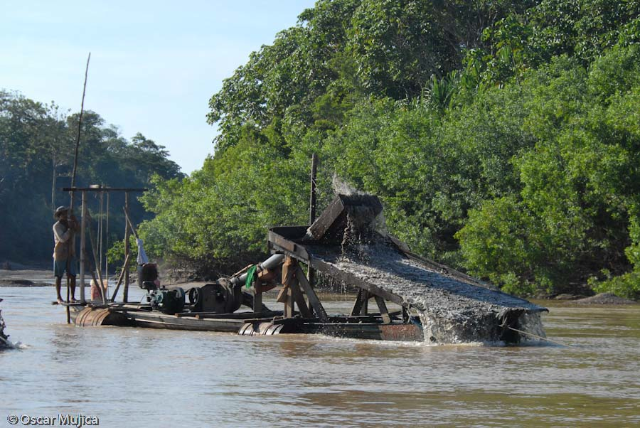
Illegal Gold Mining in Peru’s Amazon Basin

Slide 55
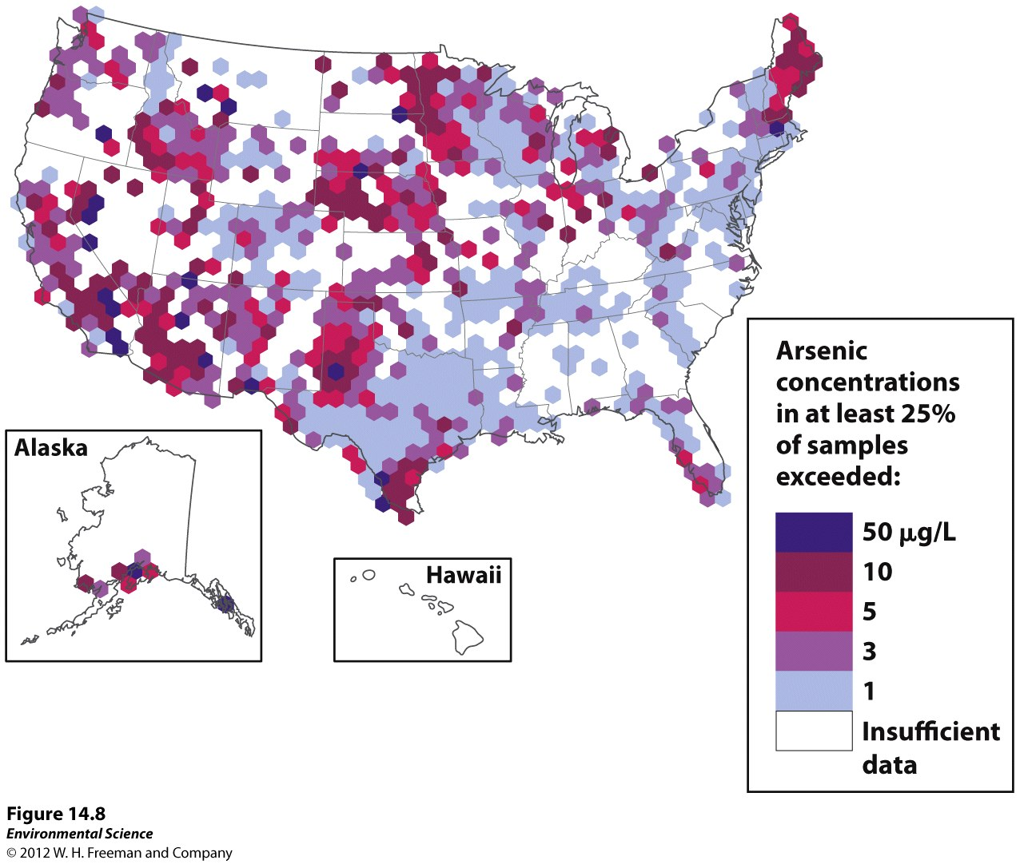

Slide 56
Acid Deposition
Wet Acid Deposition: “Acid Rain”/precip.
Dry Acid Deposition: gases and particles that attach to the surfaces of plants, soil, and water
Caused by the sulfur dioxide and nitrogen dioxide gases emitted by smokestacks of power and industry
Chemical Rx occur in atmosphere and change to sulfuric/nitric acids that cause acidification of lakes and streams (pH<5)

Slide 57
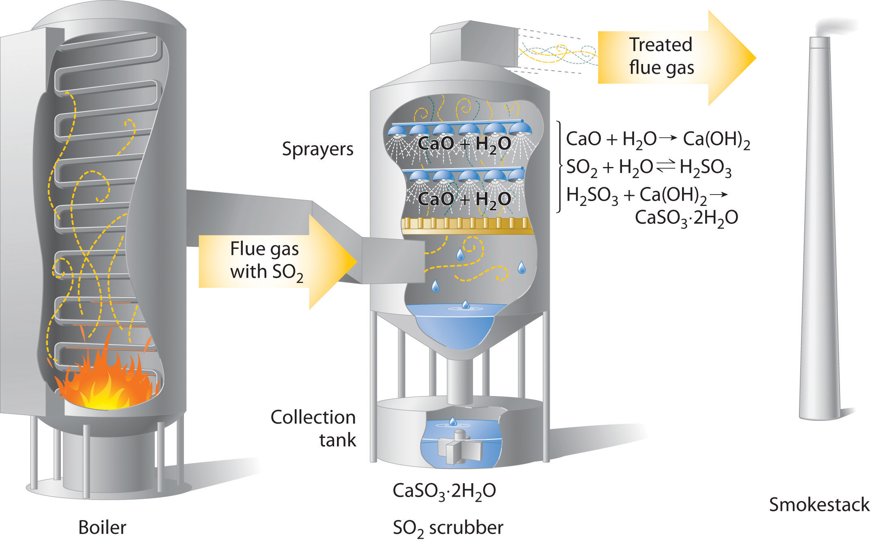
coal scrubbers help reduce acid precip.

Slide 58
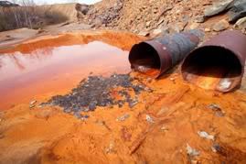
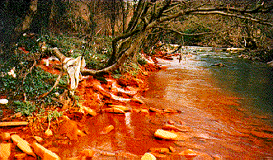
Acid Mine Drainage
The low pH of water emerging from abandoned mines mixes with stream water to lower the pH.
Causing iron precipitation out to solution and forms oxidized iron.

Slide 59
Synthetic organic compounds
Pesticides & Inert ingredients
Arsenic is natural pesticide; synthetics boom after WWII.
Indiscriminate killer of insects (DDT)
Roundup’s inert ingredients cause tadpole gill cells to swell and org. suffocates
Pharmaceuticals and hormones
USGS data over 139 US streams: 50% antibiotics reproductive hormones; 80% nonprescription drugs; 90% steroids
Some instances showing reproductive changes in amphibians; male fish found to have female eggs in testes

Slide 60
Synthetic organic compounds
Military compounds
Perchlorates are chemicals used in rocket fuel that have leached into underlying soil; contamination of groundwater and crops; causes thyroid problems and reduce hormone production that can impair functioning levels
Industrial compounds (Manufacturing)
Historical common practice was to dump directly into water bodies
PCB’s (plastics, insulation) are a carcinogen
PBDEs – flame retardants cause brain damage
2009 NYS: dredged Hudson river to remove 1.3 million pounds from General Electric pollution from 1947-1977; PCBs banned in 1979 due to persistence and negative health impacts

Slide 61
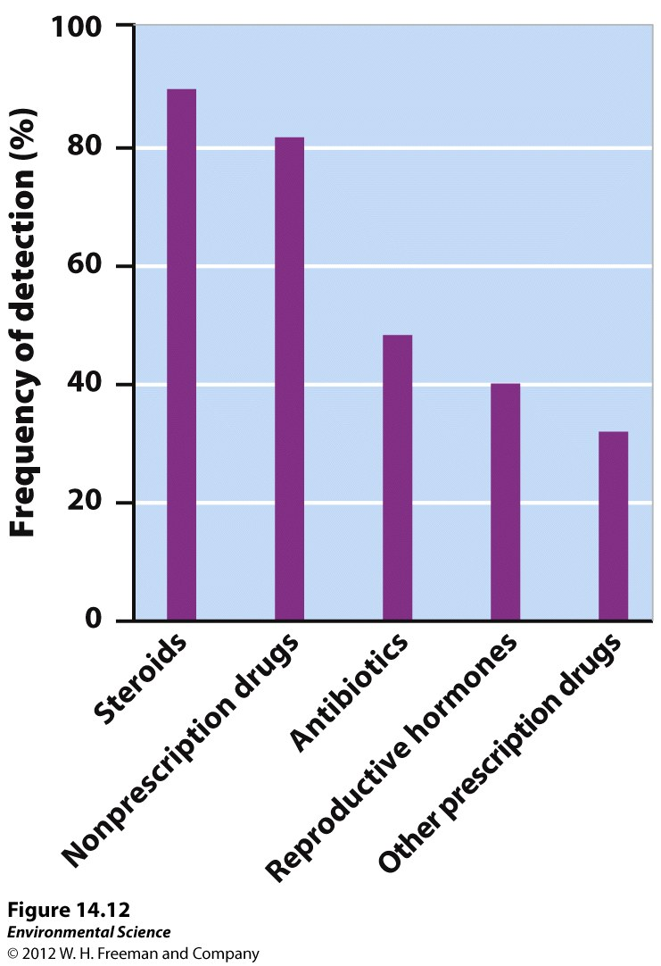

Slide 62
V. Oil pollution can have catastrophic environmental impacts
Petroleum products are highly toxic to birds, mammals, fish, algae & other microorganisms essential to the trophic structure.
Very persistent and difficult to remove.
Sources:
Offshore drilling rigs (2010 BP Spill)
Oil Tanker Spills (1989 Exxon Valdez)
Est. more than 100 years to break down oil

Slide 63
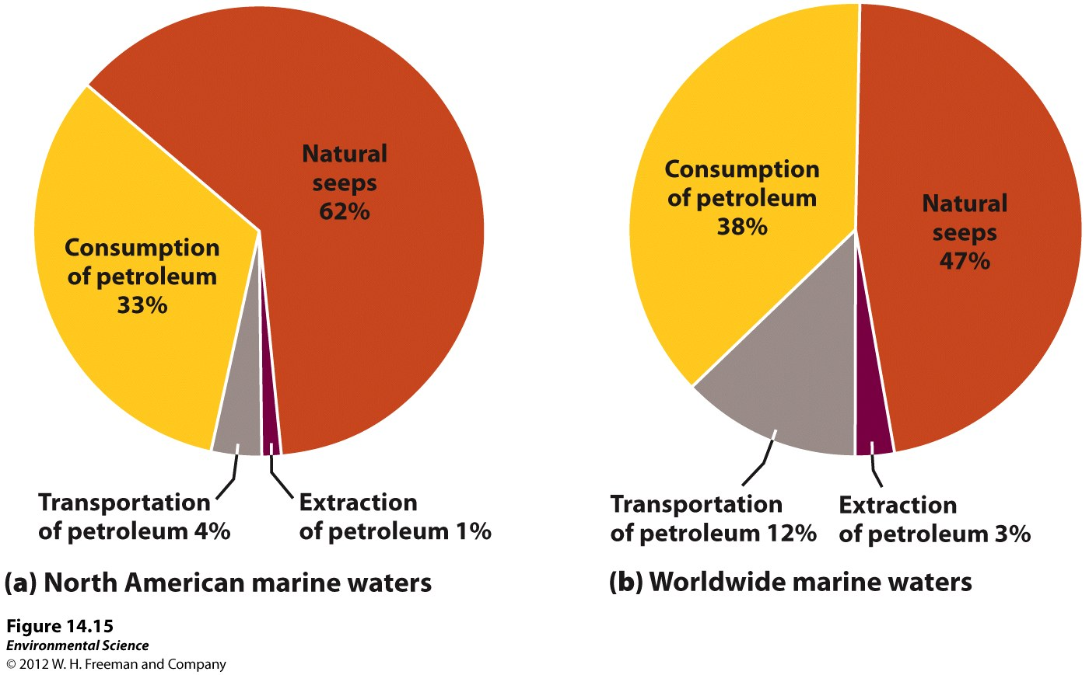
Oil Pollution

Slide 65
Ways to remediate oil pollution
Since 1989 Exxon Valdez spill, how to best control future spills?
Birds and mammals must be cleaned by hand
Oil containment booms are used to circle a spill then suck off the oil from the top
Absorbent materials wick oil from shallow areas
Genetically engineered bacteria: bacteria were found near natural seeps; very rare
BP Spill: underwater plume – oil below the surface
No current agreed upon method
Rocky Shoreline Cleanup: No good way to clean!
Several methods used
High-pressure Hot water sprayed (also removes animals and plants)

Slide 66
3 Main Ways to Remediate Oil Pollution
Containment using booms to keep the floating oil from spreading.
Chemicals that help break up the oil, making it disperse before it hits the shoreline.
Bacteria that are genetically engineered to consume oil

Slide 68
VI. Not all water pollutants are chemicals
Solid waste pollution (Garbage) – discarded materials from households and industries.
Sediment pollution (sand, silt, clay moved by streams and settle out in other locations.
Thermal pollution
Noise pollution

Slide 69
Solid waste pollution

Slide 70
Sediment pollution

Slide 71
Thermal pollution
Human activities (power plants) cause a substantial change in water temperature.
River/lake water is used to cool the steam and (warmer) condensate is returned to the source
(18-27F warmer)
Thermal shock kills organisms who are intolerable of “new” temperature
Warmer temperatures also lower DO and organisms may die from respiratory failure (suffocation)

Slide 74
Noise pollution
2003: Federal Court struck down US Navy’s request to install a network of long-range sonar systems across the ocean floor…because of suspected negative impacts on whales and other sensitive marine mammals.
2008: Supreme Court ruled that the president of the US could exempt the navy from environmental laws that were related to potential sonar effects on ocean life.

Slide 75
VII. A nation’s water quality is a reflection of the nations water laws and their enforcement
Clean Water Act
Safe Drinking Water Act
Legislation in the developing world

Slide 76
Water Laws
Clean Water Act- (1972) supports the “protection and propagation of fish, shellfish, and wildlife and recreation in and on the water”.
Issued water quality standards that defined acceptable limits of various pollutants in U.S. waterways.

Slide 77
Clean Water Act: 1972
Under the CWA, EPA has implemented pollution control programs such as setting wastewater standards for industry. The EPA also set water quality standards for all contaminants in surface waters.
The CWA made it unlawful to discharge any pollutant from a point source into navigable waters, unless a permit was obtained. EPA's National Pollutant Discharge Elimination System (NPDES) permit program controls discharges.
Point sources are discrete conveyances such as pipes or man-made ditches. Individual homes that are connected to a municipal system, use a septic system, or do not have a surface discharge do not need an NPDES permit; however, industrial, municipal, and other facilities must obtain permits if their discharges go directly to surface waters.

Slide 78
Safe Drinking Water Act: 1974
The Safe Drinking Water Act (SDWA) was originally passed by Congress in 1974 to protect public health by regulating the nation's public drinking water supply. It is the main federal law that ensures the quality of Americans' drinking water. Under SDWA, EPA sets standards for drinking water quality and oversees the states, localities, and water suppliers who implement those standards.
Maximum Containment Levels (MCL) of 77 different water-present substances
The law was amended in 1986 and 1996 and requires many actions to protect drinking water and its sources: rivers, lakes, reservoirs, springs, and ground water wells. (SDWA does not regulate private wells which serve fewer than 25 individuals.)

Slide 81
Legislation in the developing world
Developed vs Developing Countries??
Industry supports societies with lax environmental law and policy; country is in need of income and is willing to allow the polluting of its land and waters for employment and increased tax revenue.
However, awareness and increased human rights efforts have increased pollution control/cleanup efforts in developing countries…

