Slide 1
Water Quality and Water Testing

Slide 2
Studies of streams may involve the following measurements and analysis
Physical Parameters of the Stream
Biological Indicies
Chemical Composition of Stream Water

Slide 3
Physical Parameters Morphometry
The measurement of “shape”
I.e. How things change over a course

Slide 4
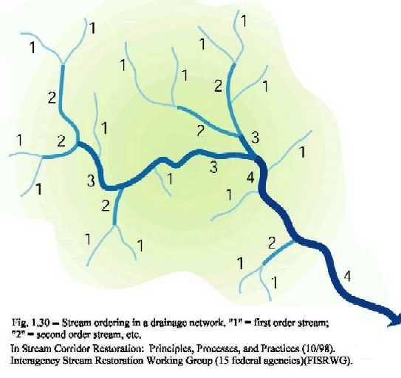

Slide 5
Stream Morphometry
Measurement of various stream attributes to discover stream properties

Slide 6
Mountain Streams
First-Order Streams
Smallest/ lowest volume
Steepest gradient
Fast Streams

Slide 7
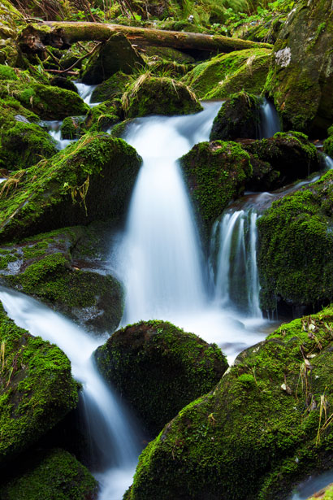
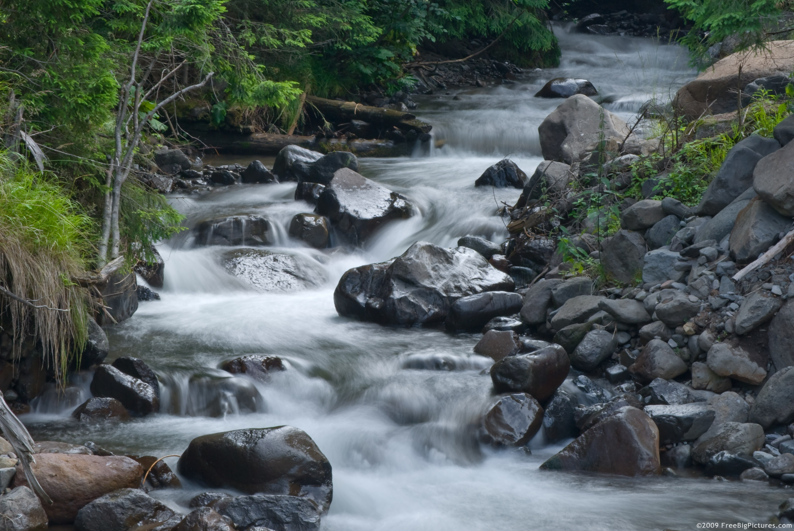
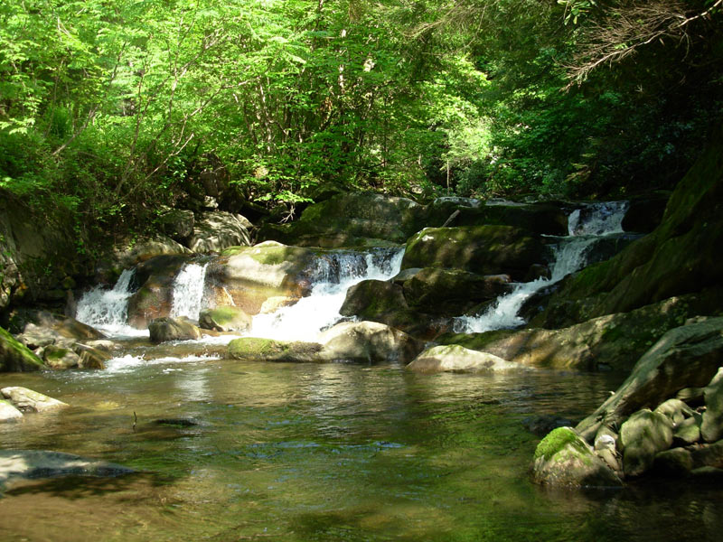

Slide 8
Streams in Flat Areas
Higher order streams
Larger/ Higher volume
Gradual gradient/ Flat
Slower velocity

Slide 9
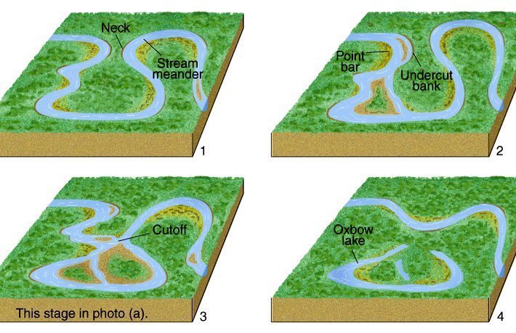

Slide 10
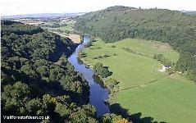

Slide 11
Physical Tests
Physical analysis of a stream is based on the following tests
Depth
Velocity
Volume of Flow/Stream Flow (discharge)
Temperature
Turbidity
Notes:
Flowing water can range from a trickle of water to a raging waterfall. Lots of factors determine how a stream flows such as gradient, channel width and depth, and how many tributaries are up stream and the flow of the water is constantly changing. Rainfall and seasons are a couple of ways flow can be affected. One of the major aspects of physics in flowing water is the speed of the water at various parts of a stream. It’s not the same. We learned how in a meandering stream faster water moves on the outside of the curve and slower water is on the inside where deposition occurs changing the shape of the stream. This causes a stream to move.

Slide 12
Depth (m)
Depth is needed to calculate Volume of Flow
Calculation:
Measure the width of the stream profile
Measure the depth at 1-meter intervals across the stream profile
Calculate the sum of all depth measurements
Divide the sum of depths by the number of measurements
Notes:
Because streams vary in depth at different spots its necessary to find and average depth.

Slide 13
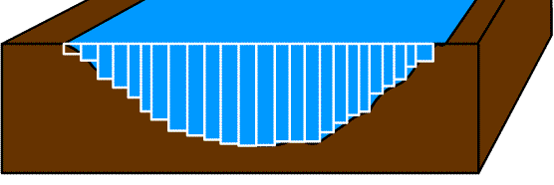
Depth (m)
A B C D E F G H I J K L M N O P Q R S TU VWXY
A+B+C+D+E+F+G+H+I+J+K+L+M+N+O+P+Q+R+S+T+U+V+W+X+Y
25
Average Depth
=

Slide 14
Depth (m)
*At most points in the Brandywine that we test, the depth will be less then 1 meter but the measurement should always be recorded in meters not centimeters
Notes:
We can record in cm and convert to m if its easier, but the final measurement should be in meters

Slide 15
Velocity depends on:
Distance from shoreline
Depth of Water
Composition of Benthic Environment
(Smooth v Rough)

Slide 16
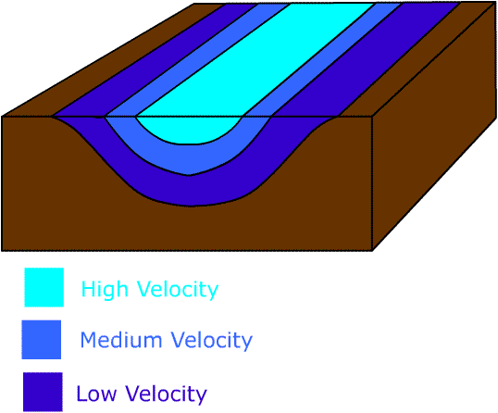
Velocity (m/sec)
Velocity is a measure of how fast the stream water is moving
Notes:
How fast the stream is moving in a given amount of time. In a nonmeandering stream the fastest water is located in the center of the stream. Here there is no friction with the sides of the channel and the bottom so the water moves faster.

Slide 17
Velocity (m/sec)
Calculation
Measure the width of the stream profile
Divide the width by 5 – you will take measurements at 4 points (not on the very edge of the stream)
Velocity is measured by timing the movement of a tennis ball over 1 meter
Record three sets of times for each point across the river and take the average
Calculate the sum of the 4 averages and divide by 4 to get an overall average velocity
Notes:
Draw a diagram on the board

Slide 18
Volume of Flow/Stream Flow (m3/sec)
The volume of water that moves past a fixed point in a specific interval of time
Stream flow or volume of flow is an important indicator of water quality.
Affects the available oxygen level in water that fish and other aquatic wildlife depend on to live.
Streams with higher flows have more oxygen available for aquatic wildlife.

Slide 19
Volume of Flow/Stream Flow
Controls the amount of sediment that is transported in a stream.
Determines how pollution is transported and influences the ability of a stream to dilute pollution.
Large, swift rivers have a greater ability to dilute and degrade runoff pollutants, unlike smaller streams.

Slide 20
Volume of Flow/Stream Flow
Calculation:
(width) x (average depth) x (average velocity) x (bottom constant)
Notes:
Bottom constant has to do with how much friction the bottom creates with the water. The more varied the bed of the stream is the larger the constant will be. Bottom constant can also tell you a bit about the health of a stream, if the bottom is rough and varied that’s a good thing, little erosion, but if it is covered with mostly fine sediment like silt and clays that’s an indication of problems upstream dealing with lots of erosion.

Slide 21
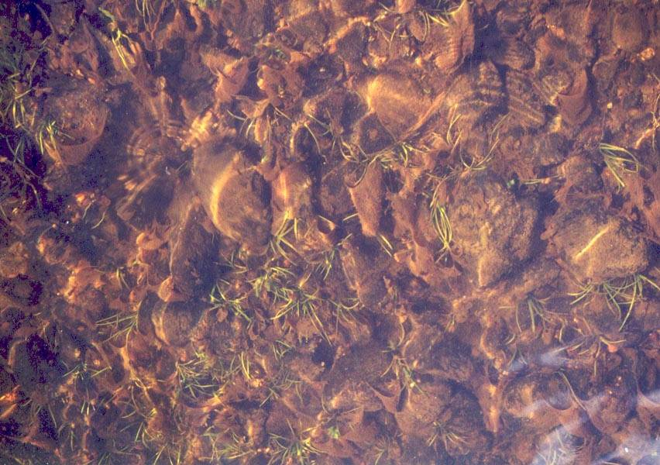
Volume of Flow/Stream Flow
Bottom Constant =
0.8 if bottom is rough: rocks and course gravel

Slide 22
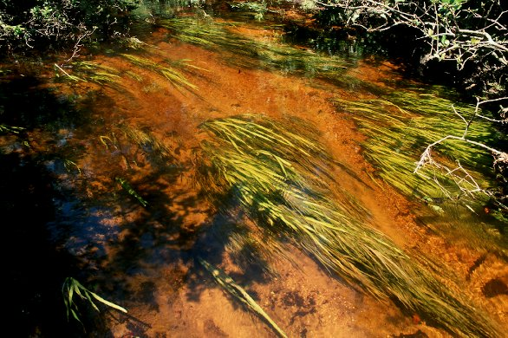
Volume of Flow/Stream Flow
Bottom Constant =
0.9 if bottom is smooth: mud, sand, or bedrock

Slide 23
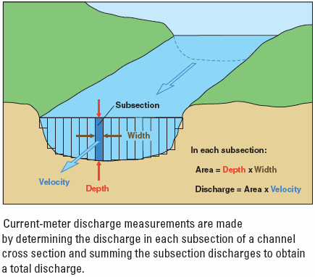

Slide 24
Water Temperature (°C)
Temperature of the water directly affects biological and chemical processes.
Lower Temperature → More Dissolved Gases (DO)
Determines the type and location of organisms
Some fish species prefer colder waters than other species.
Bottom dwelling organisms will move in the stream in order to find their optimal temperature.

Slide 25
Water Temperature (°C)
Calculation:
Temperature is measured at 4 points throughout the stream profile
Divide the sum of the measurements by 4 to get the average
Notes:
Draw diagram

Slide 26
Turbidity
Turbidity is a measure of water clarity.
Insoluble solids or suspended particles such as clay, silt, sand, algae, plankton and other substances affect the clarity of the water.
Water temperature is increased because suspended particles absorb more heat.
When turbidity is high, photosynthesis is reduced due to the decrease in the amount of light traveling through the water.

Slide 27
Turbidity
Sources of turbidity include
soil erosion
waste discharge
urban runoff
eroding stream banks
large numbers of bottom feeders that stir up sediments
excessive algal growth

Slide 28
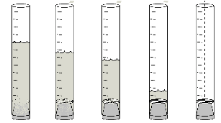
Turbidity
Measured using a Turbidity Tube
Unpolluted Streams: >53.4 cm

