Slide 1
Chapter 3: Ecosystem Ecology (57-85)
What is an ecosystem?
What are the components of an ecosystem?
What are the boundaries to an ecosystem?
What are specific examples of/components to ecosystems?

Slide 2
Ecosystem Ecology: Key Ideas
List the basic components of an ecosystem
Describe how energy flows through ecosystems
Describe how carbon, nitrogen, and phosphorous cycle within ecosystems
Explain how ecosystems respond to natural and anthropogenic disturbances
Discuss the values of ecosystems and how humans depend on them

Slide 3
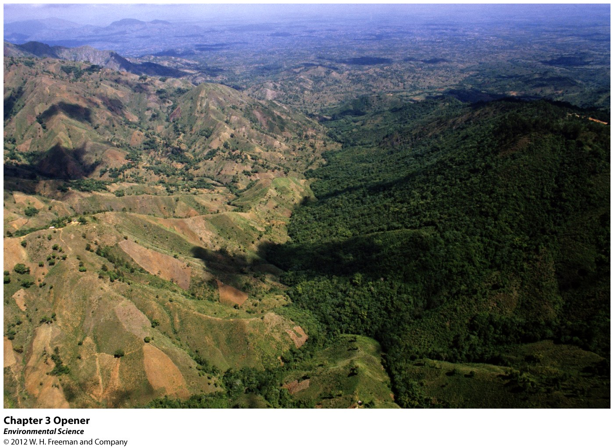

Slide 4
Case Study: Reversing the Deforestation of Haiti (57)
“By 2006, more than 9 million people lived in this small nation, and less than 2 percent of its land remained forested.”
(1923: 60% covered in forest)
Problem: Deforestation (Low Income; Trees used as a fuel source)
Effects: Tree Roots Die, Increased Soil Erosion, Infertile Soil, Flooding, Landslides
Solutions:
Planting 60 million trees wasn’t enough
(Haitians weren’t letting them grow)
Planting Mango Trees encouraged people to let them grow to maturity ($70-150 of mangoes annually)
Use of discarded paper processed into dried cakes for fuel
Value: Monetary income, soil stabilization, increased soil fertility

Slide 5
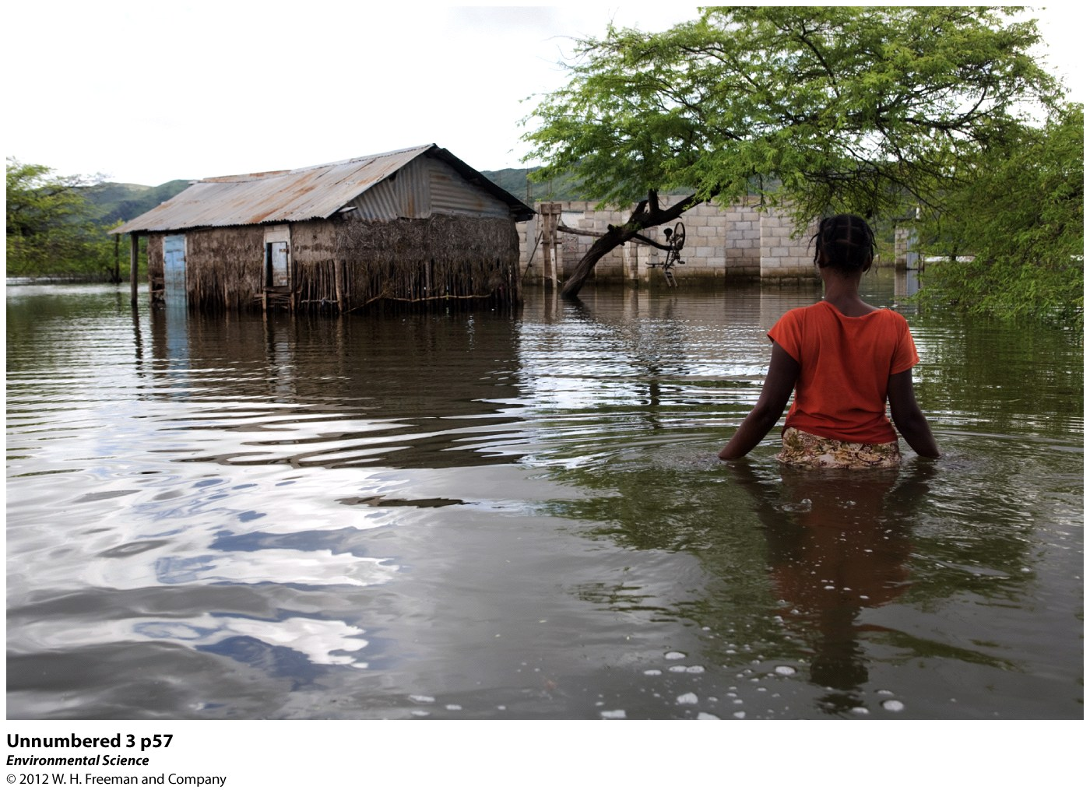

Slide 6
I. Ecosystem ecology examines interactions between the living and nonliving world (58)
Ecosystem:
A particular location on Earth distinguished by its particular mix of interacting biotic and abiotic components
Biotic: Living/Once living components (trees, stumps, insects, mammals, etc…)
All living organisms represents the ecosystems biodiversity
Abiotic: Non-living components (Sunshine, temperature, rocks, soil, water, pH, nutrients)

Slide 7
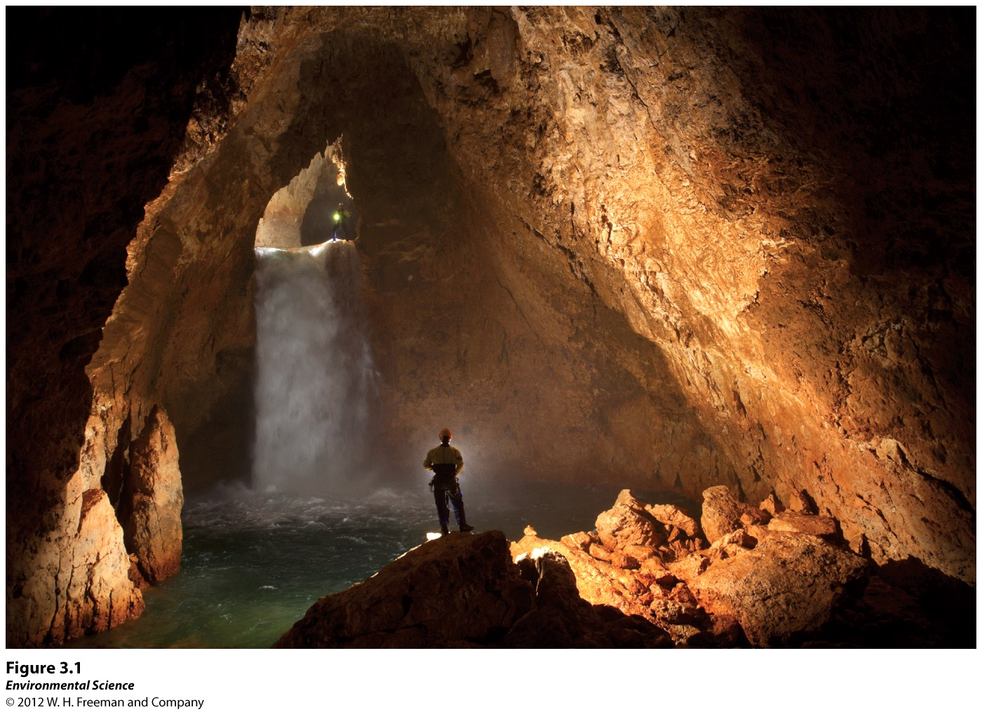

Slide 8
I. Ecosystem ecology examines interactions between the living and nonliving world
Components of a particular ecosystem are highly dependent on climate:
Dry Desert of Death Valley, Cali (120F) vs Antarctica (-120F)
Terrestrial vs. Marine Environments
Water content in soil (more=trees, less=grasses)

Slide 9
I. A. Ecosystem Boundaries
Biotic and abiotic components define boundaries:
Not all ecosystems have well defined boundaries
Ex. Cave
Biotic Components: Animals (bats) and Microorgs
Abiotic Components: Temp, salinity, water, bat feces (provides energy)
A cave is more easily studied, since it has well-defined boundaries; MOST ecosystem boundaries are more subjective…

Slide 10
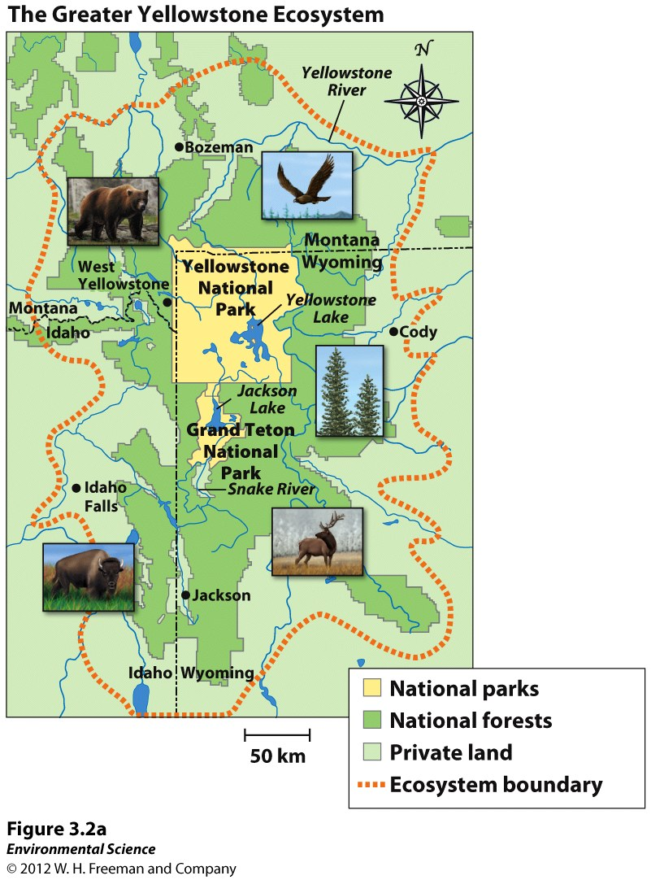
Some are set according to administrative, rather than scientific criteria… The grizzly bear did not fit into the confines into the park boundary, so ecologists came up with “The Greater Yellowstone Ecosystem”
Note the yellow area of the park, compared to the orange dotted outline of the ecosystem (incl. both private and public land)

Slide 11
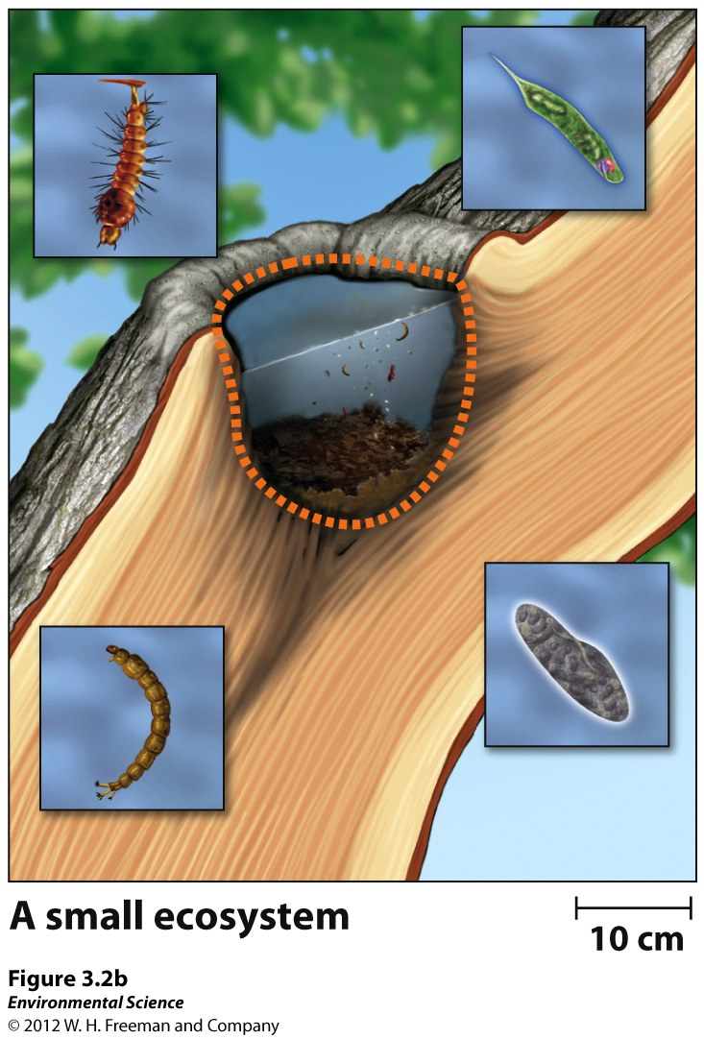
Some ecosystems are much smaller… Water filled tree knot/birdbath/tire…
“These tiny ecosystems include all of the physical and chemical components necessary to support a diverse set of species, such as microbes, mosquito larvae, and other insects” (60)
***Ecosystems occur in a wide range of sizes***

Slide 12
https://www.youtube.com/watch?v=9-8OCecOmEQ

Slide 13
I. B. Ecosystem Processes
Each ecosystem interacts with surrounding ecosystems through the exchange of energy and matter…
Think of the cave, Yellowstone, water-filled tire
There is no isolation
Changes in any one ecosystem can ultimately have far-reaching effects on the global environment

Slide 14
II. Energy flows through ecosystem (60)
Ecosystem Ecologists study:
Biotic and Abiotic components
Processes that move energy into and out of the ecosystem
The Sun is the main energy source!!
Photosynthesizers are Autotrophs : make their own energy
Heterotrophs get their energy from the autotrophs
(herbivores -> carnivores => omnivores)
Ex. Serengeti Plains Ecosystem
Most present are autotrophs (hundreds of millions), herbivores (millions), followed by carnivores (thousands)
In accordance with the Second Law of Thermodynamics:
Energy transfer is NOT efficient; most energy (90%) is lost as “heat”

Slide 15
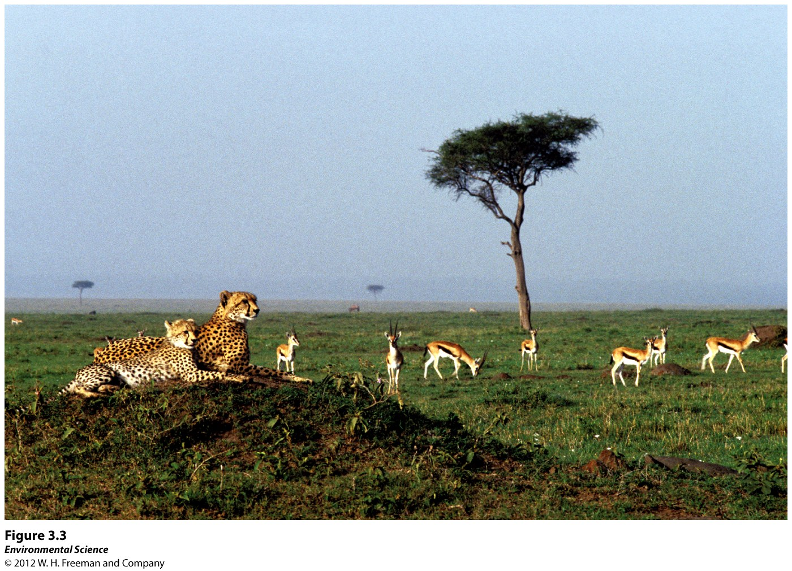
Second Law of Thermodynamics helps explain population dynamics

Slide 16
II. A. Photosynthesis and Respiration
Nearly all of the energy needed is from the Sun
Solar Energy is Kinetic Energy
Autotrophs (make their own energy) are also known as producers
Store energy and build “body” structures
(leaves, stems, and roots)
Green organisms photosynthesize sunlight and convert to usable energy (glucose)
Sun (energy) +6CO₂ + 6H₂O -> 6H₂O + 6O₂ + C₆H₁₂O₆

Slide 17
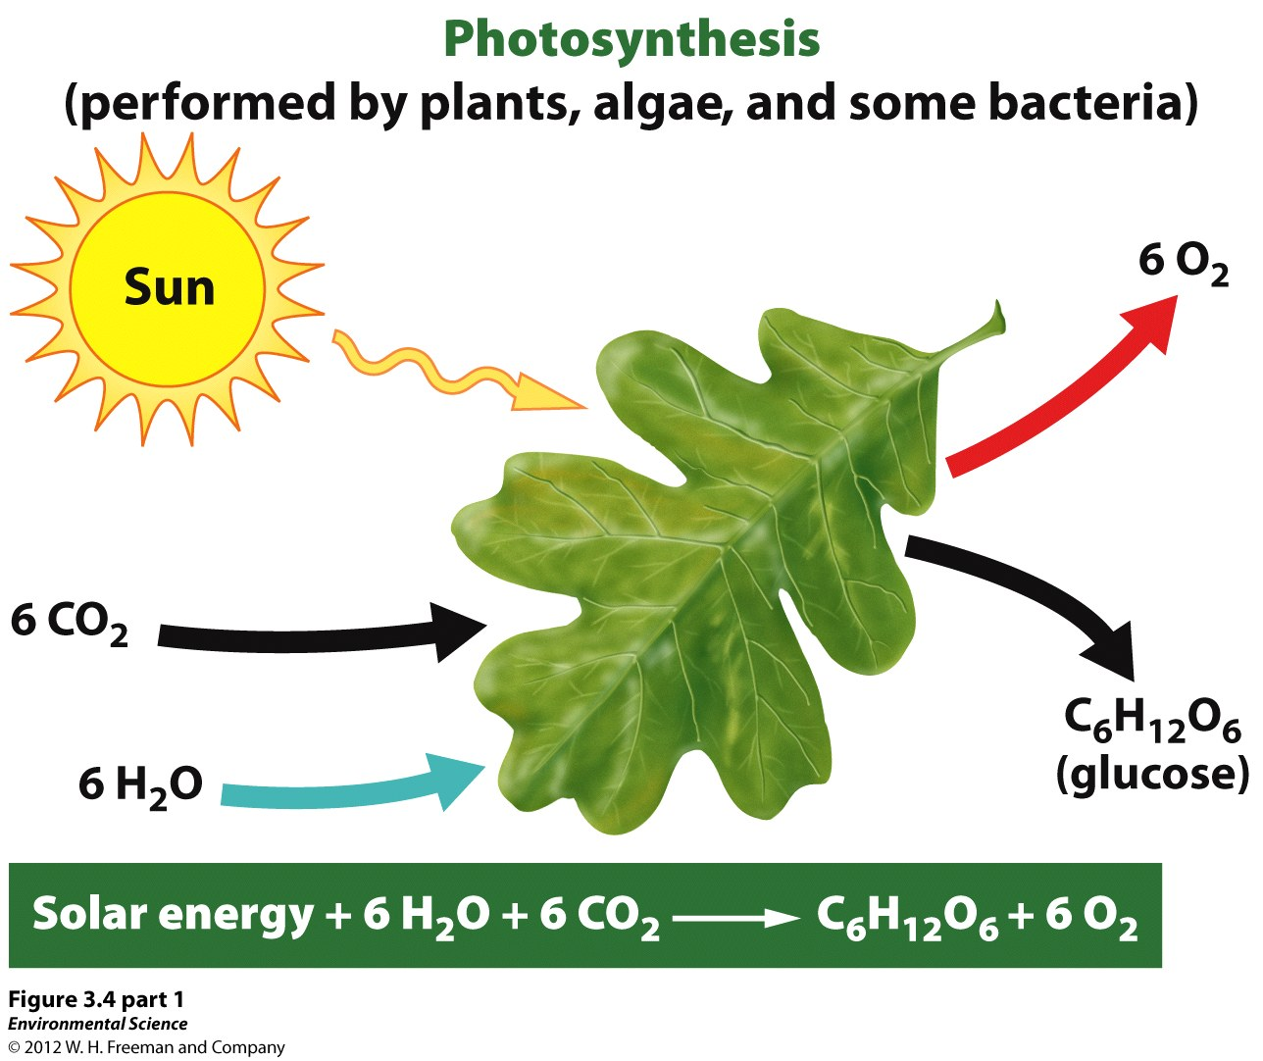

Slide 18
II. A. Photosynthesis and Respiration
2. Heterotrophs
AKA “Consumers”-consume other organisms
Eat the tissues of producers and gain energy from the chemical energy contained in those tissues
Cellular Respiration
Unlocks the energy stored in the cells of organisms
C₆H₁₂O₆ + 6O₂ + 6H₂O -> 6H₂O + 6CO₂ + Heat (energy)

Slide 19
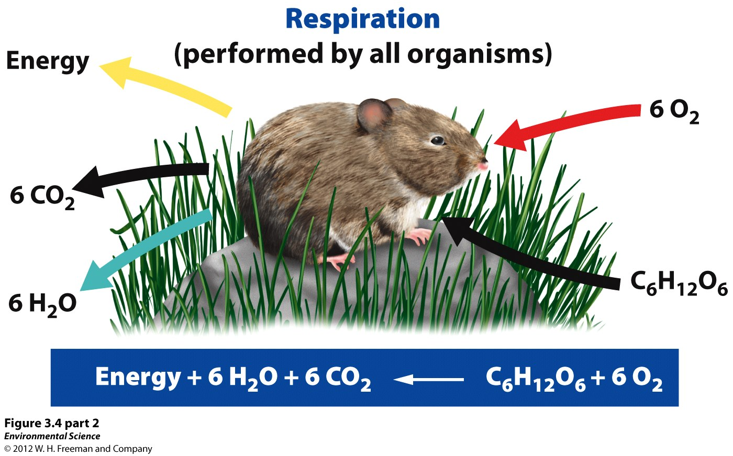

Slide 20
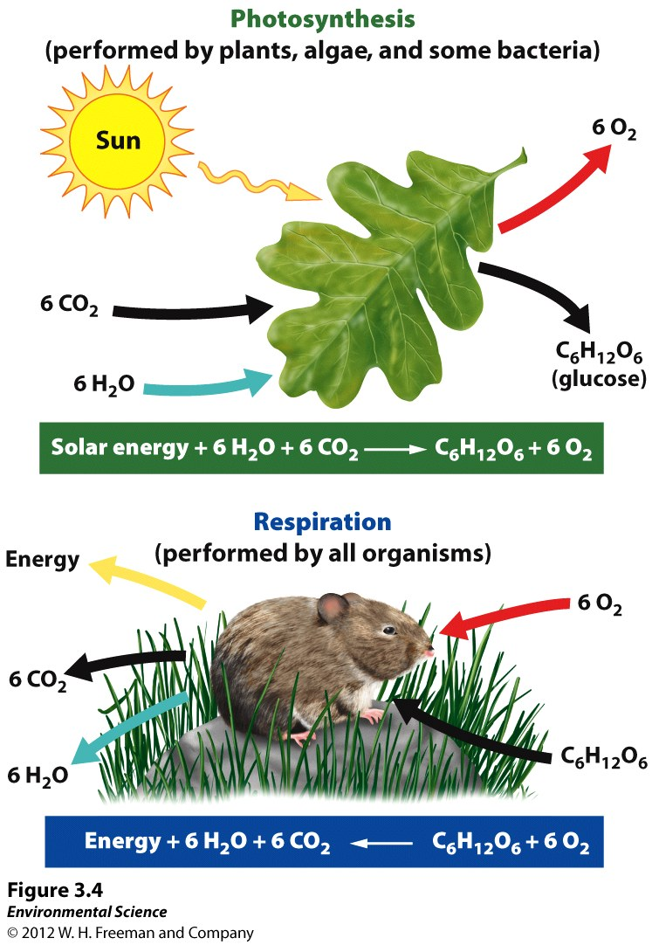
Notice how photosynthesis and cellular respiration are opposites of each other!!
Heterotrophs run photosynthesis backwards to recover the solar energy stored in the glucose of autotrophs

Slide 21
Do Note: All organisms engage in cellular respiration
Autotrophs (Producers) both produce AND consume oxygen…
During the day: more photosynthesis occurs and they generate more oxygen than they consume.
(Net oxygen production)
At night: plants only respire- consume O₂ without generating it…
Net effect: Oxygen into the atmosphere, Carbon stored in tissues
Dual Importance of plants
“source” of oxygen
“sink” of carbon: reduces runaway greenhouse effect

Slide 22
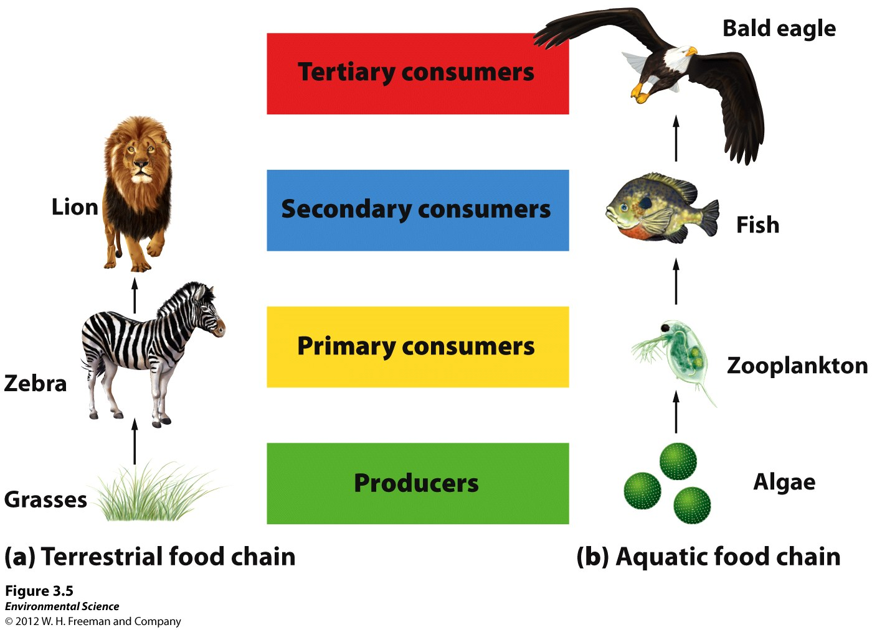
II. B. Trophic Levels, Food Chains, and Food Webs

Slide 23
II. B. Trophic Levels, Food Chains, and Food Webs
-troph: “to nourish”
(Autotrophs=Producers; Heterotrophs=Consumers)
Heterotrophs must gain their energy by consuming other organisms (producers OR consumers)
Organisms fall into different Trophic Levels:
Primary Consumers = Herbivores - Eat plants and Algae (Zebras, grasshoppers, tadpoles)
Secondary Consumers= Carnivores that eat primary consumers (lions, hawks, rattlesnakes)
Tertiary Consumers=eat secondary consumers (Eagles, mosquitoes, ticks)

Slide 24
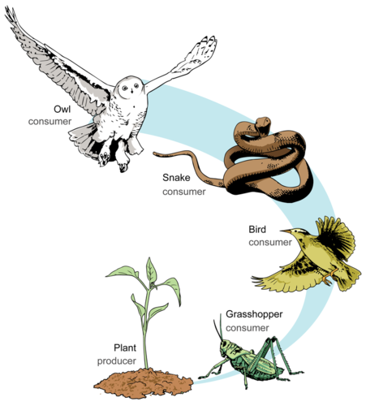
Simple Food Chain
Allows us to see the feeding/trophic relationships between organisms in a certain ecosystem.
Downside, is that it does not paint the entire picture.
Instead, “foodwebs” may be utilized

Slide 25
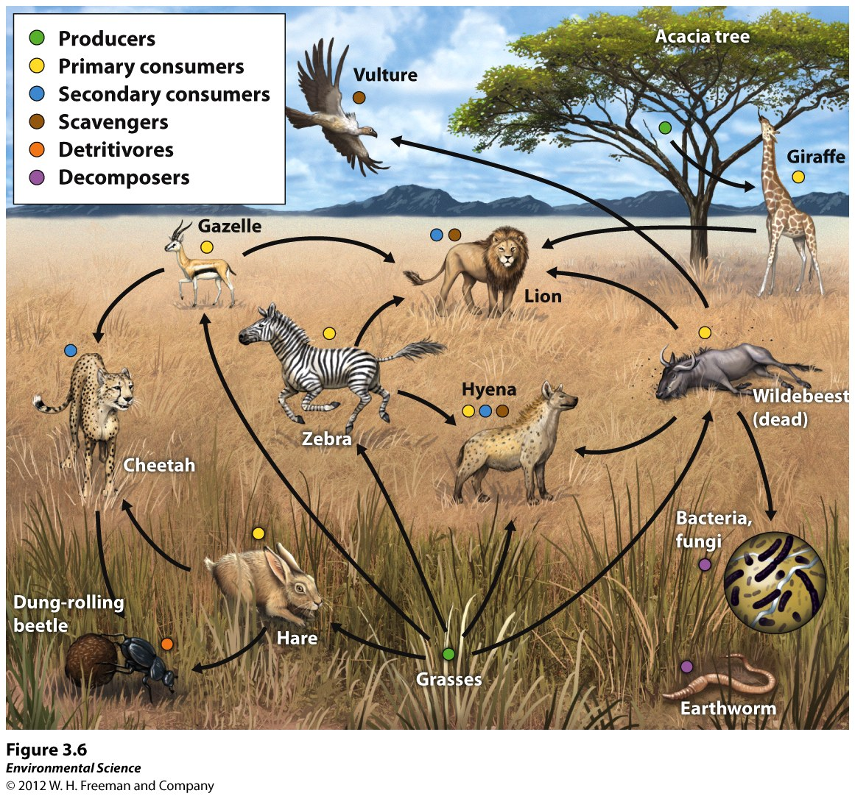
Serengeti Food Web:
Please note how some organisms can occupy multiple trophic levels

Slide 26
Other organisms “complete” the energy cycle… otherwise, nutrients would not return to the soil
Omnivores- operate at several trophic levels (Grizzly Bears, Humans,)
Scavengers- carnivores that consume carrion(Vultures)
Detritivores- specialize in breaking down dead tissues and waste products -detritus)(dung beetles,)
Decomposers- fungi and bacteria that complete the breakdown process by recycling the nutrients from dead tissues and return it to the ecosystem

Slide 27
Serengeti Food Web:
Please note how the arrows show how ENERGY is transferred from one org to another

Slide 28
II. C. Ecosystem Productivity (pg.63)
“The amount of energy available in an ecosystem determines how much life the ecosystem can support”
Sun->Algae->zooplankton->fish->birds
Gross Primary Production - measures the total solar energy that the producers in an ecosystem capture over time
Allows us to analyze the origin of energy and how its transferred through food webs.

Slide 29
Ecosystem Productivity
Gross Primary Production – the total amount of solar energy that the producers in an ecosystem capture via photosynthesis over a given amount of time.
Net Primary Production = GPP – Respiration by producers

Slide 30
II. C. Ecosystem Productivity
If Net Primary Production is
NPP = GPP – Respiration
Then: GPP = NPP + Respiration

Slide 31
How do we use GPP to calculate photosynthesis?
Measure the compounds that participate in the reaction
Measure production of CO₂ in the dark
(since photosyn. doesn’t occur in the dark)
2. Measure the uptake of CO₂ in sunlight
Numbers 1&2 provide the net movement of CO₂ when photosyn. and resp. are both occurring.
CO_{2(photosynthesis)}= CO_{2(taken up in sunlight)} + CO_{2 (produced} _{in} _{dark)}
We can derive the GPP of an ecosystem per day within a given area
(kg C/m²/day)

Slide 32
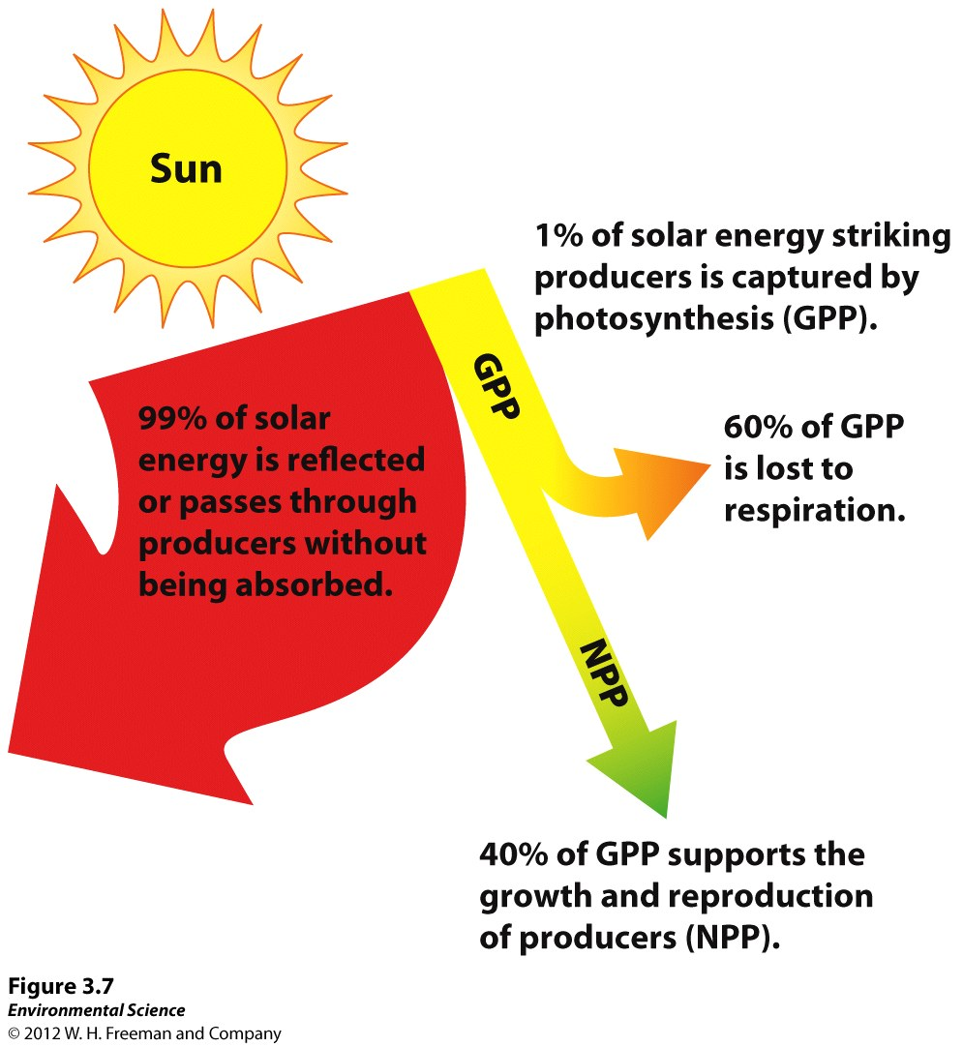
Photosynthesis is NOT efficient
Most is lost in the form of heat back into the atmosphere
Some lost energy consists of wavelengths that are not absorbed by producers
These wavelengths are reflected from the surfaces OR pass through tissue

Slide 33
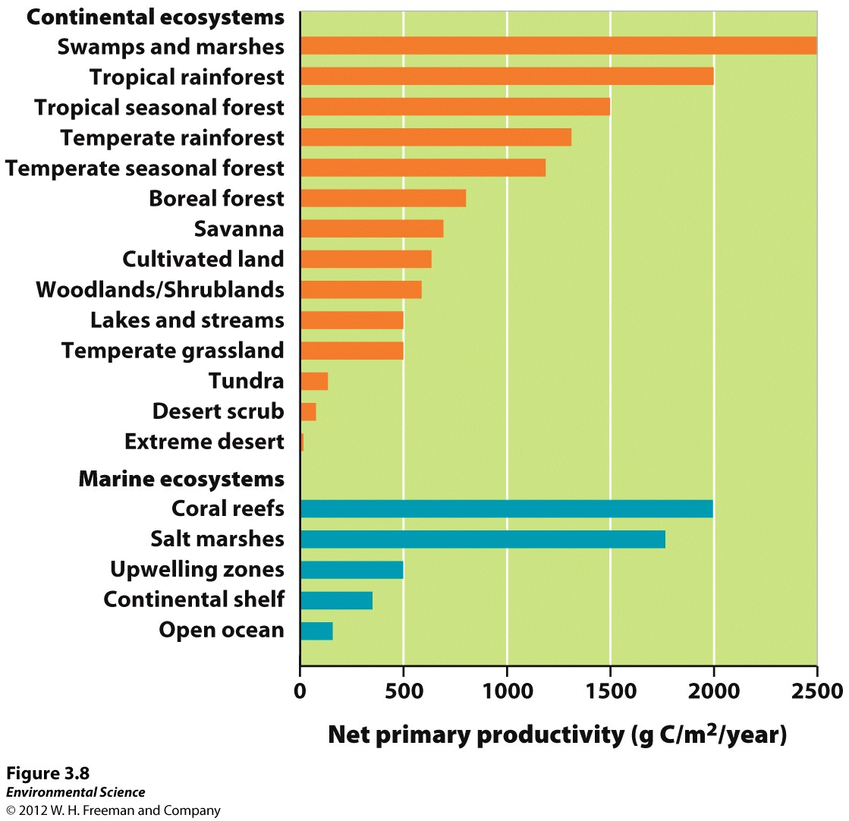
Net Primary Productivity varies among ecosystems
Measurement of NPP allows us to compare the productivity of different ecosystems.
Producers grow best:
Ample sunlight
Water and nutrients
Warm temperatures
Worst Conditions:
Cold, dry, dark
The greater the productivity, the more primary consumers can then be supported.
NPP can also be used to compare dynamic systems over time

Slide 34
II. D. Energy Transfer and Trophic Pyramids
Biomass: the total mass of all living matter in a specific area; provides the measure of energy in an ecosystem…
NPP can provide a rate of biomass production
Standing crop: the amount of biomass present in an ecosystem at a particular time
(Note that standing crop is a quantity, versus productivity, which, is a rate)

Slide 35
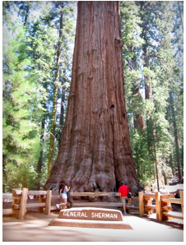
Example 1: Old Growth Forests
Low productivity- only add a small amount of biomass through growth each year
Standing crop of biomass is very high
Trees have grown over hundreds (if not thousands) of years…

Slide 36
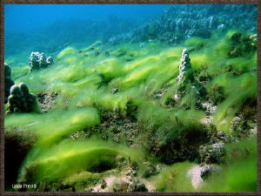
Example 2: Marine Algae
High productivity- add a very large amount of biomass through growth each year
Standing crop of biomass is very low
Consumed very rapidly by heterotrophs, resulting in lower standing crop amounts

Slide 37
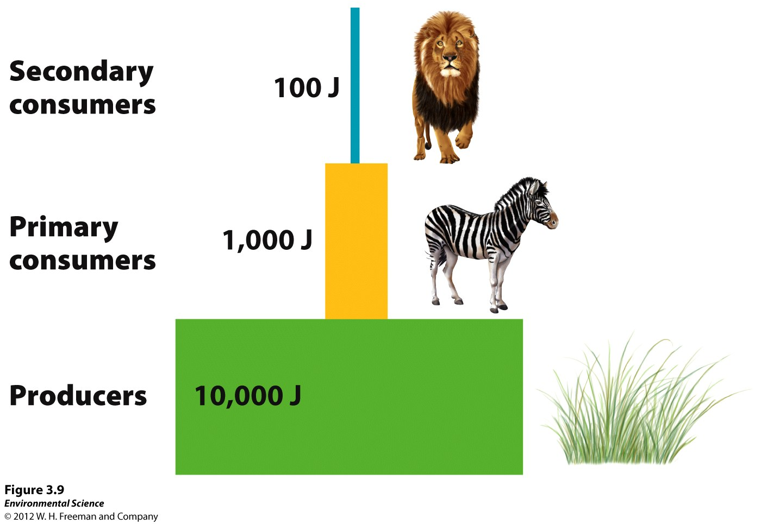
Energy transfer is not 100% efficient
“Rule of Ten”
Only 10% of energy is transferred from one level to the next…

Slide 38
Where does the “missing 90%” go??
Not all parts of the organism are digestible
Some energy goes to “bodily functions”
Homeostasis
(constant body temperature- which is eventually lost as heat)
Ecological Efficiency
The proportion of energy passed from one trophic level to another
(Range from 5-20%; most often is 10%-
HENCE the “Rule of Ten”)

Slide 39
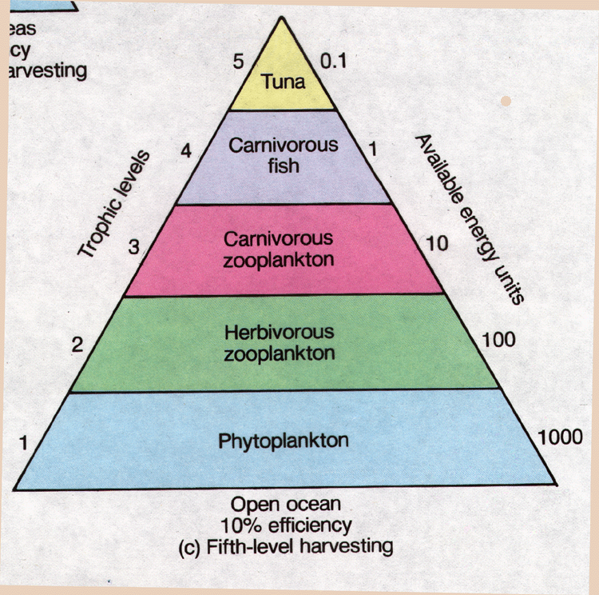
Trophic Pyramids
Show BOTH the relative energy available at each trophic level
AND
The relative biomass that is present within a certain ecosystem
Most is found at the producer level, and decrease as we ascend the pyramid

Slide 40
Food for thought
Being a vegetarian is much more efficient…
We would harvest more energy from a given area.
How??
1,000 kg. of soybeans (can feed humans directly)
This produces 100 kg of meat
(there is ten times more soy available than the meat it feeds)
Soy actually contains 2.5 times more energy than the same amount of meat. So, 1 acre of land has 25 times more energy available when planted in soy than when used for beef…
When we eat meat, we use the cumulative land AND energy from both to meat and the soy…
If herbivores only, all we need is the land from the producers…

Slide 41
III. Matter cycles through the biosphere (65)
Biosphere- The combination of all ecosystems on Earth; the region where life resides
12 mile thick “shell” from the deepest oceans to the tallest mountain peaks
Energy flows through the biosphere
(Sun ->biotic/abiotic components-> atmosphere -> exosphere)
The Sun must replenish this energy each day
Matter cycles within the biosphere
** Earth is an open system in terms of energy
…a closed system in terms of matter **

Slide 42
III. Matter cycles through the biosphere (65)
Biogeochemical Cycles:
The movements of matter within and between ecosystems
Consist of biological, geological, and chemical processes
“Pools”: components of matter
(air, water, organisms)
“Flows”: Processes that move matter between pools

Slide 43
III. Matter cycles through the biosphere (65)
Chemical elements all common to Earthly organisms:
CHOPN
These combine in different combinations to provide many essential compounds
Organisms survive by obtaining these elements through biotic/abiotic pools
Recycled from organisms through the decomposition of wastes
Focus is on the elements that are most important to autotrophic productivity…

Slide 44
III. A. The Hydrologic Cycle
The movement of water through the biosphere
Water is essential to life; >50% of the typical mammal’s body weight
Allows essential molecules to move within and between cells, draws nutrients into the leaves of trees, dissolves and removes toxic materials and performs many other critical biological functions
Water is the primary agent responsible for dissolving and transporting the chemical elements necessary for living organisms

Slide 45
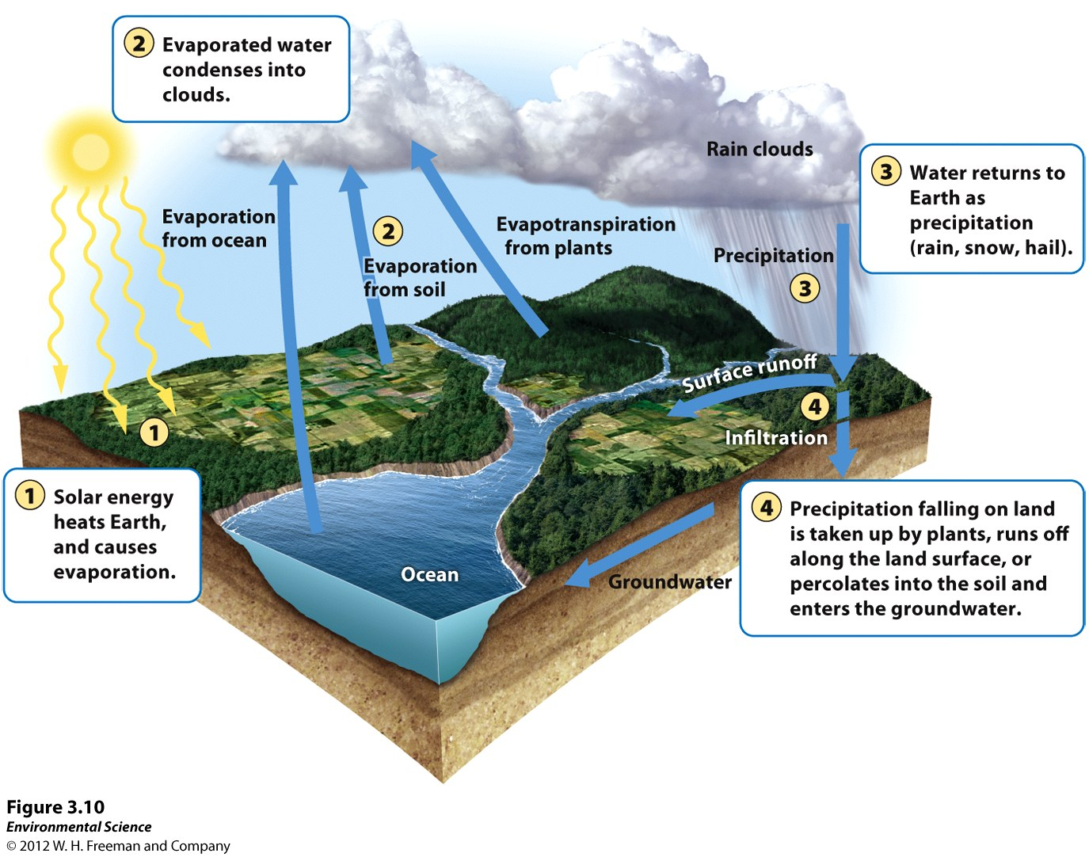
The Hydrologic Cycle

Slide 46
III. A. The Hydrologic Cycle
Human Activities and the Hydrologic Cycle
Remember: Earth is a closed system in regards to matter
Humans can alter the hydrologic cycle in many ways:
Harvesting trees reduces evapotranspiration
Paving surfaces reduces infiltration/percolation
Both Increase runoff and decrease groundwater recharge
Diverting water from one area to another can also impact the regional water cycle
(drinking, irrigation, industrial uses)

Slide 47
III. B. The Carbon Cycle
Carbon is the most important element in living organisms; 20% of total body weight
Serves as the basis of the long chains of organic molecules that form the membranes and walls of cells, constitute the backbones of proteins and store energy for later use
Six processes that drive the carbon cycle:
Photosynthesis, respiration, exchange, sedimentation and burial, extraction and combustion
*Can either be fast (organisms) or slow (geologic)*

Slide 48
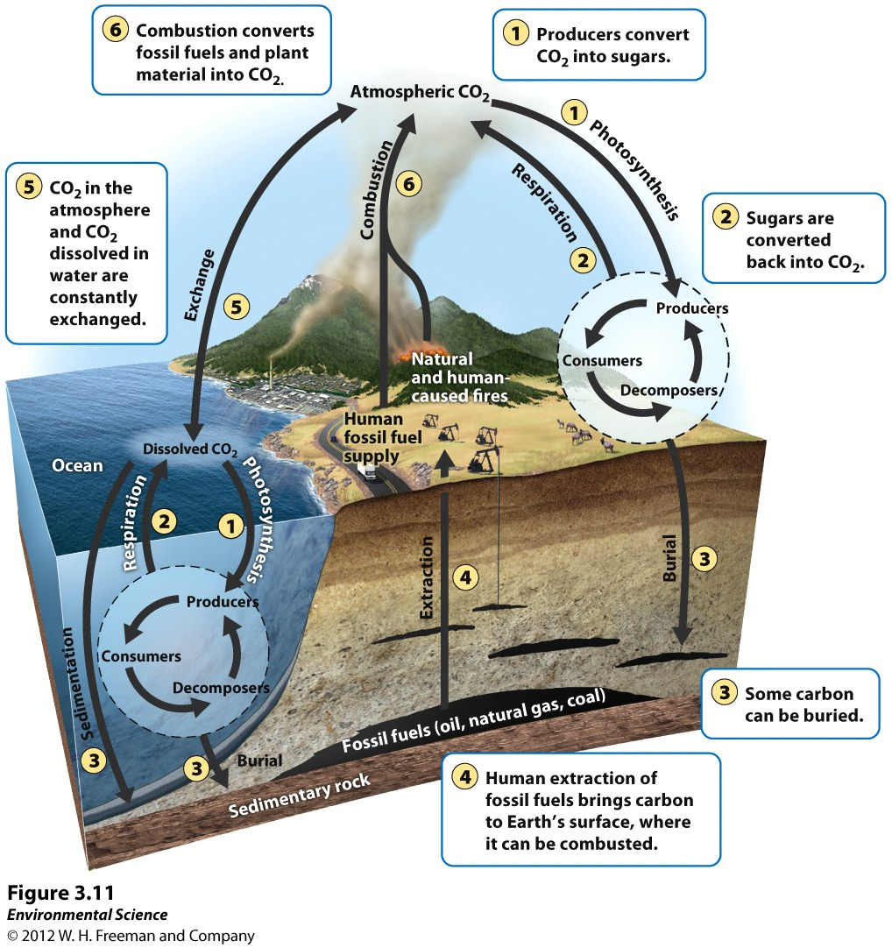

Slide 49
Carbon Cycle Reading (62)
Key Points:
Stored in tissues of producers (photosyn/resp)
Stored in the ocean floor (CO₂-> CaCO₃=Limestone)
**The Ocean Floor is the largest carbon pool on Earth**
Marine organisms use CO₂ dissolved in ocean water to construct shells and exoskeletons; become ocean sediments over time
Some organisms become buried and preserved before decomposition can occur; organic matter becomes fossilized and may become fossil fuels
Extraction of fossil fuels by humans
(relatively recent due to increasing reliance on high energy resources)
“Industrial Revolution”
Combustion releases carbon into the atmosphere (CO2) or into soil as ash
By-product is global warming due to these emissions of greenhouse gasses
Deforestation also contributes to greater atmospheric CO2 concentrations, since photosynthesis does not occur as frequently

Slide 50
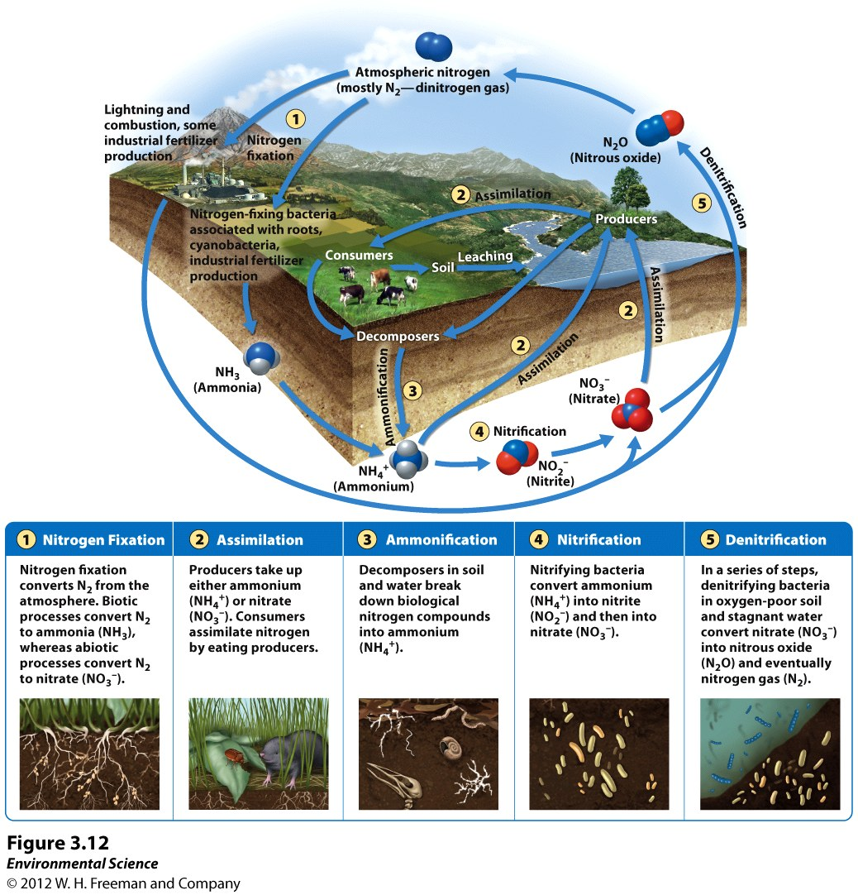
III. C. The Nitrogen Cycle (69-71)

Slide 51
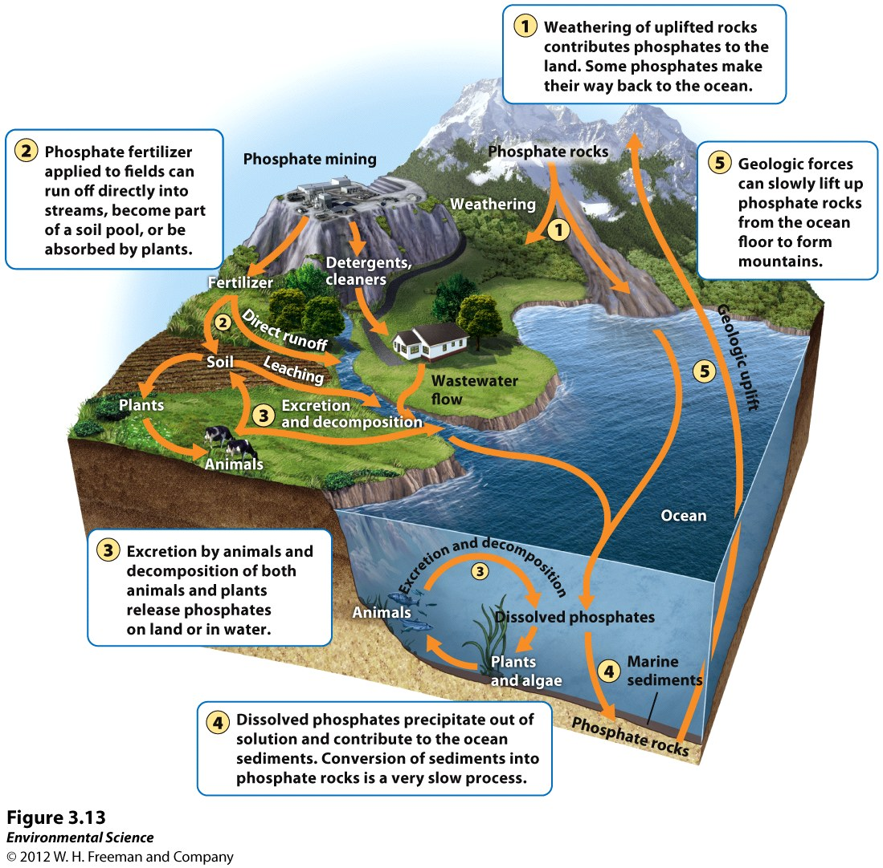
III. D. The Phosphorous Cycle (71-72)

Slide 52
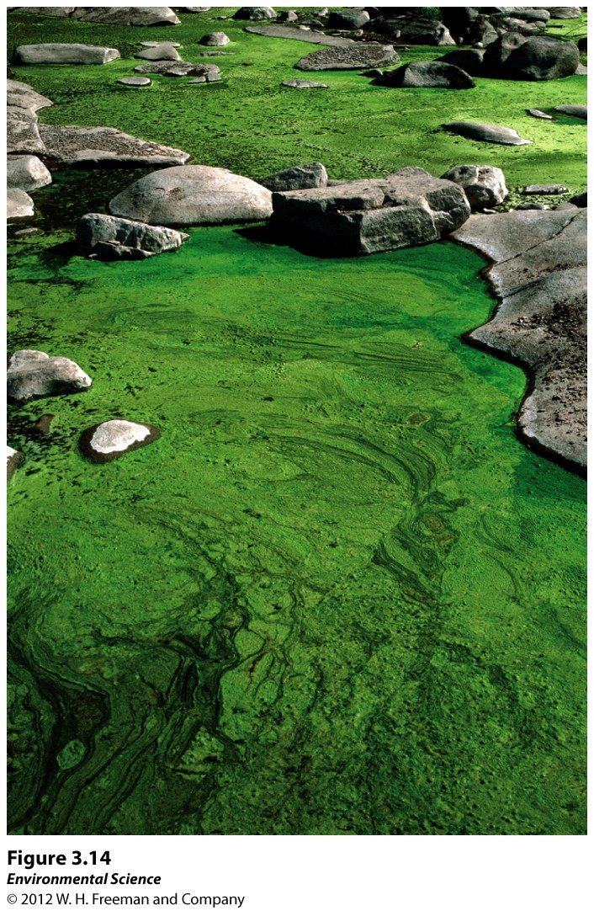
Of the cycles already discussed, which most directly influence this algal bloom, which may lead to eutrophication of this water body?

Slide 53
III. E. Calcium, Magnesium, Potassium
Ca²⁺, Mg²⁺, K⁺ all play important roles in regulating cellular processes and in transmitting signals between cells
Derived primarily from rocks and decomposed vegetation
None are found in the gaseous phase (but can be dust particles in the atmosphere)
All three can be dissolved in water as cations (+); can be attracted to charged soil anions (-)
Ca²⁺, Mg²⁺: strong attraction to anions (found primarily in limestone, marble, and dolostone
K⁺ is weakly attracted to soil; more frequently leached out of soil- constrains growth of plants and animals
K⁺ is a common fertilizer ingredient to supplement K-deficient soils

Slide 54
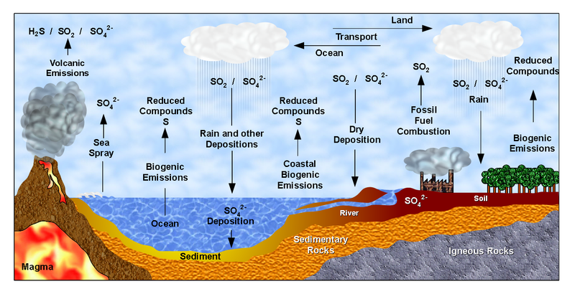
III. E. The Sulfur Cycle
Most is found in rocks -> released into soil and water
Plants absorb through roots (Sulfates: SO₄²⁻)- cycles through the food web
Sulfur also has a gaseous component (volcanic eruptions; fossil fuel combustion) as SO₂
Sulfur Dioxide converts to Sulfuric Acid (H₂SO₄) and comes back to Earth as acid precipitation
Sulfur-based acid precip has decreased due to Clean Air Act initiatives since 1995, but is still a very relevant environmental concern

Slide 55
IV. Ecosystems Respond to Disturbance (73)
Disturbance: “An even caused by physical, chemical, or biological agents that results in changes in population size or community composition”
Natural Examples: Hurricanes, ice storms, tsunamis, tornadoes, volcanic eruptions, forest fires, etc…
Anthropogenic Examples: development, agriculture, air pollution, deforestation, coal mining through mountain top removal
Disturbances can be either short or long-term time scales
We are interested in how disturbances affect the flow of energy and matter through an ecosystem
BIG QUESTION’S? Can the ecosystem:
A) Resist the Impact or B) Recover from the impact ?

Slide 56
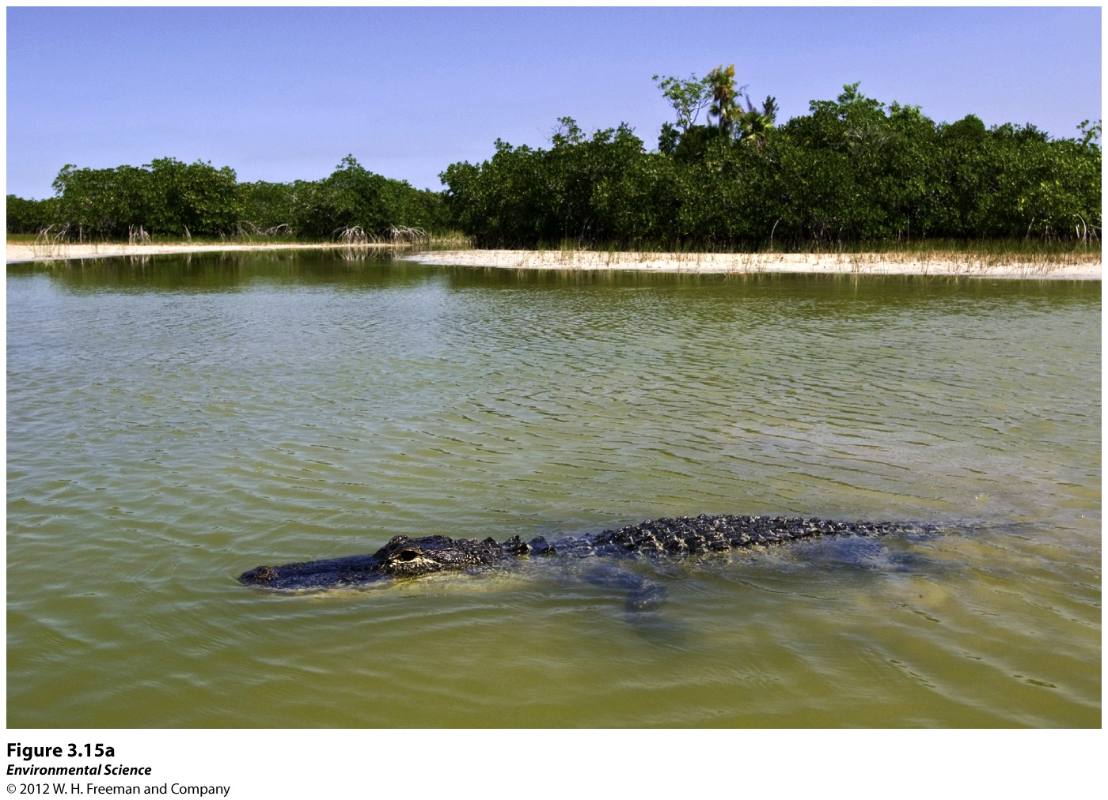
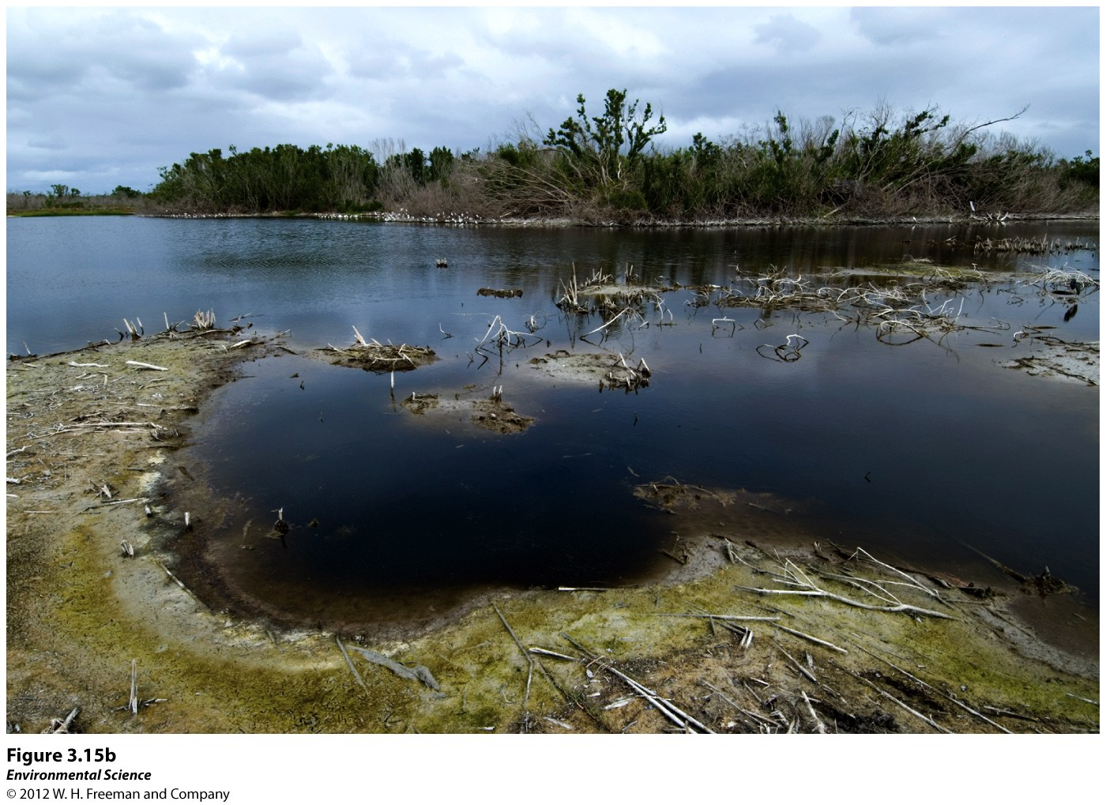
Ecosystem Disturbance: Hurricane Katrina (2005)
“The Chandeleur Islands, LA” were almost completely submerged by “Katrina”
Left; 2001: Note vegetated sand dunes
Right; 2005: Note massive erosion and loss of dunes and vegetation

Slide 57
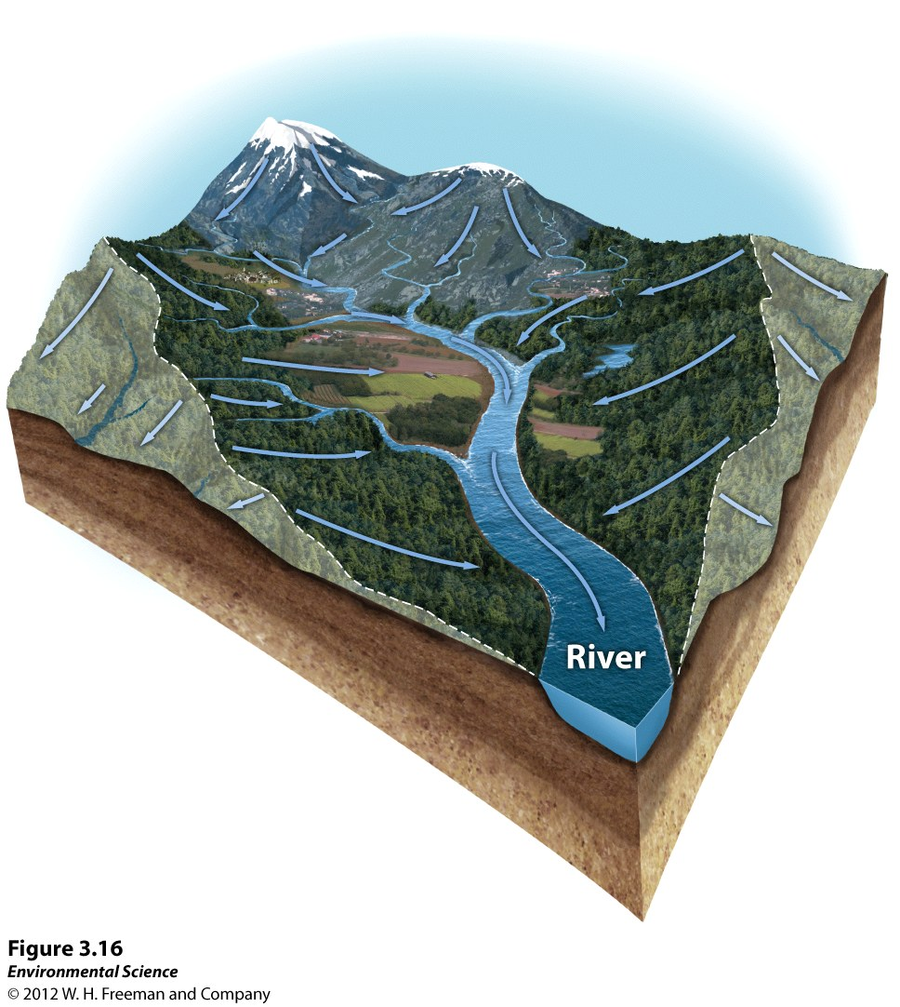
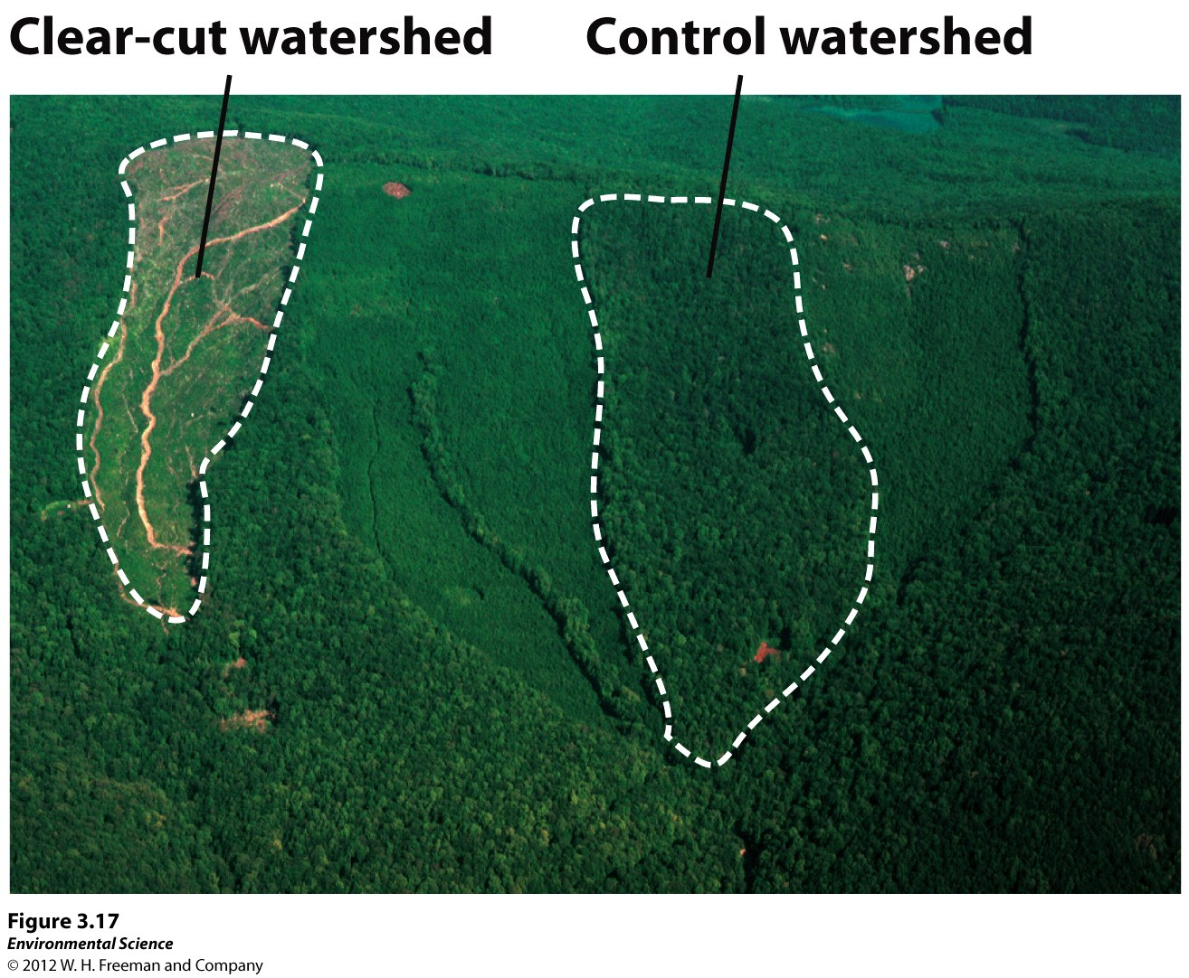
IV. A. Watershed Studies
Most disturbance studies occur on a smaller scale; watersheds are a common place to conduct such studies

Slide 58
IV. A. Watershed Studies
Watershed - all the land in a given area that drains into a particularly Lake, stream or wetland:
“Brandywine Watershed-> Christiana Watershed -> Delaware Watershed”
Previous Slide: Hubbard Brook Ecosystem, NH
1960 (over 50 years of study!!)
Investigated six watersheds of this ecosystem
Measures precip for each area (only evapotrans or runoff; not much infiltration due to shallow bedrock)

Slide 59
Hubbard Brook Ecosystem
Investigated the impacts of clear-cutting and subsequent suppression of plant regeneration
Before Clear Cut: Similar Nitrate Levels
6 mos later: CC site showed significant increase in stream NO₃⁻ levels
Conclusions:
Without vegetation, nitrate leaches from the soil and drains into the stream
Demonstrates the importance of plants in regulating the cycling of nutrients
Allows us to more fully comprehend the complicated structure of ecosystems and how these biogeochemical cycles influence the growing conditions of these areas

Slide 60
IV. B. Resistance v Resilience
Not all disturbances are a disaster…
Small scale fires and floods may help resupply nutrient poor soils
Resistance: measures how much a disturbance can affect the flows of energy and matter.
Population of a species may decrease, but NPP may stay the same
High Resistance: when many populations and communities are impacted, but the net flow of energy is not impacted

Slide 61
IV. B. Resistance v Resilience
Resilience: The rate at which an ecosystem returns to its original state after a disturbance
How quickly and completely an ecosystem, and its flow of energy and matter can recover after a disturbance
High resilience: quick rebound
Low resilience: returns to original state less rapidly

Slide 62
IV. B. Resistance v Resilience
Resilience depends on specific interactions of the biogeochemical and hydrologic cycles
Ex. 1) Increase in anthropogenic CO₂ emissions:
Terrestrial and aquatic ecosystems may react by increasing the sequestration of carbon: “carbon uptake”
Ex. 2) When a drought occurs:
Soil may dry out and harden, so when it does rain, the surface is impermeable and water cannot infiltrate. Therefore, the soil cannot be absorb moisture, and the condition can further worsen
(positive feedback loop that makes the situation worse)

Slide 63
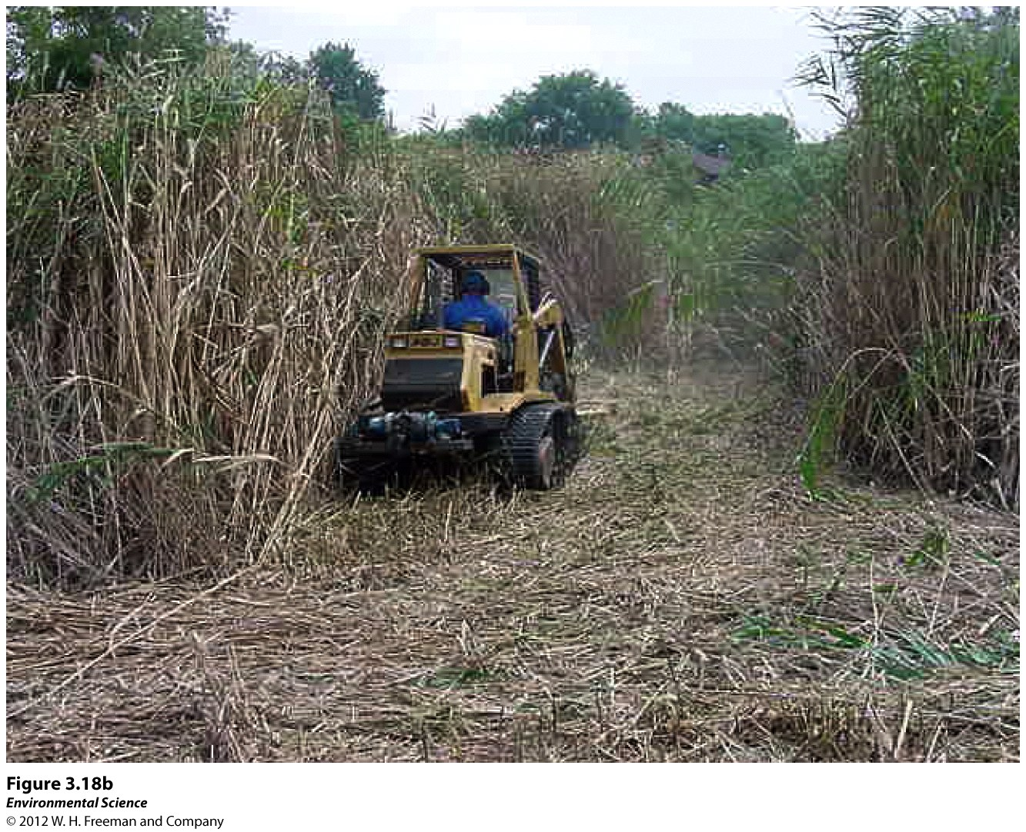
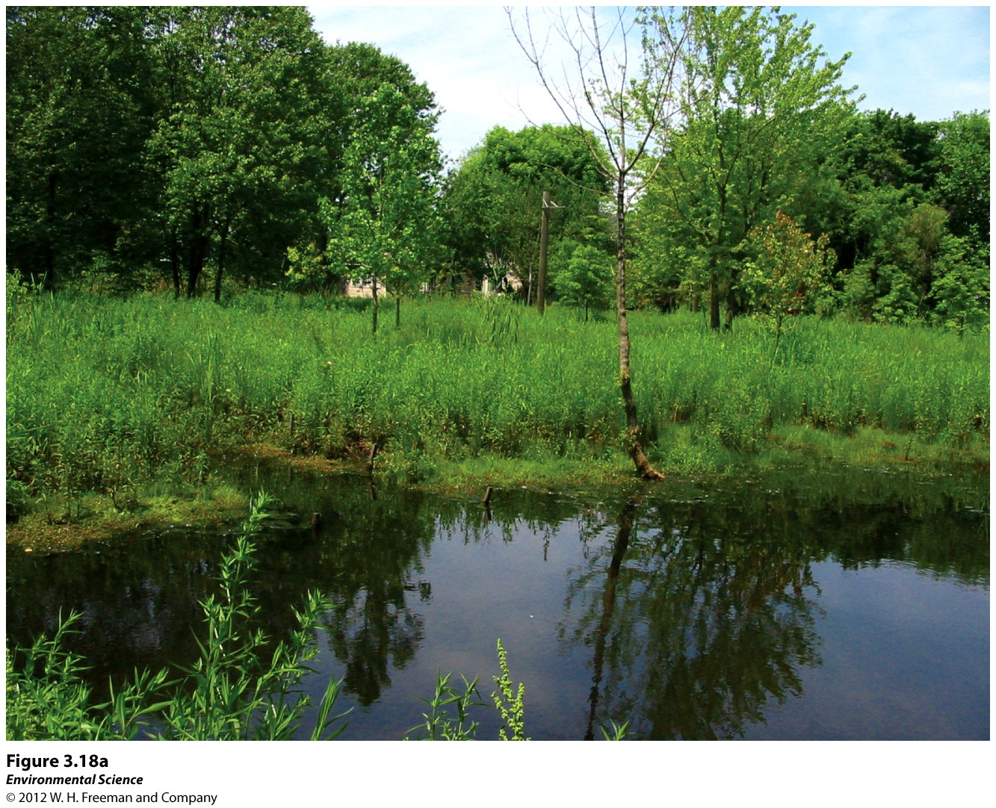
IV. B. Resistance v Resilience
Restoration Ecology: the restoration of damaged ecosystems; current projects include the Florida Everglades and the Chesapeake Bay Area
Goal is to restore water flows and nutrient inputs that are closer to historic levels in hopes to restore these ecosystems to their former states

Slide 64
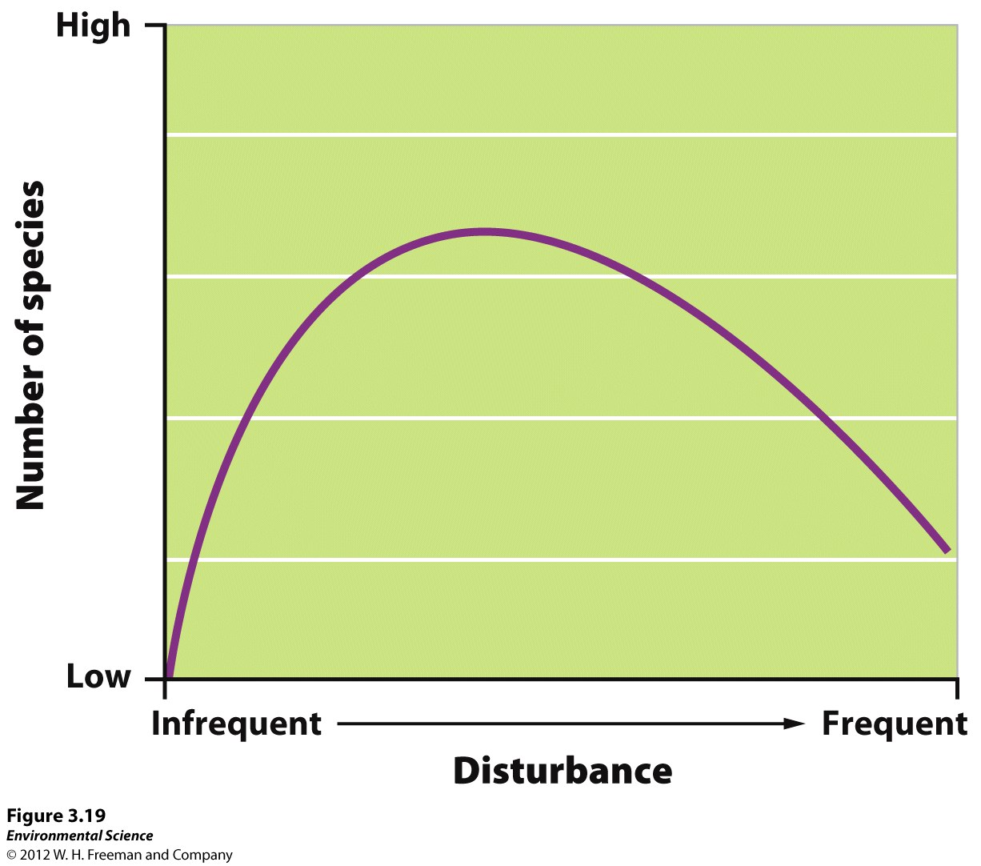
IV. C. The Intermediate Disturbance Hypothesis
“ Ecosystems experiencing intermediate levels of disturbance are more divers than those with high or low disturbance levels.”
Not all disturbance is bad….
Rare disturbance events: increases species competition; only a few dominant species survive and are successful
Frequent disturbances: population growth rates must be high enough to counter the effects of frequent disturbance and prevent species extinction
Intermediate disturbances: populations of major competitor never reach a size at which they can dominate an ecosystem, and other populations of other species are never driven too close to zero.
Intermediate disturbances result in the highest biodiversity in an ecosystem

Slide 65
V. Ecosystems Provide Valuable Services (77)
Instrumental Value:
a species that has worth as an instrument or tool that can be used to accomplish a goal; economic benefit
($$$)
Ex. Pharmaceuticals from plants, lumber
Intrinsic Value:
a species has worth independent of any benefit it may provide to humans; value that cannot be quantified
Ex. The value of an animal’s life

Slide 66
V. A. Instrumental Values of Ecosystems
Ecosystem Services:
The benefits that humans obtain from natural ecosystems.
Ex. Agricultural ecosystem: food production
Wetlands ecosystem: filter and clean water
Although it can be difficult for certain ecosystems, economists are beginning to incorporate costs and benefits of certain human activities
1997 estimate of all ecosystem services:
$30 trillion per year
Includes: cost to replace the services provided by natural ecosystems; property values (ocean front), time willing to use services (NPS fees)
Five categories to consider:
Provisions, regulating services, support systems, resilience, and cultural services

Slide 67
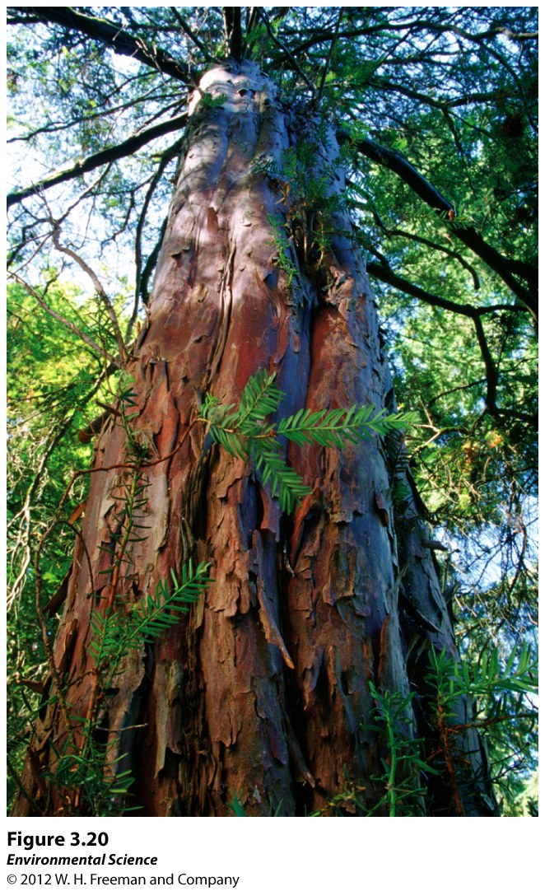
1) Provisions
Goods that humans directly use: lumber, food crops, medicinal plants, rubber, furs
Of the top 150 prescription drugs sold in US, 70% are derived from natural sources
This Pacific Yew tree is the source of the anti-cancer drug, Taxol
(within one year of FDA approval, yearly sales accounted for over $1 billion.)
Very improbable to account for natural drugs that have yet to be discovered…
Best to preserve what we have to to improve our chance of finding the next critical drug.
Ex. “Raising Mangoes” problem
Quantifying the economic value of a natural resource for the residents of Haiti

Slide 68
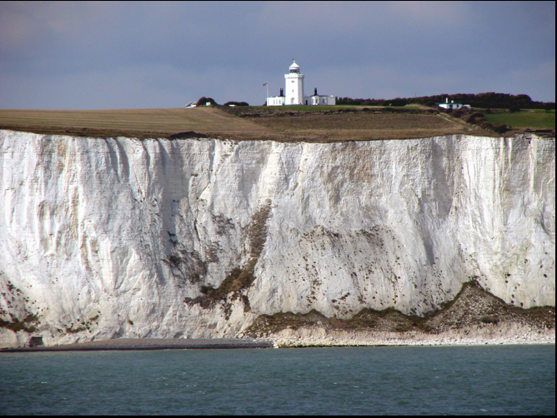
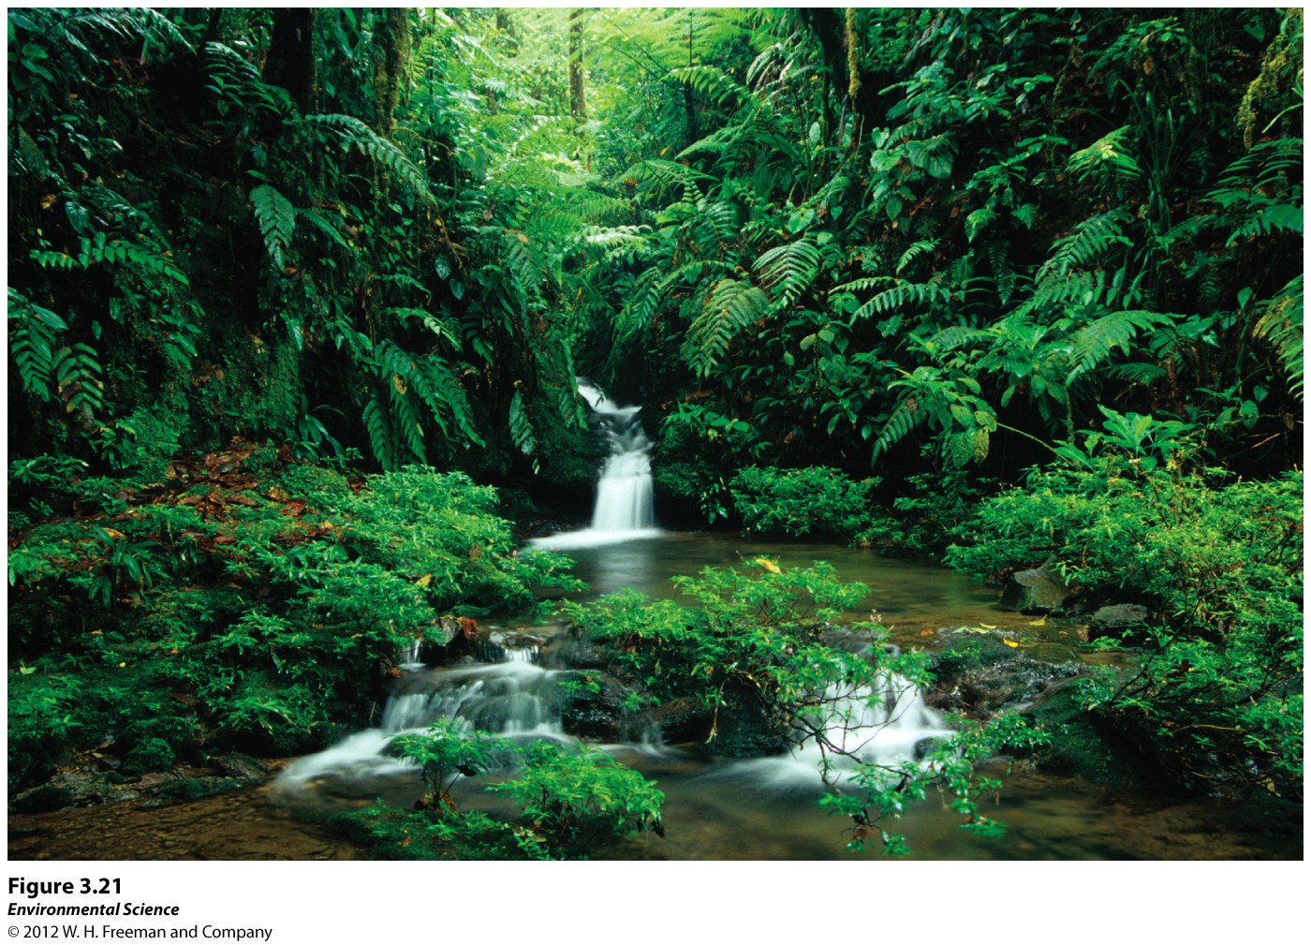
2) Regulating Services
Natural ecosystems help to regulate environmental conditions
Ex. Anthropogenic emissions of carbon
(8 gigatons = 8 trillion kgs)
Only 4 gT remain in the atmosphere: the rest is removed by rainforests and oceans
Ecosystems also play important roles in regulating nutrient and hydrologic cycles as well.

Slide 69
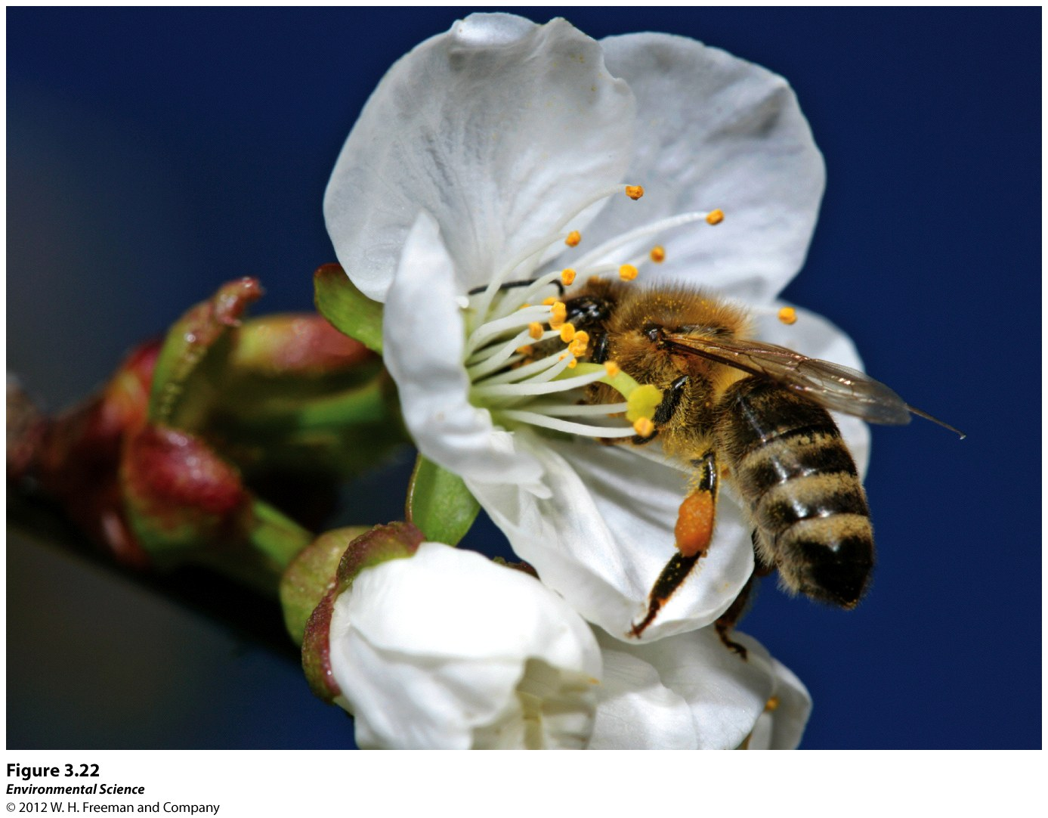
3) Support Systems
Natural ecosystems provide numerous support services that would be extremely costly for humans to generate
A) Crop Pollination = $3.1 billion in added food production
Ecosystems provide habitat for these organisms, and natural pest control services (homes for predators of ag. pests)
B) Healthy ecosystems also filter harmful pathogens and chemicals from the water
Ex. NYC from clean reservoirs of the Catskill Mtns = $6-8 billion in water treatment facility construction savings

Slide 70
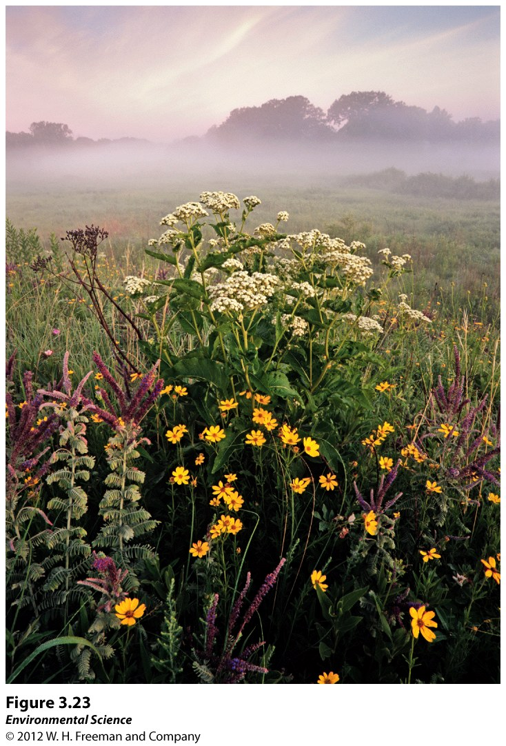
4) Resilience
The ability of an ecosystem to continue in its current state- providing benefits to humans.
Depends greatly on species diversity (biodiversity)
The elimination of one species may result in a chain reaction/domino effect that can impact other species in the ecosystem.
Genetic diversity acts as insurance/safe guard against the loss of ecosystem services
Prairies are very diverse ecosystems; if one species is lost, others are in place to continue these services
Ie. Nitrogen Fixation

Slide 71
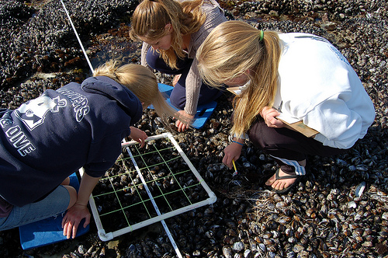
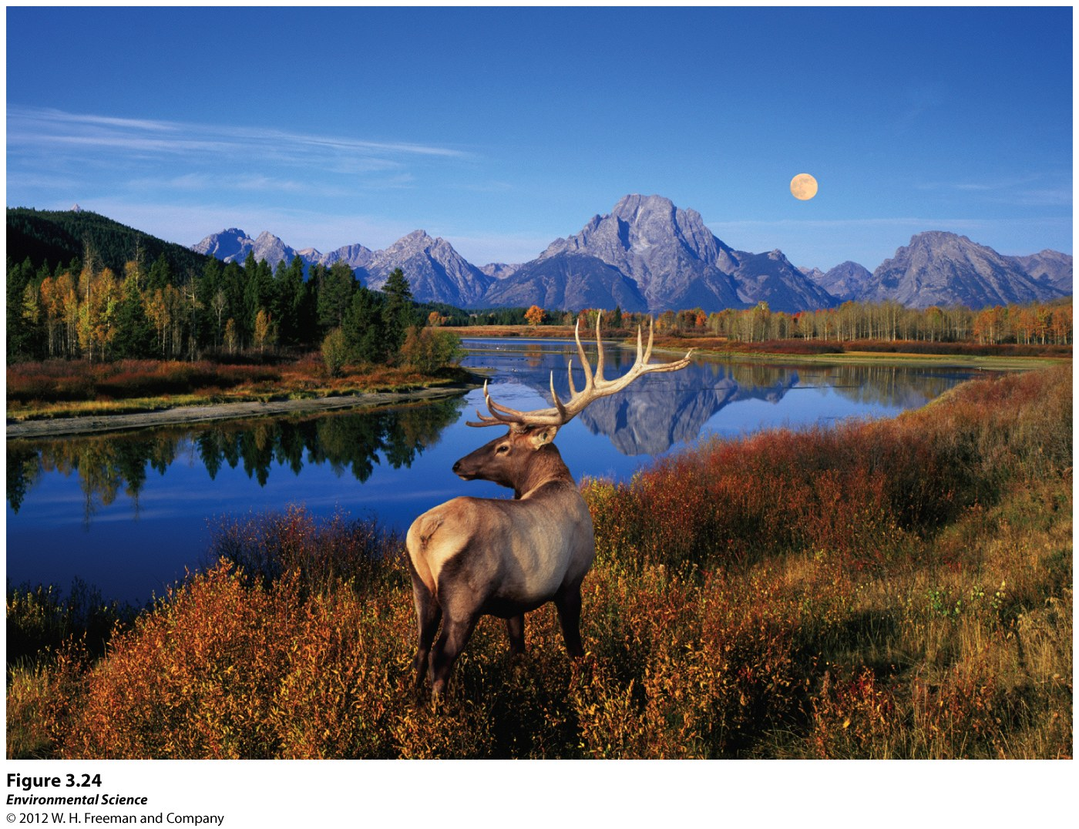
5) Cultural Services
Ecosystems provide cultural or aesthetic benefits
“The beauty of nature”; sport and recreation
Biodiversity research may not provide economic returns, but it does have instrumental value since we gain knowledge from its occurrence

Slide 72
V. B. Intrinsic Values of Ecosystems
Ecosystems have value independent of any human benefit.
Religious & philosophical beliefs may spur a moral obligation to preserve these “sacred areas”.
Many do not deny that instrumental value exists, but more so that environmental policy and the protection of ecosystems should be driven by this intrinsic value

Slide 73
Sustainability: Can We Make Golf Greens Greener?
Worldwide golf courses make up a land area of about 7.5 million acres
(about the size of Belgium!!)
Typically, they are poor examples of environmental sustainability:
Closely mowed turf grass:
Short leaves that cannot gain enough energy from photosynthesis to grow deep roots; Causes grass to dry out, is less likely to obtain soil nutrients, and increases susceptibility to pests (grubs)
Requires more irrigation, chemical fertilizers, & pesticides to combat these problems
Use 2.5 billion gallons of water every year to keep courses green; many places are not climatologically suited for this use of water
Putting greens require as much nitrogen per acre as corn; if not immediately watered, 60% of this fertilizer can leach into nearby waterways and contribute to algal blooms
Maintaining uniform “greens” texture requires up to six times the amount of agriculture pesticides as compared to conventional farms; include herbicides, insecticides, and fungicides

Slide 74
What they’re doing about it…
1991: Audubon Cooperative Sanctuary Program and the US Golf Association has been working to improve the environmental management of golf courses
Management is encouraged to design these courses to perform as natural ecosystems
Emphasis on nutrient and water recycling to reduce waste and biodiversity to increase ecosystem resilience.
Educates managers about low-impact pest management, water conservation and water quality management.

Slide 75
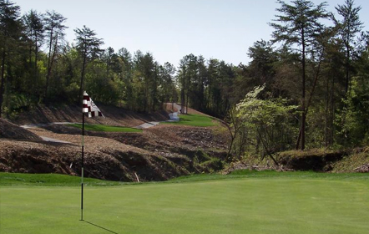
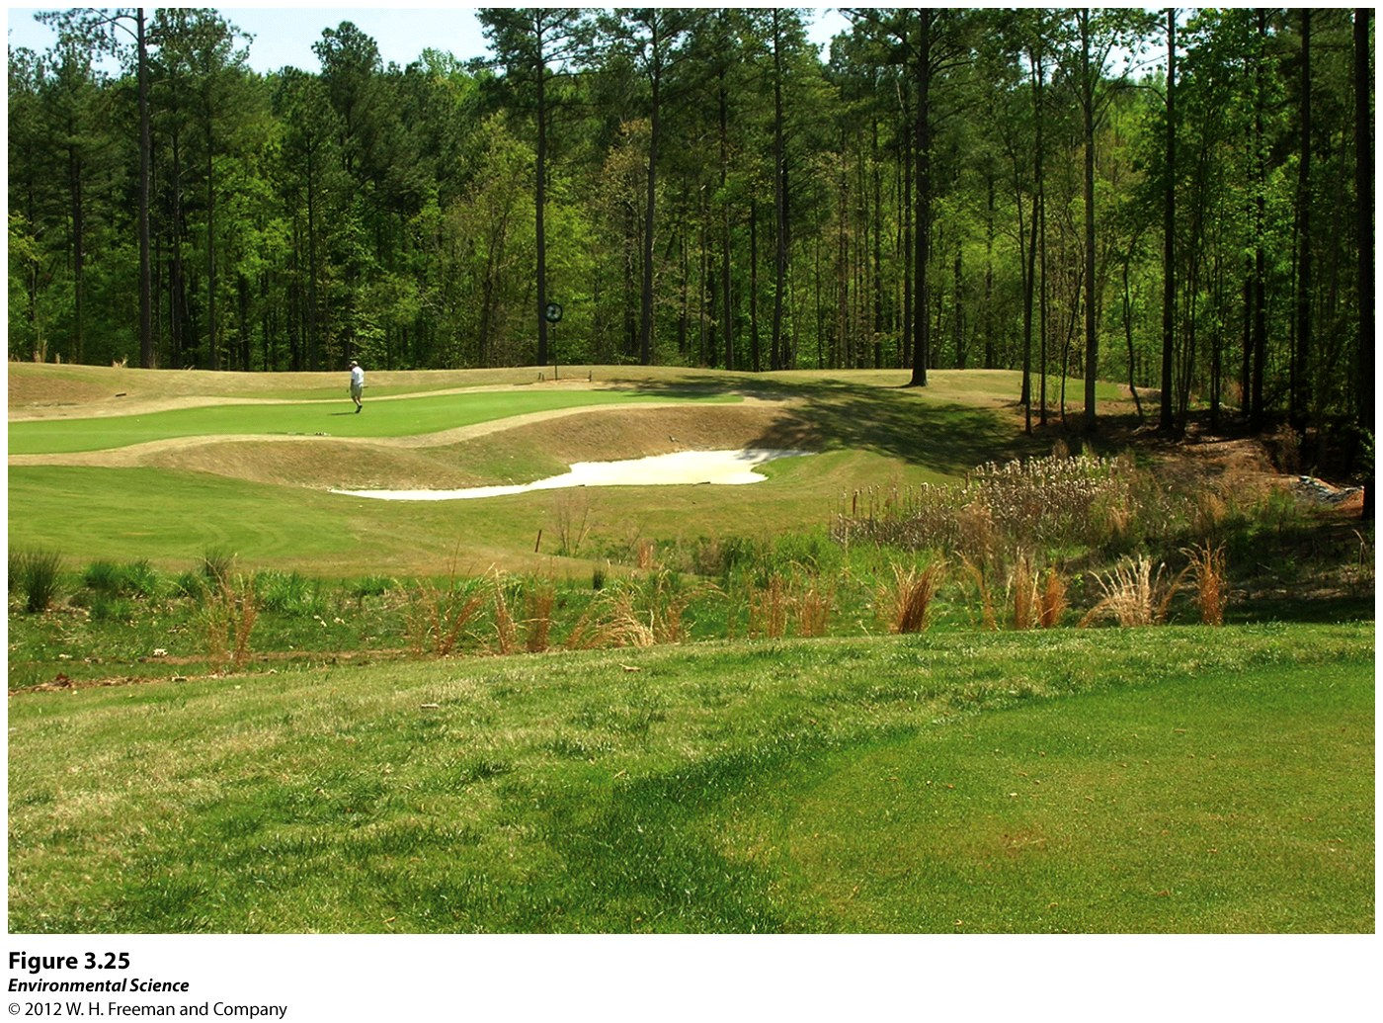
Palisades Country Club (NC)
Constructed with natural ecosystem services in mind
All runoff is directed through a treatment system
Reduces the amount of closely mowed turfgrass; deeply rooted native grasses soak up nutrients and help direct water underground
Smaller patches of turfgrass allow for more native grasses, which, provides more habitat for birds and predatory insects
Reduces needs for chemical applications: pesticides
If pesticides are implemented, they are done more wisely: targets specific nuisance organisms on wind-free days

Slide 76
What others are doing
By 2008, more than 2,100 course participated in the ACSP
Over 80% of the course in the program reduced the amounts and toxicity of pesticides applied, improved nutrient retention within the course and used less water for irritation.
The average course saved almost 2 million gallons of water per year, and the land area devoted to providing wildlife habitat increased by about 50% (from 45-67 acres for a 150-acre golf course)
99% of managers reported that playing quality and golfer satisfaction was maintained or improved
Despite high energy inputs for golf courses, many are attempting to reduce their ecological footprint, while still producing a quality product

