Slide 1
Chapter 1 and 2 Test Review

Slide 2
Environment
The sum of all conditions surrounding us that influence life.
Include: biotic and abiotic
Environmental Indicators – describe the current state of an environmental system
System – set of interacting components that influence one another by exchanging energy and materials.

Slide 3
Environmental systems support economies
Ecosystem services = essential services support the life that makes economic activities possible
*Soil formation *Pollination
*Water purification/aquifers *Forest
*Climate regulation *Waste treatment
Economic activities affect the environment
Deplete natural resources
Produce too much pollution

Slide 4
Biological Diversity
Is the diversity of life forms in an environment.
Important indicators of environmental health.
Genetic diversity – measure of genetic variations among individuals in a population.
Populations with higher genetic diversity are better able to respond to environmental changes.

Slide 5
Food Production
Grain production has increased steadily since 1950 as a result of improved irrigation, fertilizers, new crop varieties and other innovations.
However human population has outpaced food production.
Bad practice – humans use more grain to feed cattle then themselves.

Slide 6
Anthropogenic
Negative effects on the environment, derived from human activities
Increase in CO2 caused by burning fossil fuels and deforestation.

Slide 7
Sustainability: a goal for the future
Sustainability
Leaves future generations with a rich and full Earth
Conserves the Earth’s natural resources
Maintains fully functioning ecological systems
Sustainable development: Balances human needs and economic growth. The use of resources to satisfy current needs without compromising future availability of resources

Slide 8
Ecological Footprint
It is the impact of activities on the resources of the earth.
A measure of how much that person consumes, expressed in area of land.
Use of – energy, forests, cropland, fisheries, food, timber and paper, etc.

Slide 9
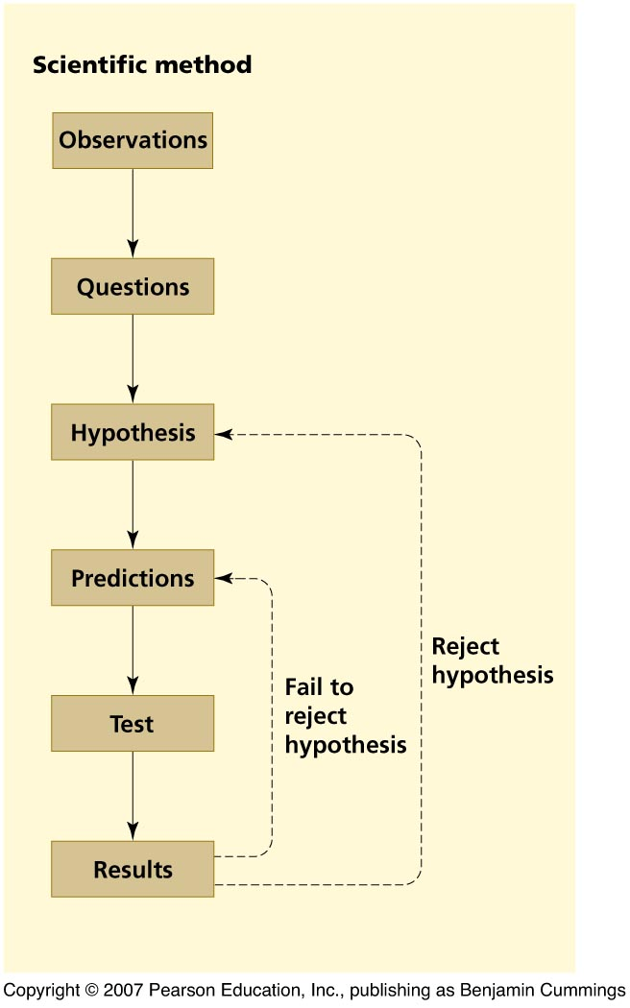
Science is a Process
A scientist makes an observation and asks questions of some phenomenon
The scientist formulates a hypothesis, a statement that attempts to explain the scientific question.
The hypothesis is used to generate predictions, which are specific statements that can be directly and unequivocally tested.
The test results either support or reject the hypothesis

Slide 10
Theory and Natural Law
A hypothesis that has been repeatedly tested and confirmed by multiple groups and has reached wide acceptance becomes a theory.
Natural Law – A theory to which there are no exceptions and can withstand rigorous testing. Highest level of confidence.

Slide 11
Atoms = the smallest components that maintain an element’s chemical properties
The atom’s nucleus has protons (positively charged particles) and neutrons (particles lacking electric charge)
Atomic number = the defined number of protons
Electrons = negatively charged particles surrounding the nucleus
Balances the positively charged protons

Slide 12
Chemical building blocks
Isotopes = atoms with differing numbers of neutrons
Mass number = the combined number of protons and neutrons
Isotopes of an element behave differently

Slide 13
Molecules & Compounds
Molecules = Combinations of two or more atoms
Oxygen gas = O₂
Compounds = A molecule composed of atoms of two or more different elements
Water = two hydrogen atoms bonded to one oxygen atom: H₂0
Carbon dioxide = one carbon atom with two oxygen atoms: CO2

Slide 14
Atoms are held together with bonds
Covalent bond = atoms in a molecule share electrons
For example, the atoms that bond to form H₂0
Polar covalent bonds = Atoms share electrons unequally, with one atom exerting a greater pull
The oxygen in a water molecule attracts electrons
Ionic bonds = an electron is transferred from one atom to another
Are not molecules, but are salts, such as table salt, NaCl
Solutions = no chemical bonding, but is a mixture of substances (i.e., blood, oil)

Slide 15
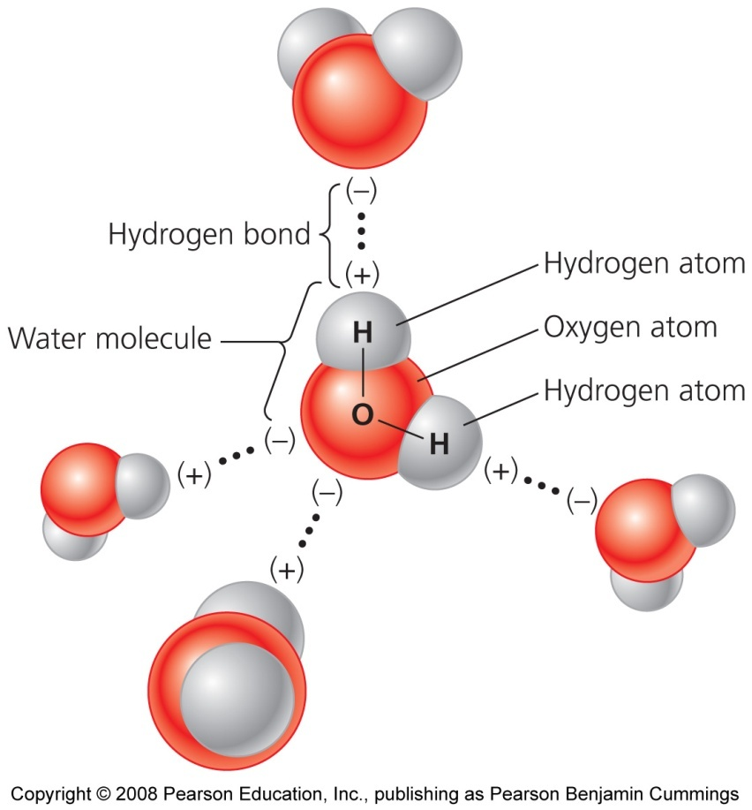
Water: the main reason life can exist
Hydrogen bond = oxygen from one water molecule attracts hydrogen atoms of another
Water’s strong cohesion allows nutrients and waste to be transported
Water absorbs heat with only small changes in its temperature, which stabilizes systems

Slide 16
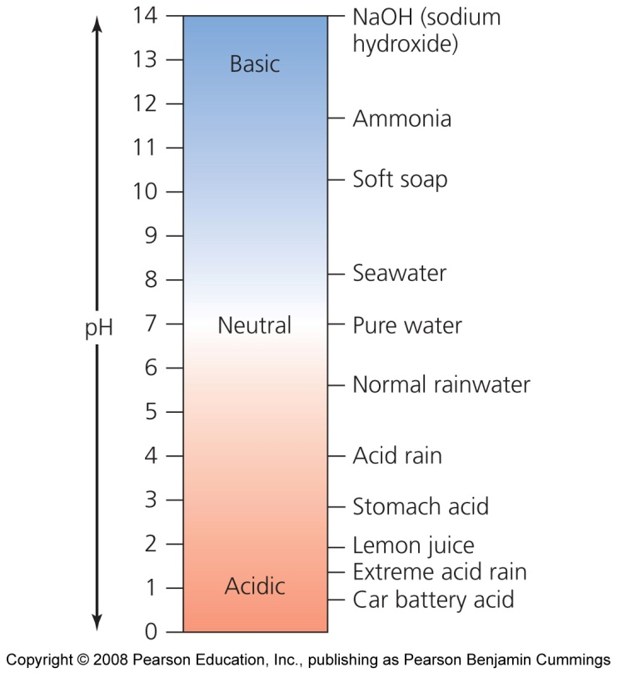
Hydrogen ions determine acidity
The pH scale ranges from 0 to 14 and quantifies the acidity of solutions
Acidic solutions have a pH less than 7
Basic solutions have a pH greater than 7
Neutral solutions have a pH of 7
Neutral pH has equal H+ and OH- ions.

Slide 17
Organic Biological Molecule Groups
Carbohydrates
Lipids
Proteins
Nucleic Acids

Slide 18
Energy Fundamentals
Potential energy = energy of position. An object can store energy as the result of its position. For example, the heavy ball of a demolition machine is storing energy when it is held at an elevated position. This stored energy of position is referred to as potential energy.
Kinetic energy = energy of motion. It is energy possessed by an object due to its motion or movement. A moving car.
Chemical energy = potential energy held in the bonds between atoms. Chemical energy is released in a chemical reaction, often in the form of heat. Such reactions are called exothermic. Batteries, biomass, petroleum, natural gas, and coal are examples of stored chemical energy

Slide 19
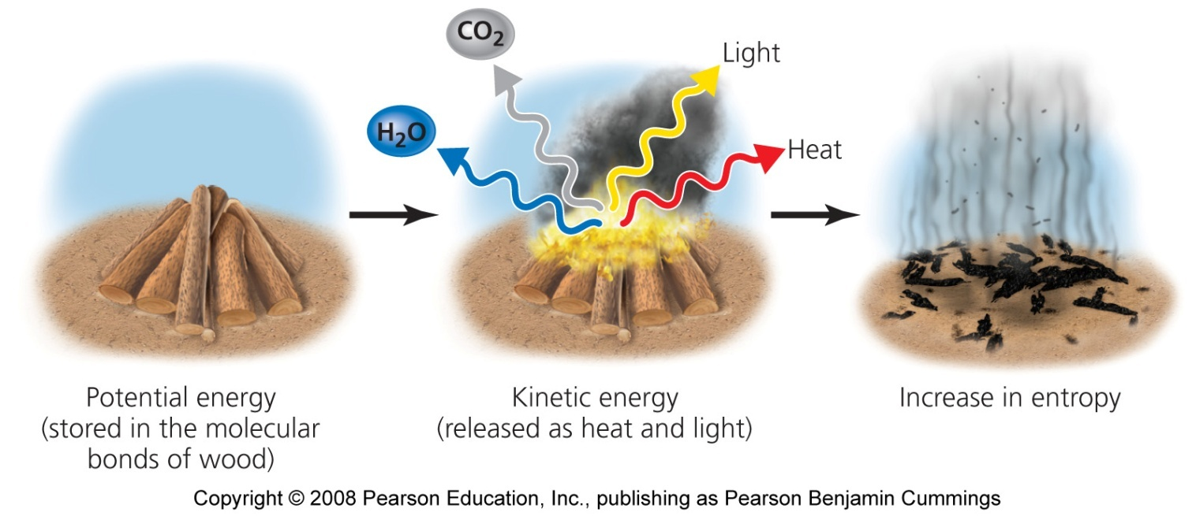
Energy
First law of thermodynamics = energy can change forms, but cannot be created or destroyed
Second law of thermodynamics = the nature of energy changes from a more-ordered to a less-ordered state
Entropy = an increasing state of disorder

