Slide 1
Chapter 7 Part II
Demography
Demography- the study of human population and population trends.
Population Size – population size does not tell the entire story, we must look at population
Density, distribution, composition, affluence and technology.

Slide 2
Demography, density and distribution
Demography
Population Density and distribution- is uneven over the planet.
Clumped distribution
Highest densities in temperate, subtropical and tropical climates (China, Mexico, Europe)
Lowest in regions of extreme climate biomes (desert, tundra, deep forest)

Slide 3
High Density
Demography
Increase density closest to water source (ocean and river valley’s)
Lower the farther away from water source.
Uneven distribution means more impact on the environment in some areas over others

Slide 4
High Density Impacts
Demography
Increased impact in river valleys such as the Nile, Mississippi, Ganges and Danube.
Urbanization causes hot spots of pollution close to city centers.

Slide 5
Low Density
Demography
Areas of low population density can also be vulnerable to impacts for the same reason the area has low density.
Areas that do not support high populations are in many cases sensitive areas. (In the IPAT model this area would have a high “S”) ex. Deserts and grasslands

Slide 6
Age Structure Diagrams
Demography
Age Structure - Describes how the members of a population are distributed across age ranges.
Types of Growth: rapid growth, slow growth, zero growth and negative.

Slide 7
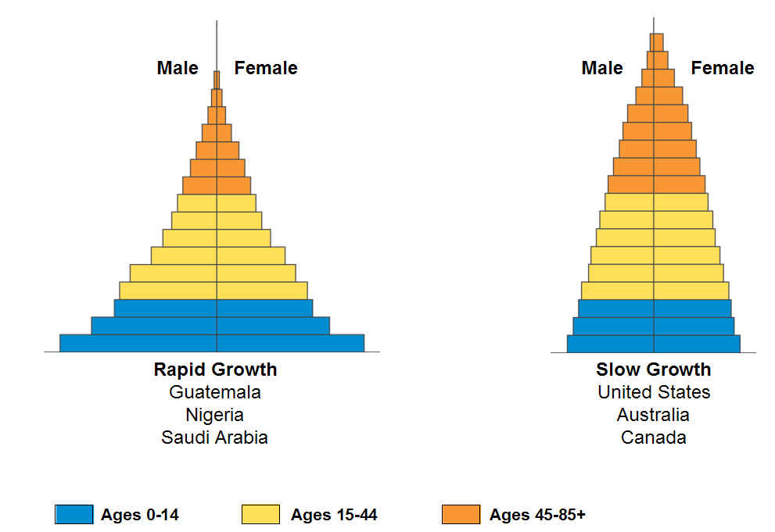
Chapter 8 Part II
Demography

Slide 8
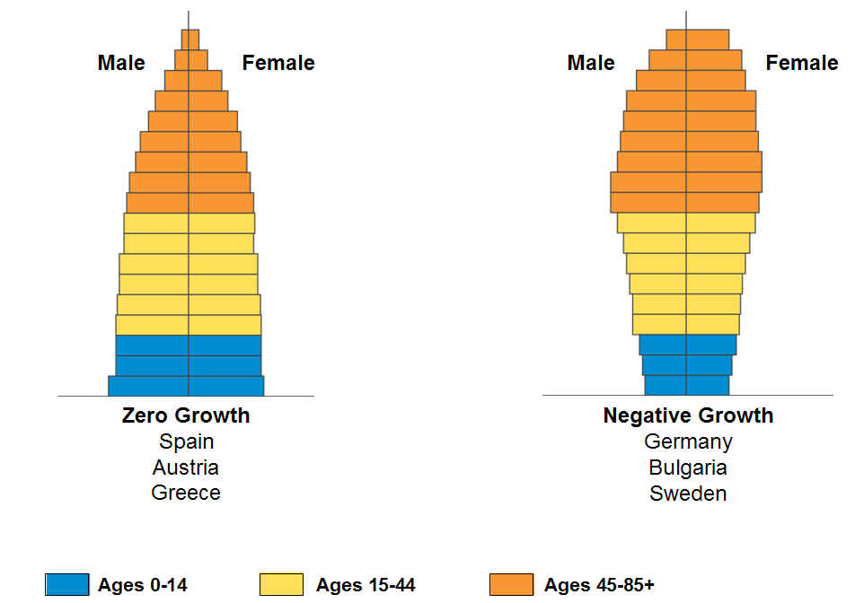
Chapter 8 Part II
Demography

Slide 9
Sex Ratio
Demography
Sex Ratio – is the ratio of males to females, this can affect population dynamics.
100 females born for every 106 males
This makes up for higher death rate of males during any given year of life.

Slide 10
Unsettling Trend In China
Demography
In recent years the ratio of boys to girls in China has been skewed.
As a result of one-child policy, people who find out the sex of their child have selectivity terminated female babies.
Sons can carry on the family name.

Slide 11
Unsettling Trend In China
Demography
The skewed birth rates can further impact the birth rates.
Other consequences – in some areas, teenage girls are being kidnapped to be brides for single males.

Slide 12
Population growth, depends on birth rate, deaths immigration and emigration
Demography
Inputs = births & Outputs = deaths
When looking at individual countries demographers must include immigration and emigration as inputs & outputs.

Slide 13
Population growth, depends on birth rate, deaths immigration and emigration
Demography
CBR – crude birth rate is the number of births per 1000 people
CDR- crude death rate is the number of deaths per 1000 people
In 2009, globally, there were 20 births and 8 deaths. The global population increased by 12 people per 1000 or roughly 1.2% increase

Slide 14
Population growth, depends on birth rate, deaths immigration and emigration
Demography

Slide 15
Doubling Time
If we know the growth rate of a population and assume that the rate of growth is constant we can calculate the number of years it takes for a population to double its size.
The Rule of 70 can be used to approximate doubling time.
70
Doubling time (in years) = growth rate

Slide 16
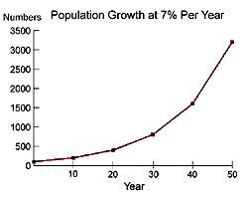
Doubling Time
Demography

Slide 17
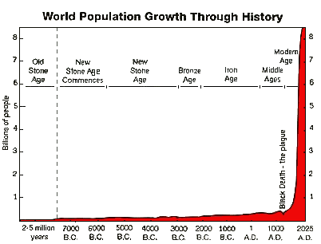
Earth’s Human Population has Doubled several times since 1600
Before 1600 the average population growth was 0.1% (700y)
By 1965 doubling time was 42 years. Since then global population growth rate has slowed.
Most Demographers predict the population will be somewhere between 8.1-9.6 billion by 2050 and that the population will stabilize by 2100.

Slide 18
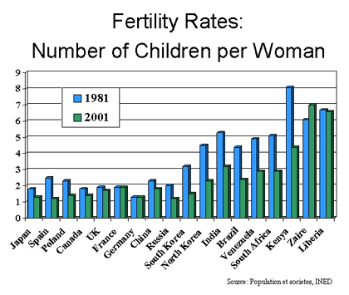
Total Fertility Rate (TFR)
Total Fertility Rate (TFR)- an estimate of the average number of children that each woman per 1000 will bear.
In the U.S. the TFR in 2008 was 2.1

Slide 19
Total Fertility Rate (TFR)
Replacement-level Fertility- the TFR required to offset the number of deaths. The country’s economic status affects this number because of the possibility of pre-reproductive mortality.
When TFR = replacement-level fertility and immigration and emigration are equal, then the population is stable.
Industrialized countries need to have a TFR of 2.1 to achieve replacement-level fertility.
Developing nations need to have a higher TFR to achieve replacement-level fertility.

Slide 20
Total Fertility Rate (TFR)
When TFR drops below below 2.1, population size, in the absence of immigration, will shrink.
Various factors influence total fertility rate.
Historically people tended to have more child then survive
Today medical care has reduced infant mortality rates

Slide 21
Total Fertility Rate (TFR)
Various factors influence total fertility rate.
Rural areas, more children to work farms
Urban areas, children go to school, higher cost to parents
Social security helps in old age, less children to have take care of aging parents
Educated females going to work, change in roles in society, less emphasis on child rearing
Europe – these factors have influenced the TFR
TFR – dropped from 2.6 to 1.5 in the past ½ century

Slide 22
Natural Rate Of Population Change
Change due to birth and death rates alone, excluding migration.
By 2007, 71 countries had fallen below the replacement fertility of 2.1
Make up about 45% of the Worlds population
China’s TFR is 1.6

Slide 23
Life Expectancy
Life expectancy is the average number of years that an individual in a particular group is likely to continue to live.
Often used to refer to average number of years a person can expect to live from birth.
In the past 50 years, life expectancy has increased from 46 to 68 years

Slide 24
Life Expectancy
Depends on when an infant is born and in what country.
Generally higher in countries with better health care.
High life expectancy is a good predictor of resource consumption rates & environmental impacts.
Life expectancy is different for males & females, but the gap is getting smaller.

Slide 25
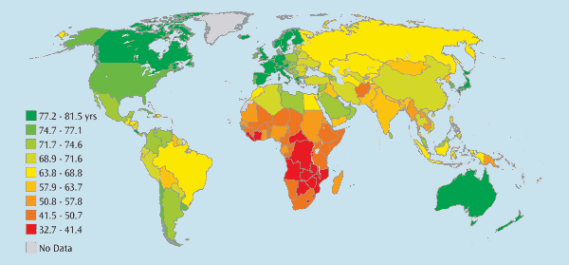
Life Expectancy

Slide 26
Factors that affect Infant & Child Mortality
Infant mortality refers to children under 1 year of age. Child mortality refers to children under 5 years of age.
Availability of health care
Access to good nutrition & potable water
Exposure to pollutants

Slide 27
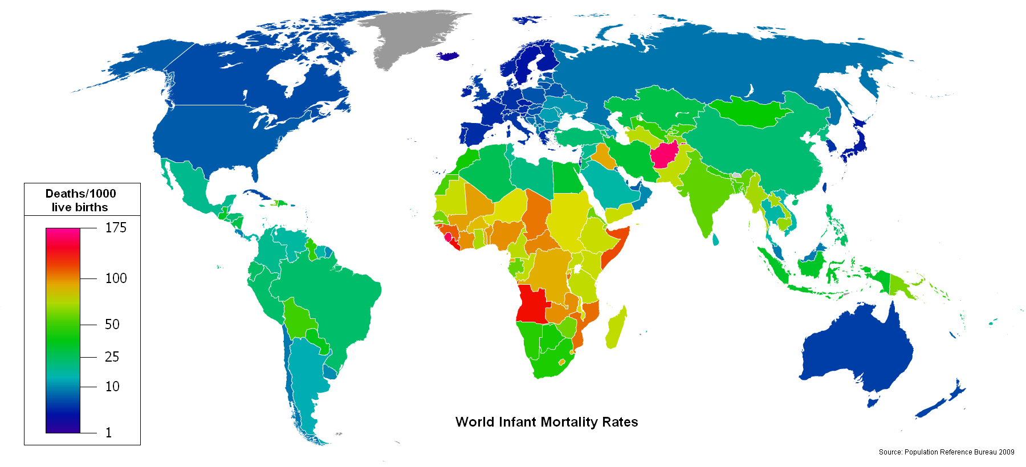
Factors that affect Infant & Child Mortality

Slide 28
Demographic Transition
This is a model of economic and cultural change in the 1940’s-50’s by
Frank Notestein to explain the declining death rates and birth rates that have occurred in Western nations as they became industrialized.

Slide 29
The Theory of Demographic Transition
As a country moves from a subsistence economy to industrialization and increased affluence, it undergoes a predictable shift in population growth.

Slide 30
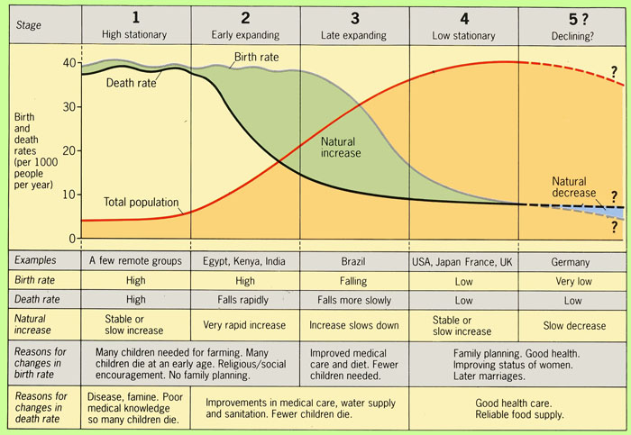
Demographic Transition Model

Slide 31
The Theory of Demographic Transition
Pre-Industrial Stage – Death rates and birth rates are high
Death rates high due to disease and lack of medical care
Birth rate high to compensate for high infant mortality

Slide 32
The Theory of Demographic Transition
Industrialization and falling death rates (transitional stage)
Declining death rates due to increase food production and improved medical care
Growth still surges due to people not use to the new economic change

Slide 33
The Theory of Demographic Transition
Industrial stage and falling death rates
Industrialization increases opportunity for employment outside the home (women)
Children not valuable in terms of economics so parents may use birth control and have fewer kids
Birth rates fall, closing the gap with death rates, population is reduced

Slide 34
The Theory of Demographic Transition
Post-Industrial stage
Both birth and death rates fall to low and stable levels
Population sizes stabilize or decline slightly
Society enjoys the fruits of industrialization without population increase

Slide 35
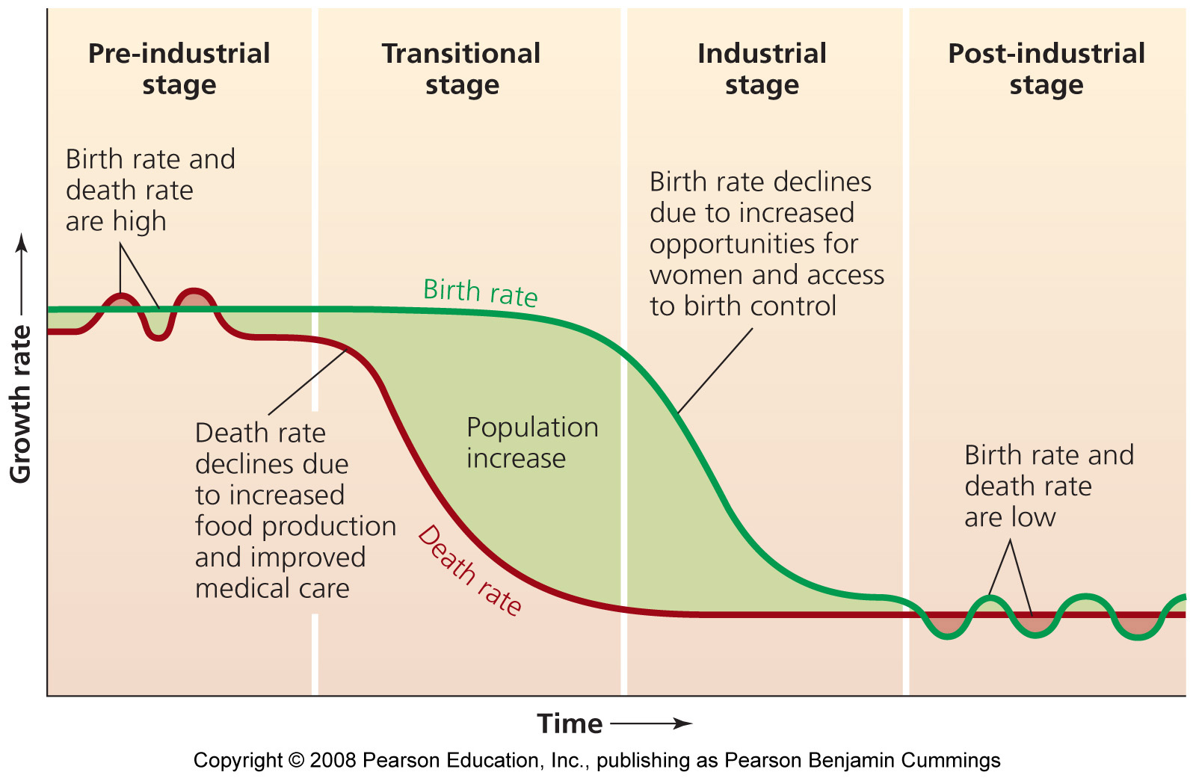
The Theory of Demographic Transition

