Slide 1
Chapter 7
Population and Society
The Theory of Demographic Transitions
links human population and societal factors.
Woman Empowerment
Population policies and family planning
Poverty and population Growth
Affluent consumption impacts the environment
Wealth gap and population growth contribute to conflict
HIV/AIDS impact on African populations
Severe demographic changes have social, political and economic
repercussions

Slide 2
Women Empowerment
Fertility rates have dropped in countries
where women have gained improved access to contraceptives and and family planning.
Better education opportunities.
When women have little power, more unintended pregnancies occur.
They have a lack of personal freedom and choice and gender equality.

Slide 3
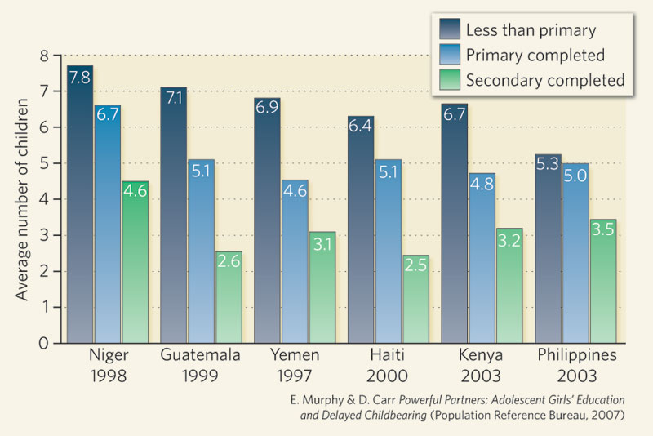
Women Empowerment

Slide 4
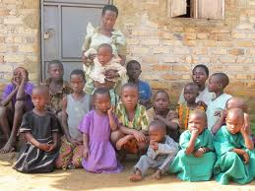
Women Empowerment

Slide 5
Population Policies and Family Planning
Data show that funding and policies that encourage family planning can effectively lower population growth rates.
India was the first nation to implement population control policies, but forced sterilization brought down the government
Thailand uses education based approach to family planning that has reduced the birthrate and slowed population since 1960’s .

Slide 6
Population Policies and Family Planning
Government funded family planning education programs have reduced populations in Brazil, Mexico, Iran, Cuba and many other developing nations.
Despite the success of family planning internationally, recent republican administrations in the United States have declined to fund family-planning efforts by the United Nations.

Slide 7
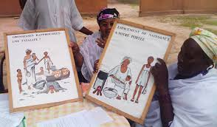
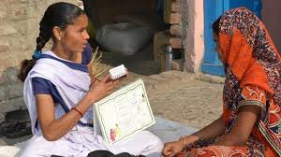
Population Policies and Family Planning
Educating women on family planning

Slide 8
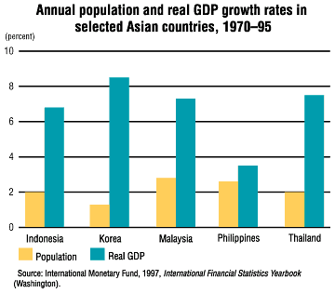
Poverty and Population Growth
Poor Countries tend to sow higher population
growth rates than do wealthier nations.
This pattern is consistent with the Demographic
Transition Model.

Slide 9
Affluent consumption impacts the environment
Poverty can lead people into environmentally
Destructive behavior, but wealth can produce
even more severe and far reaching environmental impacts.

Slide 10
Wealth gap and population growth contribute to conflict
The difference between affluent and poor
societies in the world is the cause of social as well as environmental issues.
Over half of the world’s people live below
the international defined poverty line of $2 a day
The gap between rich and poor widens and the numbers living below the poverty line grows

Slide 11
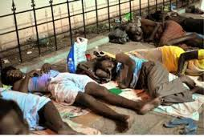
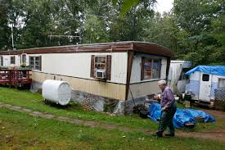
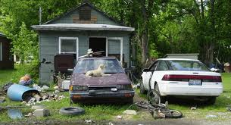
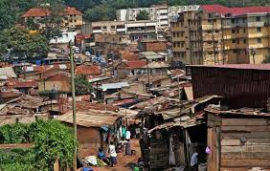
Wealth gap and population growth contribute to conflict

Slide 12
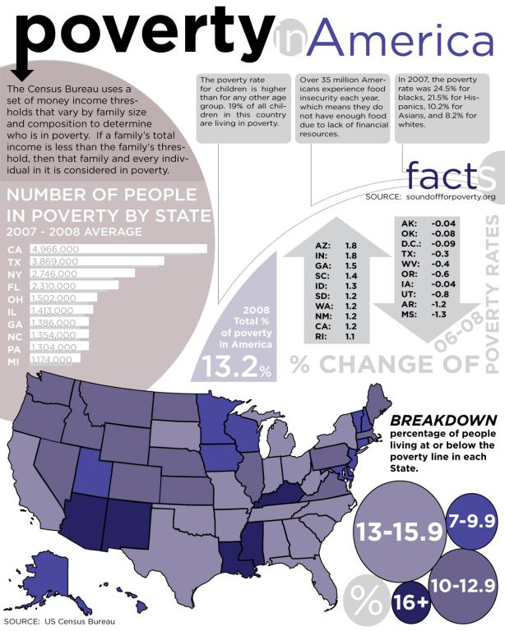
Wealth gap and population growth contribute to conflict

Slide 13
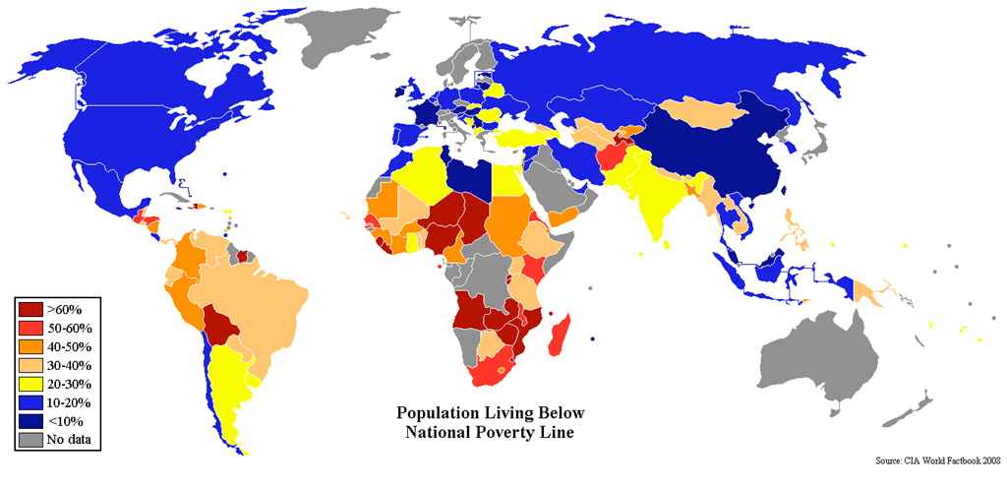
Wealth gap and population growth contribute to conflict

Slide 14
HIV /AIDS Impact African Populations
African nations are being hit the hardest by
HIV/AIDS
Aids takes approximately 6000 lives a day in Africa resulting in demographic changes in that region.

Slide 15
HIV /AIDS Impact African Populations

Slide 16
Demographic changes have social, political and economic repercussions
In Africa, AIDS is removing many of the youngest and most productive members of society.
Developing nations with AIDS related deaths are making so these nations can not transition to modern technologies because the removal of many young productive members of society.

Slide 17
Demographic changes have social, political and economic repercussions
If these countries do not do something, the country will fail to advance through demographic transition.
Rising death rates could push births back up, potentially causing these countries to fall back to pre-industrial stage.

