Slide 1
Chemical Testing
Phosphates (PO₄⁻)
Nitrates (NO₃⁻)
Dissolved Oxygen (DO)
Carbon Dioxide (CO₂)
pH

Slide 2
Safety First!!
These are chemical irritants. It is required that all testers wear the appropriate safety goggles when using these chemicals.
Thoroughly wash your hands after handling the chemicals and treated water.

Slide 3
Disposal of Treated Water
In the laboratory: All tested water may be disposed of down the drain under running water.
In the stream: All tested water must be put in the waste container and disposed of in the laboratory upon our return.
We do not want to contaminate the water with our testing waste.

Slide 4
pH
Measure of how acidic or alkaline the water is at the time of testing.
The pH of the stream affects the ability of plants and wildlife to function and live.
pH is measured on a scale from 1 to 14. Neutral pH is 7. Acids are <7 and alkalines are >7.
Aquatic organisms prefer a pH range of 6.5 to 8.

Slide 5
Dissolved Oxygen (DO)
Aquatic organisms rely on the presence of oxygen in streams.
Water temperature and altitude, time of day, and seasons can all affect the amount of dissolved oxygen.
Oxygen is both produced AND consumed in a stream.

Slide 6
Dissolved Oxygen (cont’d)
Dissolved oxygen is higher in running water/riffles than still water, such as a pond or stream pool.
The presence of aquatic plants also affects dissolved oxygen concentrations. Green plants release oxygen under water during photosynthesis.

Slide 7
Phosphorus, Nitrate-Nitrogen, & Ammonia Nitrogen
Phosphorus and Nitrogen occur naturally in streams and are essential for plants and animals in small quantities.
Larger quantities are detrimental to stream quality.

Slide 8
Phosphorus, Nitrate-Nitrogen, & Ammonia Nitrogen (cont’d)
Naturally occurring sources include:
Soils
Weathering of Rocks
Animal and Plant Waste

Slide 9
Phosphorus, Nitrate-Nitrogen, & Ammonia Nitrogen (cont’d)
Sources of Nutrients from human development:
Wastewater Treatment Plants
Runoff from fertilized agricultural fields
Residential areas/Lawns
Golf Courses
Runoff from commercial cleaning activities

Slide 10
Phosphorus, Nitrate-Nitrogen, & Ammonia Nitrogen (cont’d)
Problems occur when large amounts of phosphorus and nitrogen are introduced into the stream. As a result, there can be excessive algal growth depleting the available oxygen in the stream that fish and other aquatic organisms depend on…
Known as Eutrophication

Slide 11
Carbon Dioxide (CO₂)
CO₂ enters the water through the atmosphere and as a by product of organic decay
Thus an increase in the CO₂ reading could indicate sewage in the water
Oxygen and CO₂ are usually inversely related to one another because of the photosynthesis and respiration activities of the biota (living organisms)

Slide 12
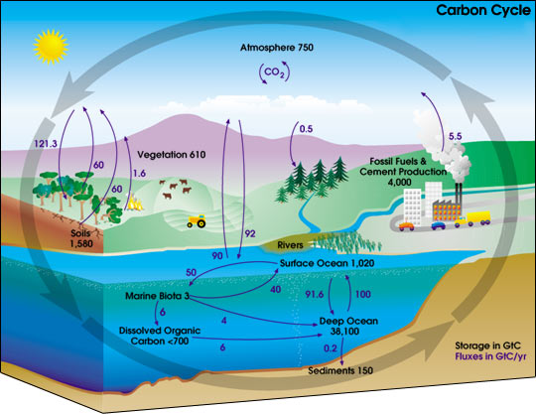
Nasa.gov

Slide 13
Site Conditions also impact water quality:
Weather Conditions
Air Temperature
Presence of debris and algae
Water color, appearance, and odor
Water temperature

Slide 14
Site Conditions also impact water quality (cont’d):
Temperature of water directly affects biological and chemical processes.
The colder the water the higher the dissolved oxygen.
Cold water and high (DO) is indicative of high quality streams.

Slide 15
Order in which tests should be conducted (Due to time constraints)
Nitrates (at least 10 min)
Phosphates (8-10 min)
Dissolved Oxygen (6 min)
Carbon Dioxide (few min)
pH (few min)

Slide 16
Please refer to the chart on the back of your packet for acceptable and unacceptable levels of chemicals and the source(s) of such values.

