Slide 1
Classification
Chapter 17 Taxonomy and Levels of Classification (pgs. 337-339)
Classification – PLACES ITEMS INTO GROUPS BASED ON STRUCTURAL SIMILARITIES.
2. The science of classification is called TAXONOMY.

Slide 2
Classification
3. ARISTOTLE was the first person to offer a system for classifying living things more than 2000 yrs ago. He grouped all organisms into two Kingdoms: ANIMALS and PLANTS.

Slide 3
Classification
4. Our current system is based on a system developed in the 1700’s by CAROLUS LINNAEUS. He gave each organism a scientific naming using a system called BINOMIAL NOMENCLATURE. Each organism is identified with a two word name written in the language of LATIN. His system grouped organisms based on their STRUCTUAL SIMILARITIES.

Slide 4
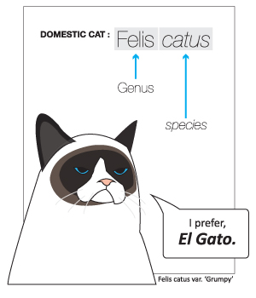
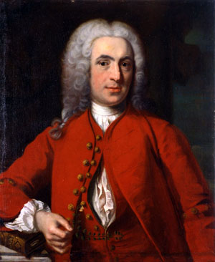
Linnaeus the Father of Taxonomy

Slide 5
Classification
5. The scientific name written in proper form for human beings is HOMO SAPIAN. The first word is our GENIUS; the first and second word together is our SPECIES, the smallest Taxon -which is any particular group within a taxonomic system. Subspecies – variations in species that live in different geographic areas.

Slide 7
Classification
6. Define a species – A GROUP OF ORGANISMS THAT LIVE TOGETHER IN A NATURAL HABITAT, THEY CAN MATE AND PRODUCE FERTILE OFFSPRING.

Slide 8
Classification
7. List the levels of classification from the most general to the most specific:
KINGDOM, PHYLUM, CLASS, ORDER, FAMILY, GENUS, SPECIES.

Slide 9
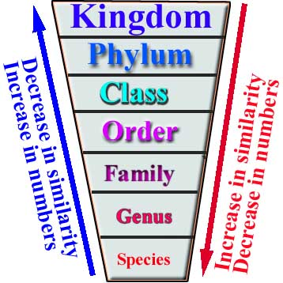
Classification

Slide 10
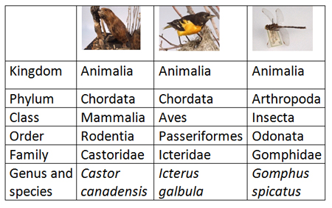
Classification

Slide 11
Classification
8. A key to identify an unknown organism is called a DICHOTOMOUS key. Define this term: USES CONTRASTING STATEMENTS REQUIRING YOU TO MAKE COMPARISONS AND CHOICES.

Slide 12
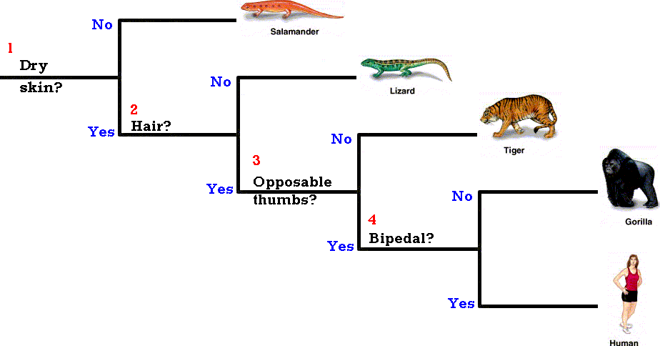
Dichotomous Key

Slide 13
Classification
9. Organisms today are grouped to show EVOLUTIONARY RELATIONSHIPS.
10. List four lines of evidence used to classify organisms today.
- Embryology
- Chromosomes
- Proteins
- DNA

Slide 14
Classification
11. Dogs belong to the family Canidae and cats belong to the same family as tigers. Both family pets belong to the same order as tigers.
Cat Dog Human
Kingdom | Animalia | Animalia | Animalia
Phylum | Chordata | Chordata | Chordata
Class | Mammalia | Mammalia | Mammalia
Order | Carnivora | Carniovora | Primate
Family | Felidae | Canidae | Hominidae
Genus | Felis | Canis | Homo
Species | Domesticus | Familiarus | Sapien
Varieties | Persian | German Shepard

Slide 15
Classification - Kingdoms
12. The most accepted system of classification includes 6 kingdoms.

Slide 16
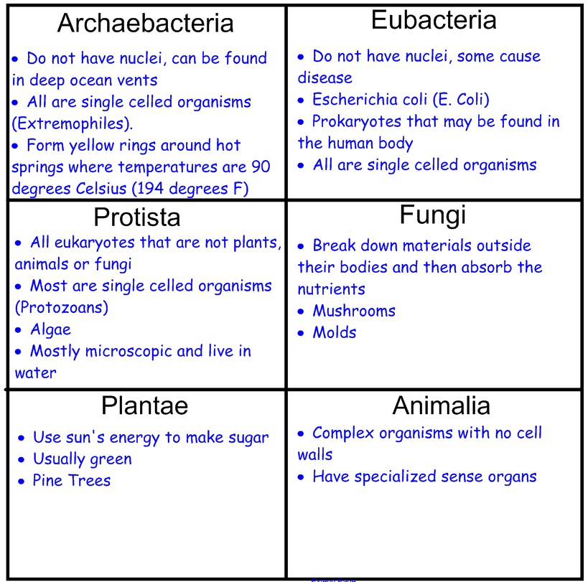
Classification

Slide 17
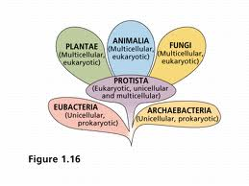
Classification

Slide 18
Systematics (pgs. 341-345)
Modern biologists consider not only visible similarities but also similarities in embryos, chromosomes, proteins and DNA.
Systematics – the goal is to classify organisms in terms of their natural relationships.

Slide 19
Phylogenetics
Phylogenetics – the analysis of the evolutionary or ancestral relationships among taxa.
Systematists often represent their hypothesis in the form of a Phylogenetic Diagram or tree.

Slide 20
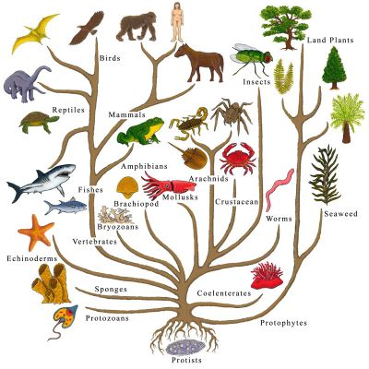
Phylogenetic Tree of Life

Slide 21
Evidence of Shared Ancestry
Biologist use fossils as important clues for the timing of evolutionary changes and divergence.
However, fossils can not be used for soft bodies organisms, so additional evidence is needed.
Systematists compare homologous structures (share a common ancestor).
The greater the number of homologous features shared, the more closely related they are.

Slide 22
Cladistics
In 1966, a German biologist Willi Hennig developed Cladistics. A system of phylogenetic analysis that uses shared and derived characters as the only criteria for grouping taxa.
A shared character is a feature that all members of a group have in common, such as hair in mammals.
A derived character is a feature that evolved only withn the group under consideration. Example – feathers in birds.
Cladogram – is a similar to a phylogenetic tree.

Slide 23
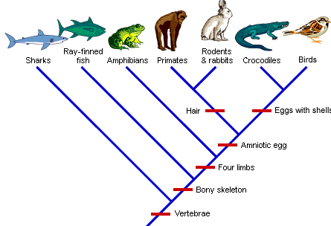
Cladogram

Slide 24
Molecular Cladistics
A biologist can count the shared, derived amino acids at each position in a protein and from analysis construct a tree that hypothesizes relationships between various species.
Biologist used evolutionary changes in the sequences of macromolecules, such as DNA and RNA, and proteins as a form of molecular clock, a tool for estimating the sequence of past evolutionary events.
Analyzing chromosomes can also help with information on evolutionary relationships.

Slide 25
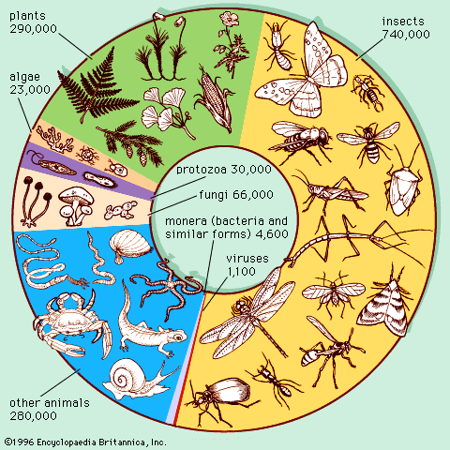
The Diversity of Living Things - The End

