Slide 1
Day 12 Communication and Technology
When we communicate we use many devices.
We can communicate in many ways.

Slide 2
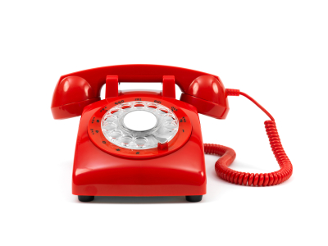
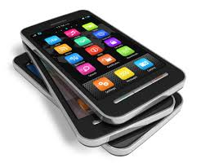
When we want to talk or chat with someone we can make a call using a telephone or cell phone.

Slide 3
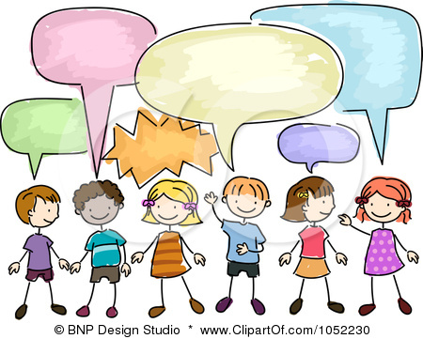
Conservation

Slide 4
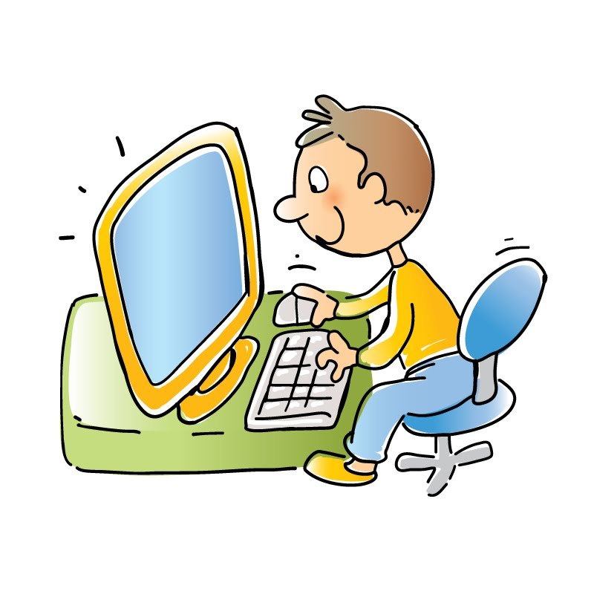
We can use the computer to send an email.

Slide 5
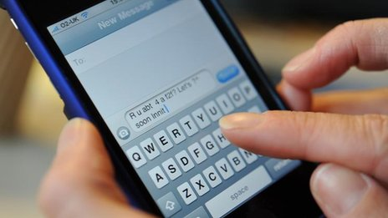
We can use our mobile phone (cell phone) to send a text message. This is called digital communication.

Slide 6
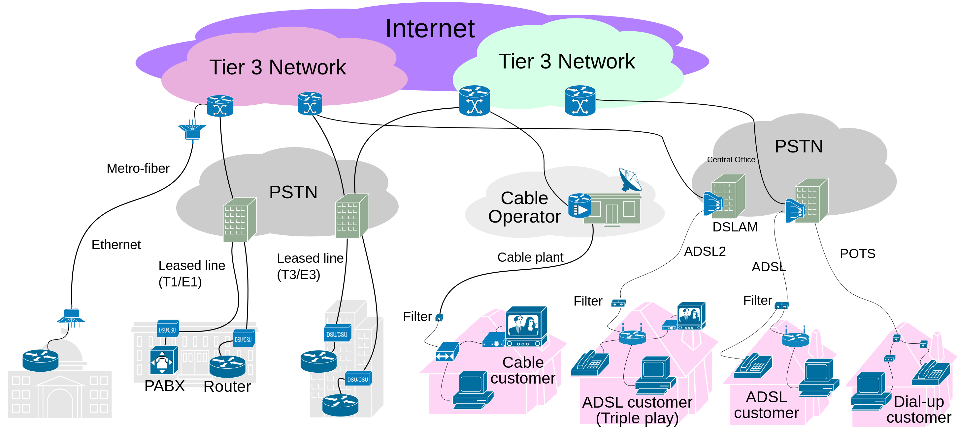
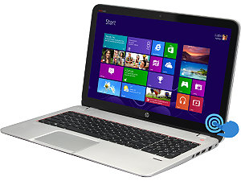
We communicate on the internet using our laptop (computer).
Screen
Keyboard

Slide 7
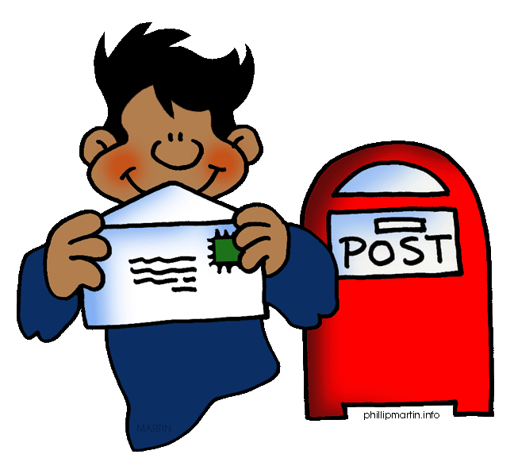
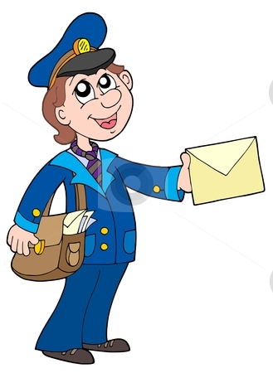
We can send a letter in an envelope by post.

Slide 8
Address
Mailing Address
40 South Street
Philadelphia, Pa. 19234
Email Address
Jsmith@gmail.com

Slide 9
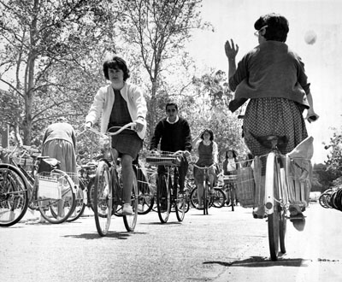
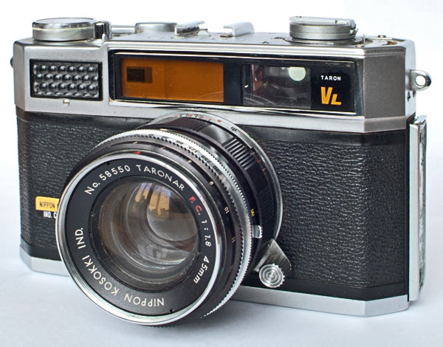
We can communicate with a photograph using a camera.

Slide 10
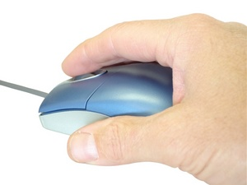
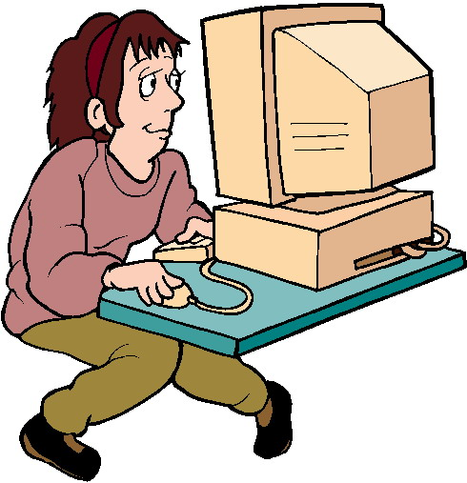
WE can download information from a website with just one click.
Computer Mouse

Slide 11
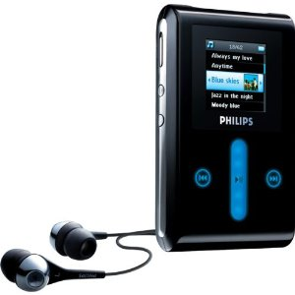
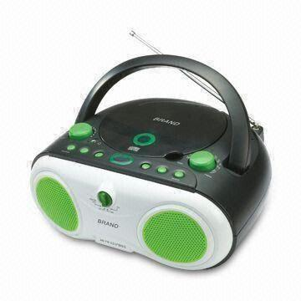
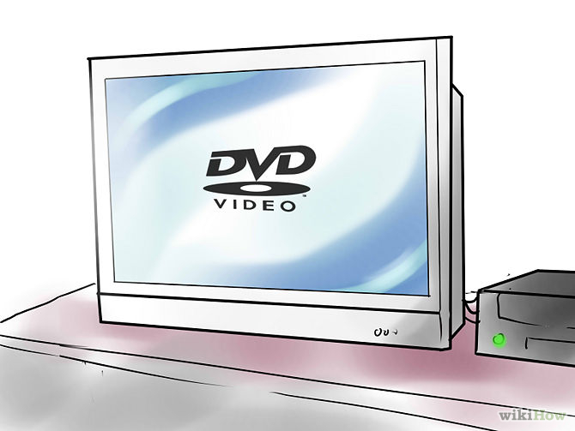
For entertainment we can use a DVD player, CD player and MP3 player.

Slide 12
The End

