Slide 1
Day 13 Documents and Text
We learn to use any documents and texts during our lives.

Slide 2
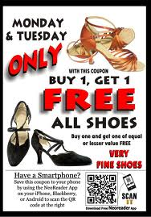
Advertisement – A message is used in an advertisement to get us to by an item.

Slide 3
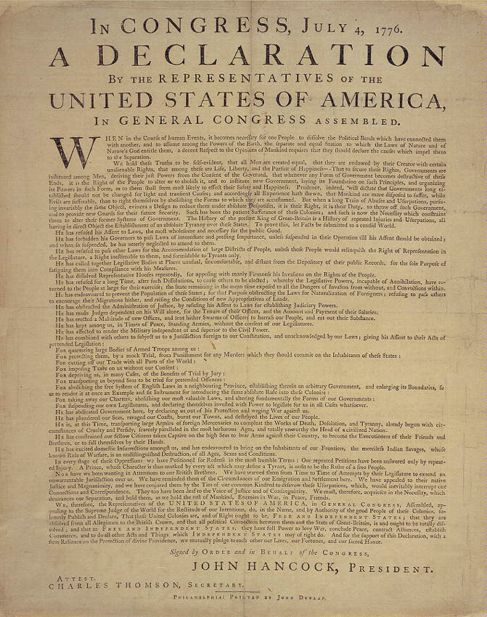
Article and Bill

Slide 4
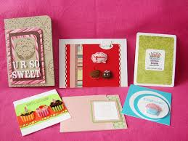
Books, cards and diary

Slide 5
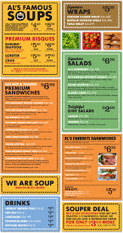
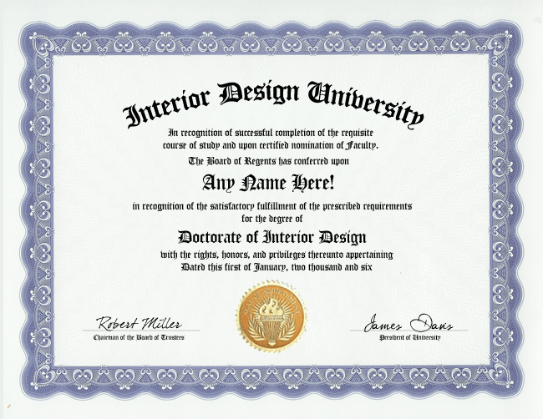
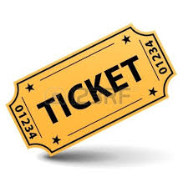
Menu, Diploma, and Ticket.

Slide 6
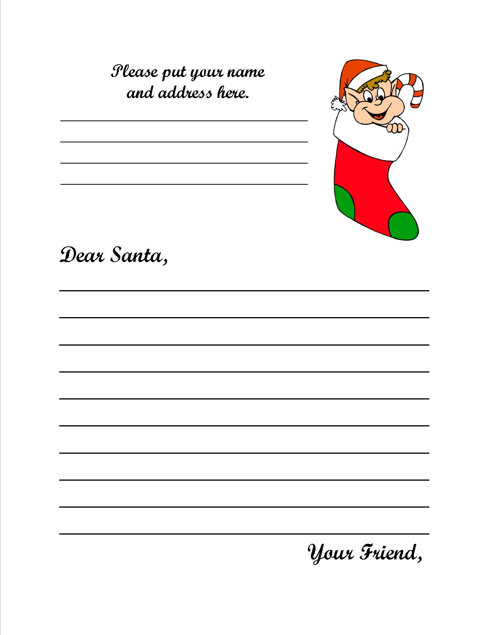
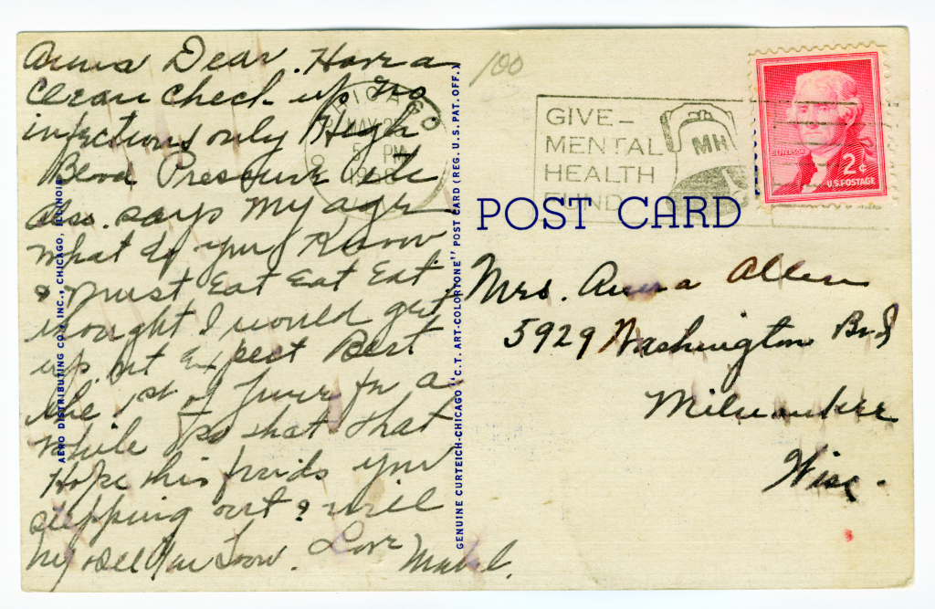
Letter and Postcard

Slide 7
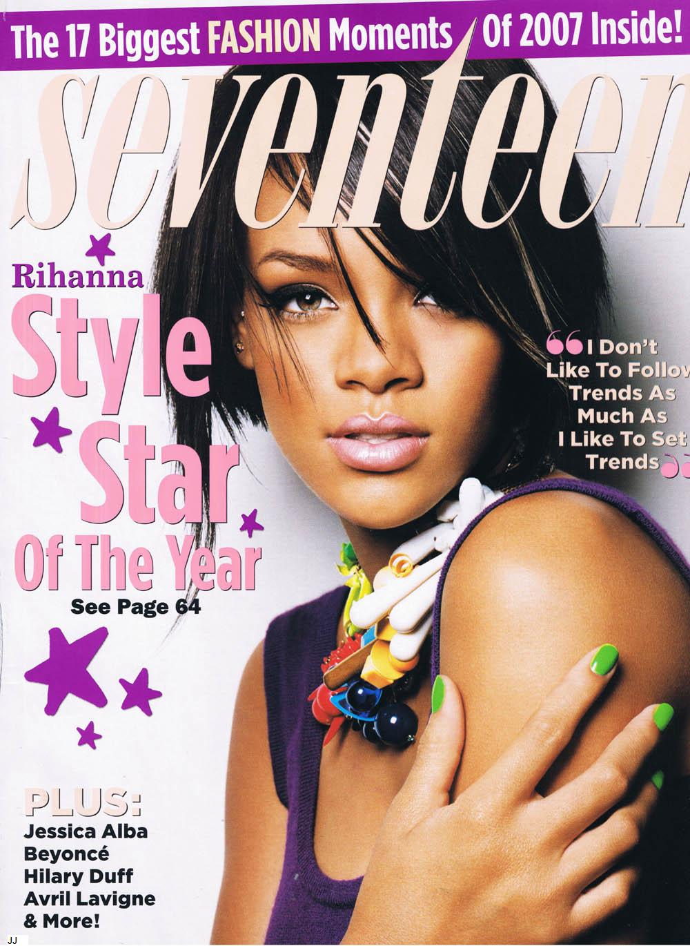
Newspaper and Magazine

Slide 8
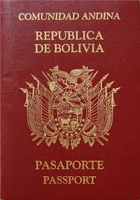
Passport

Slide 9
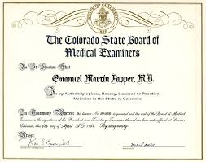
License – Types
License Plate
License to practice medicine

Slide 10
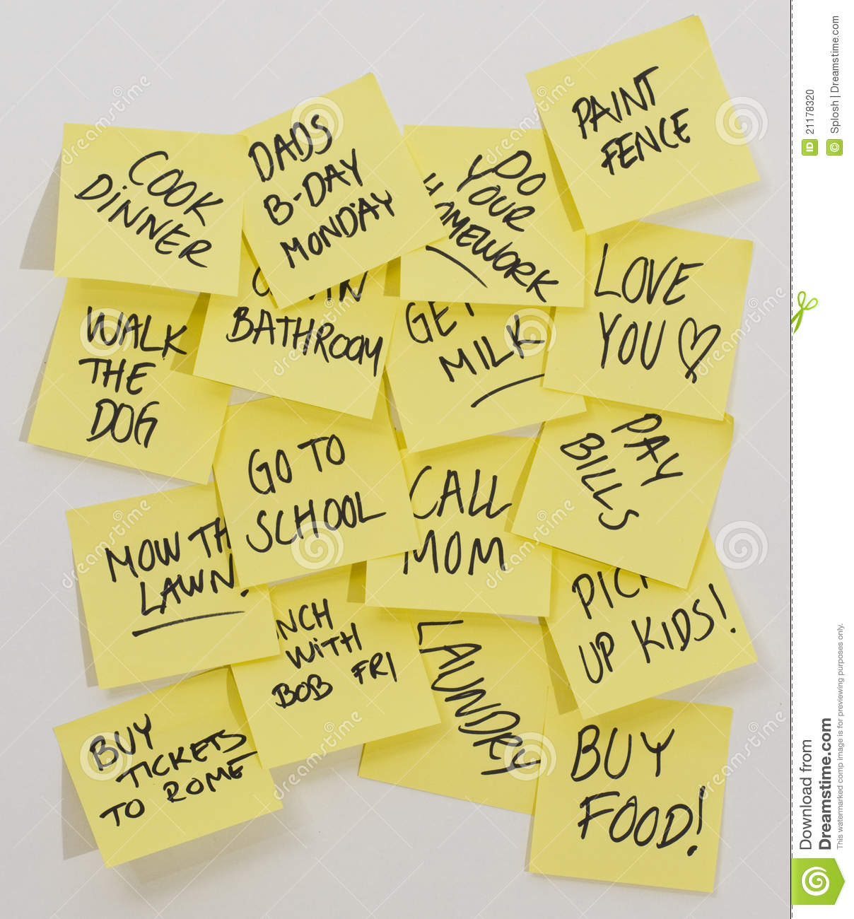
Notes

