Slide 1
Day 5 - Town and City
I was born in Downingtown, Pennsylvania, in the United States of America.
Downingtown is a small town.
Philadelphia is the closest big city.

Slide 2
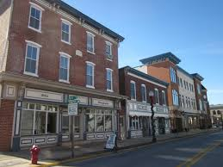
Town – Downingtown (My Town)

Slide 3
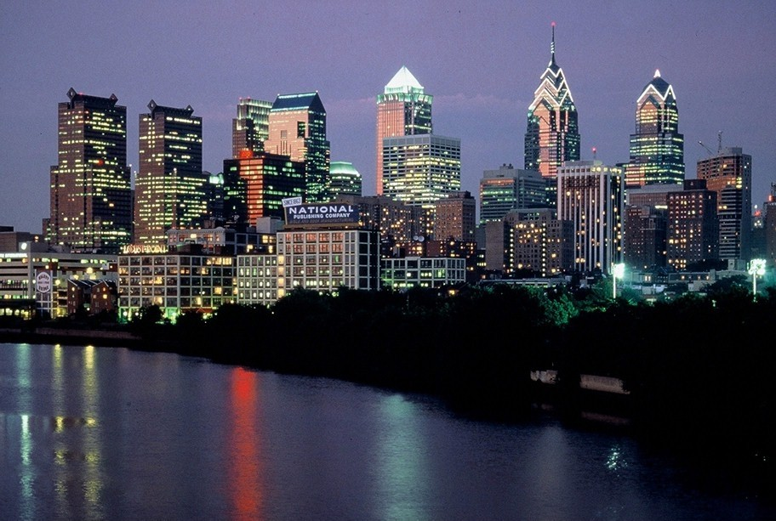
City – Philadelphia (My City)

Slide 4
Philadelphia – City of Brotherly Love
Part of Pennsylvania – created in 1682
Largest city in Pennsylvania
135 Square Miles – same as Chinese city Chengdu
1.5 million people – same as Zhuhai
Was the capital of the 13 Colonies during the American Revolution
Was the capital of the United States for a few years
Declaration of Independence and US Constitution written in Philadelphia

Slide 5
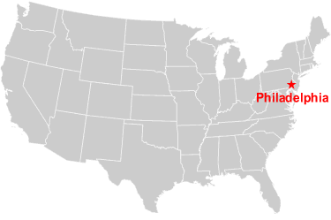
Downingtown

Slide 6
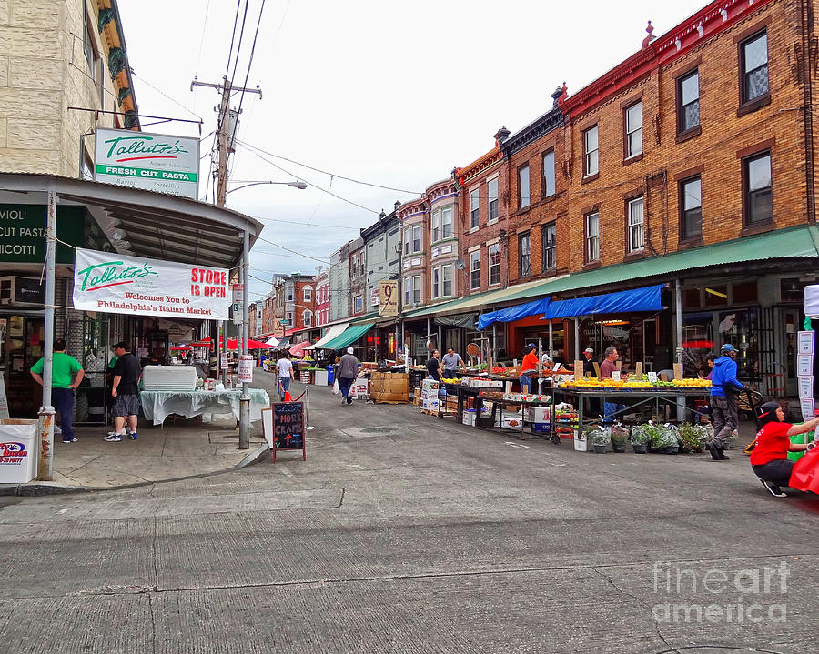
Italian Market Philadelphia

Slide 7
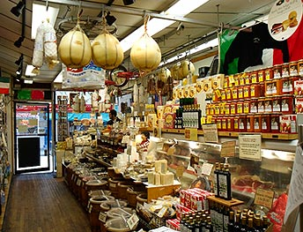
Italian Market Philadelphia

Slide 8
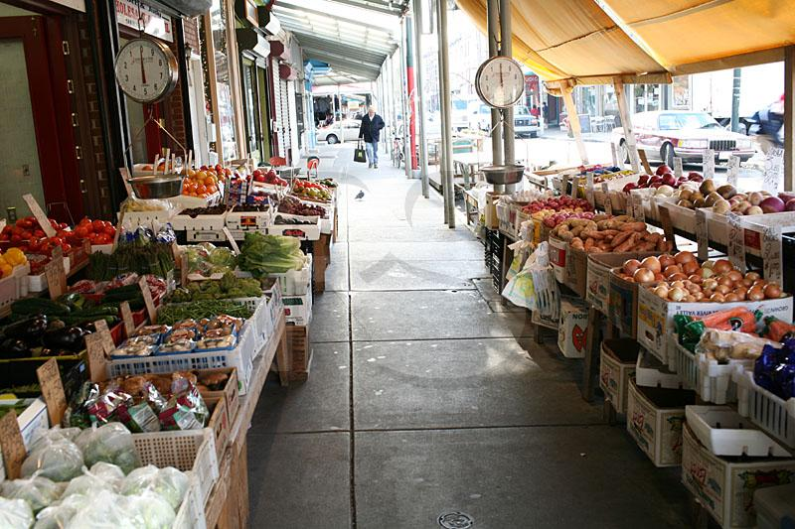
Italian Market Philadelphia

Slide 9
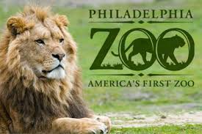
Philadelphia Zoo

Slide 10
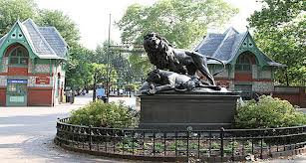
Philadelphia Zoo

Slide 11
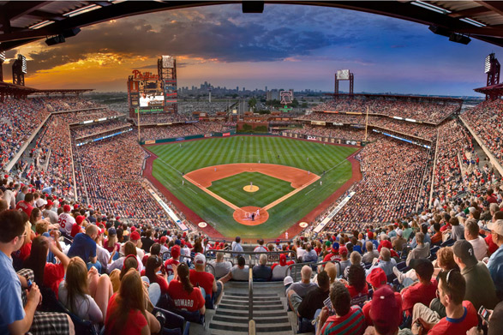
Ball Park

Slide 12
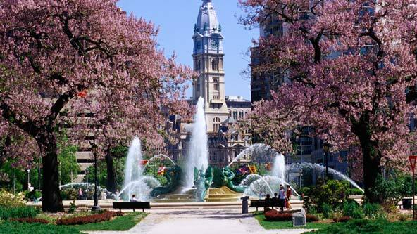
Square – with a small park to sit.

Slide 13
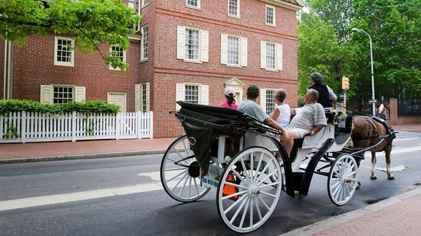
Street –Road.

Slide 14
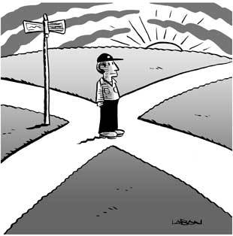
Crossroads, crossing and corner
Corner

Slide 15
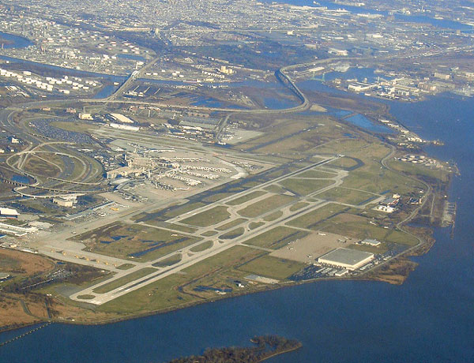
Airport

Slide 16
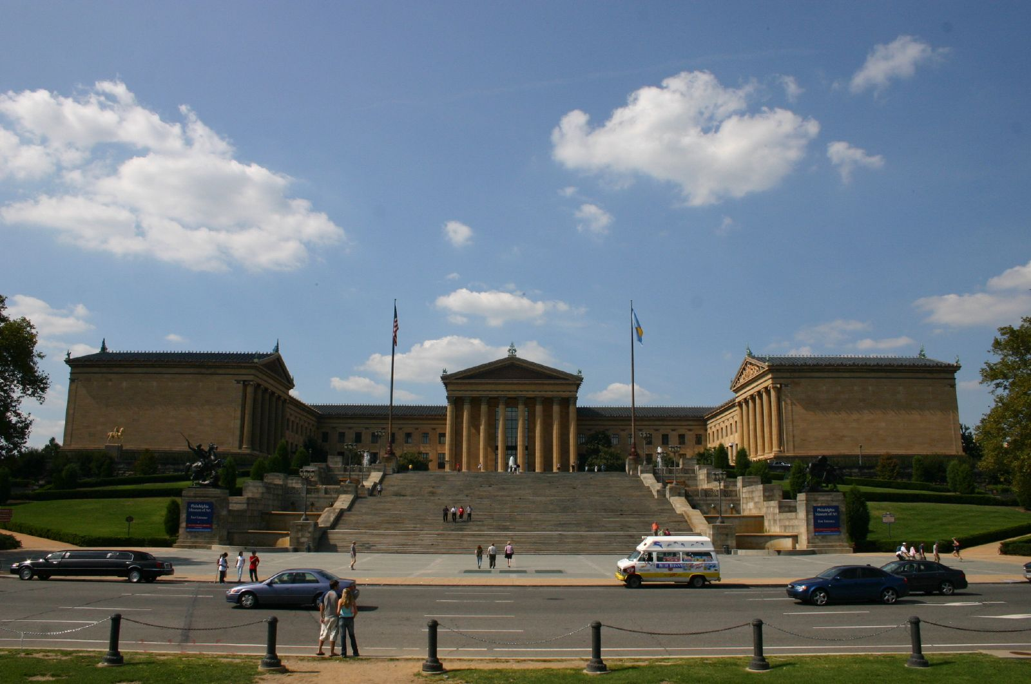
Philadelphia Art Musium

Slide 17
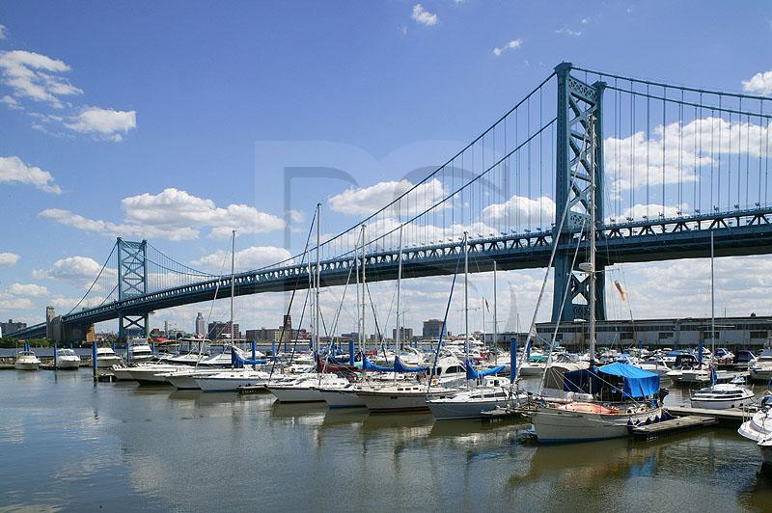
Bridge

Slide 18
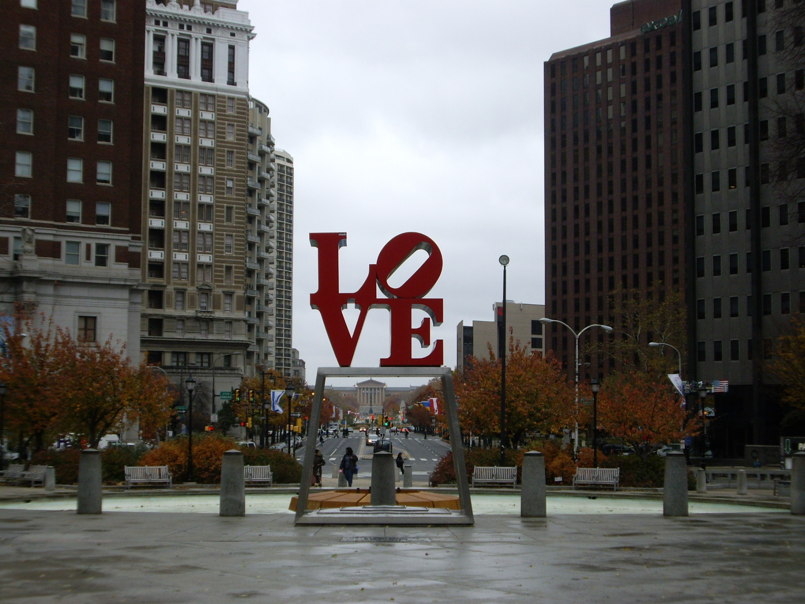
Philadelphia Love Park

Slide 19
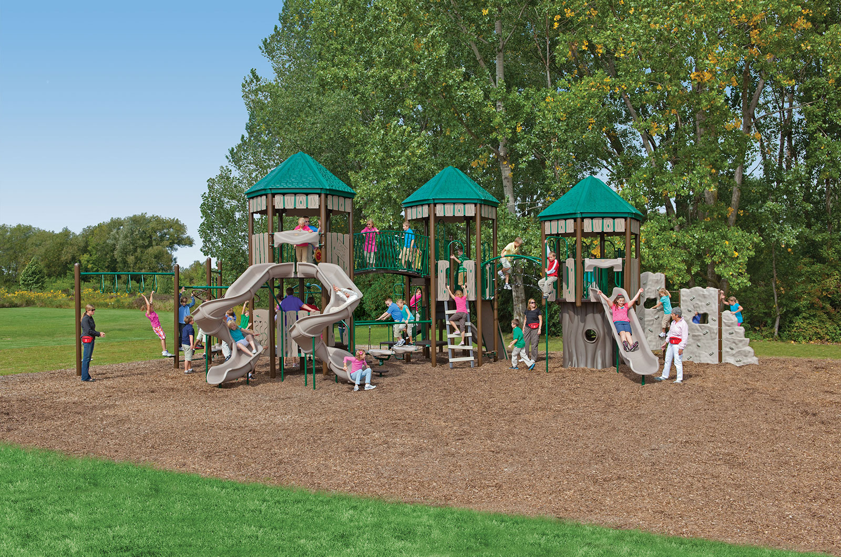
Playground

Slide 20
Train Station

Slide 21
Bus Station

Slide 22
Bus Stop

Slide 23
Subway Station - Underground

Slide 24
Gas Station

