Slide 1
Keystone Biology
Practice questions

Slide 2
1. Prokaryote/Eukaryote
2. Biochemistry
Enzymes
3. Bioenergetics
4. Movement across membrane
5. Cell Division
6. Genetics
7. Evolution
8. Ecology
Graphing/Population graphs

Slide 3
1. Basic Biological Principles
Evaluate the application of scientific reasoning, inventions, tools, and new technologies in the study of biology.
Apply the scientific concepts of hypothesis, inference, law, theory, principle, fact, and observation.
Analyze structural and functional similarities and differences between prokaryotes and eukaryotes.
Evaluate relationships between structures and functions at various levels of biological organization.
Analyze the unique properties of water and explains how they support life on Earth.

Slide 4
1. Which statement best describes a difference between prokaryotic cells and eukaryotic cells?
A. The presence of both DNA and ribosomes in prokaryotic cells indicates that they are more complex than eukaryotic cells.
B. The larger size of prokaryotic cells indicates that they are more complex than eukaryotic cells.
C. The presence of membrane-bound organelles in eukaryotic cells indicates that they are more complex than prokaryotic cells.
D. The larger size of eukaryotic cells indicates that they are more complex than prokaryotic cells.

Slide 5
1. Which statement best describes a difference between prokaryotic cells and eukaryotic cells?
A. Both cell types contain DNA and ribosomes; prokaryotes have less-complex cell organization.
B. Prokaryotes have less-complex cell organization and are generally smaller than eukaryotes.
C. Key: Eukaryotes are more complex because they have organelles that are membrane bound, such as the nuclei which contain their DNA. Prokaryotes have DNA, but it is not bound by a membrane as in eukaryotes.
D. A high surface-area-to-volume ratio usually increases cell efficiency; therefore, larger cells are usually less efficient than smaller cells.

Slide 6
2. A scientist conducts a controlled experiment to test the hypothesis that a vitamin could extend a person’s life-expectancy.
What is the independent variable?
The amount of vitamin given to the subject
The life span of the subject
The control used in the experiment

Slide 7
2. A scientist conducts a controlled experiment to test the hypothesis that a vitamin could extend a person’s life-expectancy.
What is the independent variable?
The amount of vitamin given to the subject
The life span of the subject is the dependent variable
The control used in the experiment

Slide 8
3. The bacterium Acetobacter aceti is found in acidic environments and has an acidic cytoplasm. For this reason, most of its proteins are able to function in acidic conditions. This property distinguishes Acetobacter aceti proteins from those of most other organisms. Which characteristic does Acetobacter aceti most likely share with other organisms?
A. the method that the organism uses to reproduce itself
B. the physical and chemical responses to environmental changes
C. the type of organelle used to produce energy for cellular functions
D. the process used to form proteins by transcription and translation

Slide 9
3. Which characteristic does Acetobacter aceti most likely share with other organisms?
A. Bacteria are prokaryotes and reproduce by binary fission; most organisms that are eukaryotes reproduce by mitosis and meiosis.
B. Bacteria are prokaryotes, lacking membrane-bound organelles, which respond to changes in their environment differently than eukaryotic cells.
C. Bacteria are prokaryotes and do not have membrane-bound organelles, such as mitochondria that produce energy for eukaryotic cells.
D. Key: Prokaryotes and eukaryotes both have ribosomes that synthesize proteins.

Slide 10
4. Match the statement with organelles.
A. Cell membrane
B. Chloroplast
C. Chromosomes
D. Endoplasmic reticulum
E. Golgi Apparatus
F. Mitochondria
G. Ribosome
H. Contractile Vacuole
1. Site of protein synthesis
2. Contains chemicals that convert light energy into chemical bond energy.
3. For regulation and acts as a barrier
4. Illustrates active transport/exocytosis.
5. Contains alleles of genes
6. Produces energy for cell processes.
7. Used in intracellular transport
8. Packages materials to be used.

Slide 11
4. Matching:
G. Ribosome
B. Chloroplast
A. Cell membrane
H. Contractile Vacuole
C. Chromosomes
F. Mitochondria
D. Endoplasmic reticulum
E. Golgi Apparatus
1. Site of protein synthesis
2. Contains chemicals that convert light energy into chemical bond energy.
3. For regulation and acts as a barrier
4. Illustrates active transport/exocytosis.
5. Contains alleles of genes
6. Produces energy for cell processes.
7. Used in intracellular transport
8. Packages materials to be used.

Slide 12
2. Chemical Basis for Life
Evaluate relationships between structure and function at various levels of biochemical organization.
Analyze and predict how enzymes can regulate biochemical reactions within a cell.

Slide 13
5. Match theses Organic compounds with the examples:
A. Carbohydrates
B. Lipids
C. Protein
D. Nucleic Acids
1. Fats, oils and waxes
2. Peptide bonds between amino acids
3. Glycerol and 3 fatty acids
4. Nucleotides
5. Glucose, sucrose and cellulose
6. DNA and RNA

Slide 14
5. Match theses Organic compounds with the examples:
1. B. Lipids
2. C. Protein
3. B. Lipids
4. D. Nucleic Acids
5. A. Carbohydrates
6. D. Nucleic Acids
1. Fats, oils and waxes
2. Peptide bonds between amino acids
3. Glycerol and 3 fatty acids
4. Nucleotides
5. Glucose, sucrose and cellulose
6. DNA and RNA

Slide 15
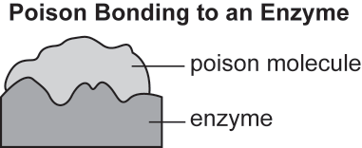
Use the diagram to answer question 6.
6. The diagram models how a poison bonds to the active site of an enzyme. Which function is the enzyme most likely unable to perform because of the attachment of the poison molecule?
A. the release of stored chemical energy
B. the donation of electrons to the substrate
C. the supply of activation energy for a reaction
D. the catalysis of the reaction with the substrate

Slide 16
6. The diagram models how a poison bonds to the active site of an enzyme. Which function is the enzyme most likely unable to perform because of the attachment of the poison molecule?
A. Release of any chemical energy comes from the substrate and not from the enzyme.
B. Enzymes do not donate electrons to the substrate.
C. Enzymes lower the activation energy needed for the chemical reaction to occur.
D. Key: Most enzymes react with only one reactant, so when a poison blocks the active site, the enzyme can no longer bond with the substrate, causing the chemical reaction to stop.

Slide 17
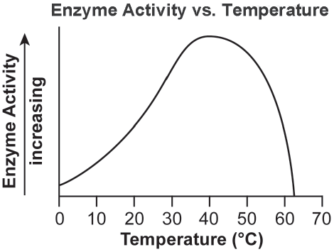
7. The graph shows how the activity of an enzyme changes at different temperatures.
Which statement best describes what happens to the enzyme when the temperature
of the reaction increases to 63°C?
A. The enzyme is used up and the reaction stops.
B. The enzyme begins to decrease the rate of the reaction.
C. The enzyme continues to increase the rate of the reaction.
D. The enzyme changes shape and can no longer speed up the reaction.

Slide 18
7. The graph shows how the activity of an enzyme changes at different temperatures. Which statement best describes what happens to the enzyme when the temperature of the reaction increases to 63°C?
A. An enzyme is not consumed during the chemical reaction.
B. The enzyme does not have the ability to decrease the rate of a reaction; the rate of reaction is affected
by temperature, pH, concentration of substrate, etc.
C. The graph illustrates that enzyme activity decreases as the temperature increases beyond 40°C. A
temperature of 63°C would cause the rate of the reaction to decrease, not increase.
D. Key: Enzymes have an optimal temperature range at which they function; when the temperature exceeds that range, the enzyme will denature, causing it to change its shape and no longer be able to bind with the substrate.

Slide 19
Use the information below about a chemical discovery to answer questions 8 and 9. A scientist formed Chemical X in a laboratory. The material was then analyzed by other scientists. Analysis showed that the chemical was composed of long chains of repeated copies of CH2 molecules.
8. A researcher noticed that a similar CH₂ molecular structure was also located in the plasma membrane of an animal cell. This CH₂ molecular structure contained a negatively charged phosphate group. Which statement best describes the primary function of the CH₂ and phosphate molecular structure located in the plasma membrane?
A. It contains the genetic information needed for protein production.
B. It catalyzes specific chemical reactions in the cytoplasm of a cell.
C. It stores the energy that a cell needs to perform various life processes.
D. It allows a cell to regulate the movement of materials into and out of a cell.

Slide 20
8. A researcher noticed that a similar CH₂ molecular structure was also located in the plasma membrane of an animal cell. This CH₂ molecular structure contained a negatively charged phosphate group. Which statement best describes the primary function of the CH2 and phosphate molecular structure located in the plasma membrane?
A. The molecule described does not indicate it is DNA, and it would not be located in the plasma
membrane.
B. The molecule described does not indicate it is an enzyme, and it would not be located in the plasma
membrane.
C. The molecule described does not indicate it is an ATP molecule, and it would not be located in the
plasma membrane.
D. Key: The molecule described is a phospholipid located in the plasma membrane that helps regulate the movement of materials into and out of a cell.

Slide 21
9. Which type of organic molecule was most likely formed by the scientist in the laboratory?
A. lipid
B. protein
C. nucleic acid
D. carbohydrate

Slide 22
9. Which type of organic molecule was most likely formed by the scientist in the laboratory?
A. Key: Most lipid molecules have long hydrocarbon chains as the main component of their structures. The molecule described has a long hydrocarbon chain with a phosphate group, which is a phospholipid.
B. Protein molecules are made of amino acids.
C. Nucleic acid molecules are made of nucleotides.
D. Carbohydrate molecules are made of carbon, oxygen, and hydrogen atoms in a specific ratio.

Slide 23
3. Bioenergetics
Analyze cell structures and processes that transform energy in living systems.

Slide 24
10. Which statement best compares the energy transformations of photosynthesis and cellular respiration?
A. Only photosynthesis uses oxygen to create energy.
B. Only photosynthesis causes an increase in kinetic energy.
C. Photosynthesis and cellular respiration both store energy in chemical bonds.
D. Photosynthesis and cellular respiration both require chemical energy to make food.

Slide 25
10. Which statement best compares the energy transformations of photosynthesis and cellular respiration?
A. Photosynthesis uses the energy from sunlight to convert carbon dioxide and water into sugars and oxygen.
B. Photosynthesis causes electromagnetic energy from sunlight to be transformed into chemical energy
in sugars.
C. Key: Both photosynthesis and cellular respiration store energy within the bonds of sugar and/or ATP molecules.
D. Photosynthesis uses energy from sunlight to produce sugars.

Slide 26
11. Which process is represented by this equation?
6CO₂ + 12 H₂O → C₆H₁₂O₆ + 6O₂ + 6H₂O
A. Fermentation
B. Photosynthesis
C. Anaerobic respiration
D. Aerobic respiration

Slide 27
11. Which process is represented by this equation?
6CO₂ + 12 H₂O → C₆H₁₂O₆ + 6O₂ + 6H₂O
A. Fermentation
B. Photosynthesis
C. Anaerobic respiration
D. Aerobic respiration

Slide 28
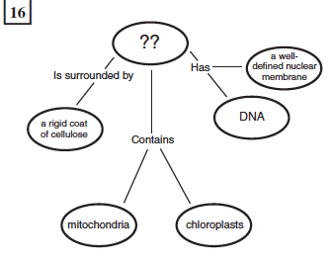
12. Which of these best completes this concept map? A an animal cell B a prokaryotic cell C a virus D a plant cell

Slide 29
12. Which of these best completes this concept map? A an animal cell B a prokaryotic cell C a virus D a plant cell

Slide 30
4. Homeostasis and Transport
Analyze and predict how cell structures transport material into, out of, and within a cell.
Analyze how organisms use feedback and response mechanisms to maintain homeostasis

Slide 31
13. Alveoli are microscopic air sacs in the lungs of mammals. Which statement best describes how the structure of the alveoli allows the lungs to function properly?
A. They increase the amount of energy transferred from the lungs to the blood.
B. They increase the flexibility of the lungs as they expand during inhalation.
C. They increase the volume of the lungs, allowing more oxygen to be inhaled.
D. They increase the surface area of the lungs, allowing efficient gas exchange.

Slide 32
13. Alveoli are microscopic air sacs in the lungs of mammals. Which statement best describes how the structure of the alveoli allows the lungs to function properly?
A. The structure of the alveoli has little impact on the lung’s ability to transfer energy.
B. The structure and function of the alveoli has little impact on the flexibility of lung tissue.
C. The millions of alveoli in the lungs of mammals decrease the total volume of the lungs.
D. Key: The millions of alveoli in mammals greatly increase the surface area of the lungs, thereby
providing a larger surface area for gas exchange.

Slide 33
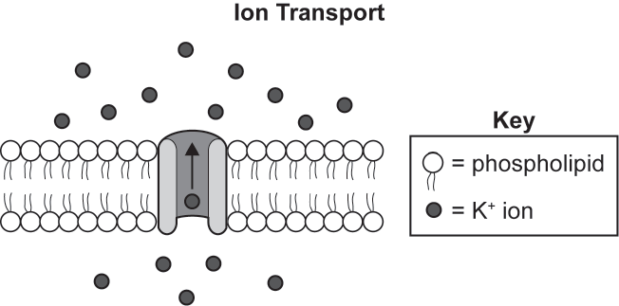
14. The diagram shows the movement of ions against a concentration gradient to an area of higher concentration. Which molecule provides the energy needed for this movement
to occur in a cell?
ATP
B. mRNA
C. protein
D. lipid

Slide 34
14. The diagram shows the movement of ions against a concentration gradient to an area of higher concentration. Which molecule provides the energy needed for this movement to occur in a cell?
A. Key: ATP is an energy molecule that can be used to actively transport ions across a concentration gradient.
B. An mRNA molecule contains genetic information and is not an energy molecule.
C. Protein molecules can be used as the channel or pump from which the ions move, but they do not provide the energy to actively transport ions.
D. Lipid molecules are part of a cell membrane, but they do not provide the energy to actively transport
ions.

Slide 35
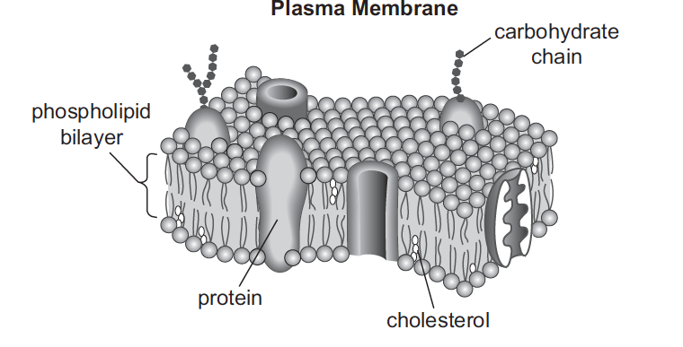
15. Which component of this membrane contains a hydrophobic region and acts as the primary barrier to most foreign substances?
A. protein
B. cholesterol
C. carbohydrate chain
D. phospholipid bilayer

Slide 36
15. Which component of this membrane contains a hydrophobic region and acts as the primary barrier to most foreign substances?
A. The function of the proteins in a plasma membrane is to allow the movement of substances across the membrane.
B. The main functions of cholesterol in a plasma membrane are to help make the phospholipid bilayer more rigid, which decreases its permeability, and to prevent phase shifts in the membrane.
C. Carbohydrate chains often function in cellular recognition.
D. Key: Each phospholipid of the bilayer consists of two main parts: a hydrophilic phosphate group and hydrophobic lipid tails. This structure allows the bilayer to be impermeable to most water-soluble (hydrophilic) molecules and ions.

Slide 37
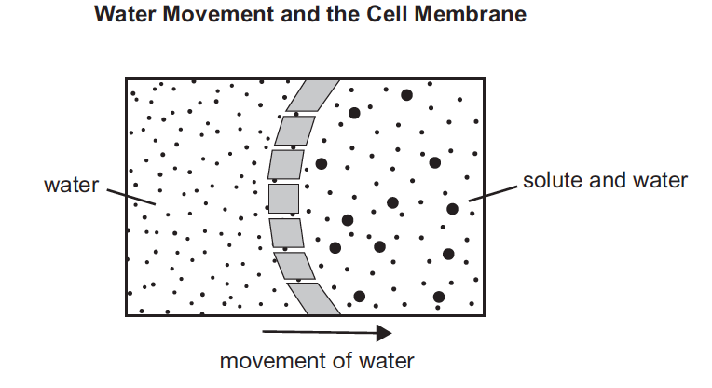
16. The relative concentration of solute inside and outside a cell can cause water molecules to move across the membrane. Which phrase would be an alternate title to the diagram?
A. Exocytosis in a Cell
B. Active Transport in a Cell
C. Osmosis Across a Membrane
D. Facilitated Diffusion Across a Membrane

Slide 38
16. Which phrase would be an alternate title to the diagram?
A. The diagram does not show the movement of a vesicle across a cell membrane.
B. The diagram does not show energy being used to facilitate the movement of water.
C. Key: The diagram shows osmosis, which is the movement of water across a semipermeable
membrane from an area of dilute solute concentration to an area of higher solute concentration.
D. The diagram does not show cell-membrane proteins that move molecules across the cell membrane.

Slide 39
5. Cell Growth and Reproduction
Compare and analyze the three stages and the outcomes of the cell cycle.

Slide 40
17. Which event most likely occurs next in mitosis?
A. The chromatin condenses.
B. The nuclear envelope dissolves.
C. The chromosomes double in number.
D. The cell membrane pinches inward to divide the cytoplasm.

Slide 41
17. Which event most likely occurs next in mitosis?
A. The condensing of the chromatin occurs during prophase at the beginning of mitosis.
B. The nuclear envelope dissolves after the chromatin condenses into chromosomes during prophase.
C. The chromosomes double in number during the S phase, not during mitosis.
D. Key: The next event would show telophase, when the cell begins to separate into two daughter cells.

Slide 42
18. Mitosis and meiosis are processes by which animal and plant cells divide. Which statement best describes a difference between mitosis and meiosis?
A. Meiosis is a multi-step process.
B. Mitosis occurs only in eukaryotic cells.
C. Meiosis is used in the repair of an organism.
D. Mitosis produces genetically identical daughter cells.

Slide 43
18. Mitosis and meiosis are processes by which animal and plant cells divide. Which statement best describes a difference between mitosis and meiosis?
A. Both meiosis and mitosis are multi-step processes.
B. Mitosis also takes place in prokaryotic cells.
C. Meiosis generates gametes used in sexual reproduction.
D. Key: Cells produced through mitosis contain DNA identical to the parent cells, whereas meiosis produces cells that are haploid and often genetically different.

Slide 44
19. A reproductive cell, containing 46 chromosomes will yield _______ cells with _________chromosomes each after meiosis.
A. 2 23
B. 4 46
C. 4 23
D. 8 23

Slide 45
19. A reproductive cell, containing 46 chromosomes will yield _______ cells with _________chromosomes each after meiosis.
A. 2 23
B. 4 46
C. 4 23
D. 8 23

Slide 46
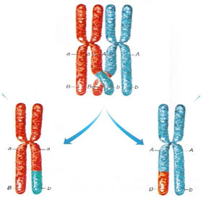
20. The diagram shows homologous chromosomes during prophase I of meiosis. Which of the following correctly describes the process being illustrated?
A. mutation in which the DNA content of the gene is altered
B. segregation of sister chromatids
C. condensation and segregation of alleles
D. crossing-over in which alleles are exchanged

Slide 47
20. The diagram shows homologous chromosomes during prophase I of meiosis. Which of the following correctly describes the process being illustrated?
A. mutation in which the DNA content of the gene is altered
B. segregation of sister chromatids
C. condensation and segregation of alleles
D. crossing-over in which alleles are exchanged

Slide 48
6. Genetics
Analyze and predict how genetic information is inherited, altered, and expressed.
Analyze the processes associated with protein synthesis.
Predict the impacts of genetic engineering on medicine, forensics, and agriculture.

Slide 49
21. In fruit flies, the gene for red eyes (R) is dominant and the gene for sepia eyes (r) is recessive. What are the possible combinations of genes in the offspring of two red-eyed heterozygous flies (Rr)?
RR only
rr only
Rr and rr only
RR, Rr, and rr only

Slide 50
21. In fruit flies, the gene for red eyes (R) is dominant and the gene for sepia eyes (r) is recessive. What are the possible combinations of genes in the offspring of two red-eyed heterozygous flies (Rr)?
RR only
rr only
Rr and rr only
RR, Rr, and rr only

Slide 51
22. If a corn plant has a genotype of Ttyy,
what are the possible genetic combinations that could be present in a single grain of pollen from this plant?
A Ty, ty
B TY, ty
C TY, Ty, ty
D Ty, ty, tY, TY

Slide 52
22. If a corn plant has a genotype of Ttyy,
what are the possible genetic combinations that could be present in a single grain of pollen from this plant?
A Ty, ty
B TY, ty
C TY, Ty, ty
D Ty, ty, tY, TY

Slide 53
23. In certain breeds of dogs, deafness is due to a recessive allele (d) of a particular gene, and normal hearing is due to its dominant allele (D). What percentage of the offspring of a normal heterozygous (Dd) dog and a deaf dog (dd) would be expected to have normal hearing?
A. 0%
B. 25%
C. 50%
D. 100%

Slide 54
23. In certain breeds of dogs, deafness is due to a recessive allele (d) of a particular gene, and normal hearing is due to its dominant allele (D). What percentage of the offspring of a normal heterozygous (Dd) dog and a deaf dog (dd) would be expected to have normal hearing?
A. 0%
B. 25%
C. 50%
D. 100%

Slide 55
24. Fur color in cats is controlled by an autosomal gene that can occur in the dominant form, (B), or the recessive form, (b). The length of the cat’s fur is controlled by another autosomal gene that occurs in the dominant form, (S), or the recessive form, (s). The table below shows the traits for these allele codes.
Gene Trait
B black fur S short-haired fur
b white fur s long-haired fur
The following genotypes were found in a male cat and a female cat.
BbSs (male) bbSS (female)
Which one of the following choices is true of the phenotype of offspring from these parents?
A. All offspring will have black fur.
B. All offspring will have white fur.
C. All offspring will have long-haired fur.
D. All offspring will have short-haired fur.

Slide 56
24. Fur color in cats is controlled by an autosomal gene that can occur in the dominant form, (B), or the recessive form, (b). The length of the cat’s fur is controlled by another autosomal gene that occurs in the dominant form, (S), or the recessive form, (s). The table below shows the traits for these allele codes.
Gene Trait
B black fur S short-haired fur
b white fur s long-haired fur
The following genotypes were found in a male cat and a female cat.
BbSs (male) bbSS (female)
Which one of the following choices is true of the phenotype of offspring from these parents?
A. All offspring will have black fur.
B. All offspring will have white fur.
C. All offspring will have long-haired fur.
D. All offspring will have short-haired fur.

Slide 57
25. If a human baby boy inherits a recessive allele from his mother, in which circumstance would he most likely show the trait coded for by the recessive allele?
A. The baby inherits the dominant allele from his father.
B. The allele is on an autosomal chromosome and the baby is a twin.
C. The allele is on the X chromosome.
D. The allele is on the Y chromosome.

Slide 58
25. If a human baby boy inherits a recessive allele from his mother, in which circumstance would he most likely show the trait coded for by the recessive allele?
A. The baby inherits the dominant allele from his father.
B. The allele is on an autosomal chromosome and the baby is a twin.
C. The allele is on the X chromosome.
D. The allele is on the Y chromosome.

Slide 59
26. In the following hypothetical situation, the length of a giraffe’s neck is determined by T allele (tall), where tall necks are dominant over short necks. What are the possible parent genotypes if the resulting offspring contain a phenotypic ratio of 2 tall :2 short ?

Slide 60
26. In the following hypothetical situation, the length of a giraffe’s neck is determined by T allele (tall), where tall necks are dominant over short necks. What are the possible parent genotypes if the resulting offspring contain a phenotypic ratio of 2 tall :2 short ?
Answer: Tt x tt

Slide 61
27. Which of the following base pair sequences
could be produced in DNA replication?
5' AGTCUT 3‘
3' TCUGTA 5'
B 5' AGTCAT 3‘
3' TCAGTA 5'
C 5' AGTCAT 3‘
3' CTGACG 5'
D 5' AGTCAT 3‘
3' UCAGUA 5'

Slide 62
27. Which of the following base pair sequences
could be produced in DNA replication?
5' AGTCUT 3‘
3' TCUGTA 5'
B 5' AGTCAT 3‘
3' TCAGTA 5'
C 5' AGTCAT 3‘
3' CTGACG 5'
D 5' AGTCAT 3‘
3' UCAGUA 5'

Slide 63
28. A mutation occurs at the midpoint of a gene, altering all amino acids encoded after the point of mutation. Which mutation could have produced this change?
A. deletion of two nucleotides
B. deletion of three nucleotides
C. insertion of six nucleotides
D. insertion of twelve nucleotides

Slide 64
28. A mutation occurs at the midpoint of a gene, altering all amino acids encoded after the point of mutation. Which mutation could have produced this change?
A. Key: A deletion of two nucleotides will most likely cause a shift in the codon sequence that codes for an amino acid. This could cause a change in the sequence of amino acids attached after the point of the mutation.
B. A deletion of three nucleotides will cause a deletion of the original amino acid in the protein but will not cause a change in the rest of the amino-acid sequence.
C. An insertion of six nucleotides will add two additional amino acids to the protein but will not cause a change in the rest of the amino-acid sequence.
D. An insertion of twelve nucleotides will add four additional amino acids to the protein but will not cause a change in the rest of the amino-acid sequence.

Slide 65
29. The frequency of an allele in a fly population changes from 89% to 20% after three generations. Which other events most likely occurred during the same time period?
A. an environmental change and a fly population increase
B. an environmental change and a fly population decrease
C. interbreeding of flies with an invasive species and fly population speciation
D. interbreeding of flies with an established local species and fly population speciation

Slide 66
29. The frequency of an allele in a fly population changes from 89% to 20% after three generations. Which other events most likely occurred during the same time period?
A. An environmental change that did not favor the individuals in the population with the allele most likely led to the change in allele frequency; however, since the allele frequency decreased by so much, there would had to have been a decrease in the population within a three-generation period of time.
B. Key: An environmental change that did not favor the individuals in the population with the allele most likely led to the change in allele frequency; since the allele frequency decreased by so much, there would had to have been a decrease in the population within a three-generation period of time.
C. Interbreeding between species is not likely to occur and can produce offspring that are not able to reproduce. Speciation would most likely need more than three generations to occur.
D. Interbreeding between species is not likely to occur and can produce offspring that are not able to reproduce. Speciation would most likely need more than three generations to occur.

Slide 67
30. A scientist observes that a certain trait is determined by a single allele. An organism inherited one version of the trait from one parent and another version from the other parent. Both versions of the trait are expressed in the phenotype of the offspring. Which pattern of inheritance best classifies the observed trait?
A. dominance
B. sex-linkage
C. co-dominance
D. incomplete dominance

Slide 68
30. Which pattern of inheritance best classifies the observed trait?
A. The pattern of inheritance does not reflect that one allele is dominant and the other is recessive since
both traits are expressed in the individual.
B. The information given does not provide enough evidence for a sex-linkage pattern of inheritance.
C. Key: The pattern of inheritance is best described as co-dominance because both traits are fully expressed in the phenotype of the individual.
D. Since both versions of the trait are expressed without a modification of the phenotype expressed, the
pattern of inheritance is not incomplete dominance.

Slide 69
31. Which relationship is correct?
A. The number of chromosomes in a gamete cell equals the number of chromosomes in a body cell.
B. The number of chromosomes in a cell equals the number of genes in a cell.
C. The number of thymine bases in DNA equals the number of adenine bases in DNA

Slide 70
31. Which relationship is correct?
A. The number of chromosomes in a gamete cell equals the number of chromosomes in a body cell.
B. The number of chromosomes in a cell equals the number of genes in a cell.
C. The number of thymine bases in DNA equals the number of adenine bases in DNA

Slide 71
7. Theory of Evolution
Evaluate the mechanisms and sources of evidence related to the theory of evolution.

Slide 72
32. A single species of squirrel evolved over time into two species, each on opposite sides of the Grand Canyon. This change was most likely due to
A. higher mutation rates on one side.
B. low genetic diversity in the initial population.
C. the isolation of the two groups.
D. differences in reproductive rates.

Slide 73
32. A single species of squirrel evolved over time into two species, each on opposite sides of the Grand Canyon. This change was most likely due to
A. higher mutation rates on one side.
B. low genetic diversity in the initial population.
C. the isolation of the two groups.
D. differences in reproductive rates.

Slide 74
33. Which of these best illustrates natural selection?
An organism with favorable genetic variations will tend to survive and breed successfully.
A population monopolizes all of the resources in its habitat, forcing other species to migrate.
C. A community whose members work together utilizes all existing resources and migratory routes.
D. The largest organisms in a species receive the only breeding opportunities.

Slide 75
33. Which of these best illustrates natural selection?
An organism with favorable genetic variations will tend to survive and breed successfully.
A population monopolizes all of the resources in its habitat, forcing other species to migrate.
C. A community whose members work together utilizes all existing resources and migratory routes.
D. The largest organisms in a species receive the only breeding opportunities.

Slide 76
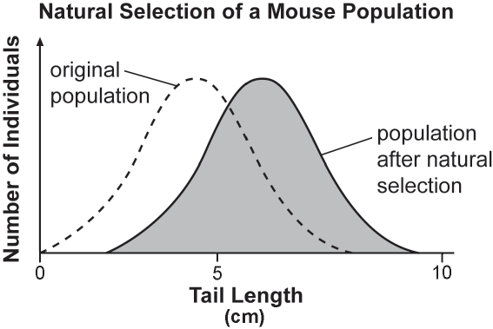
Use the graph below to answer question 34.
34. Tail length in mice varies within a population. Scientists observed change in the distribution of tail lengths in a mouse population over time. At the genetic level, what has most likely happened to the allele for the shortest tail lengths?
A. The allele changed from being dominant to being recessive.
B. The allele changed from being autosomal to being sex-linked.
C. The allele became less frequent than the alleles for longer tail lengths.
D. The allele began to code for long tail lengths instead of the shortest ones.

Slide 77
34. At the genetic level, what has most likely happened to the allele for the shortest tail lengths?
A. Alleles do not have the ability to revert back and forth from dominant to recessive.
B. It is not likely that the alleles changed their chromosome positions to cause the change in the tail-length distribution of the mouse population.
C. Key: Natural selection can cause changes in the allele frequency of a population—mice with short tails were not as successful in reproducing as were mice with longer tails due to environmental influences.
D. A genetic mutation would cause a change in the coding from the allele, not natural selection.

Slide 78
35. A population of termites initially consists of darkly colored and brightly colored members. After several generations, the termite population consists almost entirely of darkly colored members because the brightly colored termites are easier for a predatory species of insectivores to locate. This situation is an example of
A. the evolution of a new species.
B. natural selection.
C. artificial selection.
D. adaptive radiation.

Slide 79
35. A population of termites initially consists of darkly colored and brightly colored members. After several generations, the termite population consists almost entirely of darkly colored members because the brightly colored termites are easier for a predatory species of insectivores to locate. This situation is an example of
A. the evolution of a new species.
B. natural selection.
C. artificial selection.
D. adaptive radiation.

Slide 80
8. Ecology
Compare ecological levels of organization in the biosphere.
Analyze interactions and relationships in an ecosystem as they relate to energy flow, biotic components, biogeochemical cycles, and limiting factors.
Predict changes in an ecosystem in response to natural and human disturbances.

Slide 81
Use the table below to answer question 36.
Students’ Observations of a Pond Ecosystem
Quantitative | Qualitative
37 fish and 3 frogs | Leaves lie on the bottom of the pond.
2 types of aquatic grass | Water insects move along the water’s surface.
12 small rocks and 1 medium | rock All 3 frogs are sitting on a pond bank.
sand
36. A group of students measured a ten-square-meter section of a pond ecosystem and recorded observations. Which statement is a testable hypothesis?
A. The frogs living in the pond represent a population.
B. Water is an abiotic component in the pond ecosystem.
C. If the fish are given more food, then they will be happier.
D. If the frogs are startled, then they will jump into the water.

Slide 82
36. A group of students measured a ten-square-meter section of a pond ecosystem and recorded observations. Which statement is a testable hypothesis?
A. This is a statement and does not require testing to validate.
B. This is a statement and does not have a testable framework.
C. The level of happiness in a fish is not measurable.
D. Key: This is a hypothesis because the action can be observed and tested to support or disprove the statement.

Slide 83
37. A researcher observing an ecosystem describes the amount of sunlight, precipitation, and type of soil present. Which factors is the researcher most likely describing?
A. biotic factors in a forest
B. biotic factors in a tundra
C. abiotic factors in a prairie
D. abiotic factors in an ocean

Slide 84
37. A researcher observing an ecosystem describes the amount of sunlight, precipitation, and type of soil present. Which factors is the researcher most likely describing?
A. Sunlight, precipitation, and soil are all abiotic components of a forest ecosystem.
B. Sunlight, precipitation, and soil are all abiotic components of a tundra ecosystem.
C. Key: The examples given are all abiotic components that can be used to describe a prairie ecosystem.
D. Precipitation and soil types are not commonly used to describe aquatic ecosystems.

Slide 85
38. Scientists observed that the populations of top-level consumers in a particular ecosystem were rapidly decreasing. Further studies revealed that there was also a decline in producer productivity. Which other changes did the scientists most likely observe in the ecosystem?
A. increased producer diversity
B. decreased population size at all levels
C. decreased primary consumer populations only
D. increased primary and secondary consumer diversity

Slide 86
38. Which other changes did the scientists most likely observe in the ecosystem?
A. A decline in producer productivity would most likely result in a decrease in producer diversity.
B. Key: A decline in the producers of an ecosystem will cause a decrease in all other organisms because the producers are responsible for converting sunlight or chemical energy into usable energy for consumers.
C. Primary consumer populations will decrease, but secondary consumer populations will also decrease.
D. A decline in producer productivity would most likely lead to a decrease in diversity in primary and secondary consumers.

