Slide 1

Biology Keystone Exam Review Packet
2012 - 2013

Slide 2
Which characteristic is shared by all prokaryotes and eukaryotes?
  Ability to store hereditary information
  Use of organelles to control cell processes
  Use of cellular respiration for energy release
  Ability to move in response to environmental stimuli

Slide 3
All living things:
Are made up of cells
Have a universal genetic code
Need a constant flow of energy
Are capable of reproducing (on their own)
Grow and Develop
Have a level of organization (cells, tissue, organs, organ systems, organism)
Respond to Stimuli

Slide 4
2. Living organisms can be classified as prokaryotes or eukaryotes. Which two structures are common to both prokaryotic and eukaryotic cells?
  Cell wall and nucleus
  Cell wall and chloroplast
  C. plasma membrane and nucleus
  D. plasma membrane and cytoplasm

Slide 5
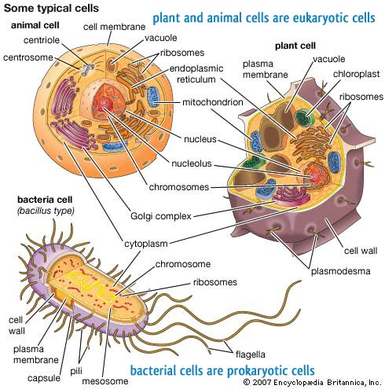
Prokaryotic vs Eukaryotic
Prokaryote
Lack a nucleus and membrane bound organelles
Have cytoplasm, plasma (cell) membrane, a cell wall, DNA and ribosomes
Bacteria and Archae
Eukaryotes
Have membrane bound organelles
Have a true nucleus with a nuclear envelope
Have a plasma membrane, cytoplasm, DNA, ribosomes, endoplasmic reticulum, golgi apparatus, nucleolus w/i the nucleus, vacuoles, a cell wall (in some) and other organelles.
Protists, Fungus, Plants, Animals

Slide 6
Prokaryotic cells are generally much smaller than eukaryotic cells.
Part A: Identify a structural difference between prokaryotic cells and eukaryotic cells that is directly related to their difference in size.

Slide 7
Prokaryotic cells are generally much smaller than eukaryotic cells.
Part B: Based on structural difference, explain why prokaryotic cells can be much smaller than eukaryotic cells.

Slide 8
Prokaryotic cells lack membrane-bound organelles. Contain:
  Ribosomes
  DNA
Due to the lack of organelles, the total volume of the cell is smaller. Cells with organelles (eukaryotic) have the ability to metabolize materials and retain a larger size.
No specialization of function due to a lack of organelles. Enzymes within the cytoplasm carry out the metabolic functions of the cell
Eukaryotic cells contain membrane-bound organelles and organelles such as:
  Mitochondria
  Endoplasmic reticulum
  Vacuoles
  Lysosomes
  golgi apparatus
  Nucleus with DNA
  Nucleolus
  Ribosomes
Have a greater division of labor. Organelles are specialized.
Prokaryotic cells and eukaryotic cells both contain ribosomes, cytoplasm, a plasma membrane, and genetic material

Slide 9
3. Prokaryotic cells are generally much smaller than eukaryotic cells.
Part C: Describe one Similarity between prokaryotic cells and eukaryotic cells that is independent of size.

Slide 10
All cells contain:
  genetic information in the form of DNA
  ribosomes(cell organelles) that translate nucleic acid (RNA) into protein
  a plasma membrane to create an internal environment and allows for the movement of materials from one side to another

Slide 11
Alveoli are microscopic air sacs in the lungs of mammals. Which statement best describes how the structure of the alveoli allows the lungs to function properly?
They increase the amount of energy transferred from the lungs to the blood>
They increase the flexibility of the lungs as they expand during inhalation.
They increase the volume of the lungs, allowing more oxygen to be inhaled.
They increase the surface area of the lungs, allowing efficient gas exchange.

Slide 12
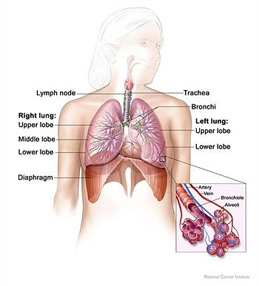
The Human Respiratory System
The alveoli increase surface area for gas exchange
The membranes of the alveoli are 1 cell thick. Oxygen and Carbon dioxide can easily be exchanged through the thin walls.
Typical human has ~ 700 million alveoli, accounting for an area of ~70 m² for gas exchange
Alveoli

Slide 13
Which statement best describes an effect of the low density of frozen water in a lake?
When water freezes, it contracts, decreasing the water level in a lake.
Water in a lake freezes from the bottom up, killing most aquatic organisms.
When water in a lake freezes, it floats, providing insulation for organisms below.
Water removes thermal energy from the land around a lake, causing the lake to freeze.

Slide 14
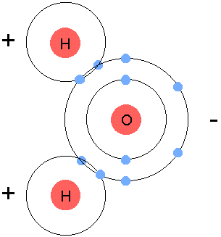
Properties of Water
Is a polar covalent molecule
Is the Universal solvent due to its polarity. Polar covalent compounds (like glucose) and ionic compounds (like salt) can easily go into solution in water.
Has a high specific heat. It is slow to heat up and also slow to cool down. This acts as an insulator in living organisms since the majority of their living tissue is water.
When water freezes, it expands and therefore floats. Ice is less dense than water. This provides an insulation to the organisms in the water. The water below will be at 4`C (if ice is above it)

Slide 15
Which statement correctly describes how carbon’s ability to from four bonds makes it uniquely suited to form macromolecules?
It forms short, simple carbon chains.
It forms large, complex, diverse molecules.
It forms covalent bonds with other carbon atoms.
It forms covalent bonds that can exist in a single plane.

Slide 16
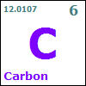
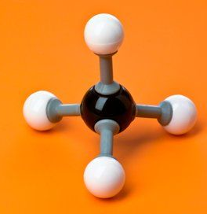
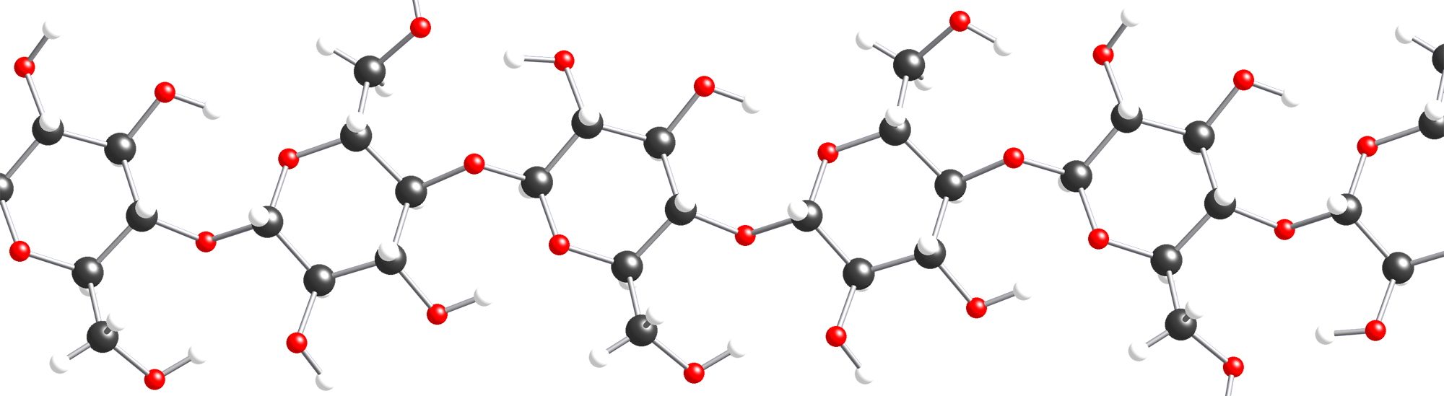
Carbon
Methane
Atomic number of 6.
  2 electrons in the 1st orbital and 4 remaining in the valance orbital.
  4 unpaired will form 4 covalent bonds
By bonding with other carbons in chains, rings, single, double and triple bonds, carbon, it can make all sorts of molecules

Slide 17
7. Use the diagram below to answer the question.
Chemical Reaction
HO – 1 – 2 – 3 – H + HO – 4 - H
HO – 1 – 2 – 3 – 4 – H + H₂O
The diagram shows a reaction that forms a polymer from two monomers.
What is this type of reaction called?
Glycolysis
Hydrolysis
Photosynthesis
Dehydration synthesis

Slide 18
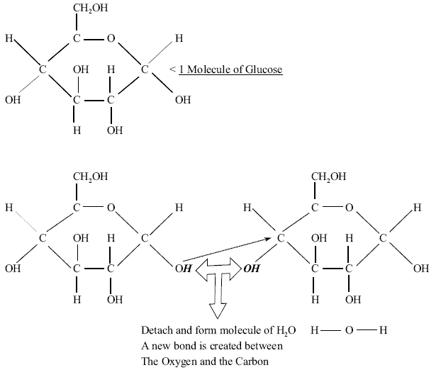
This is dehydration synthesis. During this type of reaction, a water molecule is removed (an –OH from one simple monomer and an –H from another to form a water molecule. This joins two monomers together to form a polymer. When adding another monomer to the dimer, another water molecule needs to be removed.
Monomer called Glucose
Dimer called Maltose

Slide 19
8. Carbohydrates and proteins are two types of macromolecules, which functional characteristic of proteins distinguishes them from carbohydrates?
Large amount of stored information
Ability to catalyze biochemical reactions
Efficient storage of usable chemical energy
Tendency to make cell membranes hydrophobic.

Slide 20
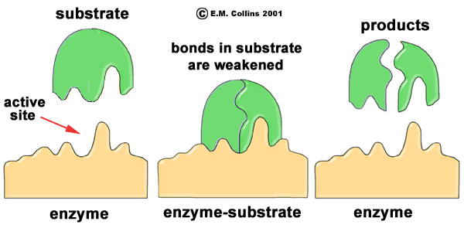
Enzymes
Enzymes are proteins, which are biological catalysts.
They decrease activation energy, allowing a chemical reaction to happen in an organism’s body at a suitable temperature and time rate
They enter into a reaction at an Active site to form an Enzyme/Substrate complex

Slide 21
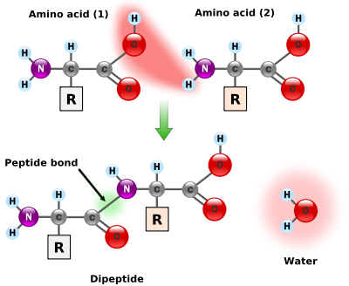
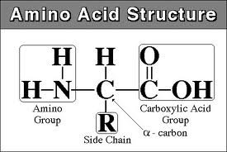
Proteins are a major part of every living cell and have many different functions within each cell. Carbohydrates also perform numerous roles in living things.
Part A: Describe the general composition of a protein molecule.
A protein is a polymer of amino acids. When amino acids are joined by dehydration synthesis (a process that removes water to form a chemical bond), they form peptide bonds.
There are three main components of an amino acid, shown below.
A dipeptide formed by the removal of water
There are three main components of an amino acid, shown below.

Slide 22
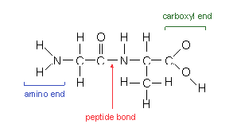
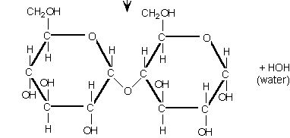
Part B: Describe how the structures of proteins differ from the structures of carbohydrates.
Proteins are made up of the elements C,H,O, and N while carbohydrates only contain C,H, and O (elemental ratio of these three is 1:2:1)
Carbohydrates do not contain peptide bonds formed during dehydration synthesis (also known as a condensation reaction)
Carbohydrate
Protein

Slide 23
Part C: Describe how the functions of proteins differ from the functions of carbohydrates.
Carbohydrates are our essential energy molecules to be use almost immediately (simple sugars like glucose) or stored in the liver as glycogen.
Proteins are building and regulatory compounds (such as hormones and enzymes). Muscles and cell membranes contain proteins

Slide 24
10.) Substance A is converted to substance B in a metabolic reaction. Which statement best describes the role of an enzyme during this reaction?
A.) It adjusts the pH of the reaction medium.
B.) It provides energy to carry out the reaction
C.) It dissolves substance A in the reaction medium
D.) It speeds up the reaction without being consumed.

Slide 25
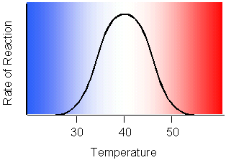
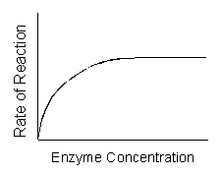
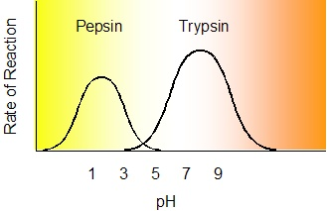
Enzymes are organic catalysts which regulate the rate of a reaction. They allow reactions to take place under conditions that will not damage a cell.
Enzymes are reusable. They do not break down under normal conditions.
  Regulated by temperature, concentration and pH.

Slide 26
11.) A scientist observes that, when the pH of the environment surrounding an enzyme is changed, the rate the enzyme catalyzes a reaction greatly decreases. Which statement best describes how a change in pH can affect an enzyme?
A pH change can cause the enzyme to change its shape
A pH change can remove energy necessary to activate an enzyme
A pH change can add new molecules to the structure of the enzyme
A pH change can cause an enzyme to react with a different substrate

Slide 27
Enzymes
Think of an enzyme like a puzzle piece or a key. If extreme heat is added to it, it will burn or melt, changing its shape. The area where the enzyme reacts with the substrate is called the active site. If the active site is altered, it can no longer function
This change in shape is
called denaturing.

Slide 28
12.) Using a microscope, a student observes a small, green organelle in a plant cell. Which energy transformation most likely occurs first within the observed organelle?
A.) ATP to light
B.) light to chemical
C.) heat to electrical
D.) chemical to chemical

Slide 29
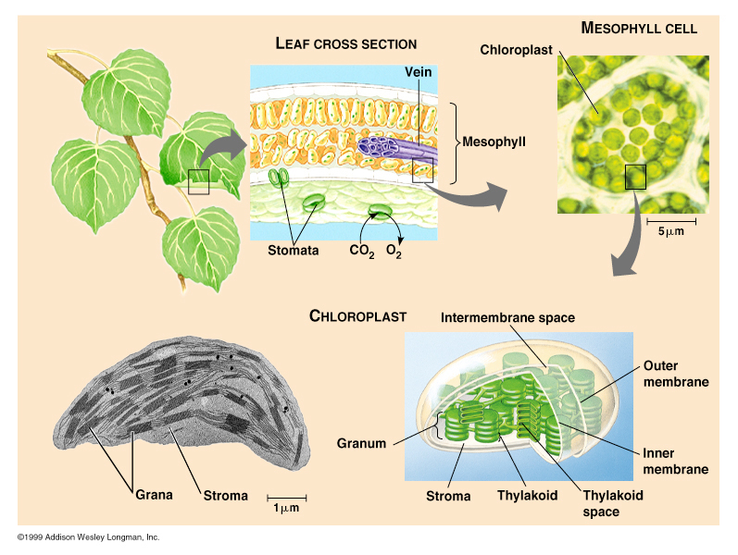
Photosynthesis
Is the process whereby organisms convert light energy into chemical bond energy of glucose
It occurs in the Chloroplasts of plant cells

Slide 30
Photosynthesis vs Respiration
Think of Photosynthesis like baking a cake. The plant takes raw material (CO2 and H20) and uses light energy to make Glucose (and releases O2 in the process)
Respiration is the process whereby organisms break down glucose to provide energy to all life processes
Breaks down glucose (sometimes with O2 and others without it), transfers energy to a small energy transferring compound called ATP
Think of Respiration like burning the cake. Energy is released from the bonds of glucose to be stored as ATP.
All plants (photosynthetic organisms) undergo both Photosynthesis (only in the presence of light) and Respiration (all of the time)
All living organisms must go through respiration 24/7

Slide 31
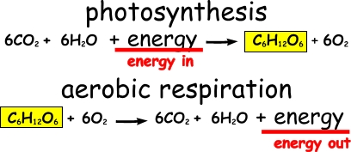
13.) Photosynthesis and cellular respiration are two major processes of carbon cycling in living organisms. Which statement correctly describes one similarity between photosynthesis and cellular respiration?
A) Both occur in animal and plant cells.
B) Both include reactions that transform energy.
C) Both convert light energy into chemical energy.
D) Both synthesize organic molecules as end products.—

Slide 32
14.) A protein in a cell membrane changed its shape to move sodium and potassium ions against their concentration gradients. Which molecule was most likely used by the protein as an energy source?
A) ATP
B) ADP
C) Catalase
D) Amylase

Slide 33
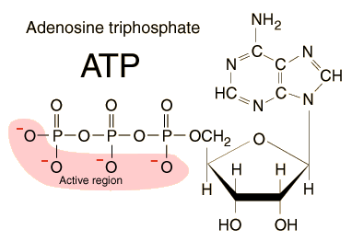
ATP – Temporary energy storage molecule
ATP is a readily usable form of chemical energy. By breaking off the 3rd phosphate (ATP = adenosine triphosphate), energy is release to allow reactions to happen, such as changing the shape of a protein

Slide 34
15.) Use the diagrams below to answer the question.
Energy in
Photosynthesis
Energy out
Respiration
Energy out
Energy in
Part A: Complete the chart below by describing energy transformations involved in each process.

Slide 35
Process | Energy Transformations
Photosynthesis | CO₂ and H₂O are transformed using the energy from sunlight to create C₆H₁₂O₆ and O₂. The captured and used energy is stored in the chemical bonds of glucose (C₆H₁₂O₆)
Cellular Respiration | O₂ and C₆H₁₂O₆ are broken down with a small amount of invested energy to form CO₂ + H₂O and a large amount of ATP which is the energy storage molecule of living things

Slide 36
Part B : Describe how energy transformations involved in photosynthesis are related to energy transformations involved in cellular respiration.
They are, in essence, the reverse of each other. The products of photosynthesis become the reactants for cellular respiration, and the opposite is true.

Slide 37
16.) Carbon dioxide and oxygen are molecules that can move freely across a plasma membrane. What determines the direction that carbon dioxide and oxygen molecules move?
A) Orientation of cholesterol in the plasma membrane.
B) Concentration gradient across the plasma membrane.
C) Configuration of phospholipids in the plasma membrane.
D) Location of receptors on the surface of the plasma membrane.

Slide 38
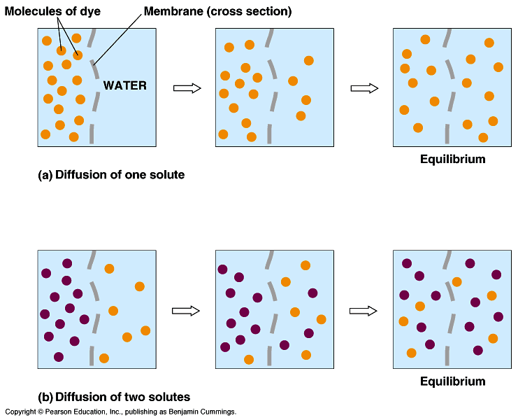
Transport through a membrane by Diffusion
Diffusion is the movement of molecules from an area of high concentration to that of a lower concentration
If the concentration of CO₂ or O₂ is too high on one side of the membrane, then the molecules would not freely be able to move from an area of high concentration to an area of low concentration

Slide 39
17.) A sodium-potassium pump within a cell membrane requires energy to move sodium and potassium ions into or out of a cell. The movement of glucose into or out of a cell does not require energy. Which statement best describes the movement of these materials across a cell membrane?
A) Sodium and potassium ions move by active transport, and glucose moves by osmosis.
B) Sodium and potassium ions move by active transport, and glucose moves by facilitated diffusion.
C) Sodium and potassium ions move by facilitated diffusion, and glucose moves by osmosis.
D) Sodium and potassium ions move by facilitated diffusion, and glucose moves by active transport.

Slide 40
Why B is correct
Due to the fact that they are highly charged molecules (and “hate” the nonpolar cell membrane and can’t pass through it) and are trying to move against a concentration gradient (from low → high), sodium and potassium ions require a protein and energy to move across the cell membrane. Glucose is a large enough molecule (and polar), so it needs the ‘help’ of a protein to move it along (facilitated diffusion)

Slide 41
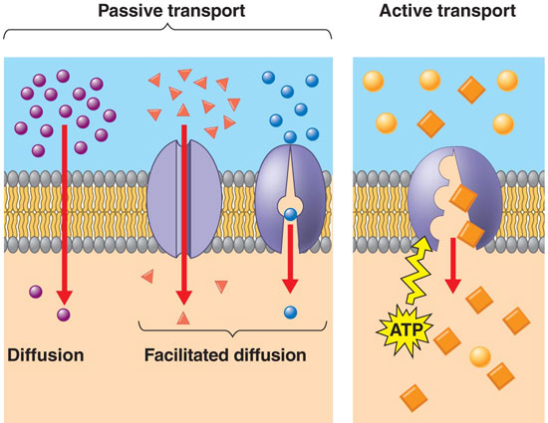
Types of Transport across a membrane
Passive – by diffusion or osmosis (if water)
  No energy is needed.
  Driven by concentration gradient
Facilitated Diffusion – movement across a membrane with the help of carrier proteins.
  No energy is needed
  Still driven by the concentration
Active transport – energy is needed to go from an area of low concentration to a more concentrated area

Slide 42
18.) Some animals can produce a potassium ion concentration inside their cells that is twenty times greater than that of their environment. This ion concentration gradient is maintained by the plasma membrane
Part A: Identify the process in the cell membrane that produces this difference in concentration.
The process is active transport (needs energy).
Part B: Explain the process that occurs as the cell produces the ion concentration gradient.
There are specialized proteins in the cell membrane that act like “pumps with a toll”. These pumps use ATP (small packets of energy) to power their transport of Na⁺ out of a cell, and K⁺ into the cell. Because different numbers of sodium ions and potassium ions are pumped back and forth, it creates an electrical gradient where one side of the cell is more positive than the other side

Slide 43
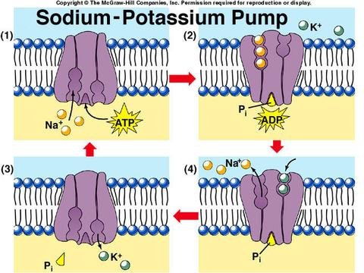
Sodium-Potassium Pump

Slide 44
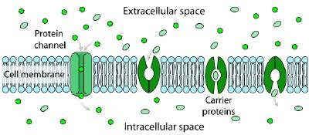
Part C: Compare the process of potassium ion transport to another mechanism that moves material across the plasma membrane.
Active transport is specific and also uses energy, which is the key distinction, as opposed to facilitated diffusion which is also specific to a molecule (or ion) but does not require energy. An example would be glucose is too big to pass through the cell membrane on its own, but can do so the with help of a specific protein.

Slide 45
19.) The rough endoplasmic reticulum and Golgi apparatus work together in eukaryotic cells. What is one way that the rough endoplasmic reticulum assists the Golgi apparatus?
It assembles nucleic acids from monomers.
It breaks down old damaged macromolecules.
It packages new protein molecules into vesicles.
It determines which protein molecules to synthesize.

Slide 46
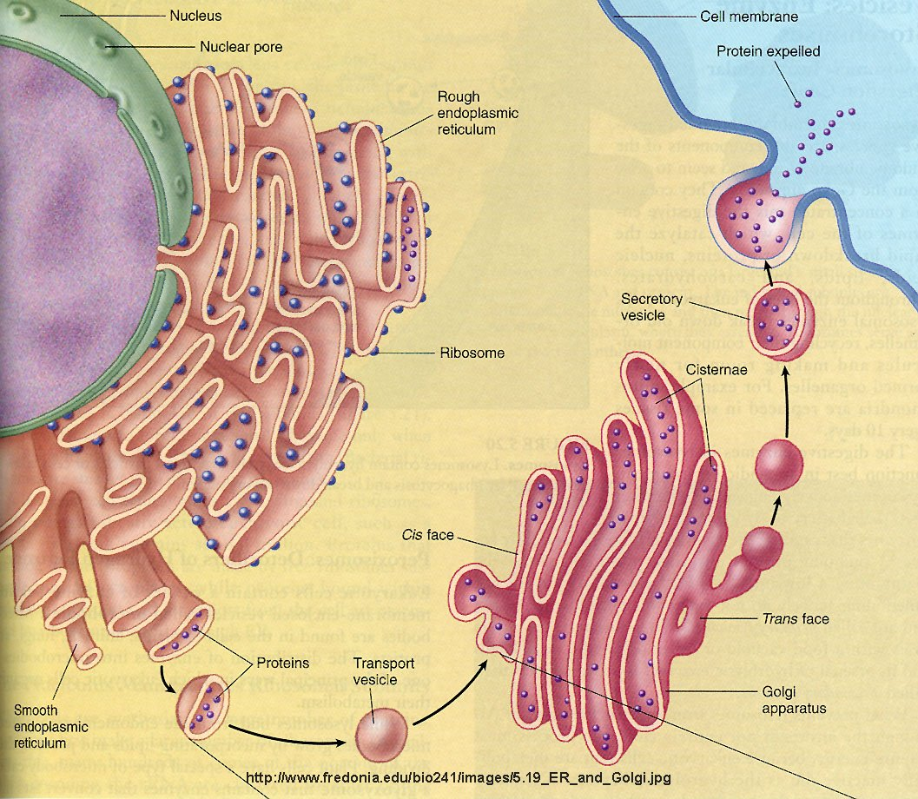
Protein Synthesis
Proteins are code for by genes on DNA.
mRNA “reads” the gene and carries the message to the ribosomes either free in the cytoplasm or attached to the endoplasmic reticulum (Rough endoplasmic reticulum if they have ribosomes on them)
At the ribosomes on the RER, DNA’s message gets uncoded and Proteins are produced (with the help of tRNA transfering amino acids (the building units of proteins) to the ribosomes
The proteins produced will be transport to the Golgi apparatus which will package the proteins and
export proteins to the cell or other cells.
2
1
4
3

Slide 47
20.) Which example is an activity that a fish most likely uses to maintain homeostasis within its body?
A.) Using camouflage to avoid predators.
B.) Feeding at night to regulate body temperature.
C.) Moving to deeper water to regulate metabolic wastes
D.) Exchanging gases through its gills to regulate oxygen levels.

Slide 48
O₂ is needed for cellular respiration to provide energy for the organism. At the gills, O₂ and CO₂ are exchanged. If CO₂ is present, the amount of O₂ will change to stay regulated.

Slide 49
21.) Use the illustration below to answer the question.
Which statement best describes the phase of the cell cycle shown?
The cell is in prophase of mitosis because the number of chromosomes has doubled.
The cell is in prophase I of meiosis because the number if chromosomes has doubled.
The cell is in telophase of mitosis because the cell is separating and contains two copies
of each chromosome.­
D. The cell is in telophase of meiosis because the cell is separating and contains two copies
of each chromosome.

Slide 50
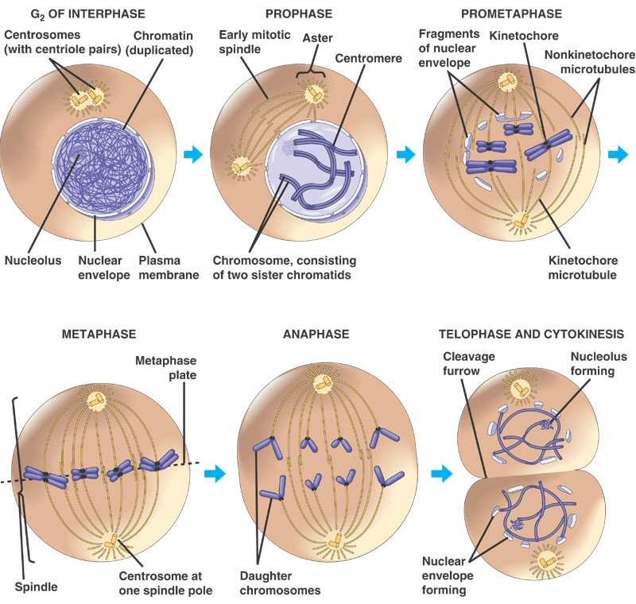
Cell Division (Mitosis)
Cell division results in two identical daughter cells.
The process of cell divisions occurs in three parts:
Interphase - duplication of chromosomes and preparing the nucleus for division
Mitosis – organized division of the nucleus into two identical nuclei
Cytokinesis- division of the cell and cellular contents into two identical daughter cells
Animation

Slide 51
22.) Mitosis and meiosis are processes by which animal and plant cells divide. Which statement best describes a difference between mitosis and meiosis?
Meiosis is a multi-step process.
B. Mitosis occurs only in eukaryotic cells.
Meiosis is used in the repair of an organism.
D. Mitosis produces genetically identical daughter cells.

Slide 52
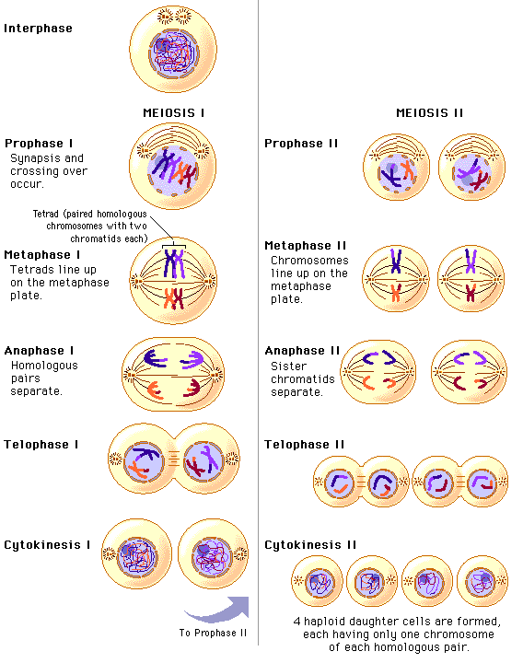
Meiosis
Meiosis occurs during the formation of sex cells (sperm and egg). It is necessary so that the sex cells only have half the number of chromosomes (23 in us) so that at fertilization, the normal chromosome number is returned (46 in us)
Meiosis involves two divisions. It begins with the replication of the chromosomes, divides up the cell into two cells, then divides again (without replication) into 4 genetically different sex cells with half the normal number of chromosomes

Slide 53
23.) Patau syndrome can be a lethal genetic disorder in mammals, resulting from chromosomes failing to separate during meiosis.
Part A: Identify the step during the process of meiosis when chromosomes would most likely fail to separate.
Most likely chromosomes would fair to separate during anaphase I or Anaphase II. In anaphase, chromosomes (anaphase I) or sister chromatids (anaphase II) are supposed to separate, or move AWAY from each other. This is called Nondisjunction.
Part B: Describe how chromosome separation in meiosis is different from chromosome separation in mitosis.
During meiosis cells and the genetic material is divided twice (the first set of division is meiosis I and the second set is meiosis II). In mitosis, the cell and chromosomes divide once.

Slide 54
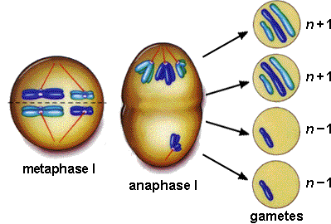
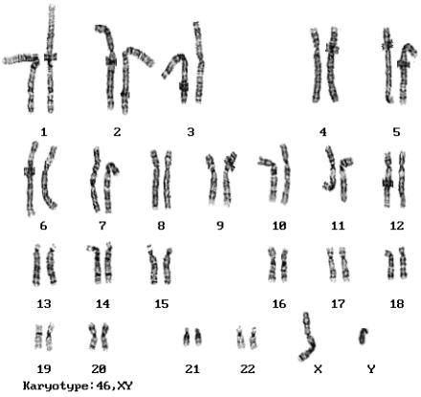
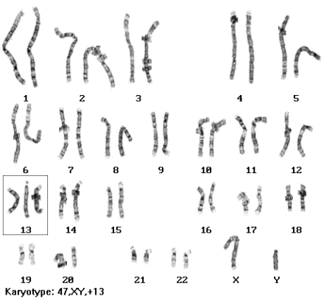
Nondisjunction and Patau’s syndrome
Nondisjunction
Karyotype of a normal male
Karyotype of a Patau’s male (notice chromosome #13 has three chromosomes instead of two

Slide 55
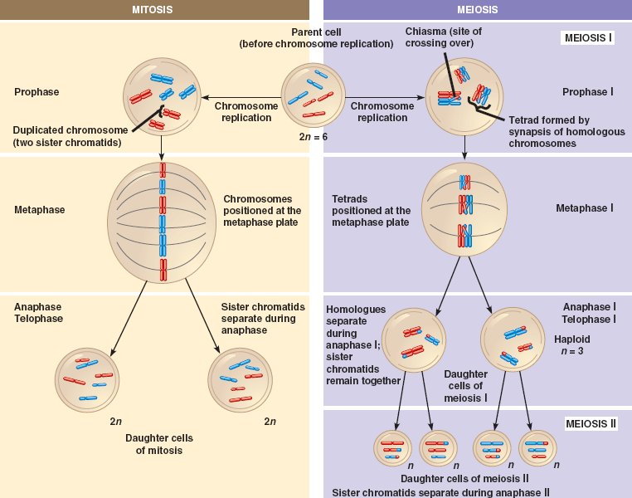

Slide 56
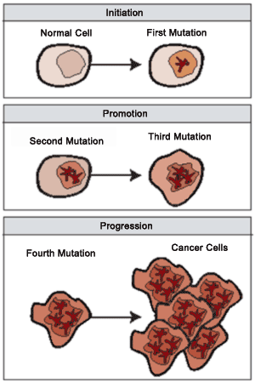
Part C: Compare the effects of a disorder caused by chromosomes failing to separate during meiosis, such as Patau syndrome, to the effects of chromosomes failing to separate during mitosis.
Due to the improper number of chromosomes, the organism has an improper amount of genetic material in the form of DNA of the sperm or egg. This mutation will be found in every cell of the organism’s body.
If chromosomes fail to separate during mitosis, it does not affect the sex cells but a body cell. This mutant body cell then can be reproduced and produce more of the abnormal cells. The cell either dies or is replicated quickly. This could possibly lead to cancer if the cells are not destroyed by the immune system.

Slide 57
24.) Which process helps to preserve the genetic information stored in DNA during DNA replication?
A.) The replacement of nitrogen base thymine with uracil.
B.) Enzymes quickly linking nitrogen bases with hydrogen bonds.
C.) The synthesis of unique sugar and phosphate molecules for each nucleotide.
D.) Nucleotides lining up along the template strand according to base pairing rules.

Slide 58
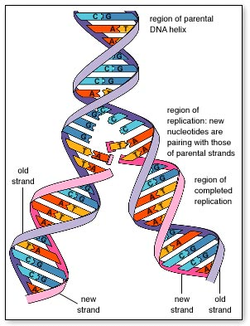
DNA Replication
This is key for DNA replication. DNA (a double stranded molecule) splits into two halves, and each half serves as a “template” or pattern to build the new half.
The result is two identical strands of DNA
  Adenine always pairs with Thymine (straight line letters AT go together) and Guanine always pairs with Cytosine (curvy letters GC go together)

Slide 59
25.) In a flowering plant species, red flower color is dominant over white flower color. What is the genotype of any red-flowering plant resulting from this species?
Red and white alleles present on one chromosome.
Red and white alleles present on two chromosomes.
A red allele present on both homologous chromosomes
A red allele present on at least one of two homologous chromosomes.

Slide 60
Genetics
Dominant traits are represented by capital letters, while recessive (non-dominant traits) are represented by lower case letters.
  Each parent has two copies of the gene, so they will get two letters. The different letters represent the different alleles (flower pedal color) of a trait.
  Since white is the recessive trait, in order to have white petals, the flower has to be ff or pure for the white trait.
  Since red color is dominant, the red parent could be Ff or FF since it shows red petals. It is either pure for the red trait or a hybrid for red.
When the dominant trait shows, only one allele (form of the gene) must be present to show the trait.

Slide 61
26. Use the table below to answer the question.
Genotype(s) | Phenotype
ii | O
I^{A}I^{A}, I^{A}i | A
I^{B}I^{B}, I^{B}i | B
I^{A}I^{B} | AB
Blood type is inherited through multiple alleles, including I^{A}, I^{B}, and i. A child has type A blood. If the father has type AB blood, what are all the possible phenotypes of the mother?
Phenotypes O or A
Phenotypes A or AB
Phenotypes A, B, or AB
Phenotypes O, A, B, or AB

Slide 62
Blood Type
The father must give his I^{A} allele or else the child would not have type A
The mother could be any of the blood types.
If the mother is O she has ii, either of these could produce a child with type A
If the mother has A should could have the genotype I^{A}i or I^{A}I^{A}, if the child inherits i or I^{A} it will have type A
If the mother has B should could have the genotype I^{B}i, she could give the i allele and the child will have type A blood.
If the mother is AB she would have to give the I^{A} allele so the child will have type A

Slide 63
27. A cattle farmer genetically crosses a cow (female) with a white coat with a bull (male) with a red coat. The resulting calf (offspring) is roan, which means there are red and white hairs intermixed in the coat of the calf. The genes for coat color in a cattle are codominant.
Part A: Although a farm has cattle in all three colors, the farmer prefers roan cattle over white or red cattle. Use the Punnett square to show a cross that would produce only roan offspring.
Part B: Explain how a roan calf results from one white and one red coated parent. In your explanation, use letters to represent genes. Be sure to indicate what colors the letter represent.
Part C: Predict the possible genotypes and phenotypes of the offspring produced from two roan cattle.

Slide 64
Codominant Inheritance
Part A
 | R | R
R’ | RR’ | RR’
R’ | RR’ | RR’
Part B:
In cattle, R is the red allele and R’ is the white allele. Since this is a codominant trait, when both alleles are present, both are expressed in the phenotype, this makes the color roan. A white cow must have the genotype R’R’ and a red bull must have the genotype RR. Since each parent is homozygous, they can only pass on one allele for red and one allele for white, creating roan offspring.

Slide 65
Codominant Inheritance
Part C:
If you do a Punnett square, you will find 25% of the offspring will be red, 50% will be roan, and 25% will be white.
 | R | R’
R | RR | RR’
R’ | RR’ | R’R’

Slide 66
28. Use the diagram below to answer the question. Which type of change in chromosome composition is illustrated in the diagram?
Deletion
Insertion
Inversion
Translocation

Slide 67
Chromosome Changes
The chromosome change seen in this diagram is translocation because a portion of DNA is being swapped between two chromosomes.

Slide 68
29. Which statement describes a cell process that is common to both eukaryotic and prokaryotic cells?
Both cell types carry out transcription in the nucleus
Both cell types use ribosomes to carry out translation
Both cell types assemble amino acids to carry out transcription
Both cell types carry out translation in the endoplasmic reticulum

Slide 69
Transcription/Translation in Pro and Eu Cells
Prokarytic cells do not have a nucleus or other membrane-bound organelles.
Both eukaryotic and prokaryotic cells have ribosomes that make proteins.

Slide 70
30. The endoplasmic reticulum is a network of membranes within the cell, and it is often classified as rough or smooth, depending on whether there are ribosomes on its surface. Which statement best describes the role of rough endoplasmic reticulum in the cell?
It stores all proteins for later use
It provides an attachment site for larger organelles
It aids in the production of membrane and secretory proteins
It stores amino acids required for the production of all proteins

Slide 71
Rough ER and Ribosomes
Ribosomes that are attached the rough ER produce proteins that are destined to be exported from the cell
Proteins that can be found in the plasma membrane are considered exports
Free-floating ribosomes in the cytoplasm produce proteins that are meant to stay and be used inside the cell

Slide 72
31. A genetic mutation resulted in a change in the sequences of amino acids of a protein, but the function of the protein was not changed. Which statement best describes the genetic mutation?
It was a silent mutation that caused a change in the DNA of the organism
It was a silent mutation that caused a change in the phenotype of the organism
It was a nonsense mutation that caused a change in the DNA of the organism
It was a nonsense mutation that caused a change in the phenotype of the organism

Slide 73
DNA Mutations
A nonsense mutation alters the DNA so that the resulting amino acid sequence is unrecognizable and may create a nonfunctioning protein.
A silent mutation alters the DNA so that the amino acid sequence does not change or the changed amino acid does little to affect the overall protein structure.

Slide 74
32. Genetic engineering has led to genetically modified plants that resist insect and bacterial and fungal infections. Which outcome would most likely be a reason why some scientists recommend caution in planting genetically modified plants?
Unplanned ecosystem interactions
Reduced pesticide and herbicide use
Improved agricultural yield and profit
Increased genetic variation and diversity

Slide 75
GMOs
The biggest threat to using GMOs in agricultre is the possible interactions the organism will have with other organisms in the environment. If the plant were to fertilize a non-GMO plant, the genes could become part of the environment and potentially upset the ecosystem but preventing natural bacteria, fungus, and insects from living where they naturally occur (on plants)

Slide 76
33. Use the circle graphs below to answer the question. The graphs illustrate change in a lizard population over time. Which process most likely led to the change in the lizard population?
natural selection for a trait that is beneficial to lizards
natural selection against a trait that is beneficial to lizards
artificial selection for a trait that is beneficial to lizards
artificial selection against a trait that is beneficial to lizards

Slide 77
Natural vs. Artificial Selection
Artificial selection would be the selection for a trait that is beneficial to humans, not necessarily the organism we are breeding.
Natural selection is the selection of a trait that would lead to increased fitness of the individual (the individual would survive longer and be able to produce more offspring)

Slide 78
34. In North America, the eastern spotted skunk mates in late winter, and the western spotted skunk mates in late summer. Even though their geographic ranges overlap, the species do not mate with each other. What most likely prevents these two species from interbreeding?
Habitat isolation
Gametic isolation
Geographic isolation
Reproductive isolation

Slide 79
Mechanisms for Speciation
This is an example of reproductive isolation because these two species are never given the opportunity to produce offspring.
They live in the same region and could produce offspring if they were to mate at the same time of the year.

Slide 80
35. A mutation occurs in the genes that code for coat color in deer. Which change will most likely result from this mutation?
A change in the selection pressures acting on coat color.
A change in the coat-color genes of deer predator species.
An increase in coat-color diversity in the population.
An increase in the number of genes for coat color in the population

Slide 81
Mutations
From the wording of the question, you would have to assume that coat color in deer in controlled by only one gene.
Genes can only control what the organisms looks like, not what is the best fit for the environment.
Adding another coat color to the population would increase the diversity

Slide 82
36. Use the illustration below to answer the question. The skeletons of mammalian forelimbs represent variations of a structure that was present in their common ancestor. What has most likely caused the variation in forelimbs?
Changes in muscle structure
Changes in the genetic codes
Trait formation due to behaviors
Development of vestigial structures

Slide 83
Forelimbs
The similarity in structure of all the mammalian forelimbs can be attributed to the fact that we all evolved from a common ancestor that had a similar forelimb structure.
Over time, these structures may change in order to best suit the environment the organism is living in

Slide 84
37. Use the table below to answer the question. The gene COII is the genome of many organisms. A comparison of the number of base differences between the COII gene in a rat and that of two other animals is shown.
Part A: Based on the data, describe a possible evolutionary relationship between rats, mice, and cow.
Part B: Describe how different organisms having a common gene, such as COII, supports the theory of evolution.

Slide 85
Part C: The COII gene of a monkey has 203 base differences from the same gene in a rat and 210 base differences from the same gene in a mouse. Compare the evolutionary relationships between the monkey, the rat and the mouse.

Slide 86
Inferring Evolutionary Relationships
Part A: The fewer the number of base differences, the more closely related two organisms are. The mouse and the rat have the fewest number of differences (101), therefore they are more closely related to one another than the rat is to the cow.
Part B: The fact that many organisms use the same protein suggests that we all are descendant from a common ancestor. It would be highly unlikely that different species evolved to use the same proteins to carry out the same functions in the body unless they shared a common ancestor. The common ancestor used the COII protein and when it branched into other species, those species continued using the protein.

Slide 87
Inferring Evolutionary Relationships
Part C: The rat and the monkey have fewer differences than the monkey and the mouse. Therefore, the rat and the monkey are more closely related than the mouse and the monkey.

Slide 88
38. Use the table below to answer the question. A group of students measured a ten-square-meter section of a pond ecosystem and recorded observations. Which statement is a testable hypothesis?
The frogs living in the pond represent a population
Water is an abiotic component in the pond ecosystem.
If the fish are given more food, then they will be happier.
If the frogs are startled, then they will jump into the water.

Slide 89
39. Use the list below to answer the question. A student wrote several observation in a field notebook. Which term best classifies all of the student’s observations?
Observations
Two grey wolves
five moose
several species of conifer trees
large granite rock
shallow pond
Population
Food chain
Ecosystem
community

Slide 90
Observations
The addition of the granite rock and shallow pond makes this list of living and nonliving things.
A population consists of only one species, a food chain only includes living individuals, and a community includes all living things.

Slide 91
40. A researcher observing an ecosystem describes the amount of sunlight, precipitation, and type of soil present. Which factors is the researcher most likely describing?
biotic factors in a forest
biotic factors in a tundra
abiotic factors in a prairie
abiotic factors in an ocean

Slide 92
Biotic vs. Abiotic
All the things being described are nonliving (Abiotic)
The addition of soil would indicate this ecosystem is terrestrial (found on land)
The only option that meets both these criteria is a prairie

Slide 93
41. Use the diagram below to answer the question. Which sequence correctly describes the flow of energy between organisms in the marine food web?
from seals to penguins to krill
from whales to drill to small fish
from sea birds to seals to
penguins
from small fish to penguins to seals

Slide 94
Food Webs
The arrows on the food web indicate the movement of the energy.
The energy in a food web begins with the primary consumer, in this case, krill.
The correct sequence for this food web is from small fish, to penguins, to seals.

Slide 95
42. A species of snapping turtles has a tongue that resembles a worm. The tongue is used to attract small fish. Which best describes the interaction between the fish and the snapping turtle.
Predation
Symbiosis
Parasitism
Competition

Slide 96
Symbiosis
Symbiosis describes any relationship between two species.
The turtle is using its tongue to attract small fish in order to eat them. This is an example of predation.

Slide 97
43. Which statement correctly describes how nitrogen in the soil returns to the atmosphere?
Soil bacteria convert into nitrogen gas.
Decomposers directly convert ammonium into nitrogen gas.
Plants assimilate nitrites and convert them into nitrogen gas.
Nitrogen-fixing bacteria in plant roots convert nitrates into nitrogen gas.

Slide 98
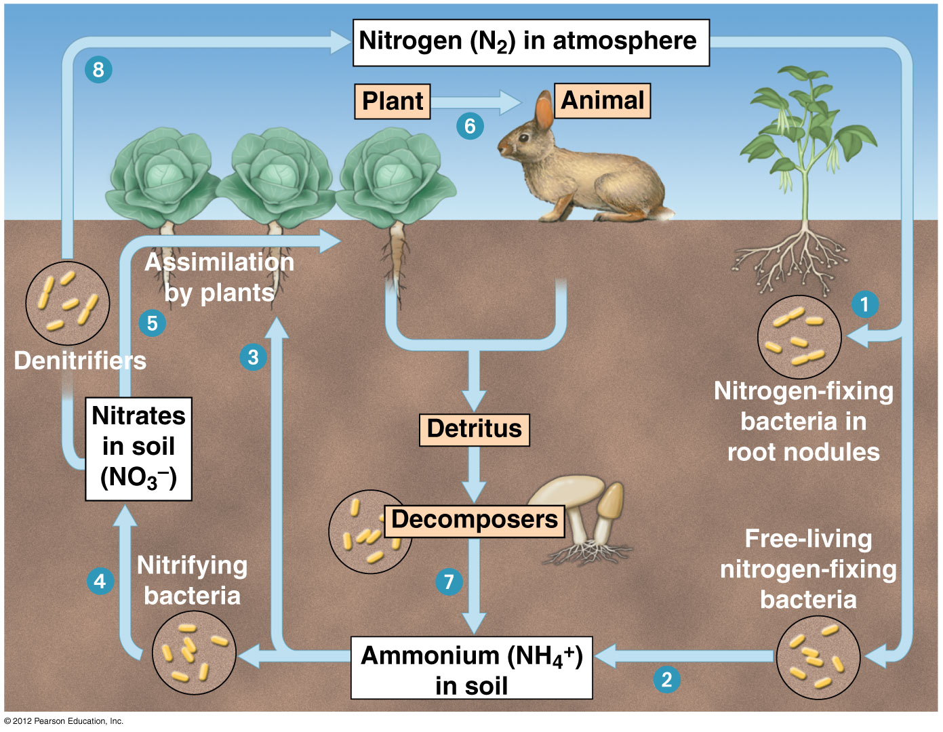
Nitrogen Cycle
If you recall the nitrogen cycle, only bacteria can convert nitrogen gas to a useable form, conversely, they are also the only organisms that can return it to the atmosphere.

Slide 99
44. Agricultural runoff can carry fertilizers into lakes and streams. This runoff can cause algae populations to increase. Which effect does this change in the algae population sizes most likely have on affected lakes and streams?
an increase in water level
an increase in water clarity
a reduction in dissolved oxygen needed by fish and shellfish
a reduction in temperature variations near the water’s surface

Slide 100
Algal Blooms
An increase in the algae population in a body of water is referred to as an algal bloom.
This is not good for the other organisms living in that type of ecosystem. The water is difficult to see through, and the algae use all the dissolved oxygen so fish can no longer breath

Slide 101
45. A farmer observed that an increase in a field’s soil nitrogen content was followed by an increase in producer productivity. What does this observation most likely indicate about the relationship between nitrogen and the producers in the field?
Nitrogen was a biotic factor.
Nitrogen was a limiting factor.
Nitrogen became a surplus resource.
Nitrogen became a selection pressure.

Slide 102
46. Use the graph below to answer the question. Isle Royale is located in Lake Superior. Isle Royale is home to populations of wolves and moose. The interactions between the wolves and moose, as well as the individual population sizes, have been studied since 1958. The graph shows the population sizes over time for both wolves and moose.
Part A: Describe one limiting factor for the moose population
Part B: Explain one likely reason why the wolf population rapidly increased between 1975 and 1980.
Part C: Predict what will happen to the moose population's size after 1994 by describing the shape of the curve. In your answer, be sure to explain the reasoning behind your prediction.

