Slide 1
Photosynthesis Light Reaction Details
Honors Biology
2015

Slide 2
Light Reaction pg. 116
Two Types of Photosystems (I and II) – PS I and PS II
Starts when accessory pigments in photosynthesis absorb light
Absorbing light ➔ ENERGY
The energy gets passed to chlorophyll molecules

Slide 3
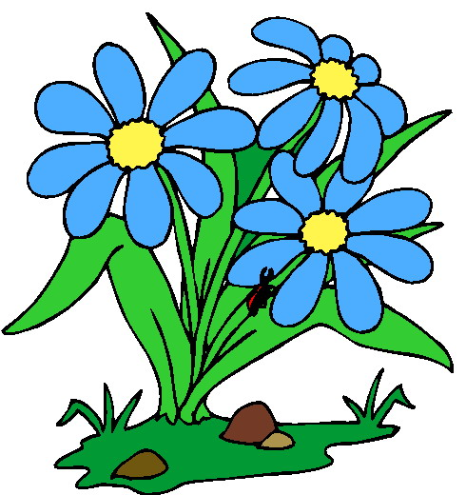
The Steps
Light energy forces electrons to enter a higher energy level in Photosystems II (excited e⁻), in chlorophyll a molecules.
Electrons then leave chlorophyll a molecules thus and oxidation reaction (loss of electrons) happens.
The acceptor of these reactions is called the primary acceptor and it is located in the thylakoid membrane.

Slide 4
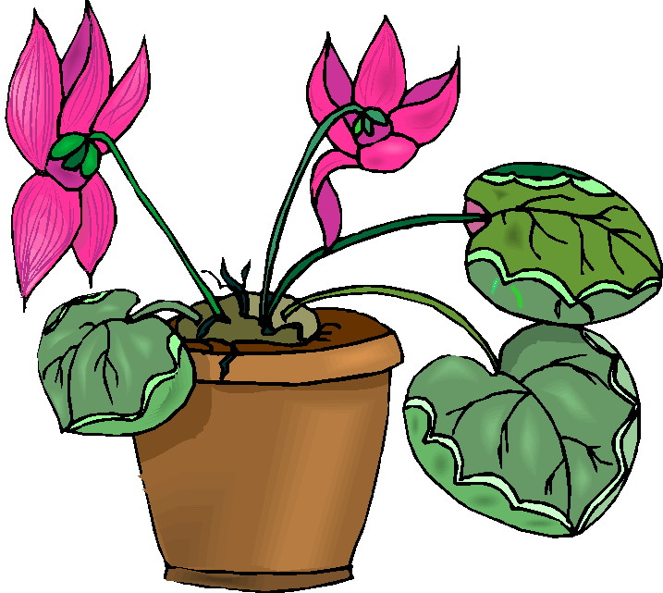
Steps Continued
The primary electron acceptor passes the electrons to other chlorophyll molecules in the electron transport chain (ETC) or system.
As electrons move from molecule to molecule, they loose energy
This energy is used to move (H+) into the thylakoid

Slide 5
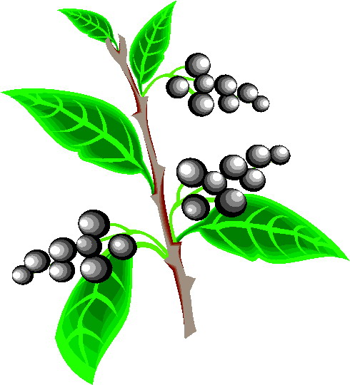
Steps Continued
Light is absorbed by photosystems I
Electrons move from chlorophyll to a primary electron acceptor
Electrons lost by these chlorophyll molecules are replaced by electrons that hae passed through the ETC of Photosystems II.
Electrons of PS I get passed to another ETC of PS I
The eletrons combine with a proton and NADP+ (electron acceptor)

Slide 6
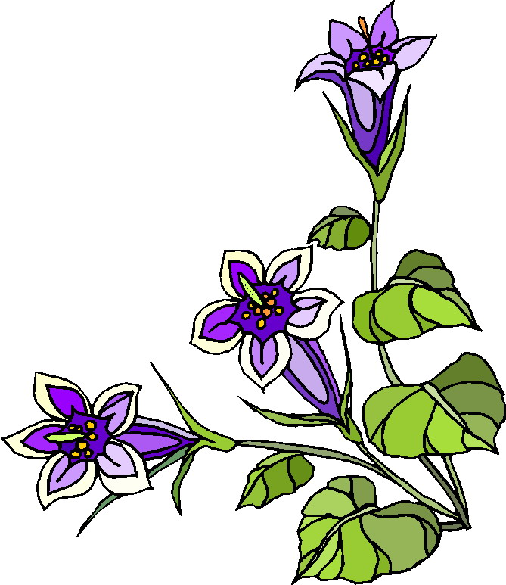
Steps Continued
NADP+ accepts electrons is reduced (gains electrons) and becomes NADPH
Draw Diagram

Slide 7
Replacing Electrons in Light Reaction
In step 4 chlorophyll molecules in PS II replaces e⁻ that leave chlorophyll molecules of PS I
Water molecules are split into photons, electrons and oxygen. These e⁻ replace those lost in PS I
DRAW DIAGRAM

Slide 8
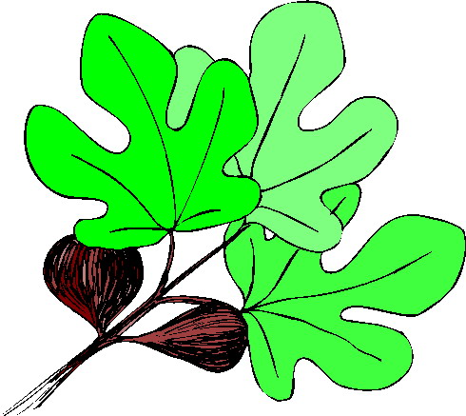
Making ATP in the Light Reaction
CHEMIOSMOSIS – relies on a concentration gradient of protons across the thylakoid membrane.
Recall protons (H+) are produced from splitting of water in the thylakoid membrane.
More protons are pumped from stroma to thylakoid
Protons build up causing a concentration gradient – The protons are more in the thylakoid then in the stroma.

Slide 9
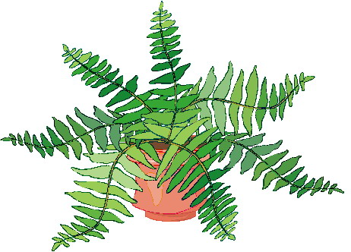
Chemiosmosis Steps
The concentration gradient represents potential energy
Energy is used by ATP synthase and enzyme that drives the reaction that adds a phosphate (P) to ADP making ATP.
The energy that drives this reaction is provided by the movement of H+ (protons) from inside the thylakoid to the stroma from high concentration to low concentration.
FINALLY
Both NADPH and ATP are the energy used to drive the Calvin Cycle. Which make glucose for the plants.

Slide 10
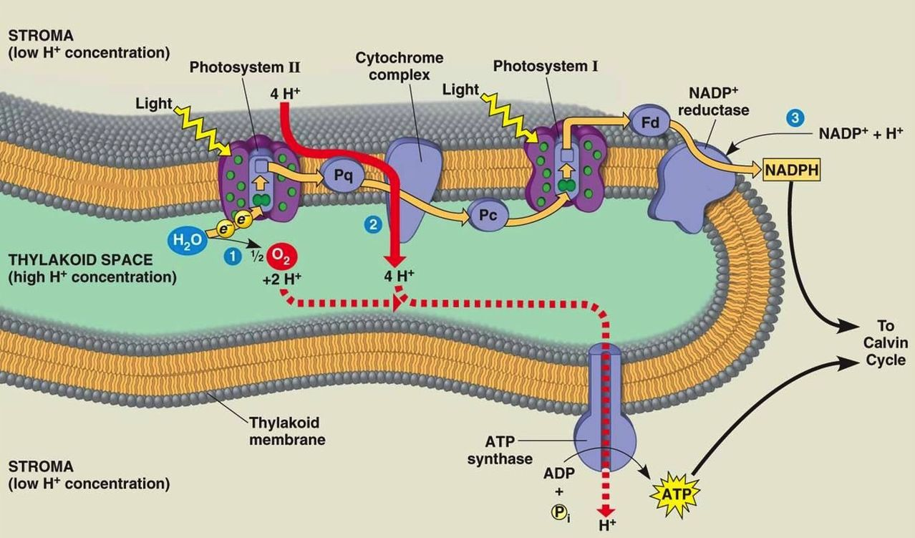

Slide 11
THE END

