Slide 1
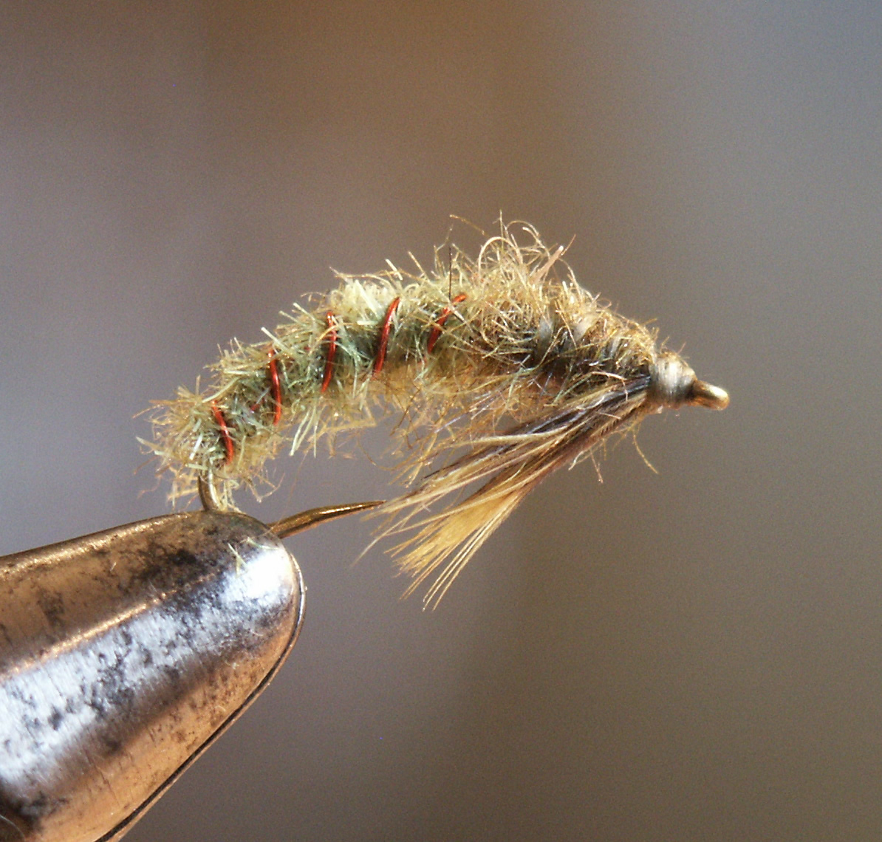
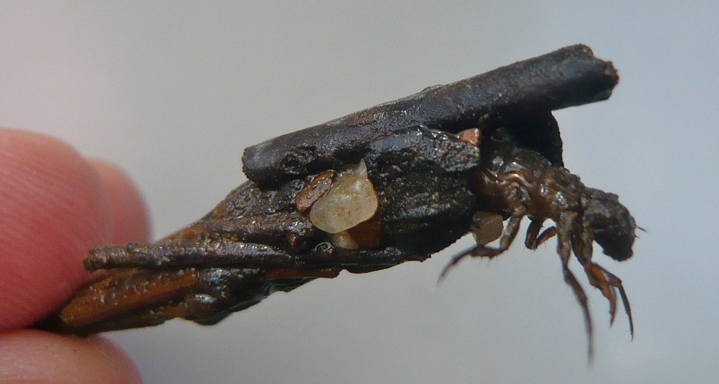
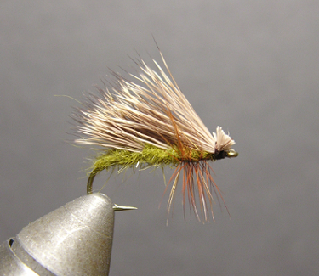
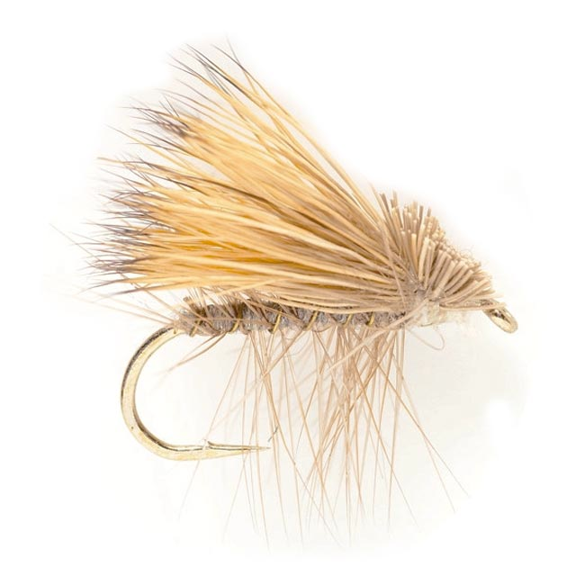
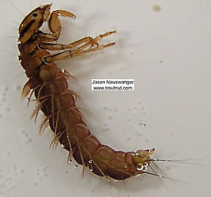
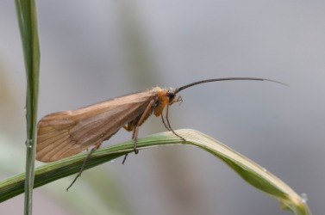
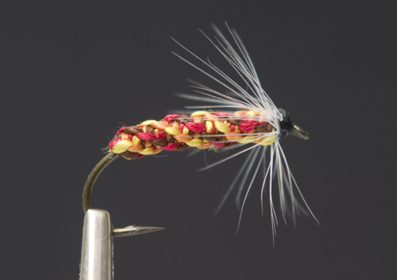
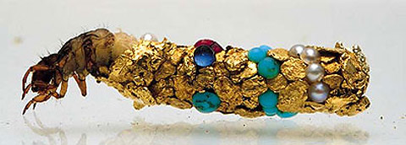
Macroinvertebtates

Slide 2
Macroinvertebrates
Who
Macro -> “large”; invertebrate -> “without backbone”
Easily seen with the naked eye
Benthic Macroinvertebrates live on the streambed
What/ Where
Insects (dragonfly nymph) and crustaceans (crayfish) that live and crawl along rocky bottoms in high oxygenated riffles
When
Live in the water for over a year before full maturation*
Collection in Spring* and Autumn

Slide 3
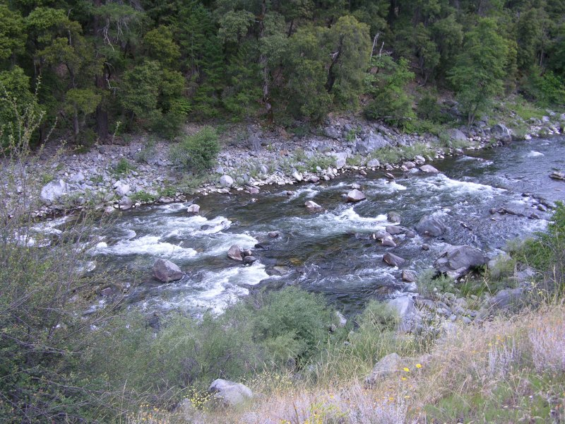
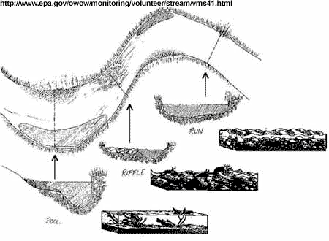
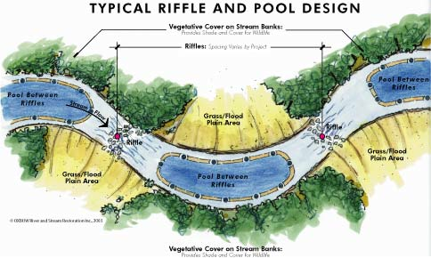

Slide 4
Why Good “snapshot” of water quality - May indicate if a problem exists and further data collection and analysis are needed Live in aquatic ecosystem for over one year Cannot easily escape changes in water quality Can be collected very easily How Pollution Sensitive Macros -> found only in good quality water Pollution Tolerant Macros -> found in good to poor water Higher Biodiversity indicates better stream quality

Slide 5
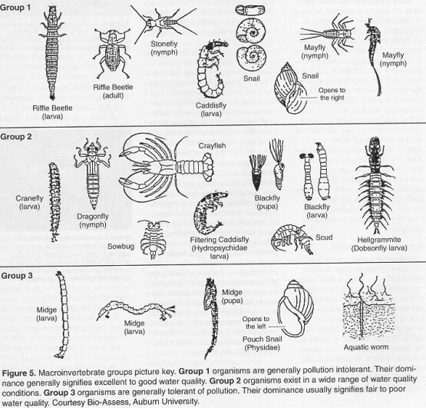

Slide 6
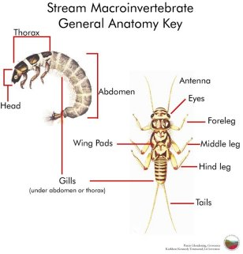

Slide 7
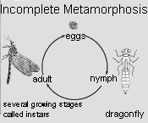
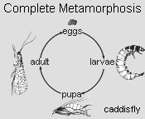
Life cycles
Water
Water
Land
Water
Land
Caddisflies (Trichoptera)
Aquatic Flies & Mosquitoes (Diptera)
Fishfly, Dobson Fly, Alderfly (Megaloptera)
Water Beetle (Coleoptera)
Spongillafly (Neuroptera)
Aquatic Moths (Lepidoptera)
Mayflies (Ephemeroptera)
Dragonflies & Damselflies (Odonta)
Stoneflies (Plecoptera)
Surface Bugs (Hemiptera)

Slide 8
Collection for Biotic Index Calculation
Keeping in mind the classes of macroinvertebrates, you will use a net (see demonstration) to collect samples from the stream
Then you will determine which Class or Group the organisms fit into (1, 2, 3 or 4)
**you have a reference sheet to do this
Biotic Index estimates/forecasts stream quality
NOTE – There are several different biotic indices that can be used. We will go over a few.

Slide 9
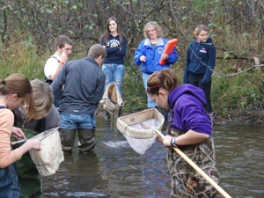
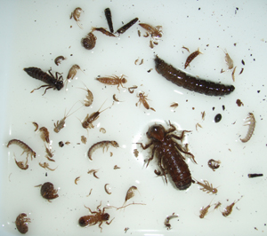
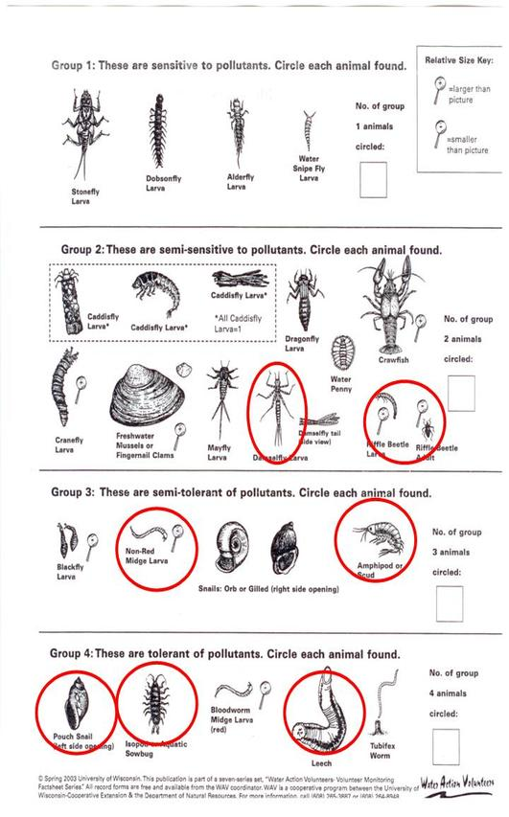
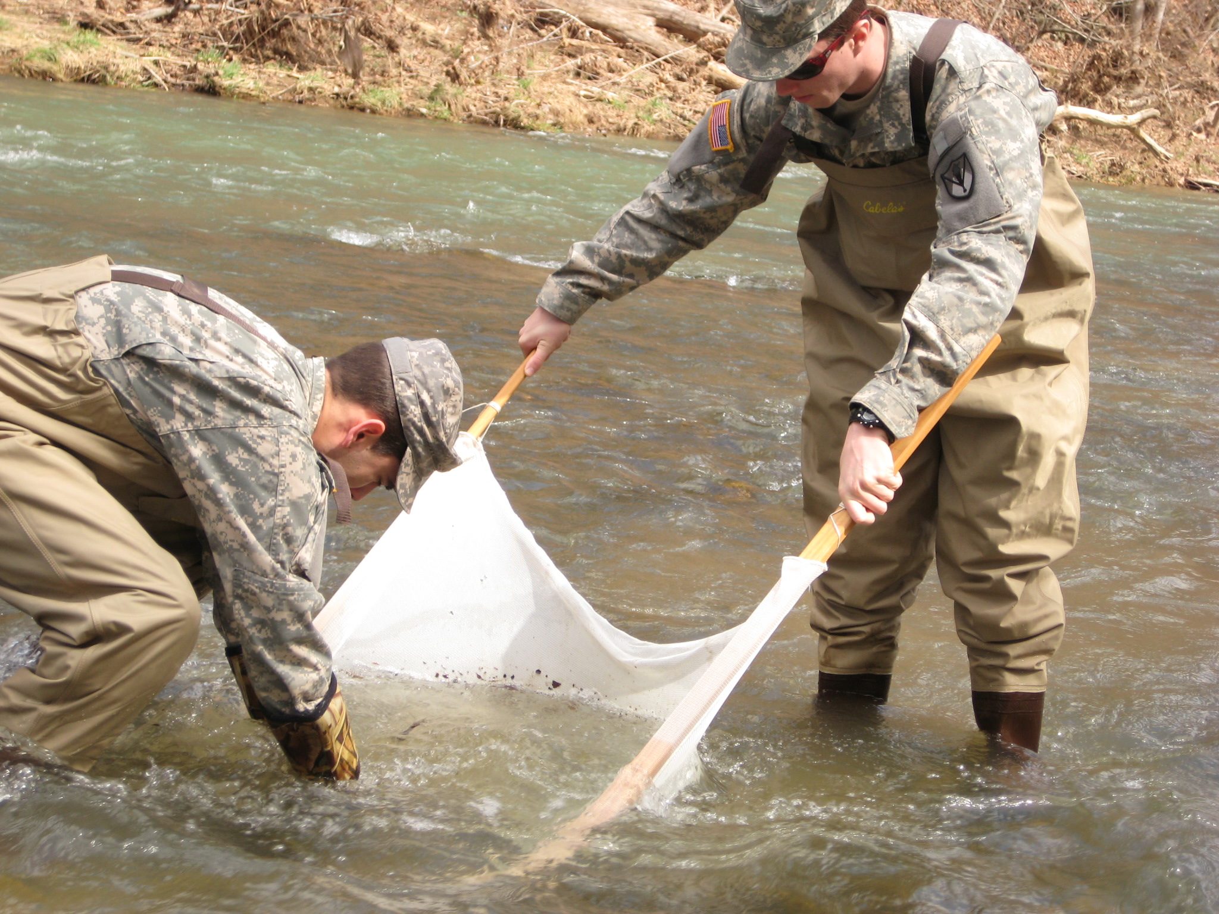
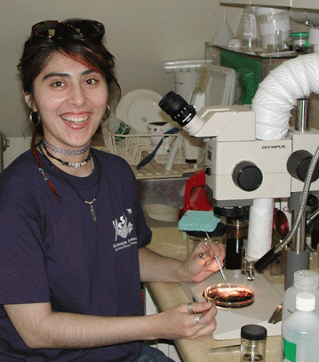

Slide 10
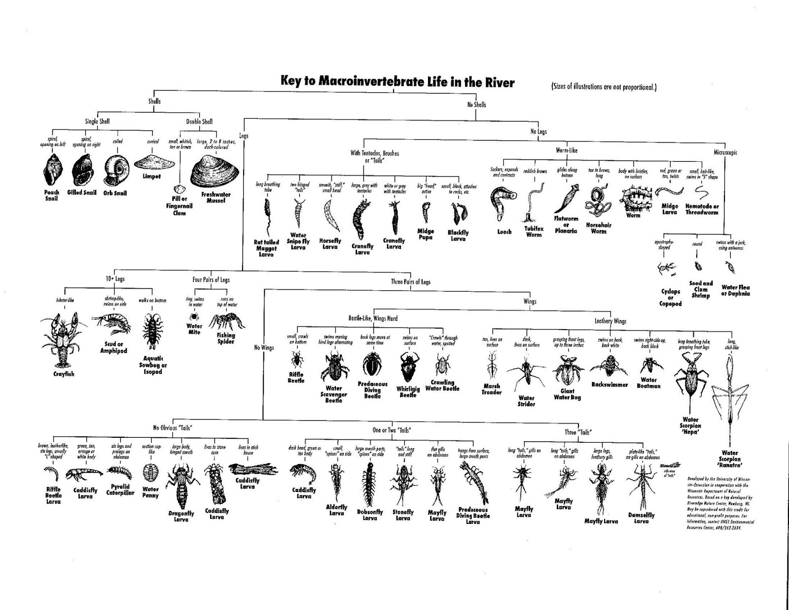

Slide 11
Using the Simple Method
Next you will calculate the Biotic Index: number that determines how polluted the stream is based on the organisms found there:
Class 1 = 2 points
Class 2 = 1 point
Class 3 = 0 points
Notes:
Class 1 is sensitive to pollutants

Slide 12
Simple Method
Add up all points for organisms found in the stream
10 or better = pollution free
7-10 = mostly clean stream
1-6 = moderately polluted
0 = VERY polluted

Slide 13
Using the Citizens Monitoring Method
Next you will calculate the Biotic Index: number that determines how polluted the stream is based on the organisms found there:
The Number of Group 1 X 4
The Number of Group 2 X 3
The Number of Group 3 X 2
The Number of Group 4 X 1
Notes:
Class 1 is sensitive to pollutants

Slide 14
Citizens Monitoring Method
Add up all points for organisms found in the stream
Excellent -----3.6+
Good ----------2.6 – 3.5
Fair ------------2.1 – 2.5
Poor ----------1.0 – 2.0

Slide 15
Keep in mind, you may see organisms in different life cycle stages:
Larva: newly hatched, wingless, doesn’t look like the adult form
Nymph: newly hatched, wingless, looks similar to the adult form
** What would happen if the quality of streams is reduced and a certain species are lost?

Slide 16
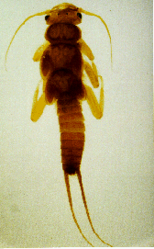
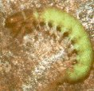
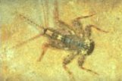
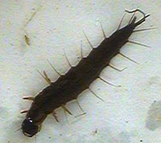
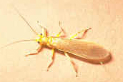
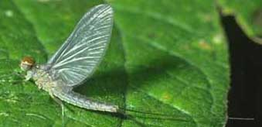
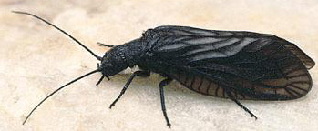
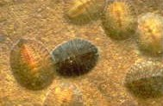
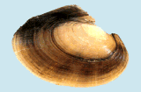
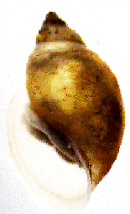
Macroinvertebrate Identification Key
GROUP 1 DO NOT TOLERATE POLLUTION
Stonefly nymph 5-35mm | Caddisfly larva 2-40mm | Mayfly nymph 3-10mm | Alderfly nymph 10-25mm | Fishfly larva 5-16mm
Stonefly adult 10-40mm | Caddisfly adult 14-25mm | Mayfly adult 5-25mm | Alderfly adult 24-50mm | Water penny 4-6mm
Hellgrammite (dobsonfly larva) 25-90mm | Freshwater mussel 2-250mm | Pouch snail 2-70mm | Ramshorn snail 2-70mm | Snipe fly larva 12-18mm

Slide 17
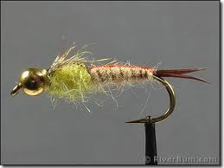
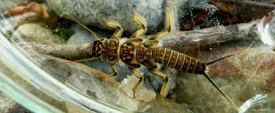
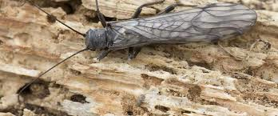
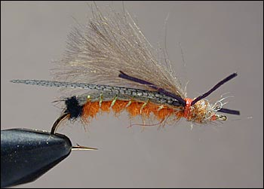
Stoneflies Plecoptera: “Braided Wings”
Nymph
Adult

Slide 18
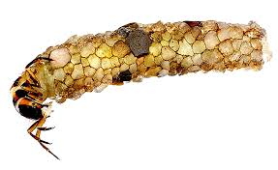
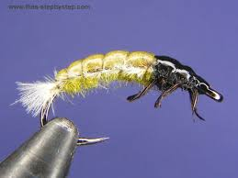
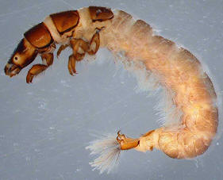
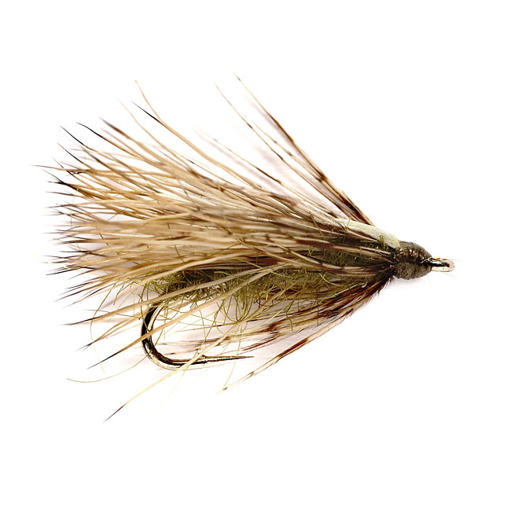
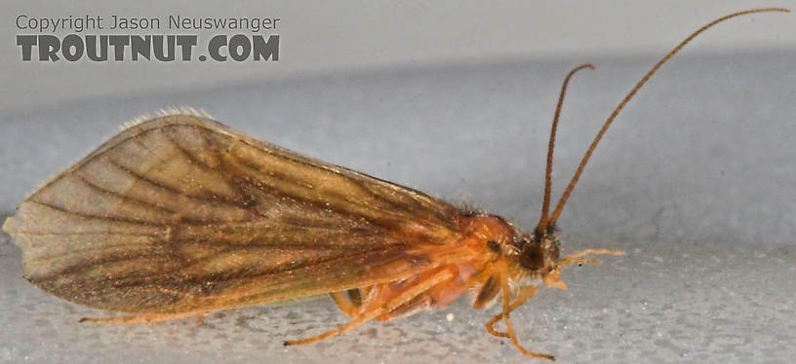
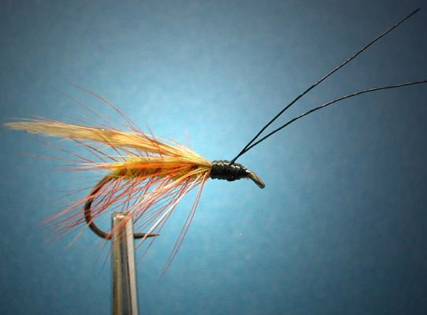
Caddisfly Trichoptera: “Hair Wings”
Larvae
Adult

Slide 19
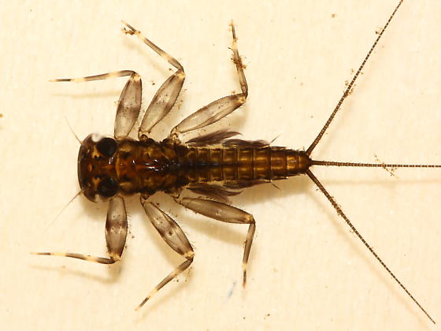
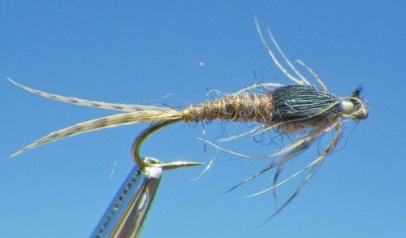
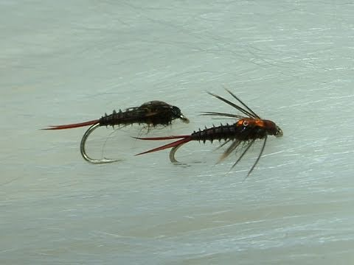
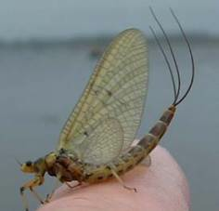
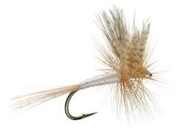
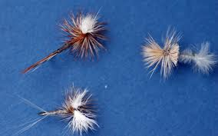
Mayflies Ephemeroptera: “Short-Lived Wing”
24 hour lifespan for adults
Nymph
Adult

Slide 20
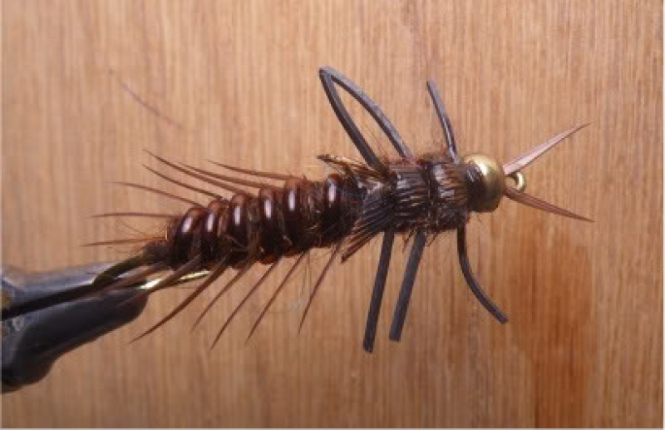
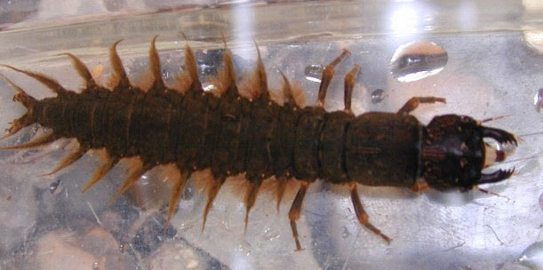
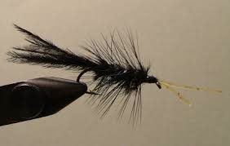
Dobsonfly/Hellgrammite Megaloptera: “Large Wing”
Larger than its relative fish fly larva
Larva
Adult
“Wooly Bugger”

Slide 21
Surface/True Bugs Hemiptera: “Half-Wing”

Slide 22
Macroinvertebrate Identification Key
GROUP 2 TOLERATE SOME POLLUTION
Dragonfly larva 15-50mm | Damselfly larva 10-50mm | Water beetle larva 2-6mm | Whirligig beetle 3-15mm | Riffle beetle adult 2-4mm
Dragonfly nymph 30-50mm | Damselfly nymph 10-50mm | Water beetle 3-40mm | Whirligig beetle larva 3-12mm | Water strider 10-25mm
Dragonfly adult 17-200mm | Damselfly adult 25-55mm | Backswimmer 5-16mm | Waterboatman 5-16mm | Cranefly larva 10-25mm
Scud (amphipod) 5-21mm | Crayfish 10-150mm | Water scorpion 20-43mm | Sowbug 5-22mm | Freshwater clam 30-270mm

Slide 23
Dragonflies Odonata: “Tooth”
Dragonfly Nymph
Adult Dragonfly

Slide 24
Damselflies Odonata: “Tooth”
Nymph
Adult

Slide 25
Macroinvertebrate Identification Key
GROUP 3 TOLERATE POLLUTION
Blackfly larvae 3-12mm | Midge larva 2-15mm | Mosquito larva 1-6mm | Flatworm (planaria) 1-6mm | Freshwater worm 1-30mm
Blackfly adult 2-5mm | Midge adult 3-4mm | Mosquito adult 6-13mm | Leech 5-40mm | Water snail 2-70mm

Slide 26
Now let’s practice…
I am going to show you a group of pictures of organism. Using the both the Citizens Monitoring Method and simple method with the reference sheets, you need to fill out the chart below by writing the specimen name, class (1,2,or 3 for simple), Biotic Index value, and then add the biotic index together to find the level of stream quality.
Use the citizens monitoring biotic index sheet and complete.

Slide 27
Specimen 1
Notes:
Dragonfly larva taxa 2 biotic index = 1

Slide 28
Specimen 2
Notes:
Crayfish, taxa 2 biotic index = 1

Slide 29
Specimen 3
Notes:
Damsel fly larva taxa 2 biotic index = 1

Slide 30
Specimen 4
Notes:
Midgefly larva taxa group 3 biotic index =0

Slide 31
Specimen 5
Notes:
Aquatic beetle larva class 2 biotic index = 1

Slide 32
Specimen 6
Notes:
Pouch snail class 3 biotic index = 0

Slide 33
Results of Using the Simple Method
Specimen Name | Class/Group | Biotic Index
1. Dragonfly larva | 2 | 1
2 Water Penny | 1 | 2
3. Damsel fly | 2 | 1
4. Amphipod or Scud | 2 | 1
5. Mayfly | 1 | 2
6. Pouch Snail | 3 | 0
 |  | Total biotic Index = 7

Slide 34
Simple Method
Add up all points for organisms found in the stream
10 or better = pollution free
7-10 = mostly clean stream
1-6 = moderately polluted
0 = VERY polluted

Slide 35
Results of Using the Citizens Method
Specimen Name | Group
1. Dragonfly larva | 2
2. Water Penny | 2
3. Damsel fly | 2
4. Amphipod or Scud | 3
5. Mayfly | 2
6. Pouch Snail | 4
No. of animals from group 1 ____0___ x 4=_____0_____
No. of animals from group 2 _____4_____ x 3=_______12____
No. of animals from group 3 _____1_____ x 2=_____2______
No. of animals from group 4 _____1_____ x 1=_____1______
TOTAL ANIMALS(a)___6____ TOTAL VALUE(b)___15_____
Divide totaled value (b) by total no. of animals (a) for index score.
Index Score = _____2.5___________

Slide 36
Simple Method – Citizens Monitoring
Add up all points for organisms found in the stream
Excellent -----3.6+
Good ----------2.6 – 3.5
Fair ------------2.1 – 2.5
Poor ----------1.0 – 2.0

