Slide 1
Organelle Quiz

Slide 2
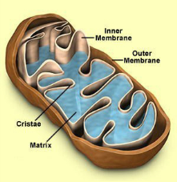
What organelle is this?
A mitochondrion
What process occurs
in this organelle?
Cellular Respiration
What high energy
molecule is produced
by this organelle?
ATP

Slide 3
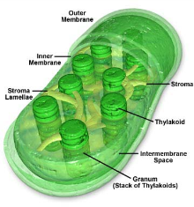
What organelle is this?
A chloroplast
What process occurs
in this organelle?
Photosynthesis

Slide 4
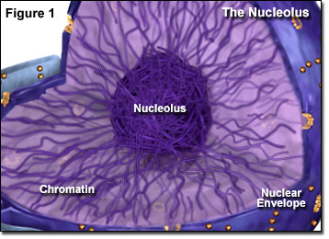
?
What is the dark structure in the center of the diagram ?
nucleolus
What other cell organelle is made by this structure ?
ribosomes

Slide 5
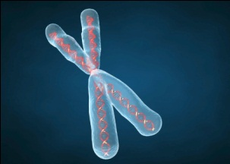
What is this structure?
A chromosome
What important molecule
is found in this structure?
DNA
What information is contained
in the DNA of a chromosome?
How to make proteins

Slide 6
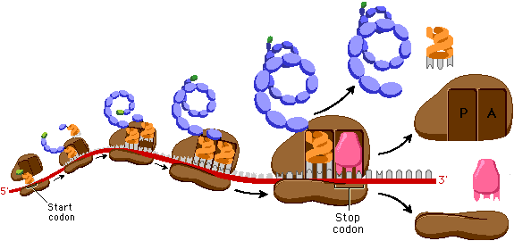
The blue structures are chains of amino acids. The long
red and gray molecule is mRNA.
What are the brown organelles?
ribosomes

Slide 7
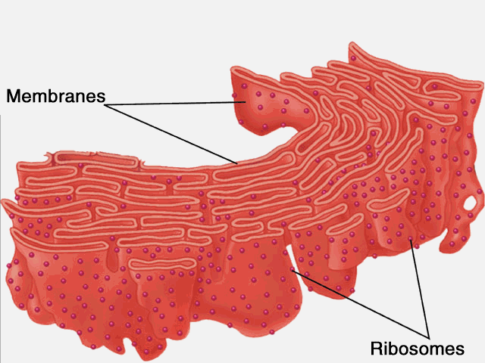
What organelle is this?
Rough Endoplasmic
Reticulum
What is the function of this
organelle?
Transports materials through
the cell (mostly proteins)
What are the small dots attached
to this organelle?
?
ribosomes

Slide 8
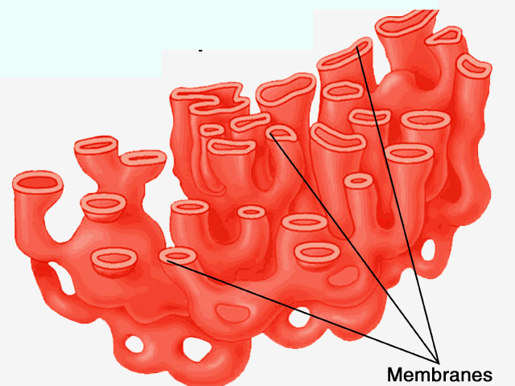
What is this organelle?
Smooth endoplasmic
reticulum (ER)
What cell products are
made by this organelle
Lipids such as cholesterol,
estrogen & testosterone

Slide 9
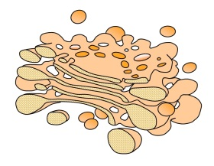
What is this organelle?
Golgi Apparatus
What are the small sacs
pinching off from this
organelle?
vesicles

Slide 10
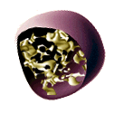
This organelle contains digestive
enzymes used to digest food and
worn out cell parts.
What is the name of this organelle?
A lysosome
What organelle is responsible for
producing this organelle?
The Golgi Apparatus

Slide 11
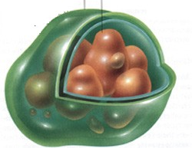
If the brown particles in this
organelle were starch, which
organelle would it be?
An amyloplast
If the particles in this
organelle were pigments,
which organelle would it be?
A chromoplast
Both amyloplasts and chromoplasts,
along with chloroplasts, are known as
what type of organelle which are found
only in plants?
plastids

Slide 12
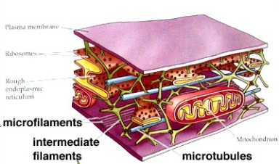
The microfilaments, intermediate filaments and microtubules shown
here are part of which cell structure?
The cytoskeleton
All of these components of the cytoskeleton are made of what type
of organic molecules?
proteins

Slide 13
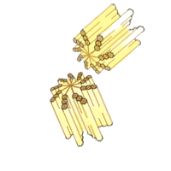
These structures are found in animal
cells and are involved in cell division.
What are they?
centrioles
What are these structures composed of ?
microtubules

Slide 14
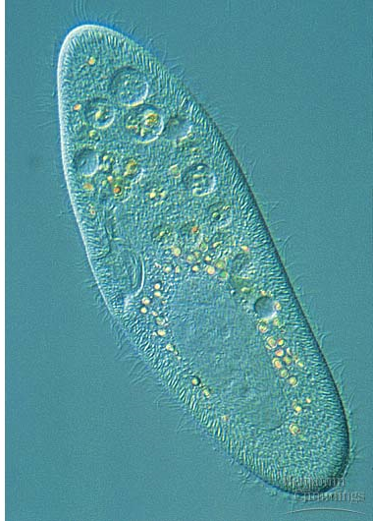
What are the hair-like
structures extending
beyond the cell membrane
of this paramecium?
cilia
What are cilia composed of ?
microtubules

Slide 15
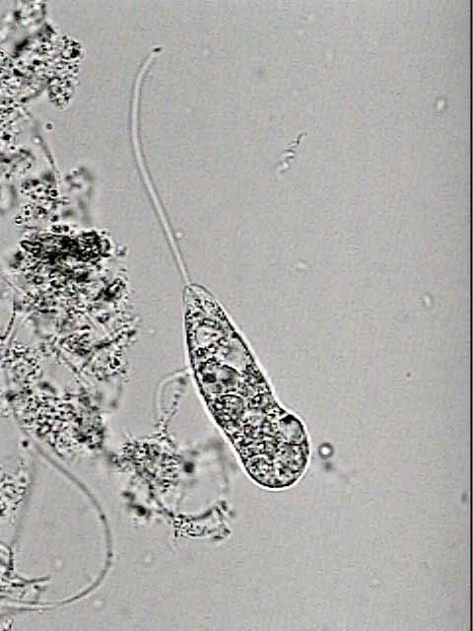
What is the long hair-like
structure extending from
this protozoan?
A flagellum

Slide 16
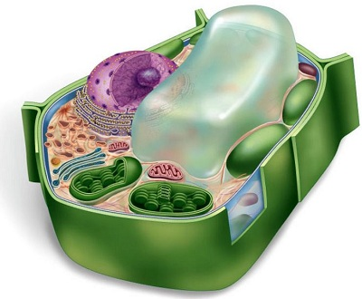
A
What is structure A ?
A central vacuole
What is structure B ?
A chloroplast
Name another structure
found in this cell that
would not be found in
an animal cell
Cell wall
B
The cell wall

Slide 17
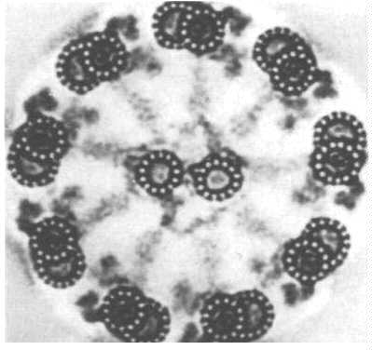
This electron micrograph shows a cross section of what cellular structure?
A cilium or a flagellum

