Slide 1
How are you feeling today? We answer with emotions, or feelings.

Slide 2
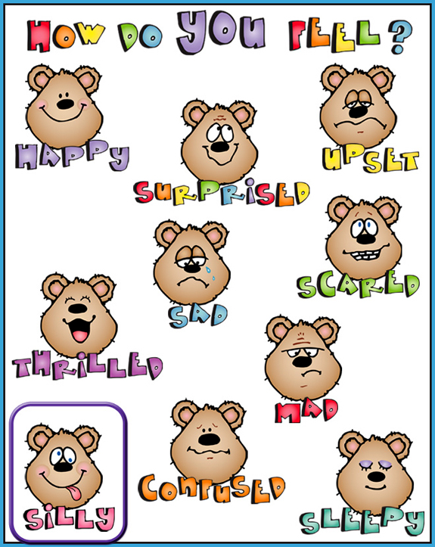
Emotions and Feelings

Slide 3
Happy

Slide 4
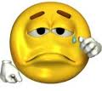
Un Happy/Sad

Slide 5
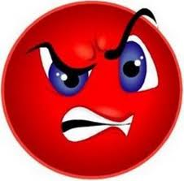
Angry/Mad

Slide 6
Excited

Slide 7
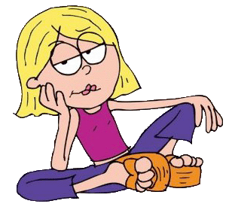
Bored

Slide 8
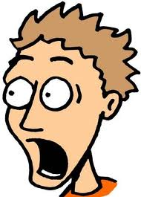
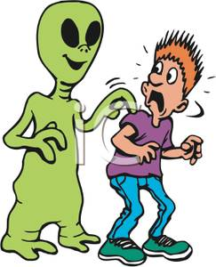
Afraid/Scared

Slide 9
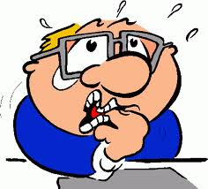
Nervous

Slide 10
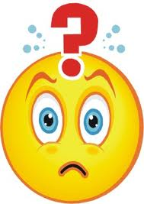
Confused

Slide 11
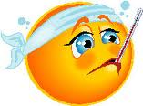
Sick

Slide 12
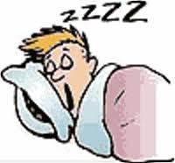
Tired/Sleepy

