Slide 1
Day 2 Introduction to Food and Drink

Slide 2
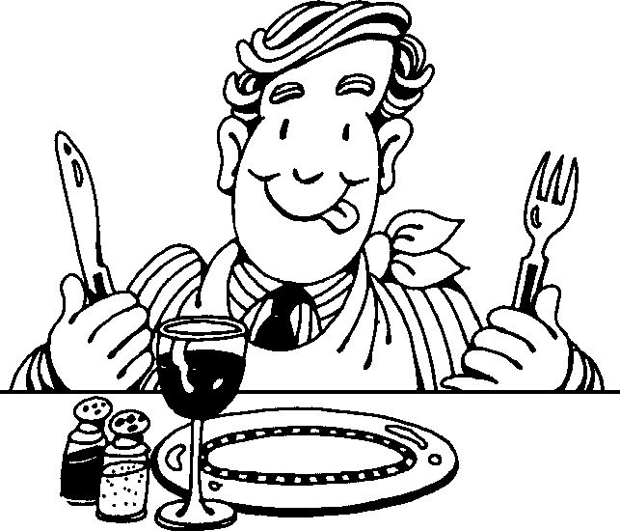
Food and Drink
I am Hungry so I go to the Kitchen. I Cook in the kitchen.

Slide 3
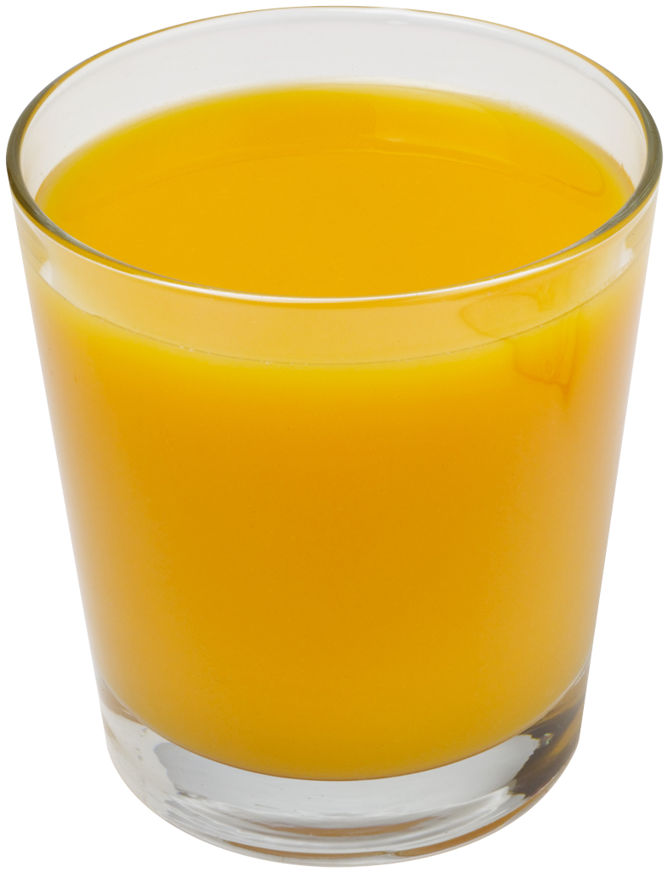
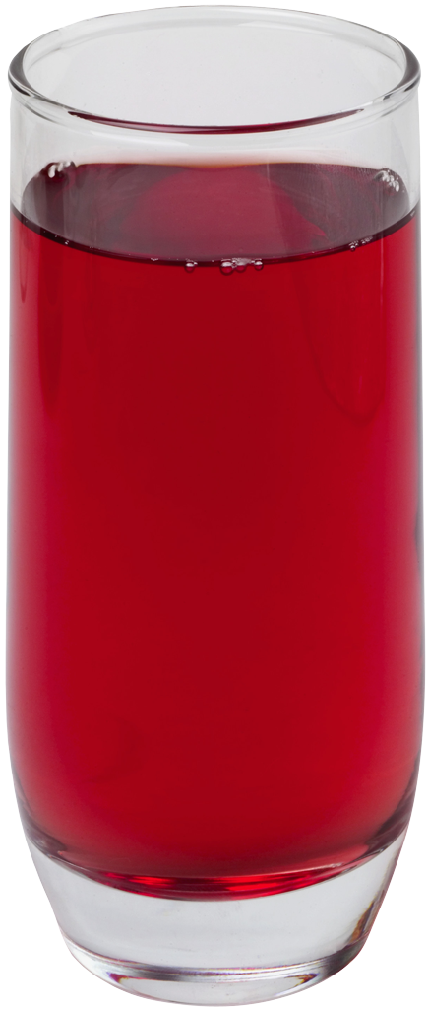
Food and Drink

Slide 4
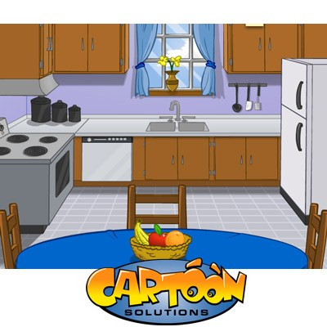
In the Kitchen
Sink
Fridge
Stove

Slide 5
We Cook our Meals

Slide 6
Cooking – Oven and Grill
Grill
Oven

Slide 7
Boil

Slide 8
Do Not Burn Your Food
Toast and Butter

Slide 9
Warning - Do Not Burn Yourself When Cooking

Slide 10
Warning - Do Not Cut Yourself When Cooking. Only Cut Your Food!

Slide 11
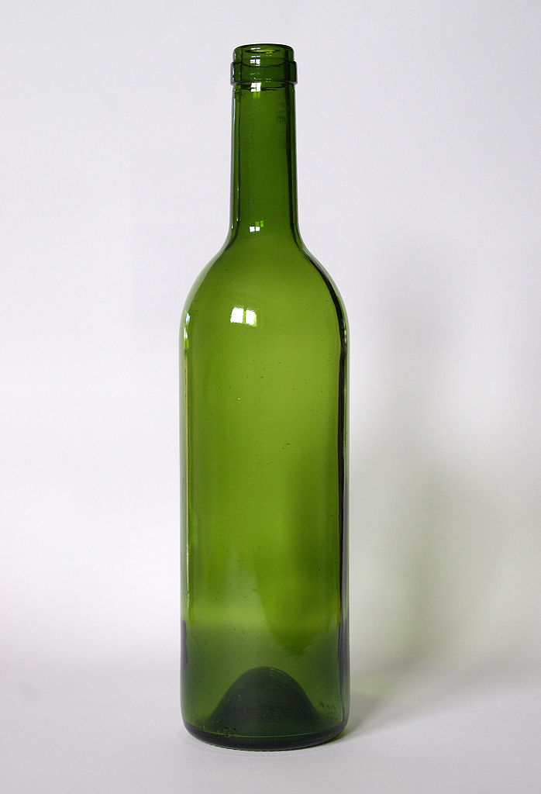
Utensils and Appliances
Bottle

Slide 12
Place Setting
Glass

Slide 13
Cups, Plate (Dish), and Bowels
Glass

Slide 14
The End

