Slide 1
Day 3 – Sports

Slide 2
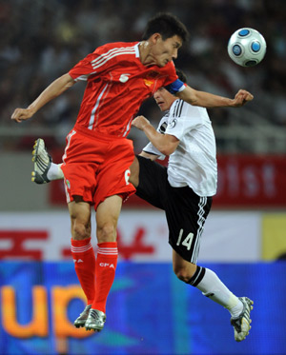
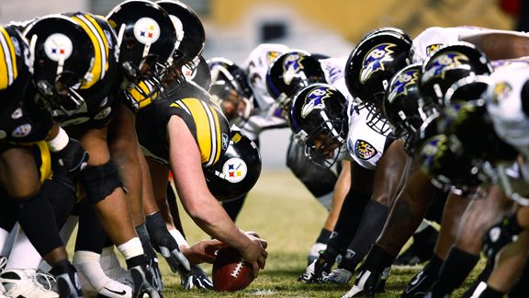
Sports - Football
Soccer/Football American Football

Slide 3
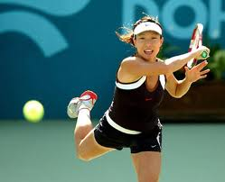
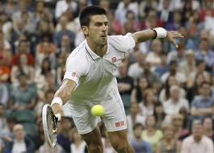
Tennis

Slide 4
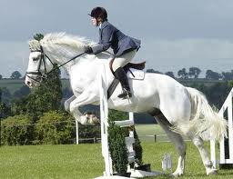
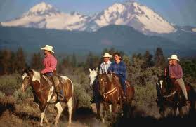
Horseriding and ride

Slide 5
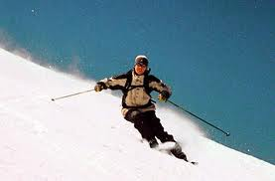
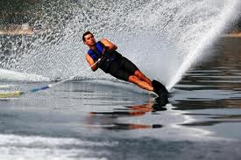
Skiing
Snow Skiing Water Skiing

Slide 6
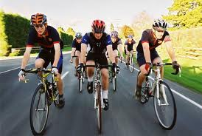
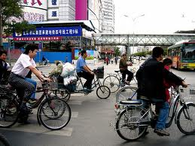
Bike, Bicycle, and Cycling

Slide 7
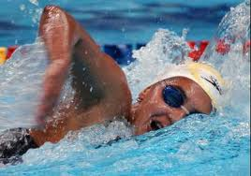
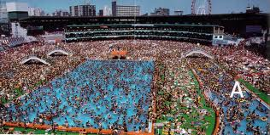
Swimming and Pool

Slide 8
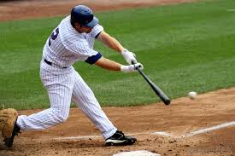
Ball and Baseball
Catch

Slide 9
Basketball

Slide 10
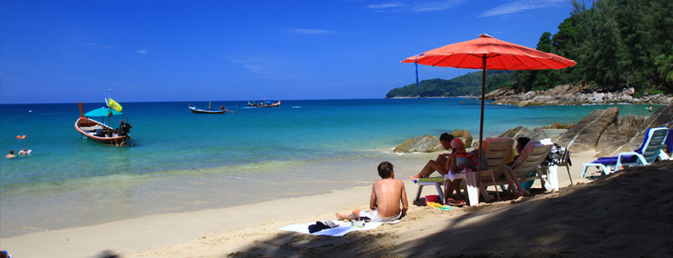
Boat and Boating at the Beach

Slide 11
Rock Climbing

Slide 12
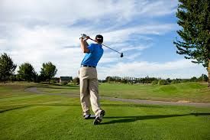
Golf

Slide 13
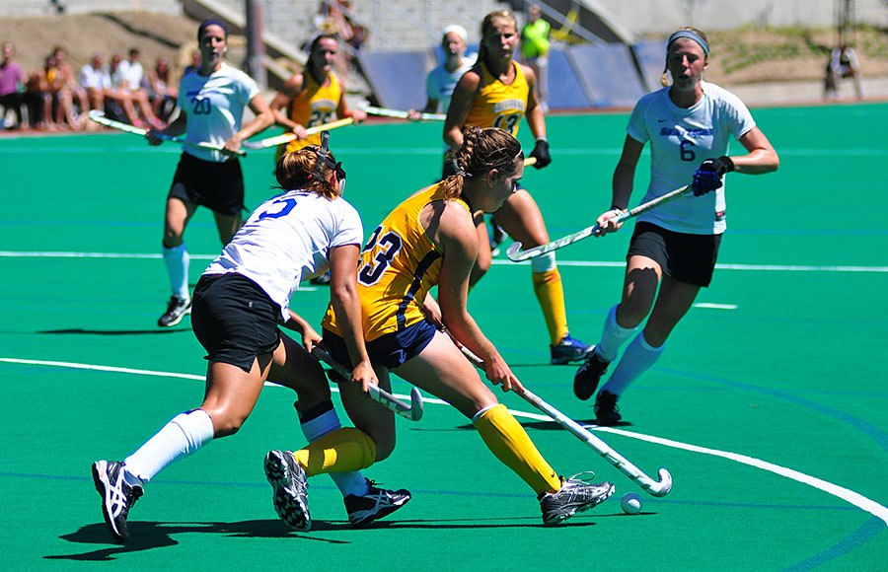
Hockey
Ice Hockey Field Hockey

Slide 14
Sailing on the Sea

Slide 15
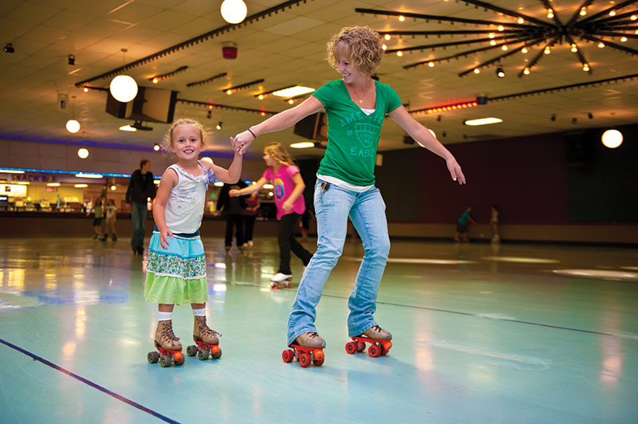
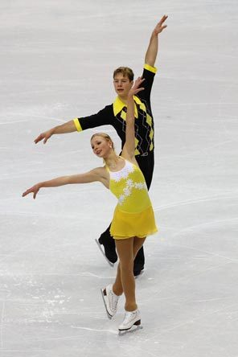
Skate
Roller Skate Ice Skate

Slide 16
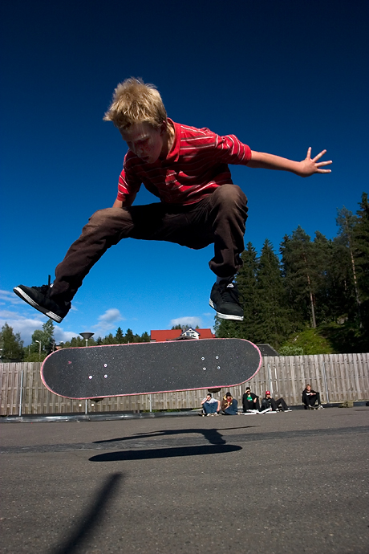
Skateboarding

Slide 17
Snowboarding

Slide 18
Surfboarding

Slide 19
Volleyball

Slide 20
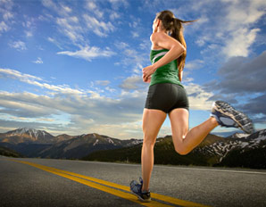
Walking and Running

Slide 21
Fishing

Slide 22
Table -Tennis

