Slide 1
Day 8 Travel and Transport

Slide 2
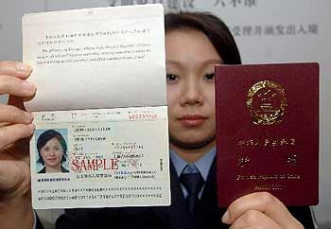
Taking a Trip or a Tour
If you were taking a tour, you might visit the tourist information center and use a tour guide. You are the tourist.
Exploring the world requires you to have a passport.

Slide 3
When you visit a new place you are a visitor.
It is best if your go on a tour with a tour guide.

Slide 4
Tour Guide

Slide 5
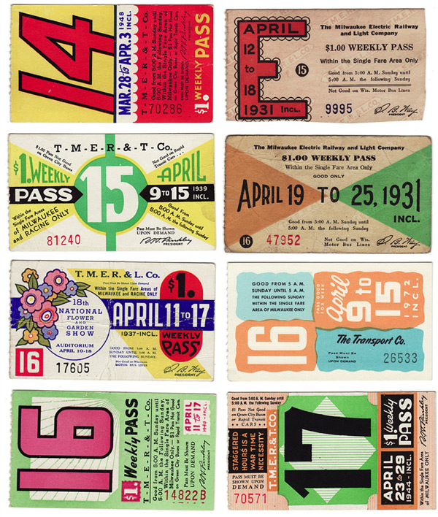
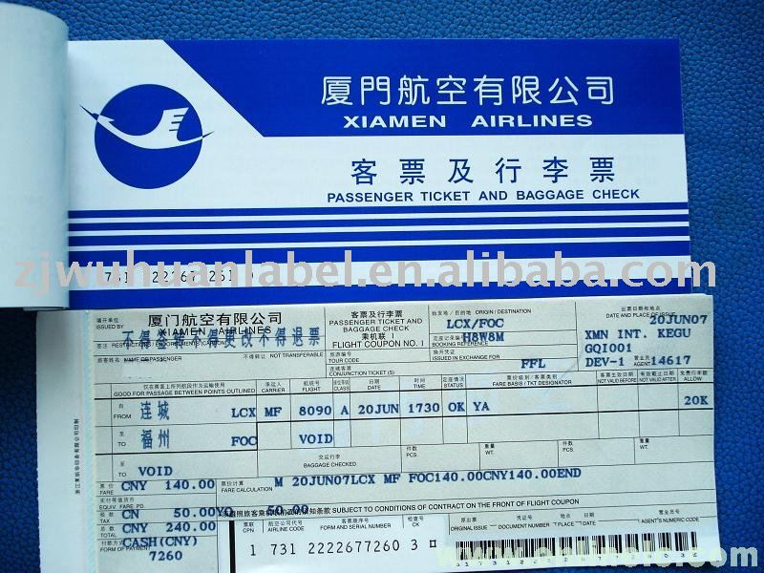
Ways that you can travel are many. But do not forget, you might have to buy a ticket to reserve a seat.

Slide 6
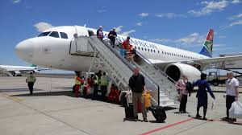
Ways to Travel: Fly
If you want to travel by airplane you will go to an airport. Do not be late or you will miss your flight, so leave on time for your Journey.

Slide 7
Pilot Flies the Plane

Slide 8
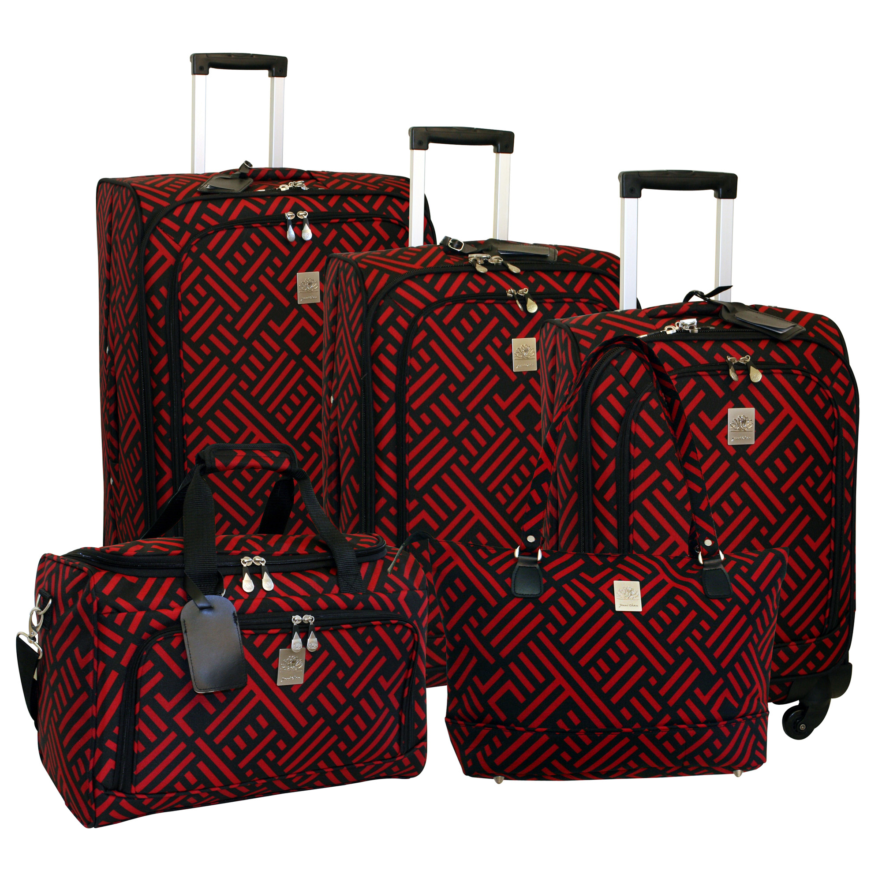
Do not forget your luggage (suitcases)

Slide 9
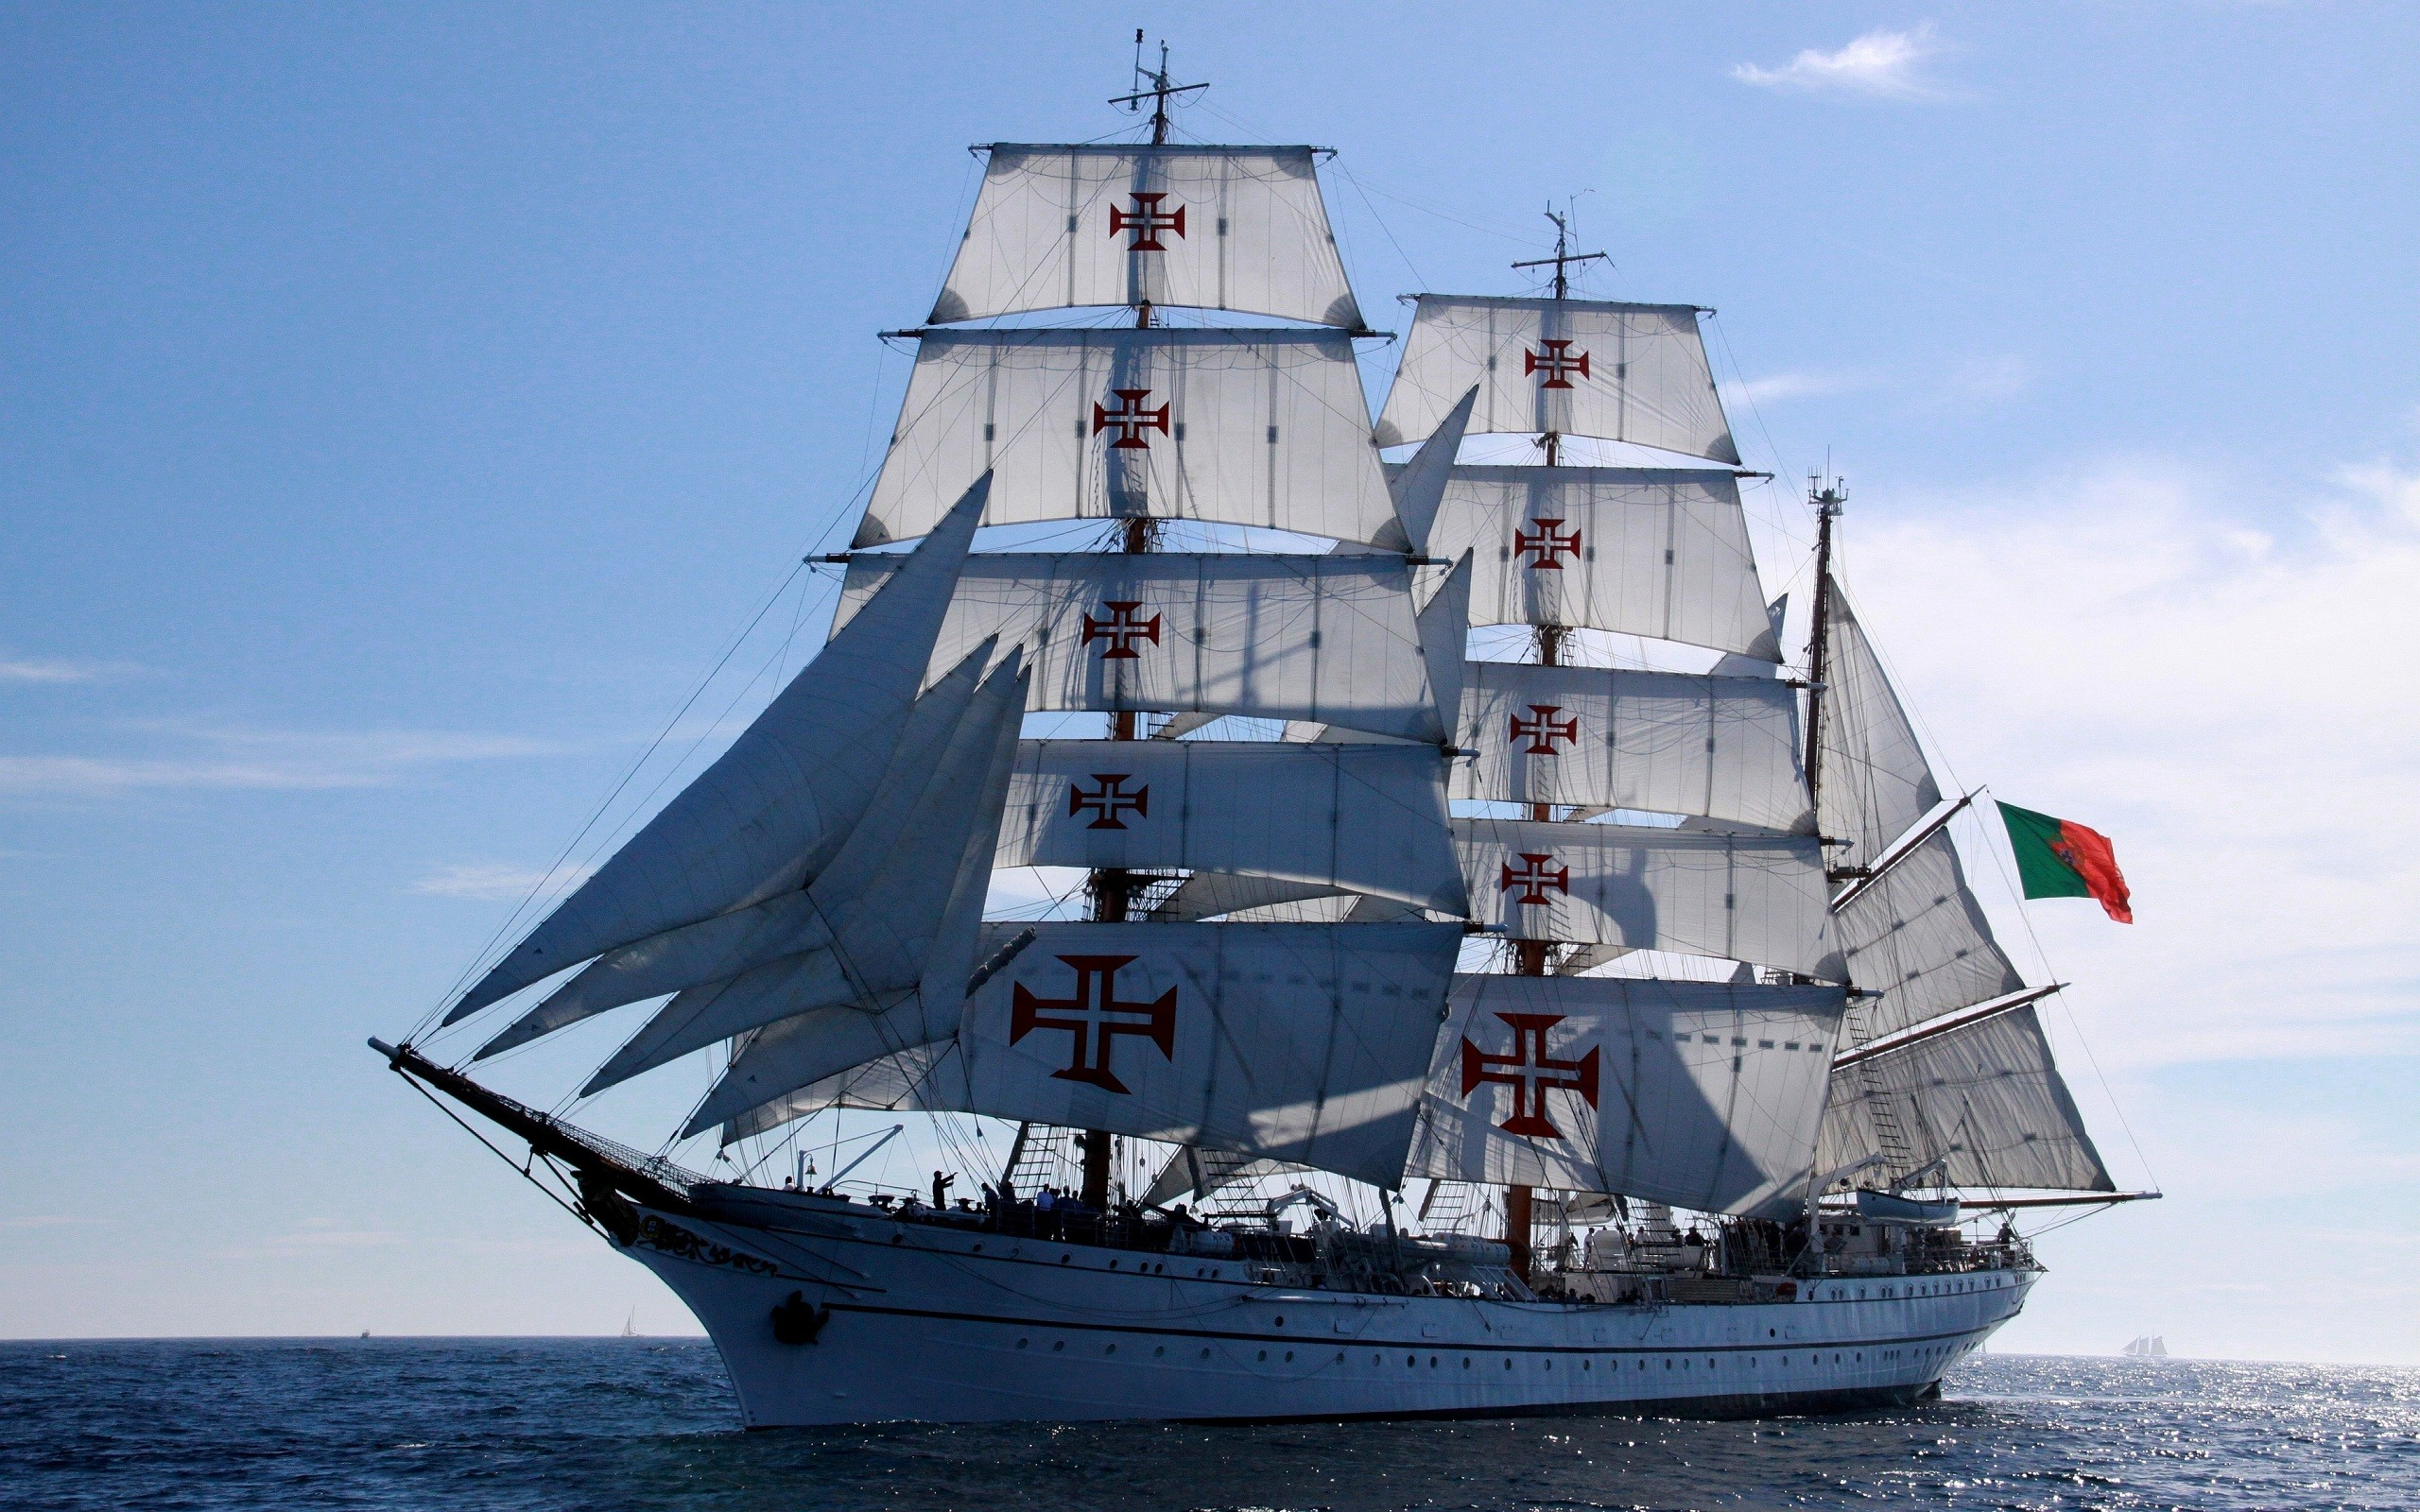
Boat Travel – Sail or go by Ship

Slide 10
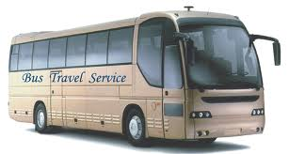
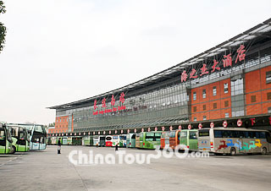
Bus Travel – to travel by bus you will have to go to a bus station.

Slide 11
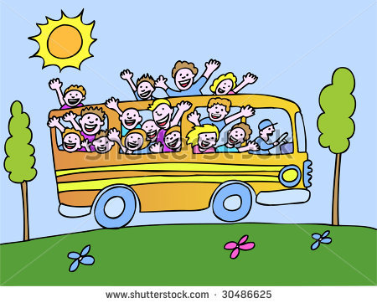
Bus Tour

Slide 12
Car Travel

Slide 13
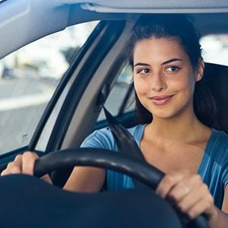
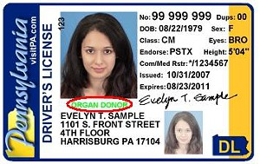
Car Travel
If you travel by car and you are the driver, you will need a drivers license.

Slide 14
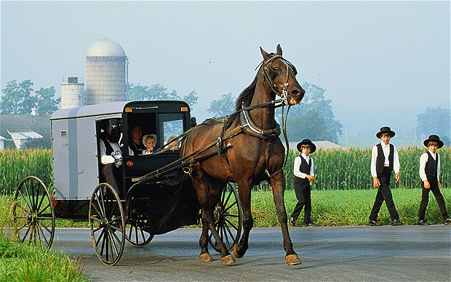
In Pennsylvania the Amish travel by horse and buggy (wagon)

Slide 15
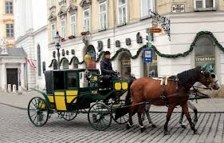
Some still travel by horse drawn coach.

Slide 16
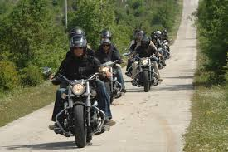
Motor Bike Travel

Slide 17
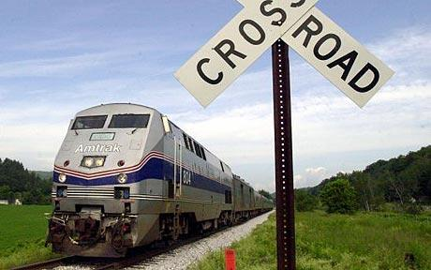
Railway Travel

Slide 18
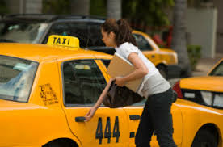
Taxi Travel

Slide 19
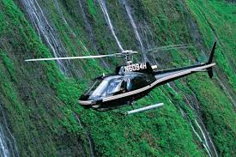
Helicopter Travel

Slide 20
The End

