Slide 1
Hobbies in the united states
Day 3

Slide 2
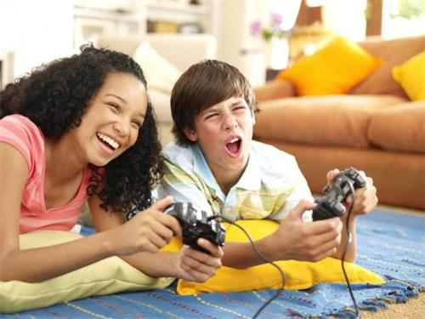
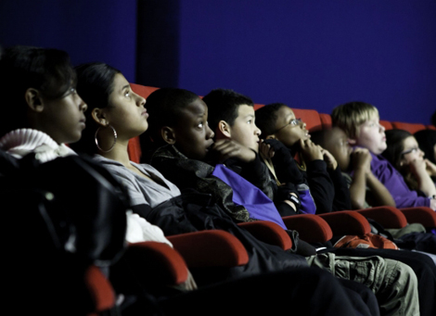
Going to the movies, bowling and playing video games Are popular weekend activities.

Slide 3
Young people in the united states enjoying going shopping with their friends

Slide 4
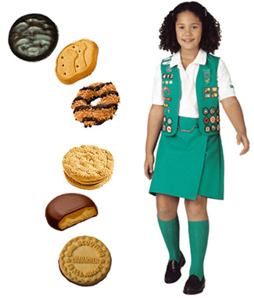
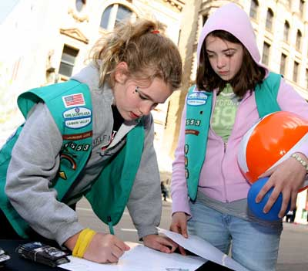
The Girl Scouts teaches girls skills to use as they grow up such as map reading, first aid and arts & craft amongst other things. They are famous for their annual cookie sale in America.

Slide 5
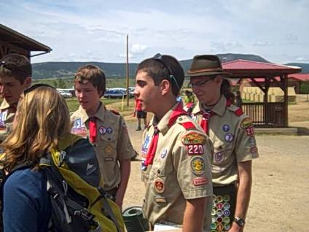
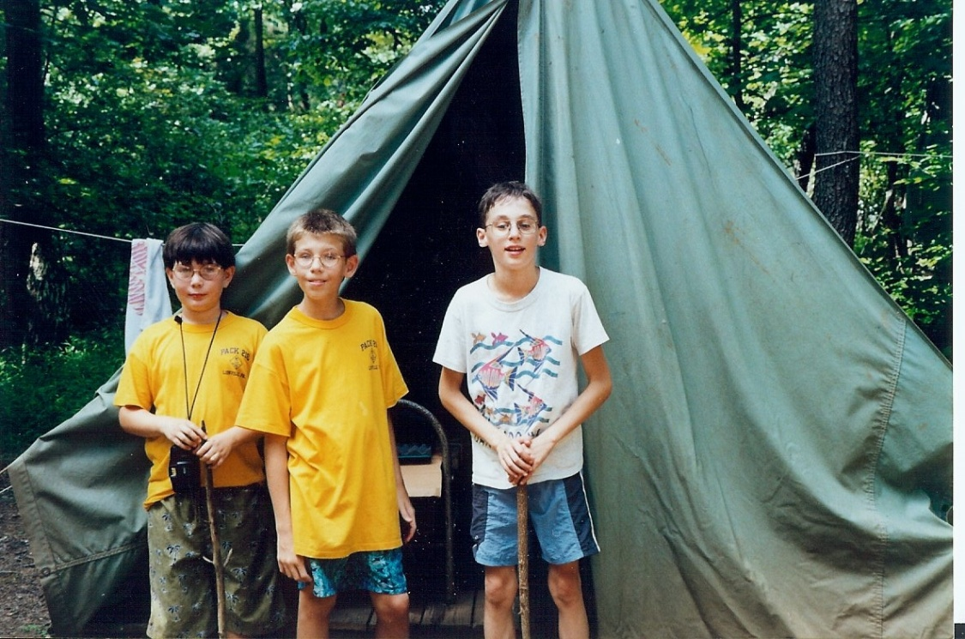
The boy scouts are for boys 6-18 years old. They learn camping, survival skills, leadership and community service.

Slide 6
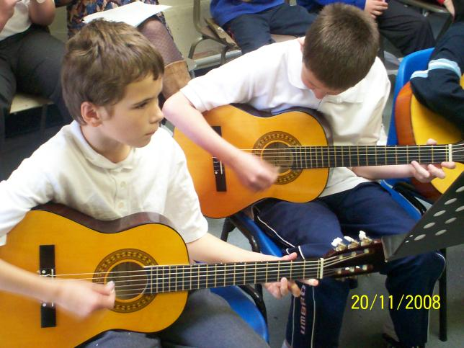
Lots of young people learn musical instruments both in school and outside school. Instruments such as guitar, piano, drums and brass instruments.

Slide 7
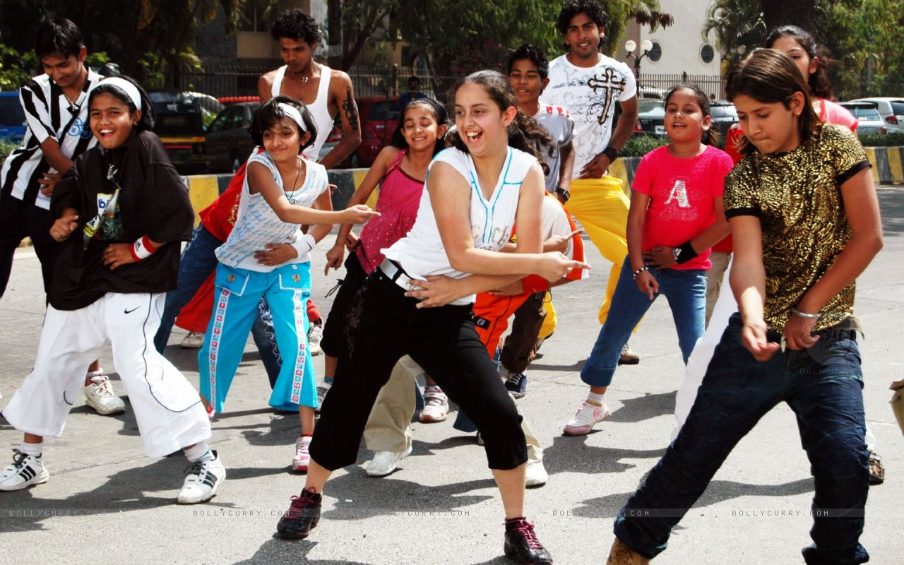
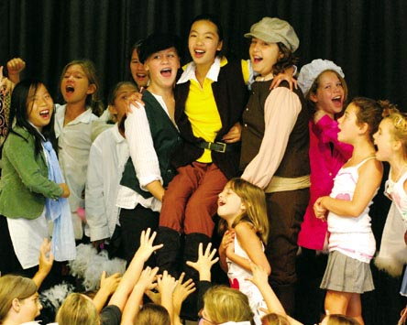
Many students like to dance and perform and make videos, so dance groups and drama clubs are well attended inside and outside of school.

Slide 8
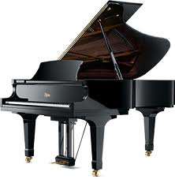
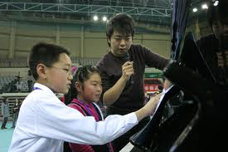
Playing Music - Piano

Slide 9
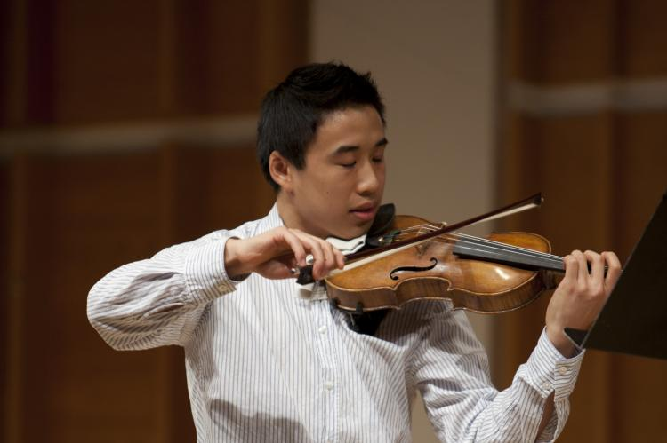
Musicians Playing the Guitar and Violin

Slide 10
Listen to Music

Slide 11
Reading Books

Slide 12
Dancing

Slide 13
Photography (Camera)

Slide 14
Camping, Camp, and Campsite

Slide 15
Watching TV or a DVD (Movie)

Slide 16
Festivals

Slide 17
Picnic in the Park

Slide 18
Party

Slide 19
Drawing and Painting

