Slide 1
Day 10 Descriptive Words
Adjectives - Words that describe Nouns.
Adverbs – Words that describe Verbs.

Slide 2
Ugly and Pretty/Beautiful

Slide 3
Alone

Slide 4
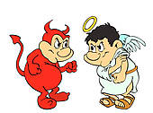
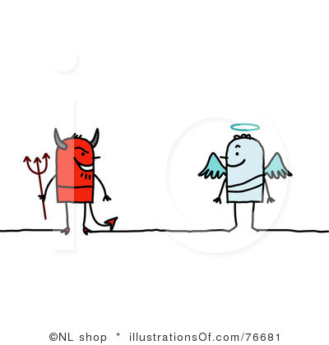
Bad and Good

Slide 5
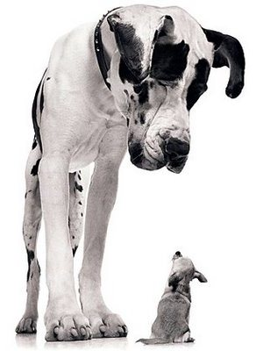
Big (Tall) and Small (Short)

Slide 6
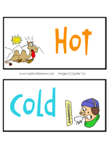
Hot and Cold (Cool)

Slide 7
Fast (quick) and Slow

Slide 8
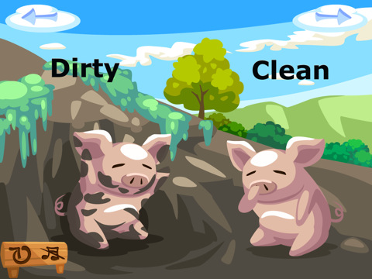
Dirty and Clean

Slide 9
Hard and Soft

Slide 10
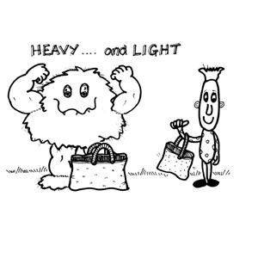
Heavy and Light

Slide 11
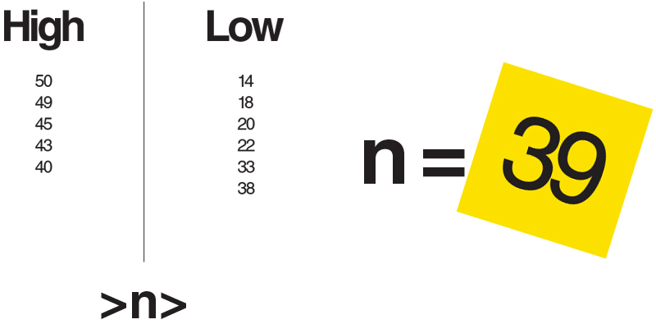
High and Low

Slide 12
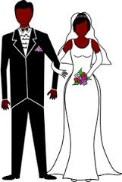
Married and Single = 1

Slide 13
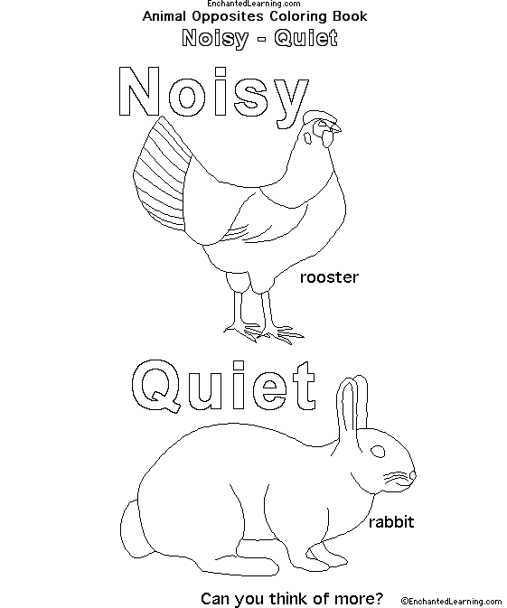
Noisy (Loud) and Quiet

Slide 14
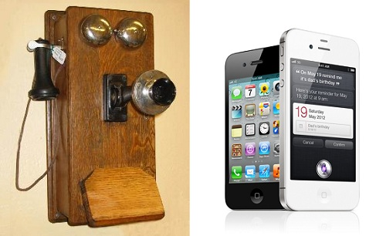
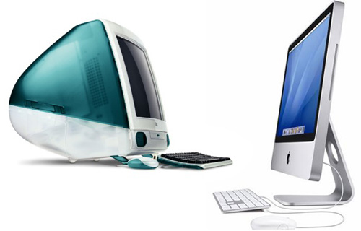
Old and New

Slide 15
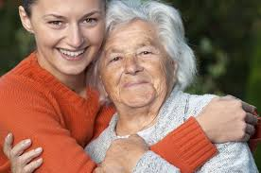
Young and Old

Slide 16
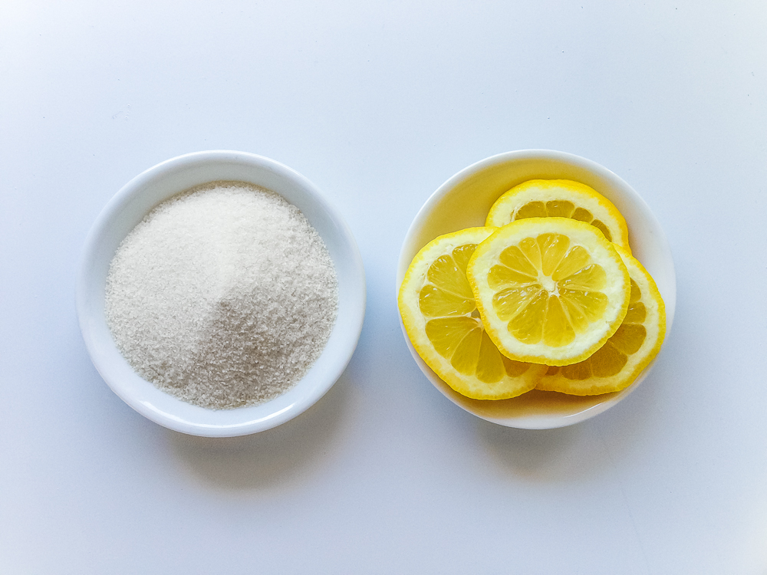
Sweet and Sour
Sugar Lemons

Slide 17
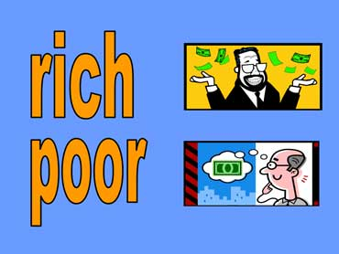
Rich and Poor

Slide 18
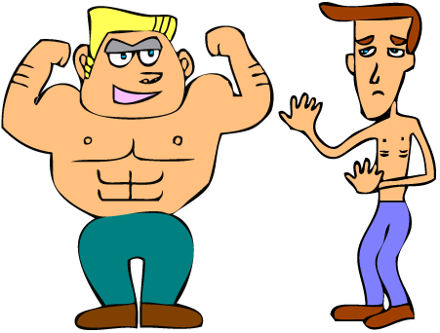
Strong and Weak

Slide 19
The End

