Slide 1
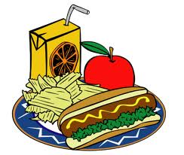
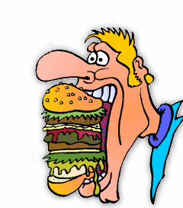
Day 2 – Food and Drink Meals and Eating

Slide 2
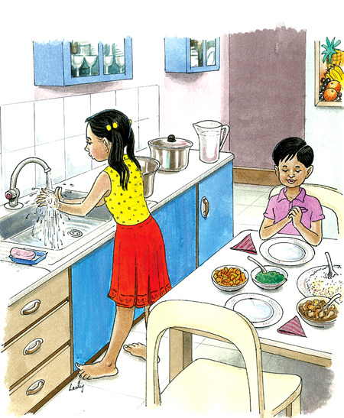
Wash Up
Wash Up Before You EAT!

Slide 3
Breakfast – In the Morning
Bread/Toast
Eggs
Fried Potato

Slide 4
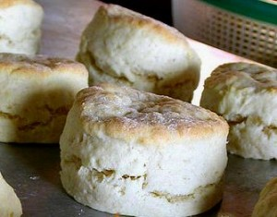
Breakfast – Tea, Biscuit, and Coffee
Tea and Biscuit
Biscuit and Coffee

Slide 5
Sugar and Cream for Tea and Coffee
Sugar is Sweet

Slide 6
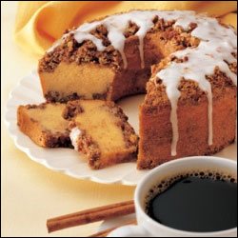
Breakfast – Bit of Cake
Coffee Cake

Slide 7
Breakfast - Omelet

Slide 8
Take a Break and Have a Snack

Slide 9
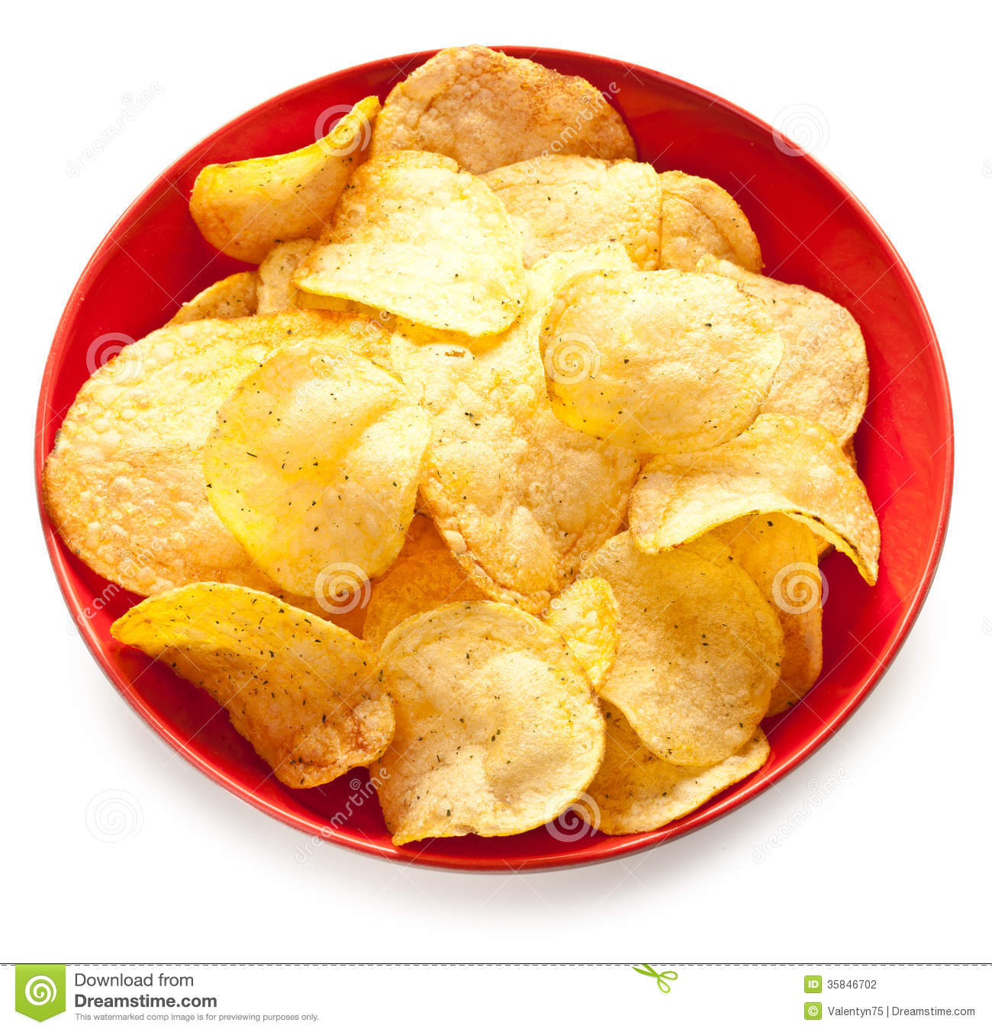
Break and Snack
Chips

Slide 10
Snack – Ice Cream

Slide 11
Lunch – Pizza Lunch
Carrots and Celery
Pizza

Slide 12
Lunch – Soup and Salad

Slide 13
Lunch – Sandwich

Slide 14
Thirsty? - Drink

Slide 15
Thirsty? Drink – Iced Lemonade
Lemons and Ice

Slide 16
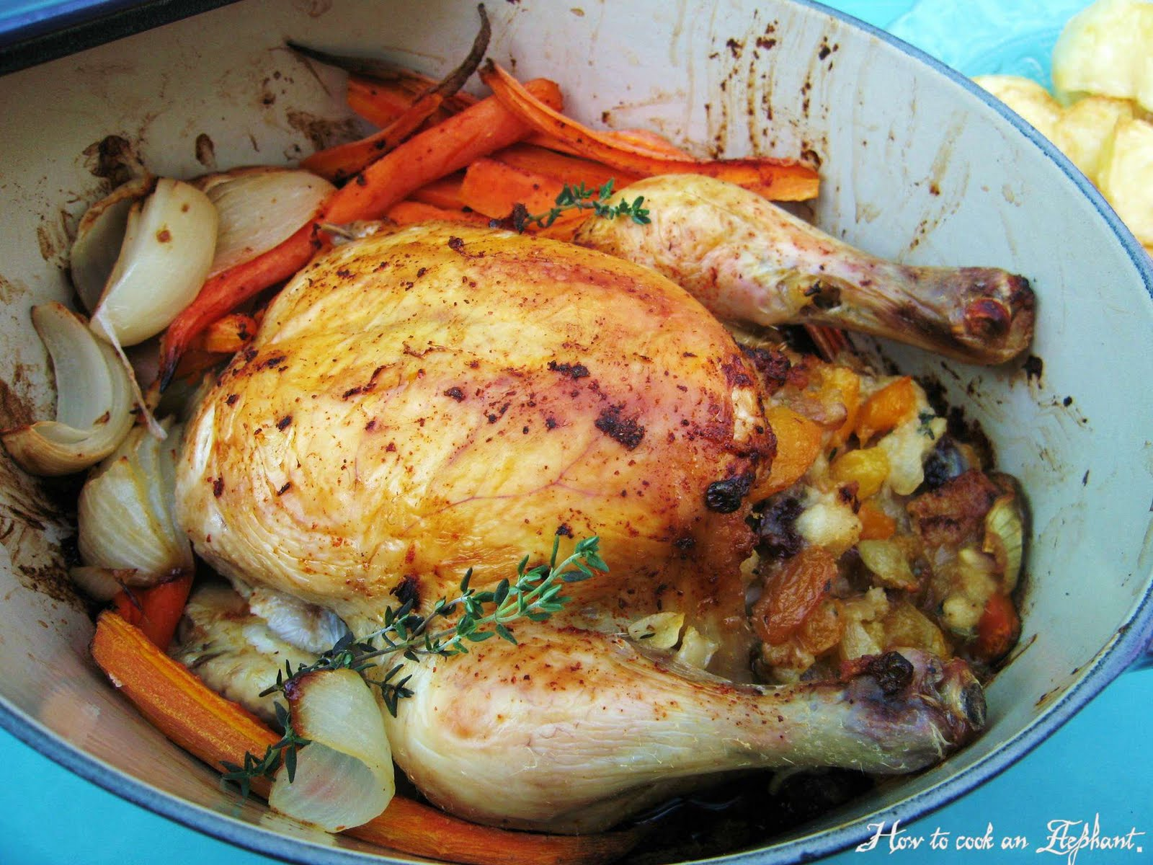
Dinner – Main Course
Chicken Dinner

Slide 17
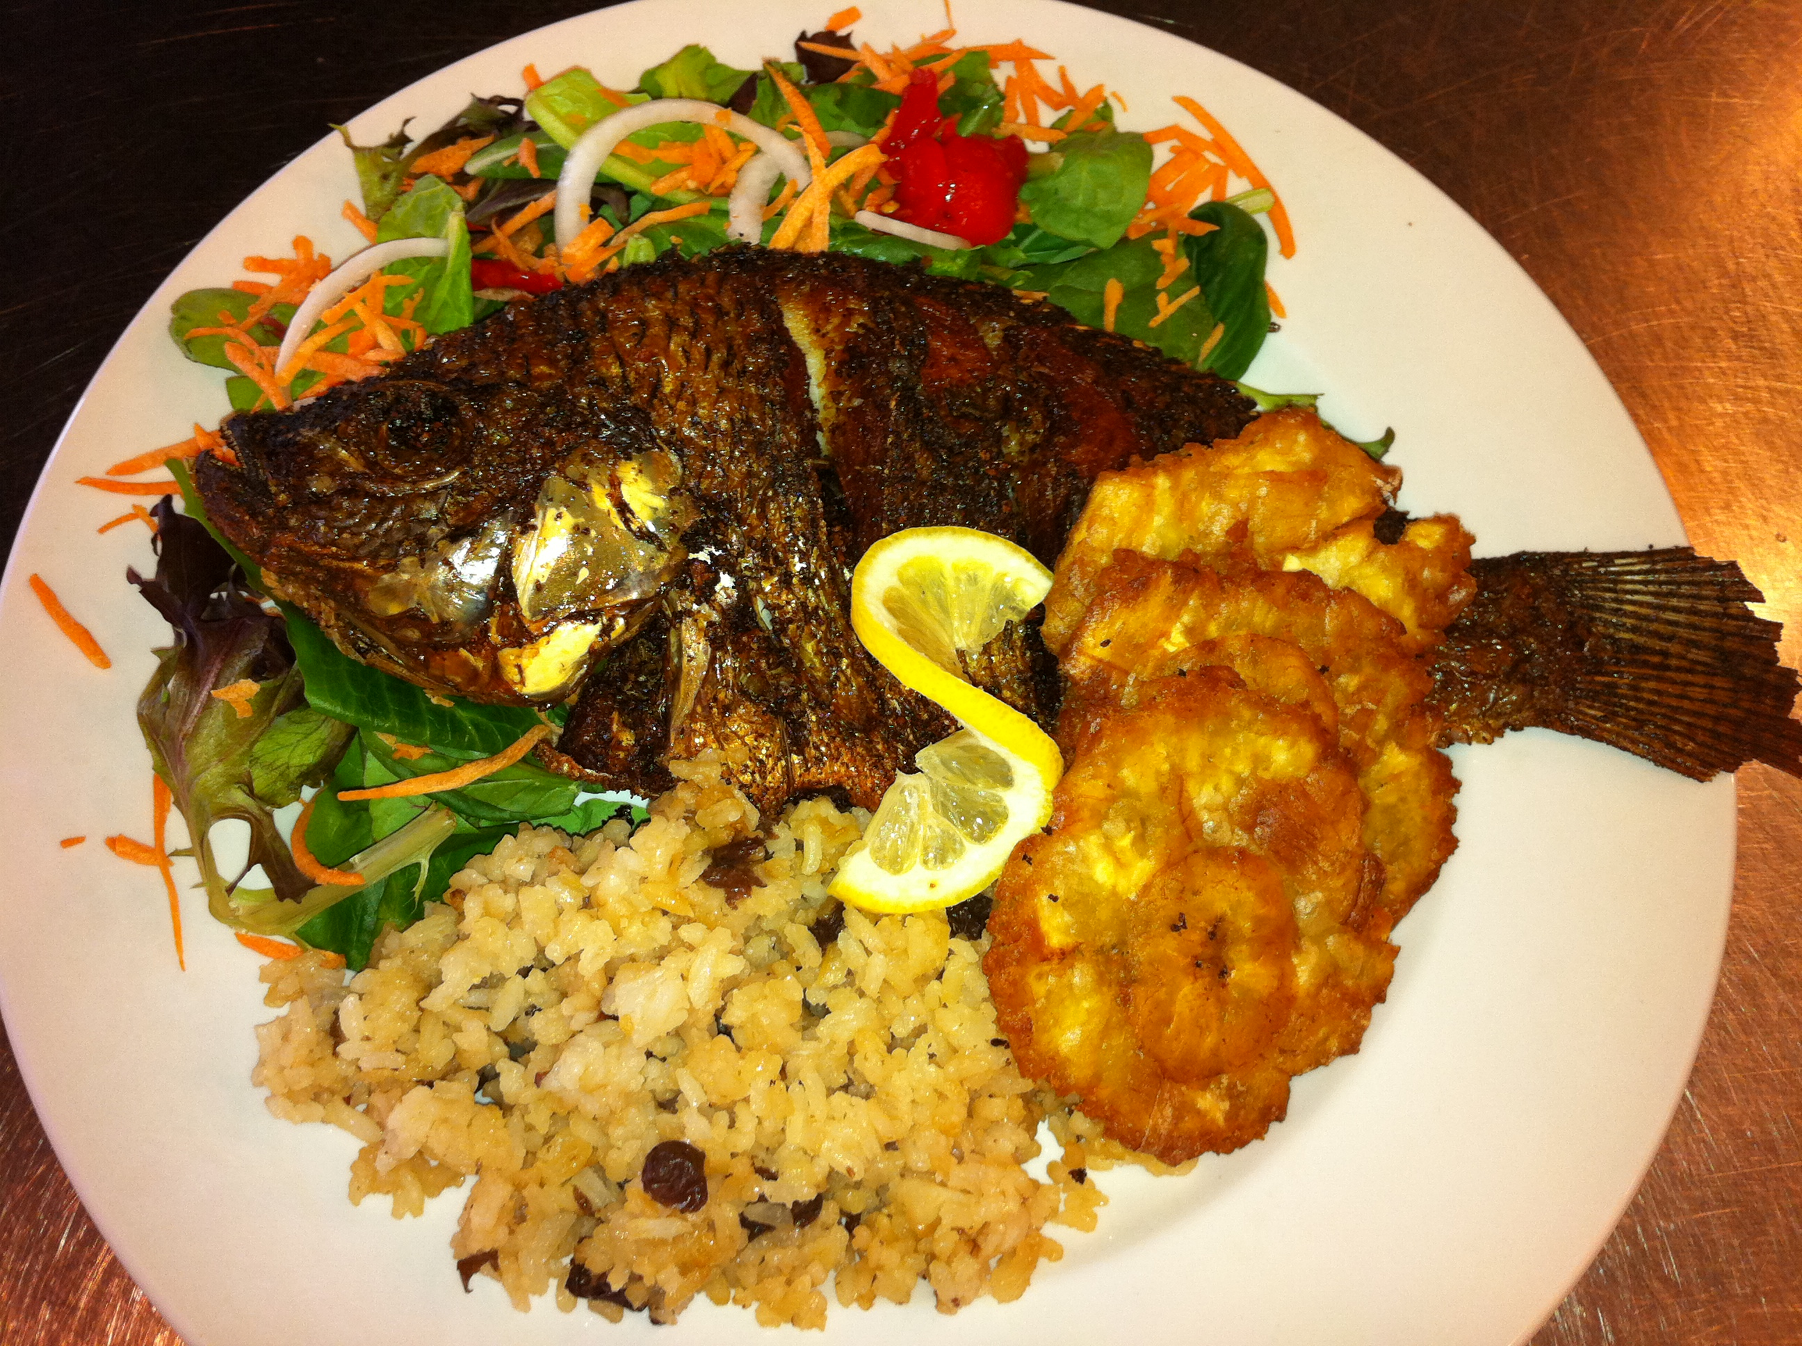
Dinner – Main Course
Fish and Rice Dinner

Slide 18
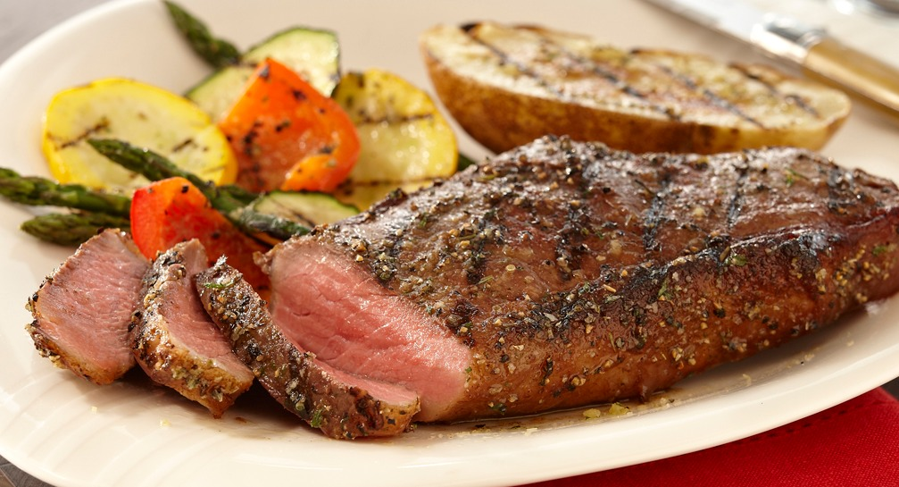
Dinner – Main Course
Steak and Vegetable Dinner

Slide 19
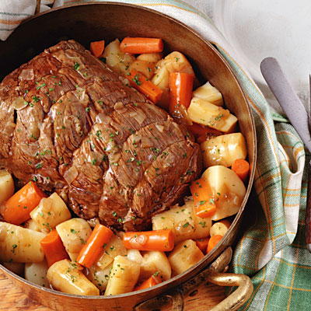
Dinner – Main Course
Roast Dinner

Slide 20
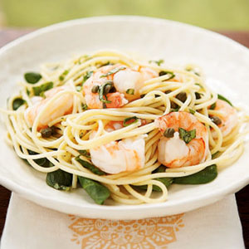
Dinner – Main Course
Pasta and Shrimp Dinner

Slide 21
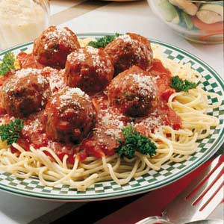
Dinner – Main Course
Pasta – Spaghetti and Meatballs

Slide 22
Picnic

Slide 23
Barbecue

Slide 24
The End

