Slide 1
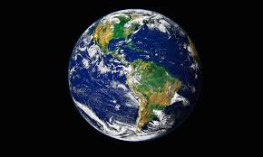
Day 7 – The Natural World

Slide 2
North, South, East and West

Slide 3
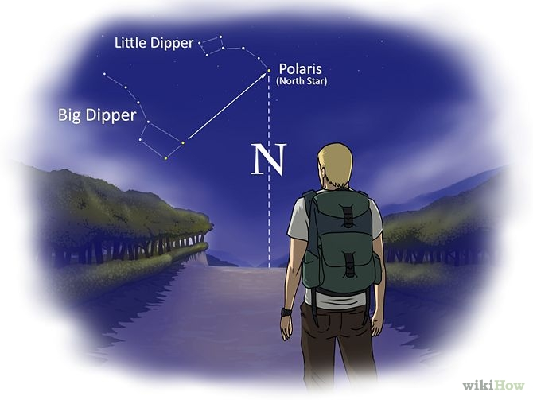

Slide 4
Air, Island and Water

Slide 5
Beach, Water (Sea), and Sky

Slide 6
Countryside, Hills, Fields and Forest

Slide 7
Outdoors – Mountains and Lakes

Slide 8
Plants, Flowers, and Grass

Slide 9
Trees and Wood

Slide 10
Moon, Stars, and Space

Slide 11
River

Slide 12
Forest Fire

