Slide 1
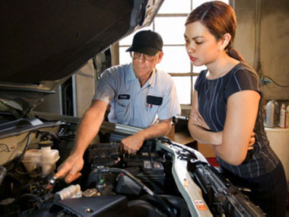
A Garage is also called a repair station or gas station.
If your car has a problem, you can take it to a mechanic.

Slide 2
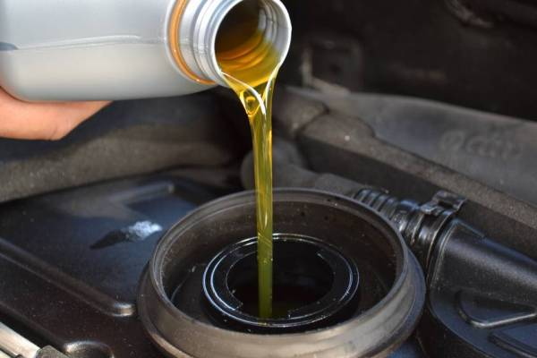
The mechanic will change your oil.

Slide 3
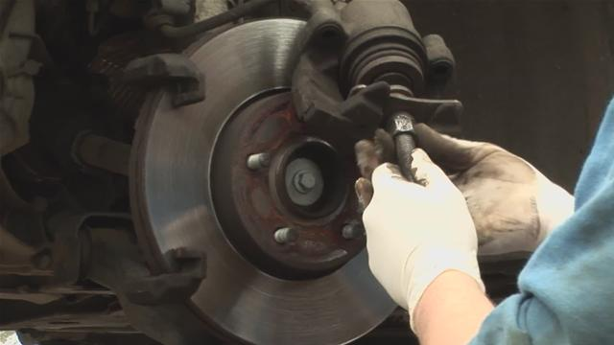
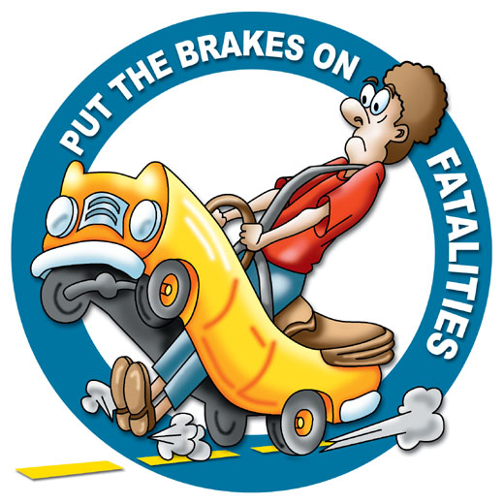
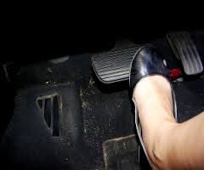
The mechanic can fix your brakes.

Slide 4
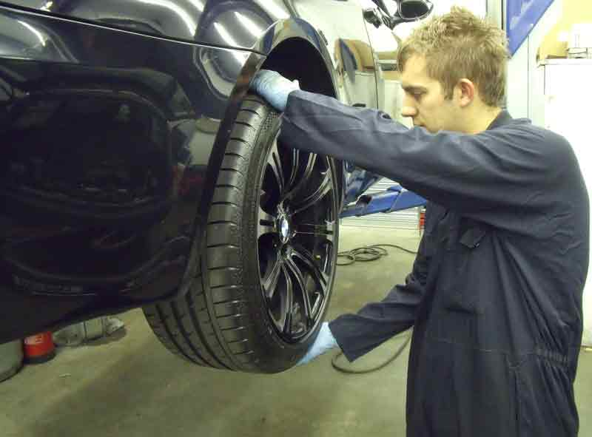
The mechanic can check your wheels.

Slide 5
The mechanic can fix your window.

Slide 6
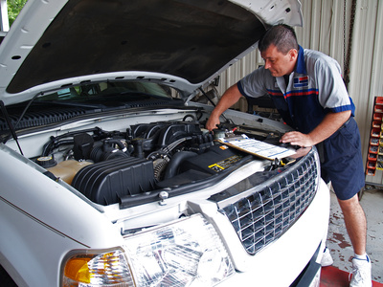
The mechanic can fix your engine.

Slide 7
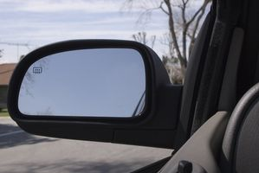
The mechanic can fix your mirror

Slide 8
The End.

