Slide 1
Medicine, Sickness, and Injuries

Slide 2
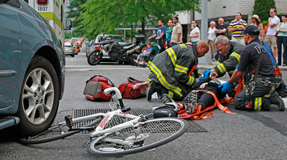
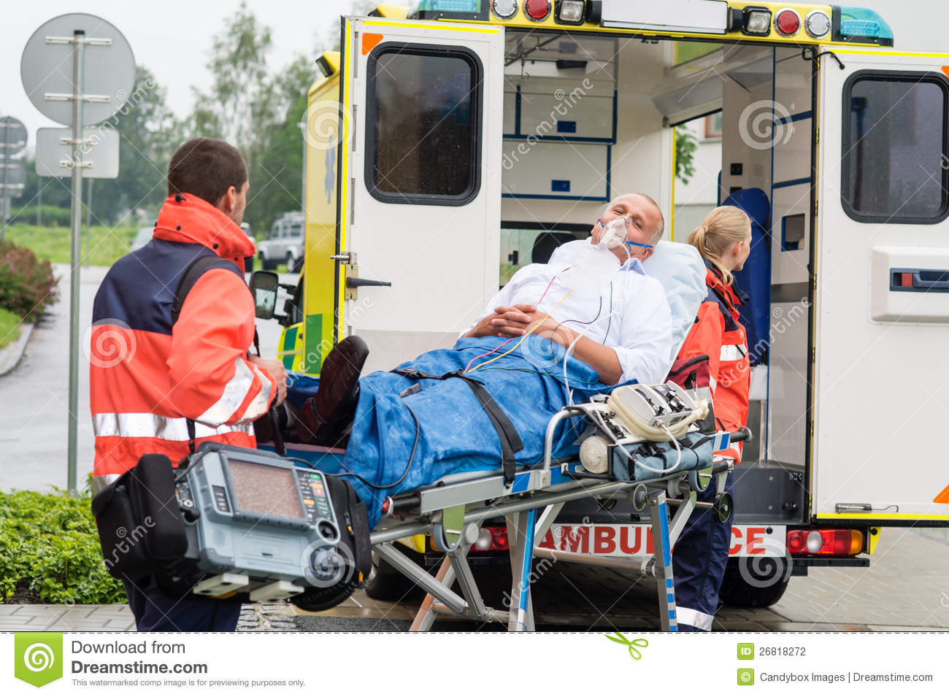
Accident and Ambulance
If you have an accident, the ambulance can take to the hospital.

Slide 3
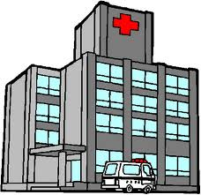
Hospital

Slide 4

Doctor – When you are sick (ill) or, you go to a doctor or a nurse.

Slide 5
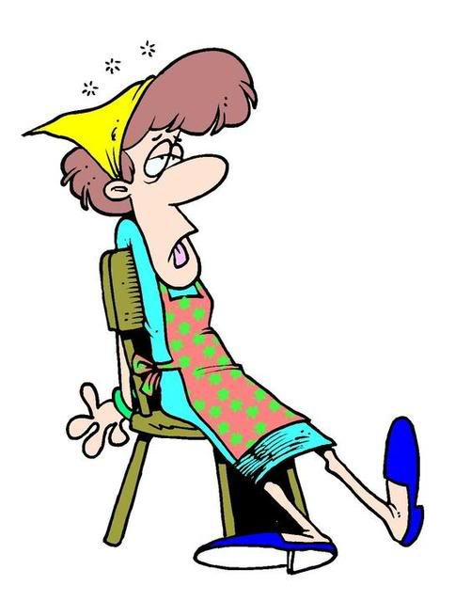
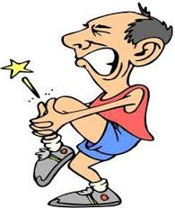
When your tired, hurt or are in pain you go to a doctor.
Pain

Slide 6
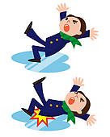
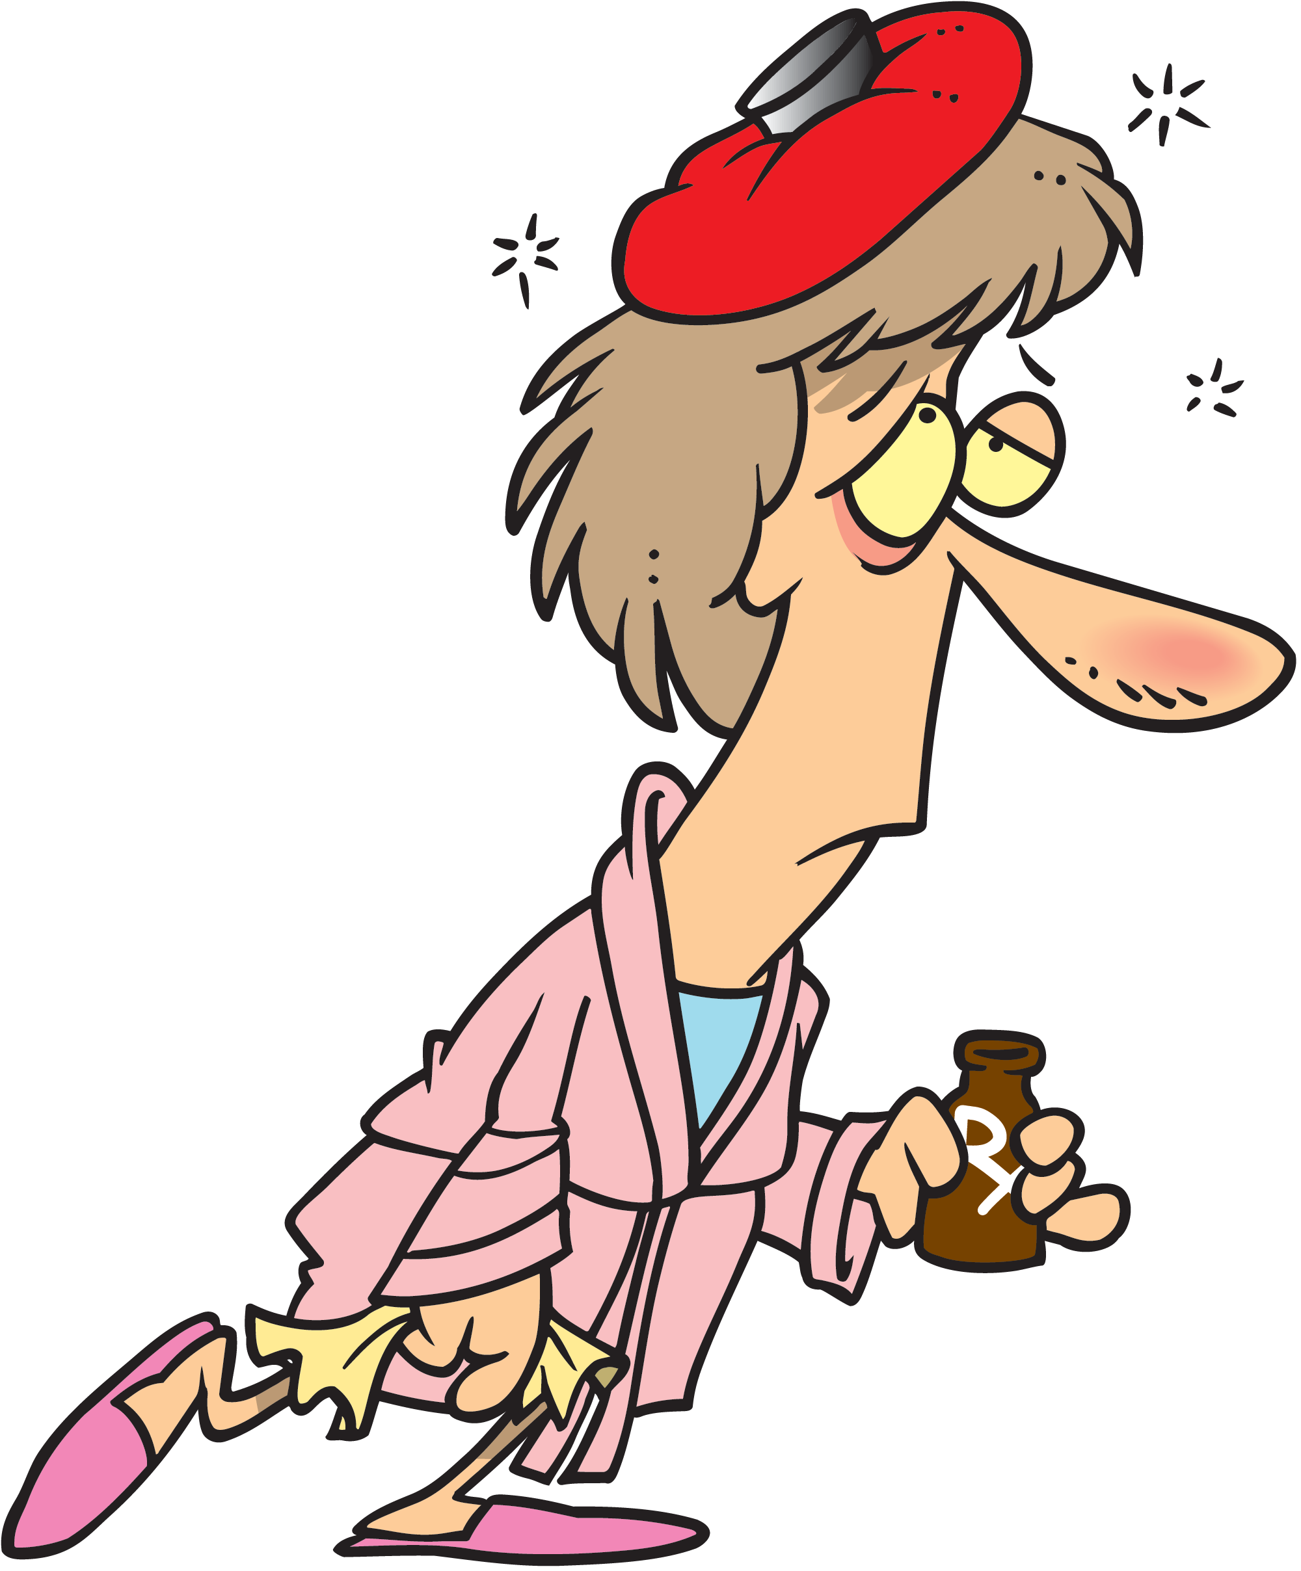
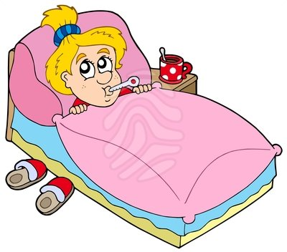
If you are tired, you fall or feel sick, you should lie down.

Slide 7
If you do not feel well, you need to rest!

Slide 8
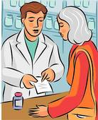
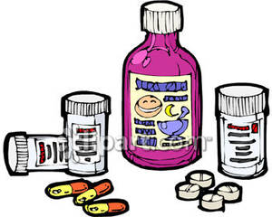
Medicine and Pharmacy
When you are sick, you may need to go to the pharmacy to get medicine.

Slide 9
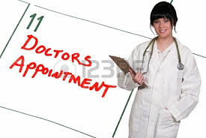
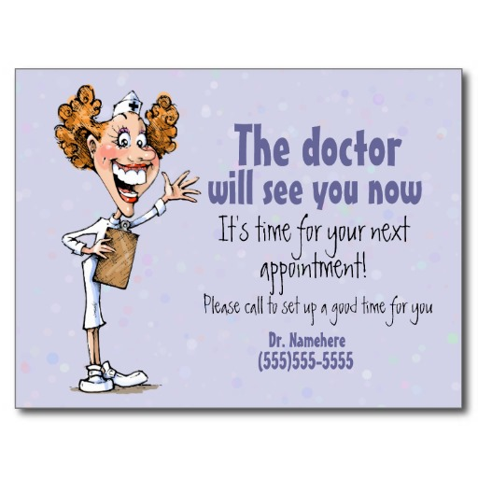
Appointment - When you go to the doctors, you need an appointment.

Slide 10
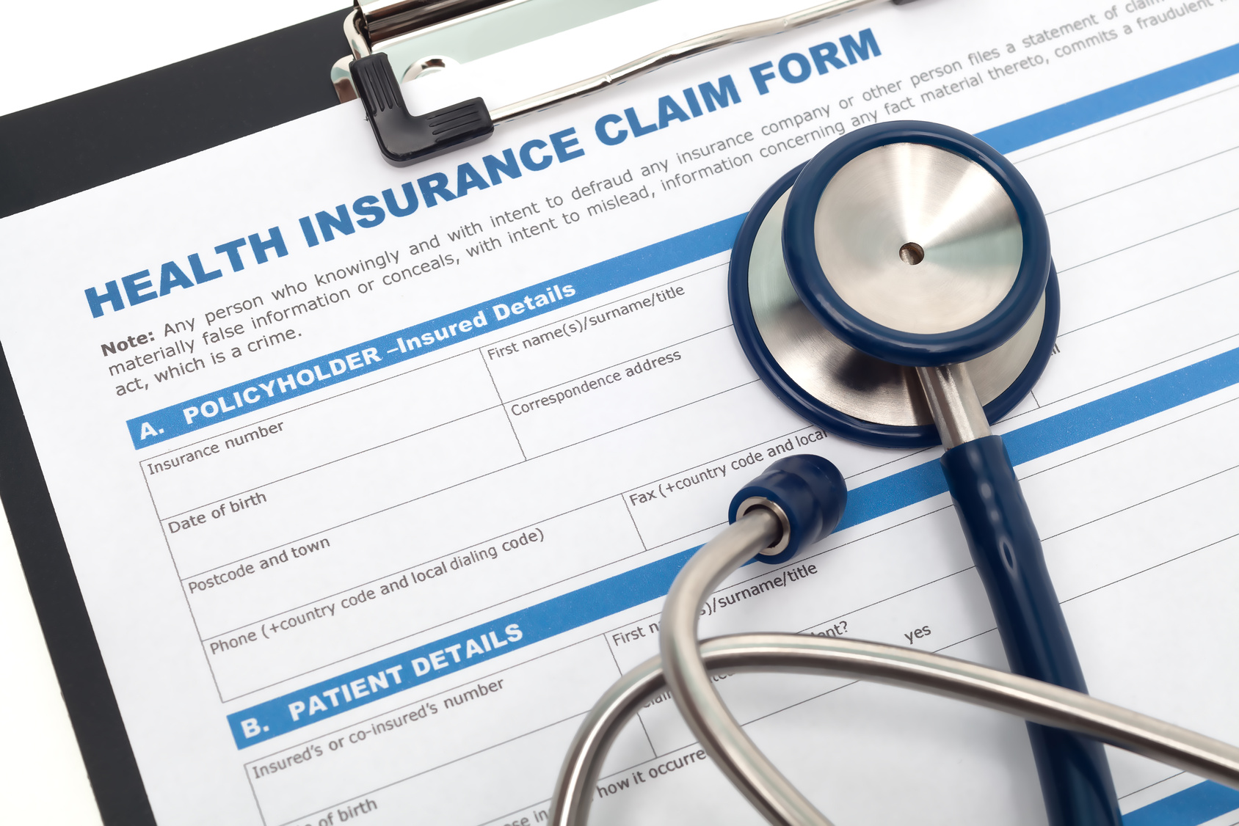
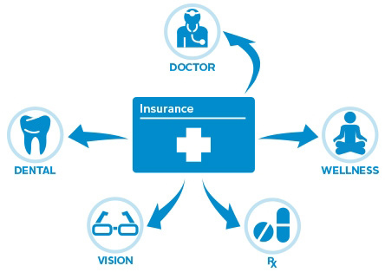
Health Insurance
When you go to the doctor’s you can pay with Health Insurance.

Slide 11
SICKNESS OF BODY PARTS
COLD
I have a cold.

Slide 12
SICKNESS OF BODY PARTS
Temperature
or
Fever
I have fever.

Slide 13
SICKNESS OF BODY PARTS
HEADACHE
I have a headache.

Slide 14
SICKNESS OF BODY PARTS
BACKACHE
I have a backache.

Slide 15
SICKNESS OF BODY PARTS
STOMACHACHE
I have a stomachache.

Slide 16
SICKNESS OF BODY PARTS
TOOTHACHE
I have a toothache.

Slide 17
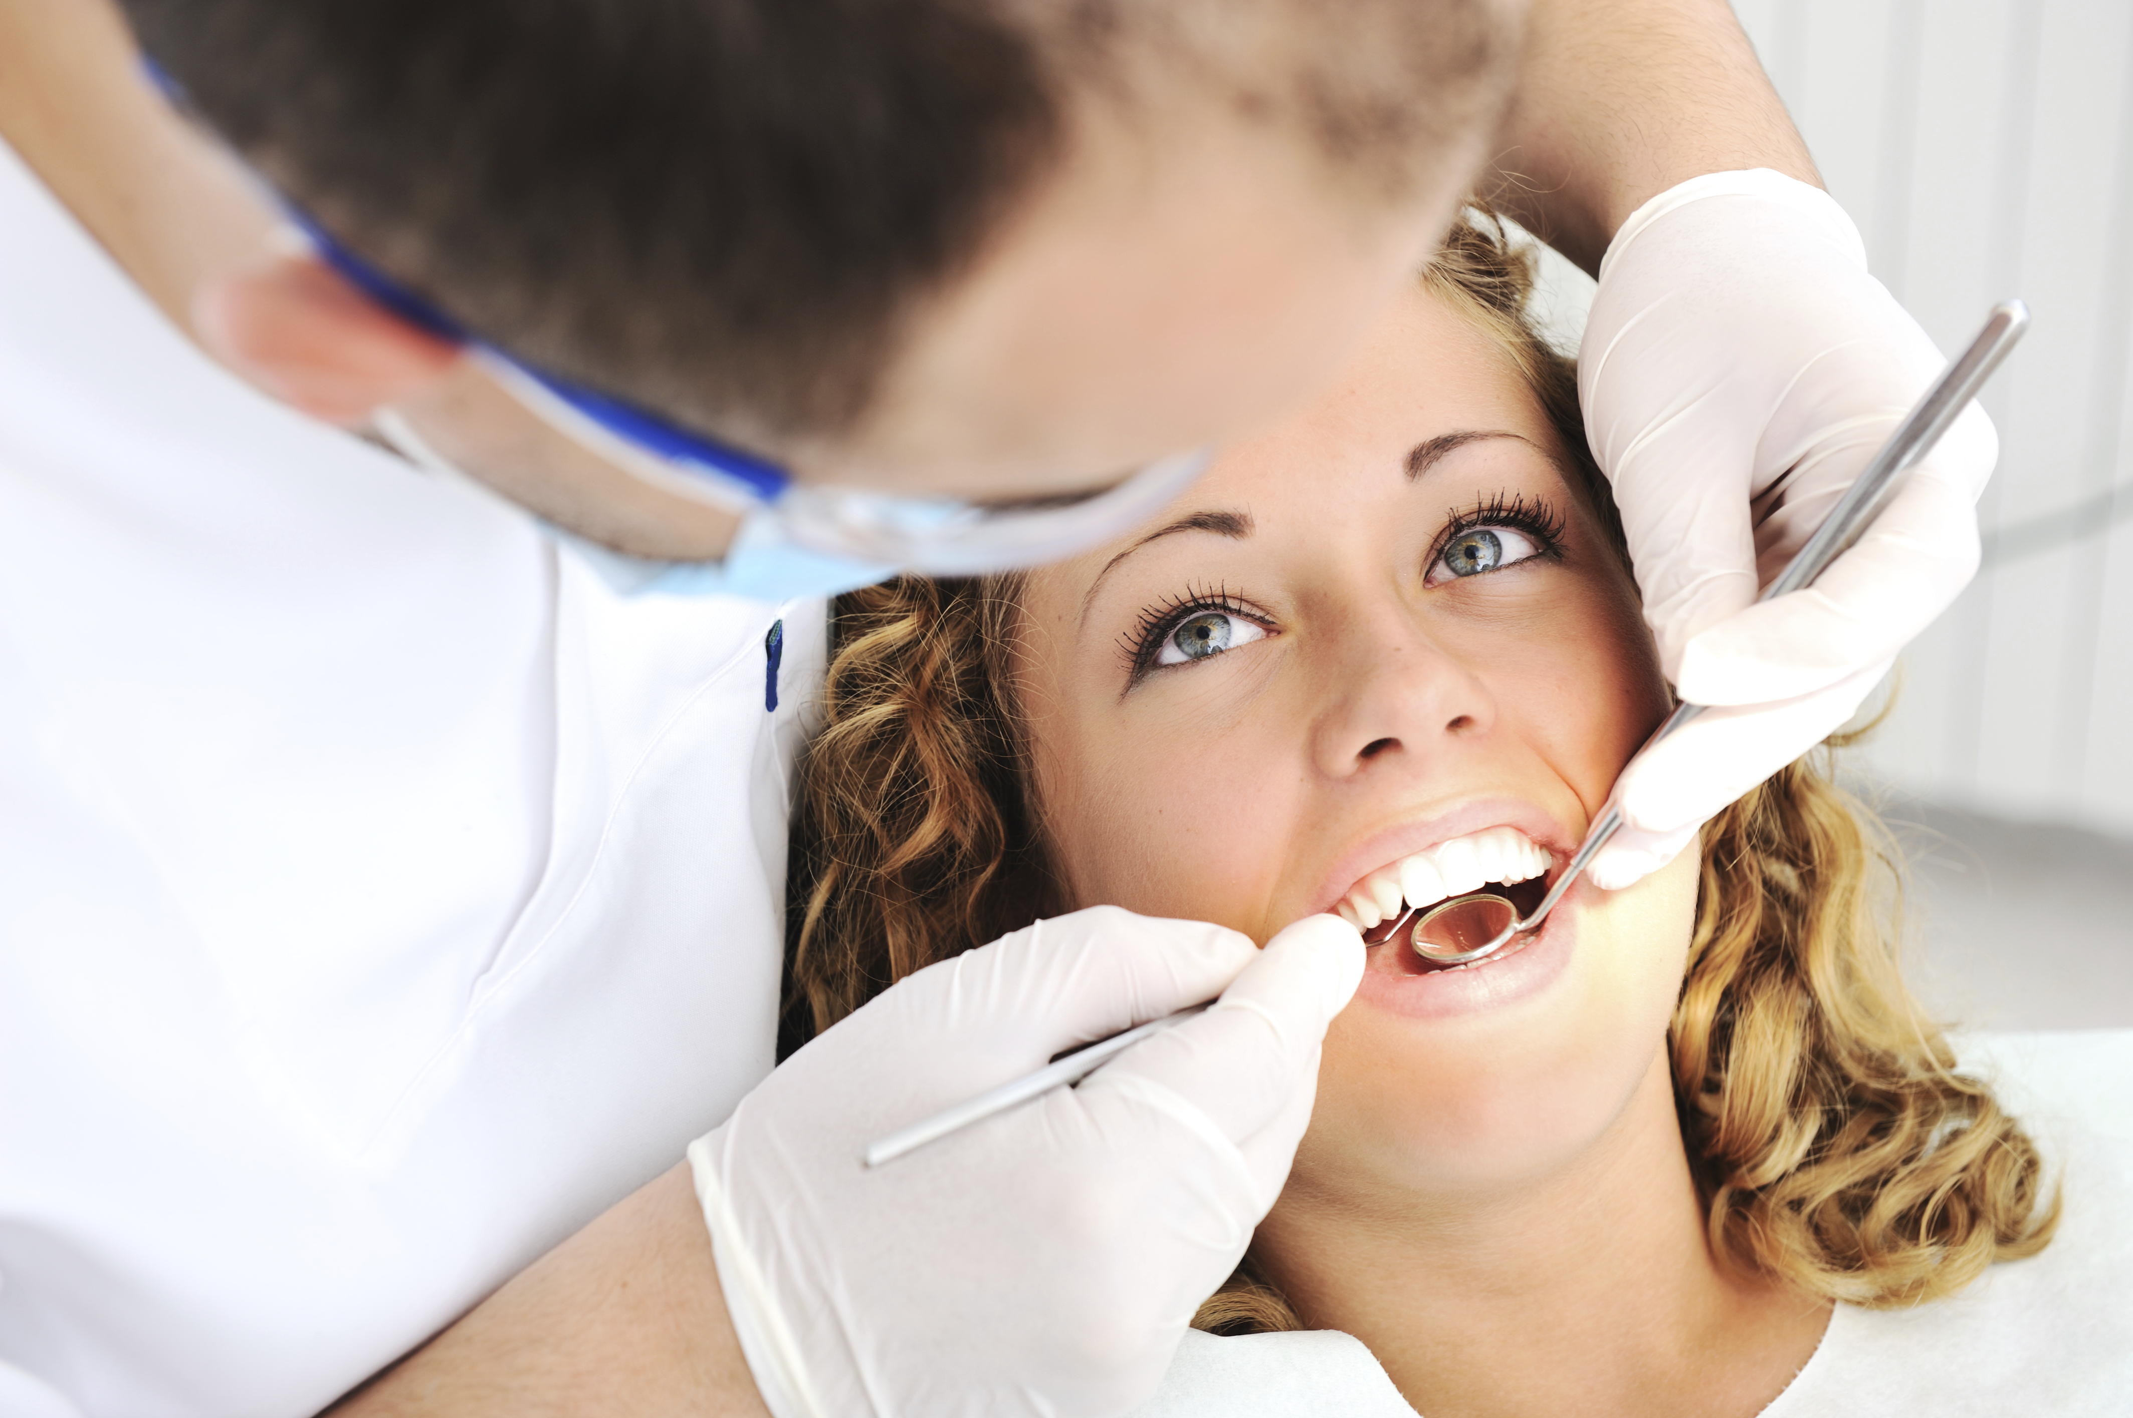
Dentist – When you have a toothache you go to the the dentist to get your teeth fixed.

Slide 18
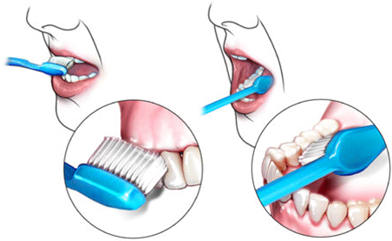
Toothbrush
Prevent a toothache.
Brush your teeth with a toothbrush.

Slide 19
SICKNESS OF BODY PARTS
EARACHE
I have an earache.

Slide 20
SICKNESS OF BODY PARTS
CUT
I have a cut.

Slide 21
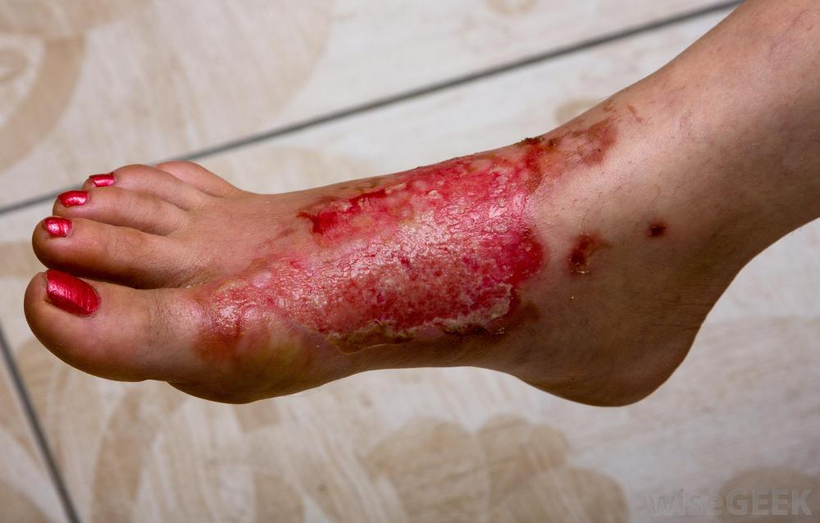
SICKNESS OF BODY PARTS
BRUISE
BURN
I have a bruise.
I have a burn.

Slide 22
SICKNESS OF BODY PARTS
BLOODY NOSE
I have a bloody nose.

Slide 23
SICKNESS OF BODY PARTS
HIGH BLOOD PRESSURE
I have high blood pressure.

