Slide 1
Day 2 - Fruits and Vegetables

Slide 2
fruit

Slide 3
apple

Slide 4
banana

Slide 5
orange

Slide 6
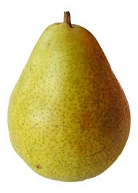
pear

Slide 7
melon

Slide 8
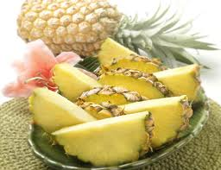
pineapple

Slide 9
cherries

Slide 10
grapes

Slide 11
strawberries

Slide 12
raspberries

Slide 13
vegetables

Slide 14
potatoes

Slide 15
carrots

Slide 16
cauliflower

Slide 17
tomato

Slide 18
Onion

