Slide 1
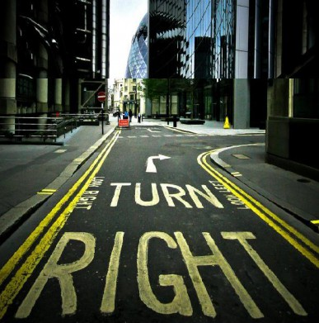
Out and About: Basic Directions.

Slide 2
Backward
Forward

Slide 3
At the traffic light

Slide 4
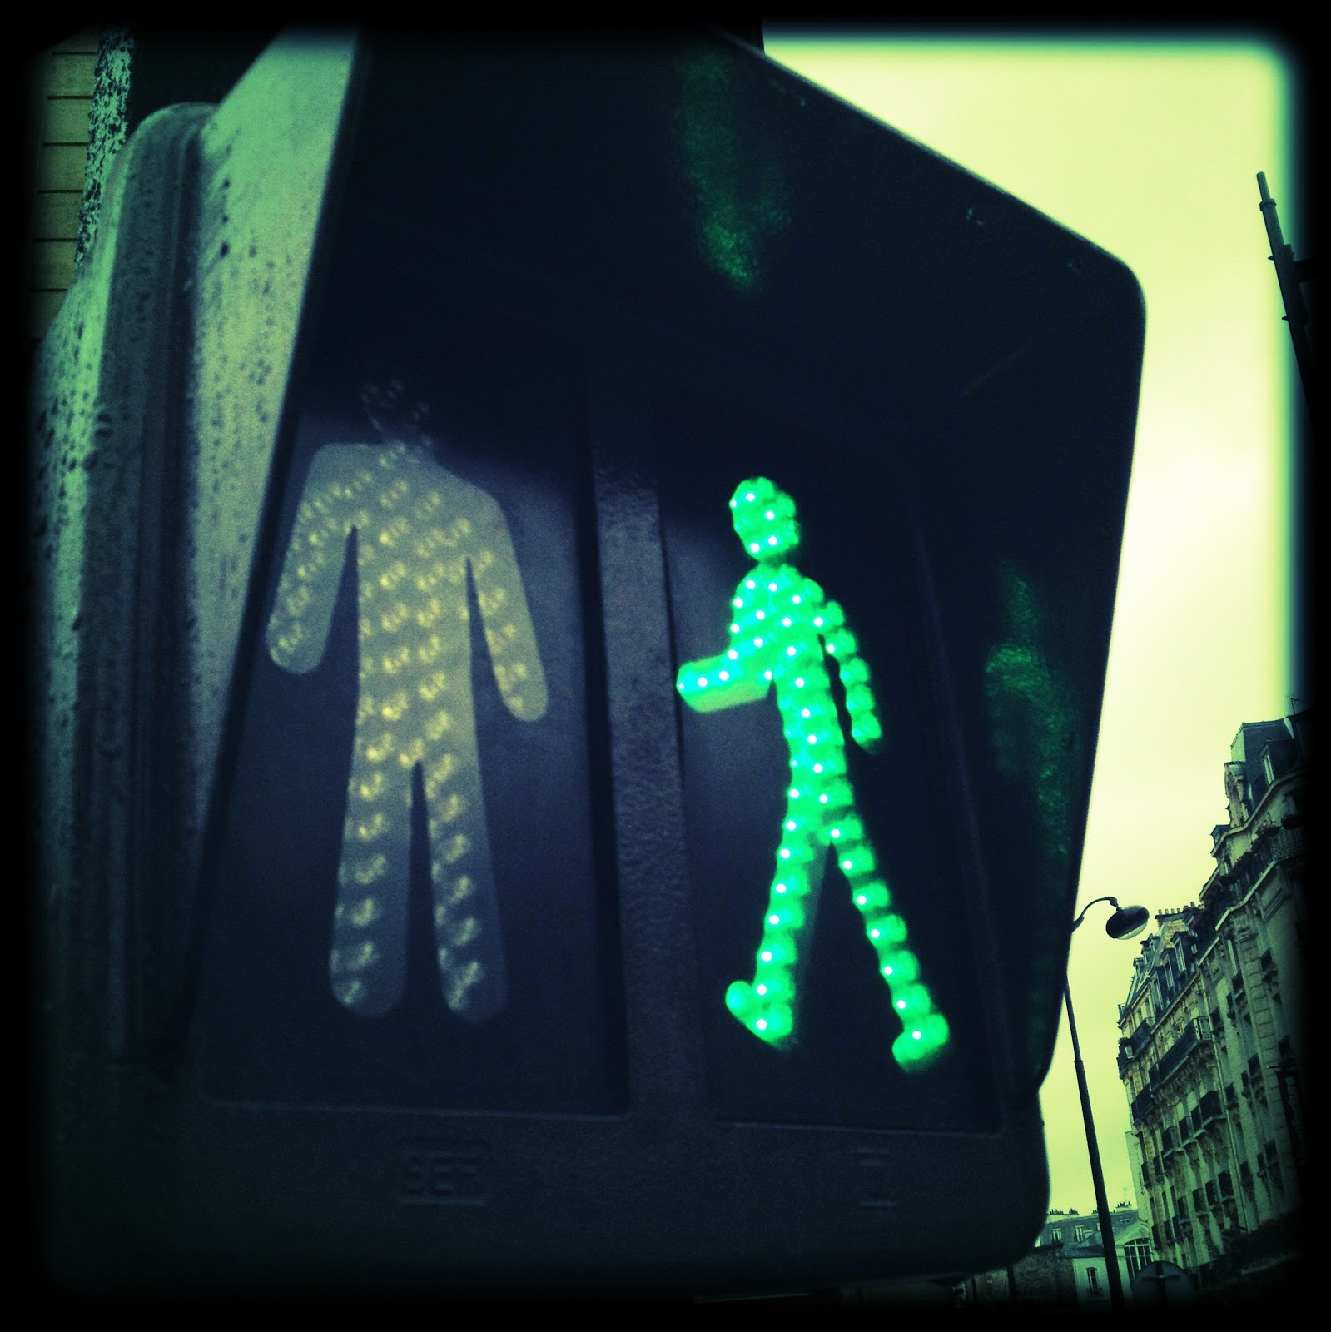
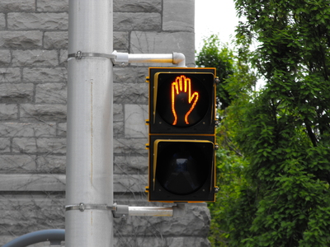
Go – Walk Stop – Do Not Walk

Slide 5
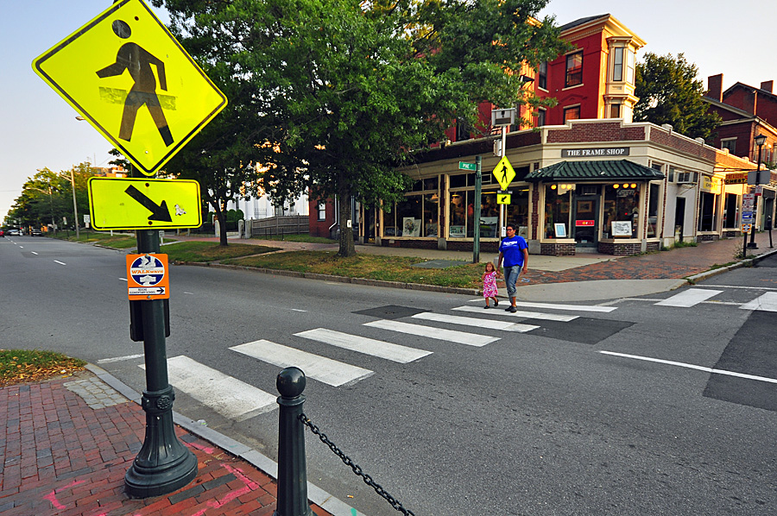
Walk straight on, across the street

Slide 6
Ask a police for directions if you get lost.

