Slide 1
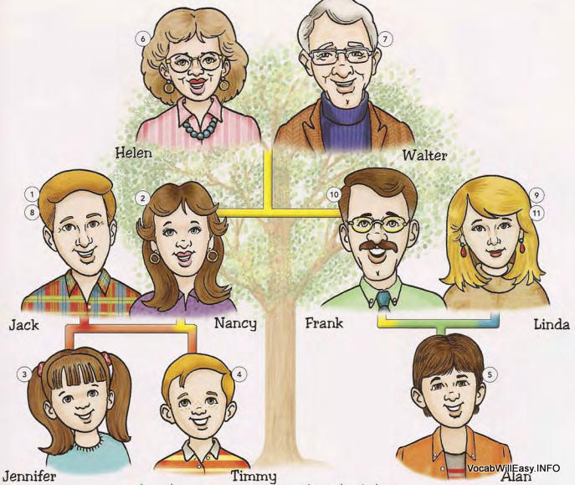
Day 1 – Family and Friend Words
Cousin
Cousin

Slide 2
Day 1 – Family and Friend Words
Friend

Slide 3
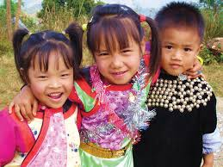
Day 1 – Family and Friend Words
Friendly

Slide 4
Day 1 – Family and Friend Words
Group

Slide 5
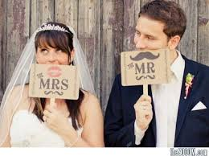
Day 1 – Family and Friend Words
Mrs. and Mr.

Slide 6
Day 1 – Family and Friend Words
Miss

