Slide 1
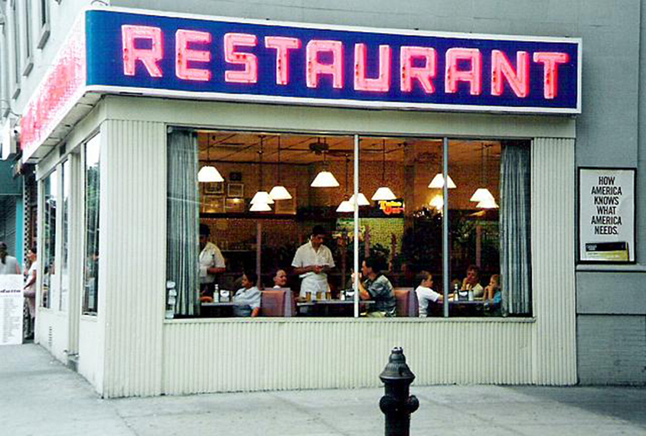
Day 2 – Eating Out
Restaurant

Slide 2
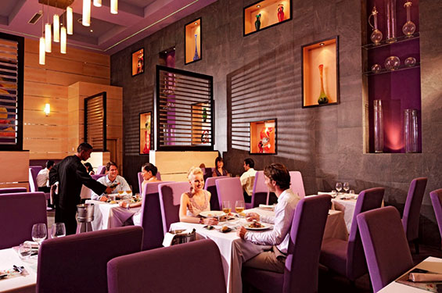
Day 2 – Eating Out

Slide 3
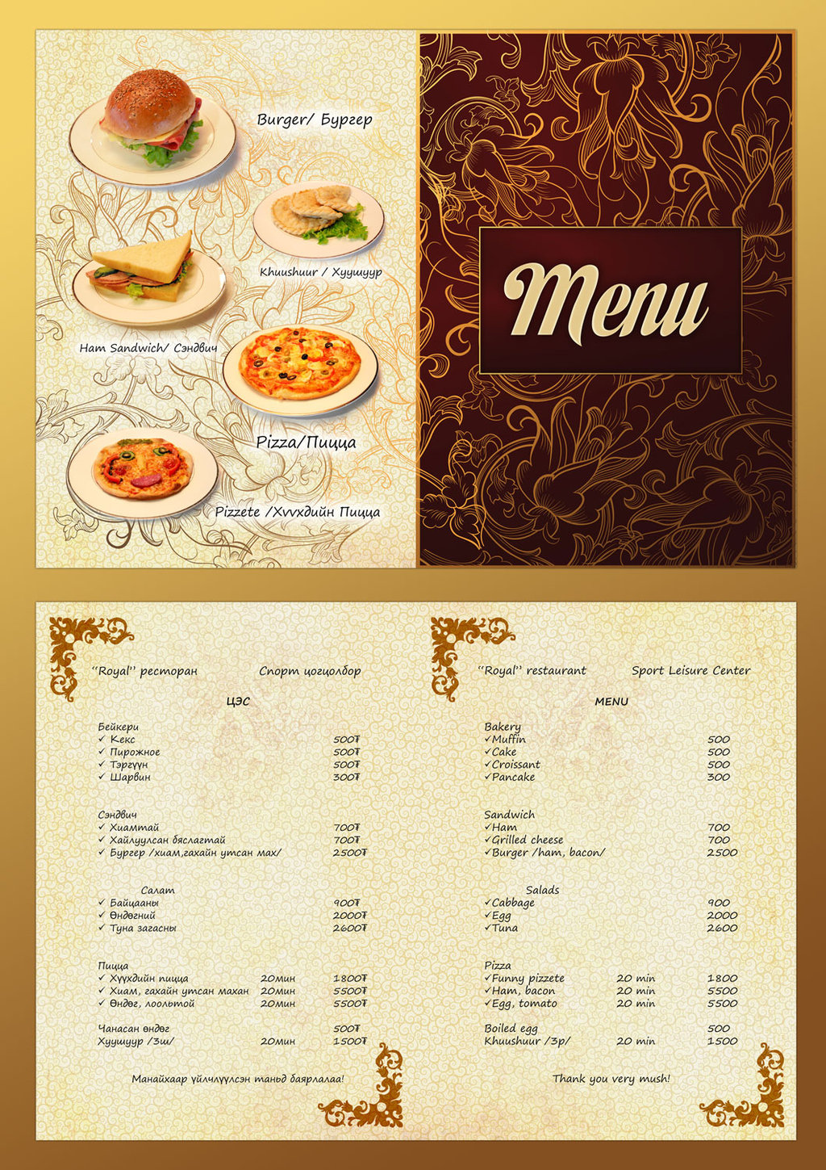
Day 2 – Eating Out
Menu

Slide 4
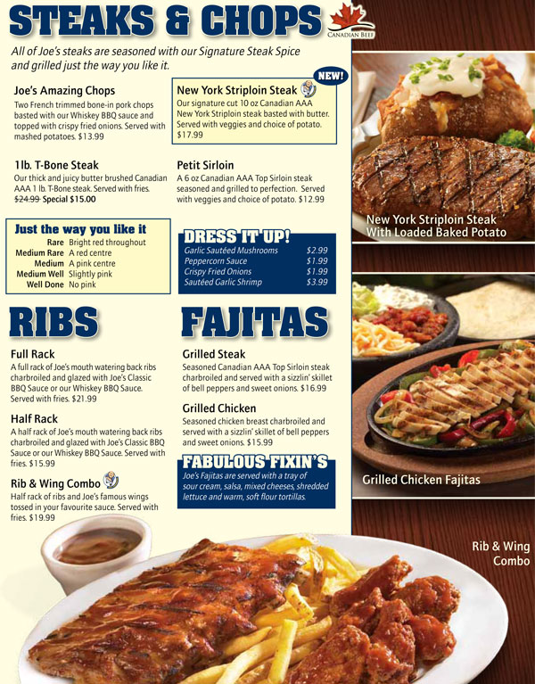
Day 2 – Eating Out
Menu

Slide 5
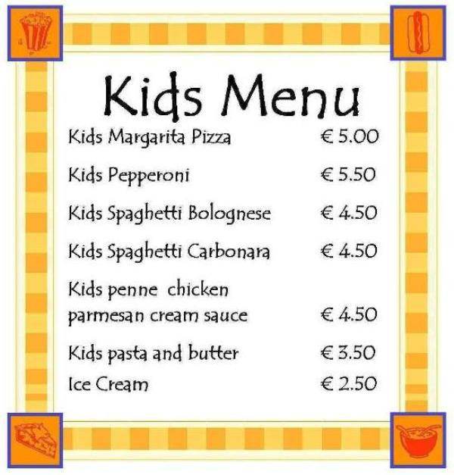
Day 2 – Eating Out
Menu

Slide 6
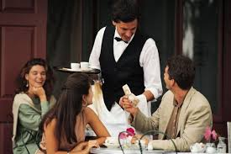
Day 2 – Eating Out
Waiter

Slide 7
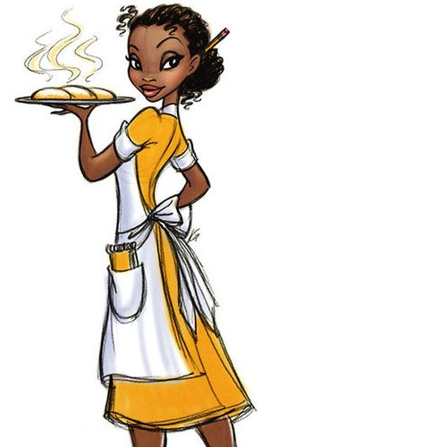
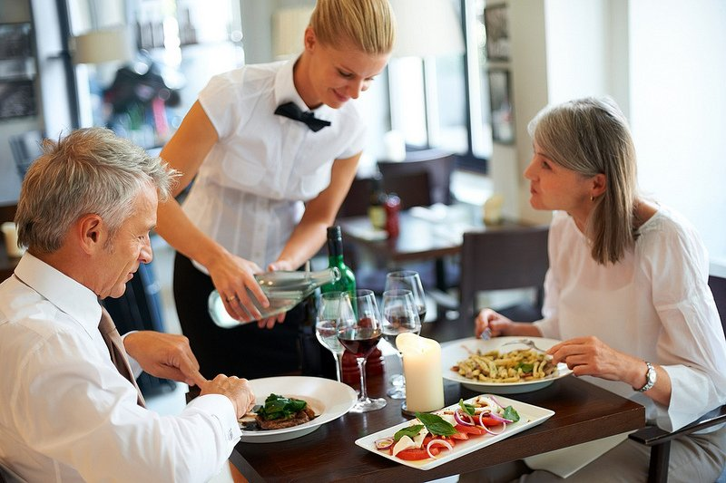
Day 2 – Eating Out
Waitress

Slide 8
The End

