Slide 1
Tragedy of The Commons and Sustainability
Summary and Analysis

Slide 2
Tragedy of the commons
In 1968, ecologist, Garret Hardin explored the social dilemma he called "The Tragedy of the Commons", in an essay he published in the journal, Science.
The tragedy of the commons is the depletion of a shared resources by individuals, acting independently and rationally according to each one's self-interest, despite their understanding that depleting the common resource is contrary to the group's long-term best interests.

Slide 3
Tragedy of the Commons
The “commons” are un-owned or commonly-held resources that are “free” for all to use.
Many resources are (e.g. clean air, biodiversity, fresh water) available to many people, and when resources are shared and limited (though potentially renewable), they are often exploited.
This is due to the fact that benefit to one person of using more of the resource outweighs the cost to that individual of the resource’s overuse.
Each person looks out only for his own interests and succumbs to the logic of “if I don’t use the resource, then someone else will”

Slide 4
Tragedy of the Commons
Learning to overcome our natural tendency to overuse common resources is a significant challenge we face in working to improve the environment.
As stewards of the environment we need to recognize situations that lead to a tragedy of the commons and how to prevent resource exploitation.

Slide 5
Tragedy of the Commons
Hardin believes population is at the root of the problem and must be brought under control.
Hardin rejected the idea that improved food production and technology will allow an indefinite increase in population.
He also rejects the idea that individuals will restrain from individual reproduction.
We are pushing the envelope of the worlds “Carrying Capacity” – the limit of how many individuals in a population the food supply can sustain.

Slide 6
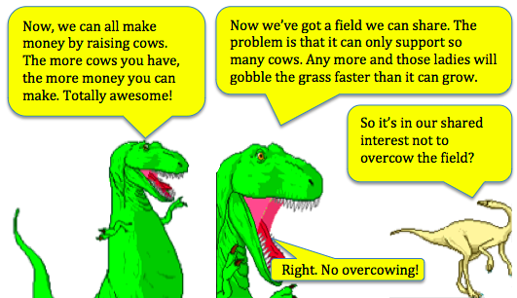

Slide 7
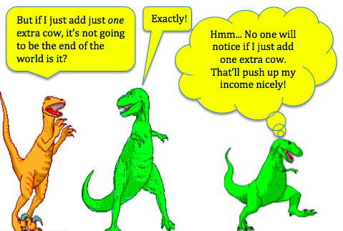

Slide 8
Whether it’s the problem of conserving fish stocks, or reducing greenhouse gas emissions, the underlying conflict is between short-term individual gain and the long-term benefits that individuals might get from collaborating with others.

Slide 9
Tragedy of the Commons Solutions
Communications between users
Education about resource use and dangers of the “tragedy”
Partnership between users
Privatization of the resources if done properly
Long-range thinking – long-term connection to the resource
Incentives for sustainable resource use
Governmental regulation/laws if fully enforced

Slide 10
Sustainability
A guiding principle of environmental science that requires us to live in such a way as to maintain Earth’s systems and its natural resources for the foreseeable future.
Sustainable agriculture
Sustainable foretsry
Sustainable development
Something is sustainable when it meets the needs of the present generation without compromising the ability of future generations to meet their own needs.

Slide 11
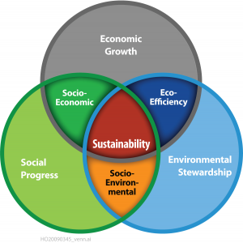
Sustainability
The triple bottom line concept states that we need to take into account three factors - economic, environment, and social when making decisions about business, the economy, and development.

