Slide 1
Viruses

Slide 2
Virus Introduction
Are Viruses Alive?
They are life like in that they have genes and are highly organized
They are non-cellular
They have either DNA or RNA but not both
Survival depends on infecting a living cell
Host specific
Always parasitic

Slide 3
What is a Virus
The word virus means POISON in Latin
To see a virus, scientist must use an ELECTRON microscope.
Viruses are composed of the following:
CAPSID – OUTER PROTEIN COAT SURROUNDED BY AN ENVELOPE
CORE - DNA OR RNA, NEVER BOTH
Viruses must bind to CELLS SURFACE and then use the host genetic material to replicate themselves.
Most viruses are HOST specific.

Slide 4
Types of Viruses
I. Bacteriophages - INFECT BACTERIA
Once they infect a bacterium, phages enter either a LYTIC OR LYSOGENIC CYCLE
III. Plant viruses – INFECT PLANTS
III. Animal viruses - INFECT ANIMALS

Slide 5
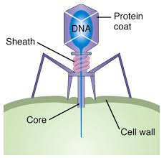
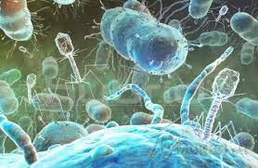
Bacteriophages (PHAGES)
Attack only BACTERIA
Once they infect a bacterium, phages enter either a LYTIC CYCLE or LYSOGENIC CYCLE

Slide 6
Lytic Cycle and Lysogenic Cycle
Lytic Cycle
Virus enters a cell and makes copies of itself and causes the cell to burst.
Lysogenic Cycle
Embeds viral DNA into DNA of host cell and replicates along with the host DNA.
Viral DNA occurs without death to the cell, right away.

Slide 7
Lytic Cycle Steps
1. Attachment – virus attaches to the host.
2. Penetration – Nucleic acid of virus moves into the cell
3. Replication – Virus induces host to make components for replication
4. Assembly – New viral components assemble into new viruses.
5. Releases – New viruses are released and they burst and kill the cell.

Slide 8
Lysogenic Cycle Steps
Steps 1 and 2 are the same as in the Lytic Cycle.
3. The porvirus/prophage DNA inserts into the bacterial (host) DNA.
4. Bacteria reproduce normally, replicating the prophage (DNA).
5. Prophage may be carried in host chromosomes for many years. As the cell reproduces it reproduces the viral DNA as it reproduces.

Slide 9
I. Bacteriophage Life Cycle

Slide 10
II. Plant Viruses
STUNT growth
DIMINISH crop yield
Most have RNA instead of DNA (example: tobacco mosaic virus)
Plant viruses must be able to penetrate plants protective layer.
Plants most susceptible:
WIND damaged
FROST damaged
INJURED or DAMAGED by insects
Spread through use of pruning shears
Infected plants can pass to offspring

Slide 11
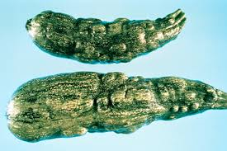
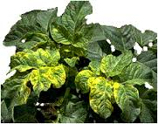
Plant Viruses
Usually no cure so focus is on the following:
Reducing number of plants that are infected.
Breed varieties resistant to viral infections.
Examples:
- strains of tomatoes, squash, cantaloupe have been breed to resistant to tobacco mosaic virus.

Slide 12
III. Animal Viruses
COMMON CAUSE OF DISEASE
Types of viruses based on replication procedures:
1. DNA viruses: use DNA – mRNA – Protein synthesis
2. RNA viruses: use RNA – mRNA – protein synthesis
3. Retro – viruses: use RNA – DNA – mRNA – Protein synthesis.

Slide 13
DNA viruses: Examples
CHICKEN POX, HERPES, HEPATITUS
RNA viruses: Examples
INFLUENZA, COMMON COLD, MEASLES AND MUMPS
Retro viruses: Examples
HIV, AND POLIO
HIV – Human Immunodeficiency Virus is the virus that causes AIDS – AQUIRED IMMUNODEFICIENCY SYNDROM.
HIV – infects and usually kills several types of white blood cells important in our bodies immune system.
- Loss of immune fighting cells causes the body to become susceptible to infections
- Secondary infections cause (syndrome) that eventually kills AIDS patients.

Slide 14
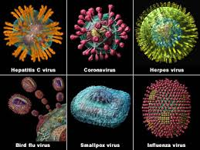
Animal Viruses

Slide 15
HIV Video
www.youtube.com/watch?v=#60AEC3
Treatment:
Antiviral drugs – interfere with reproduction of the virus.
AZT – inhibits enzymes used in viral reproduction.
PROTEASE INHIBITORS – inhibit the enzymes (protease) which is needed in making HIV proteins.
Combination of the two types of drugs should be used

Slide 16
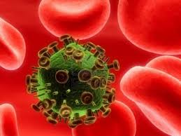
HIV Virus

Slide 17
If medication is discontinued, HIV reproduction and AIDS symptoms return.
No cure, only prevention.
Prevention Measures
Avoid Unprotectived Sex
Needle Sharing
Viruses: Emerging Viruses
ILLNESS CAUSED BY NEW OR REAPPEARING INFECTIOUS AGENTS THAT TYPICALLY EXIST IN ANIMAL POPULATIONS AND INFECT HUMANS WHO INTERACT.
Emerging viruses are viruses that have recently appeared or recently come to the attention of medical scientist. Examples – EBOLA AND HAUNTA

Slide 18
Ebola
Single stranded RNA virus
Causes hemorrhagic fever
First identified in 1976 (outbreaks killed more than 400 people)
Between outbreaks, virus remains hidden.
High mutation rate causes rapid evolution of new species.
1995 Ebola outbreak in Zaire, Africa.
Within 3 days of infection, victims develop fever, followed by a rash and vomiting, victims hemorrhage internally, and bleed from mouth, eyes, ears, and other body openings, internal organs shut down, 50% - 90% die.
Known to infect chimpanzees, but because they die quickly, they are not thought to be the reservoir species.
Other primates may be the host reservoir, research continues to indentify origin of Ebola.

Slide 19
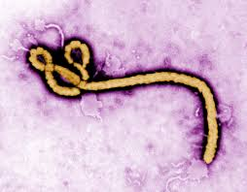
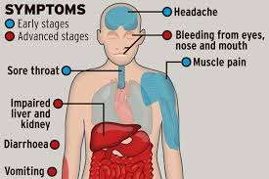
Ebola

Slide 20
Ebola Videos
www.youtube.com/watch?v=#60AFBE
www.youtube.com/watch?v=#60AFDB

Slide 21
Hantavirus
1993 outbreak in Southwestern USA.
Killed more than 50 people.
Hantavirus is carried in the urine and feces of rodents.
High rainfall caused more available food for rodents, so there was a rodent (field mice) population explosion.
Due to poverty conditions of indigenous people of the Southwest, they lived close contact with mice.
Hantavirus was spread by people breathing the virus from dried urine and feces.
www.youtube.com/watch?v=#60B07C

Slide 22
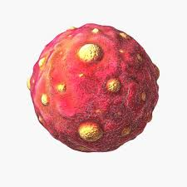
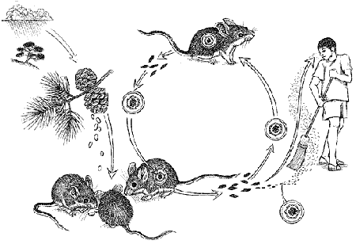
Hantavirus

Slide 23
Reasons for Emergence
Human activity: including social factors, such as urbanization and global travel contributes to epidemics of infectious diseases.
Populations are concentrated in cities
Large numbers of people are in close contact, permits rapid spread of disease.
Sanitation, nutrition and physical stress are all factors.
Level of health care and sexual practices
Changing natural habitats can create conditions necessary for pathogens to emerge (cutting rainforest)
Infectious disease in US accounts for 4% to 8% deaths.
Developing Countries, 30% to 50% deaths.

Slide 24
Viroids and and Prions
Viroids:
SMALLEST PARTICLES THAT ARE ABLE TO REPLICATE, MADE OF SHORT STRANDS OF RNA WITH NO CAPSID.
Prions:
INFECTIOUS PROTEIN PARTICLES THAT DO NOT HAVE A GENOME AND THEY ARE AN ABNORMAL FORM OF A BRAIN PROTEIN.
They clump together in the brain and cause death (ex. Mad Cow Disease and human Spongiform Encephalitis)
www.youtube.com/watch?v=#60B219

